Slide 1
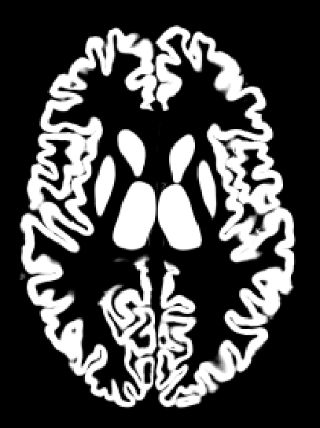
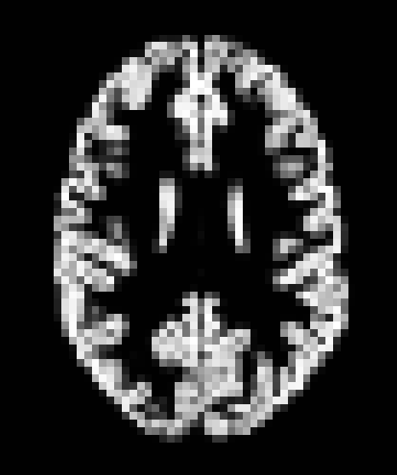
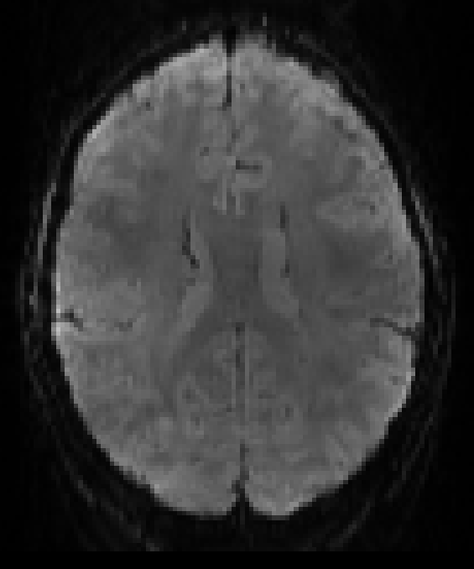
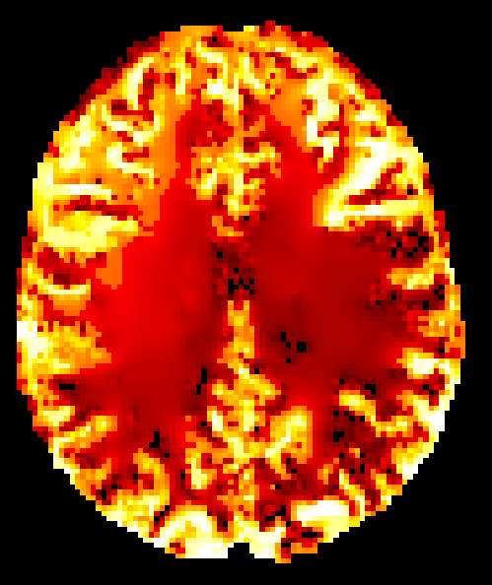
Common aligned PV estimates
T1 image
estimate registration with T1
downsample to ASL
raw ASL data
estimate CBF:
oxasl with PVEc
apply registration
common aligned
ASL data

Slide 2
2) apply inverse registration to get native space PV maps
T1 image
1) estimate registration for ASL -> T1
4) estimate CBF:
oxasl with PVEc
raw ASL data
acquisition specific PV maps
3) apply forward registration to both ASL and corresponding PV maps
common aligned
ASL data and PV maps

Slide 3
Native space
Transformed space
ground truth PVs
ASL resolution
ground truth PVs
ASL resolution
PVEc CBF
transformed
CBF with PVE
CBF with PVE

Slide 4
Native space
Transformed space
ground truth PVs
ASL resolution
transformed PVs
ASL resolution
PVEc CBF
transformed
CBF with PVE
CBF with PVE

Slide 5
Native space
Transformed space
ground truth PVs
T1 resolution
transformed PVs
ASL resolution
PVEc CBF
ground truth PVs
ASL resolution
transformed
CBF with PVE
CBF with PVE

Slide 6
Native space
Transformed space
ground truth PVs
ASL resolution
CBF with PVE
PVEc CBF
ground truth PVs
T1 resolution
transformed PVs
ASL resolution

Slide 7
Native space
Transformed space
transformed
PVEc CBF
PVEc CBF
ground truth PVs
ASL resolution
CBF with PVE

Slide 8
Native space
Transformed space
ground truth PVs
ASL resolution
transformed
PVEc CBF
reformed
CBF with PVE
PVEc CBF
ground truth PVs
T1 resolution
CBF with PVE
transformed PVs
ASL resolution
re-run PVEc CBF

