Slide 1
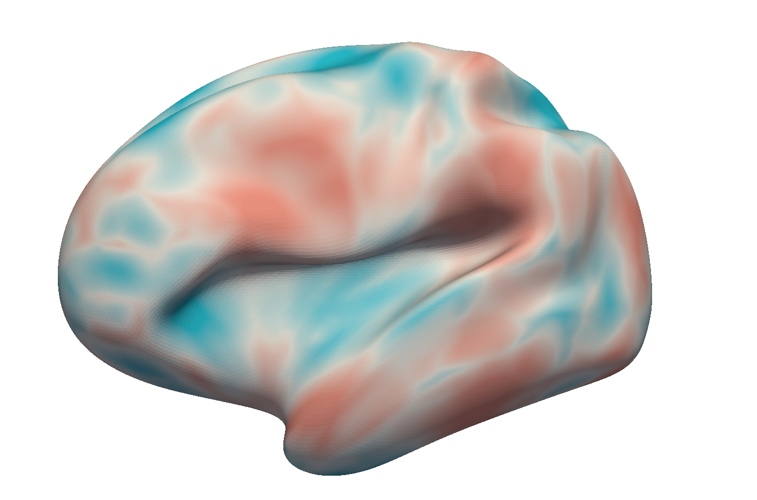

ground truth
Toblerone (S→V)
RC (S→V)
1
surface-volume projected data
surface space
2
volume space
3
Toblerone (V→S)
RC (V→S)
Toblerone (lsQR on S→V)
RC (lsQR on S→V)
surface-volume-surface projected data
calculate error wrt. ground truth

