Slide 1
Topic Model Analysis of Berkshire Hathaway’s Annual Shareholder Letters
Capstone Project II for Springboard Data Science Career Track
Tom Halloin

Slide 2
Background
Berkshire Hathaway is run by Warren Buffett.
Famous for long track record of beating S&P 500.
Annual report released every year details performance, investment holdings, and economic commentary.
Problem: Summarize letters so investors who are not interested in reading letters get the most important advice.

Slide 3
Natural Language Processing (NLP)
Natural language processing studies how computers process and analyze large amounts of text data.
Topic modeling is a branch of NLP that attempts to find common themes within documents.

Slide 4
Getting the Letters
Letters come in both PDF and HTML form from Berkshire Hathaway’s website.
Used Python libraries PyPDF2 and BeautifulSoup to scrape text from PDF files and HTML text.

Slide 5
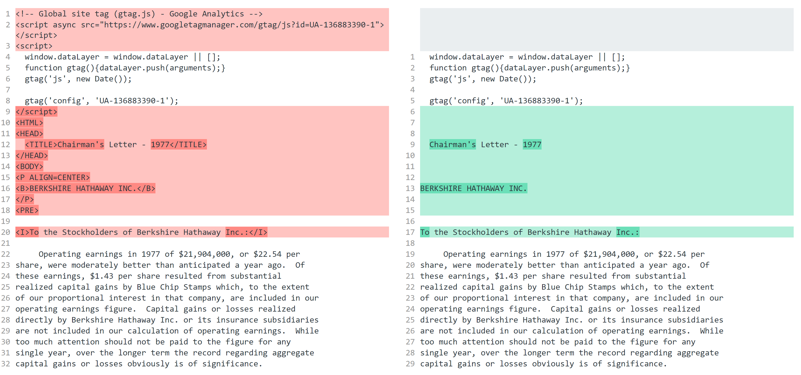
Preprocessing Data: Removing HTML

Slide 6
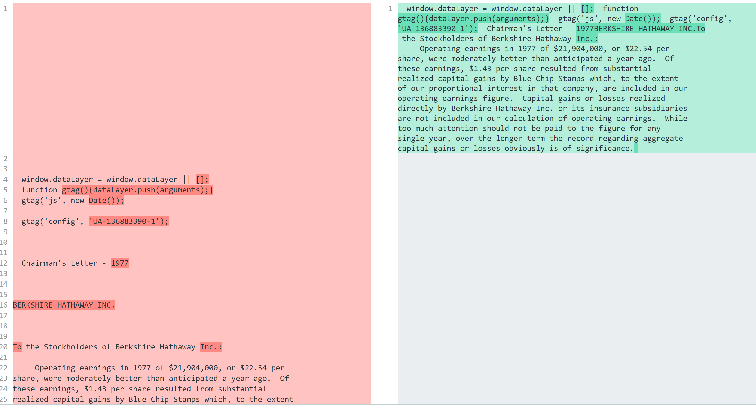
Preprocessing Data: Removing newlines

Slide 7
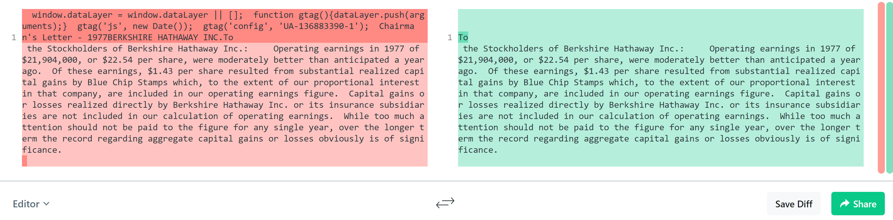
Preprocessing Data: Remove text not in letter

Slide 8
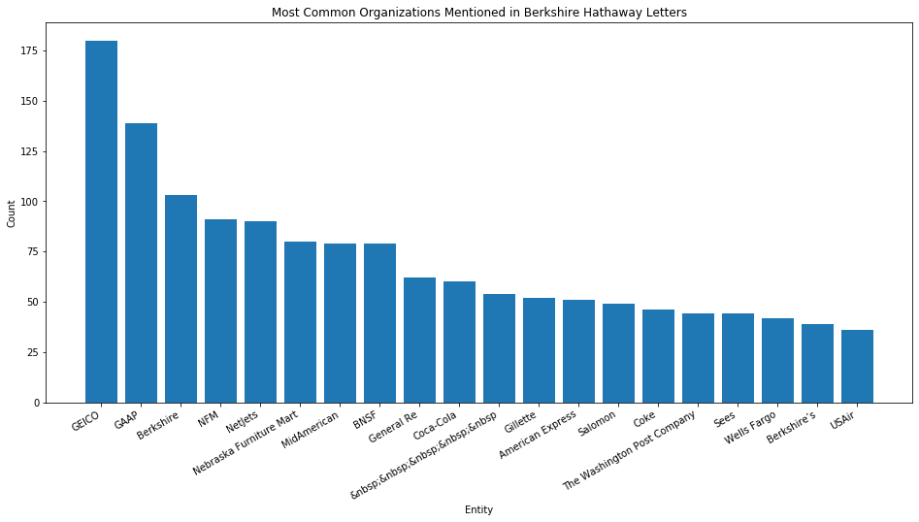
Exploratory Data Analysis – Common Entities (Organizations)

Slide 9
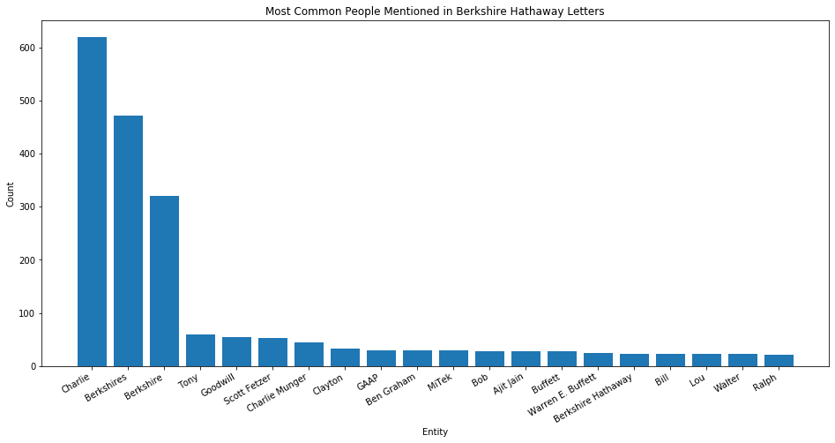
Exploratory Data Analysis – Common Entities (People)

Slide 10
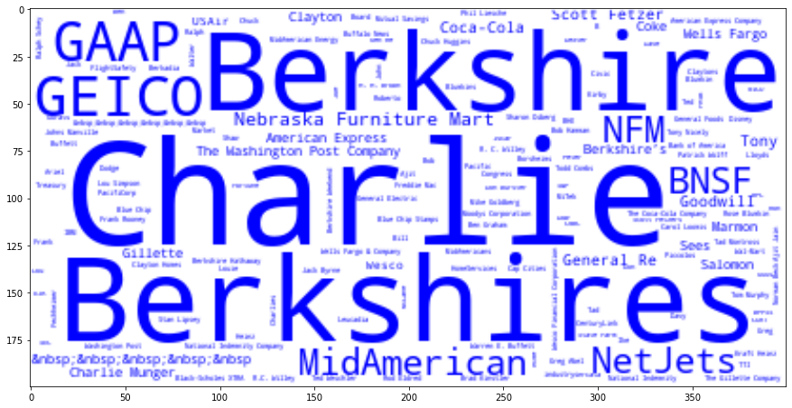
Word clouds – People and Places

Slide 11
Types of Summarization
Extractive summarization involves finding the most salient sentences and presenting them as a summary.
Abstractive summarization creates new summaries based on sentences given.
Extractive summarization easier for computers to process – abstractive requires deep learning beyond the scope of this project.

Slide 12
Summarization Methods
Textrank is a graph based weighting model similar to Google’s PageRank algorithm.
Lexrank uses the same graph-based weighting model as Textrank, but differs in the method of generating weights.
LSA analyzes similarities between the meanings of a series of documents and produces a series of concepts related to the documents. – This provided the “best” summaries.

Slide 13
Summarization Examples using LSA - 2019
'Nevertheless, when business ownership was sliced into small pieces stocks buyers in the pre-Smith years usually thought of their shares as a short-term gamble on market movements.’
'Sometimes this job has been easy at other times, more than difficult, particularly when we began working with huge and ever- growing sums of money.’
'Today, we have most of your money deployed in controlled businesses that achieve good-to-excellent returns on the net tangible assets each requires for its operations.’
'We exclude our Kraft Heinz holding 325,442,152 shares because Berkshire is part of a control group and therefore must account for this investment on the equity method.’
'First, Berkshires assets are deployed in an extraordinary variety of wholly or partly-owned businesses that, averaged out, earn attractive returns on the capital they use.'

