Slide 1
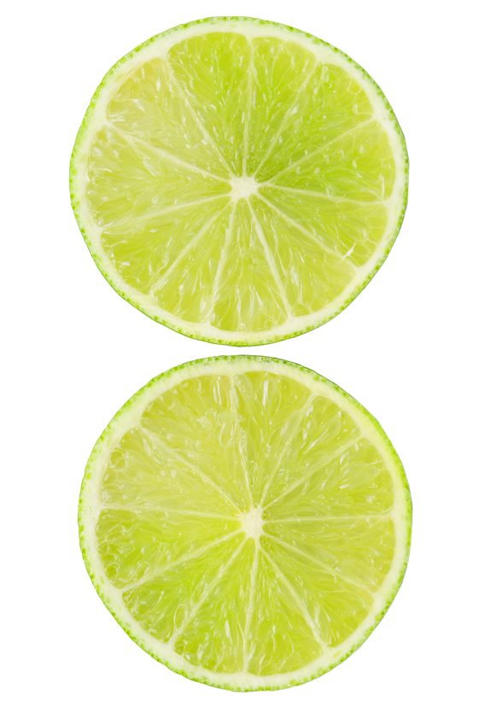
Form Designer
Qt4
Tomáš Hanák
Radek Valášek
Software Developer
Tieto, Devices R&D Ostrava
tomas.hanak@tieto.com
radek.valasek@tieto.com

Slide 2
Overview
Mission target:
  Explore differrent technologies supported by Qt
Technical areas:
  Qt Model/View framework
  Qt Undo framework
  GUI – drag&drop, plugins, input event processing…
  Doxygen documentation
  Project files management automation
Other areas:
  SCRUM assimilation
  Architecture design
  Project time estimation
Available at http://form-designer.googlecode.com
2010-03-01

Slide 3
Features
Simple form editor implemented
Opened documents shown in custom MDI containers
Embedded property editor modifies selected widget
Drag&Drop new widgets to the form
Moving/resizing widgets using mouse with snapping to the grid
Prepared support for zooming forms
Simple dictionary editor implemented with multiple language and various context support
Available row sorting and column hiding
Integrated undo stack for all actions
2010-03-01

Slide 4
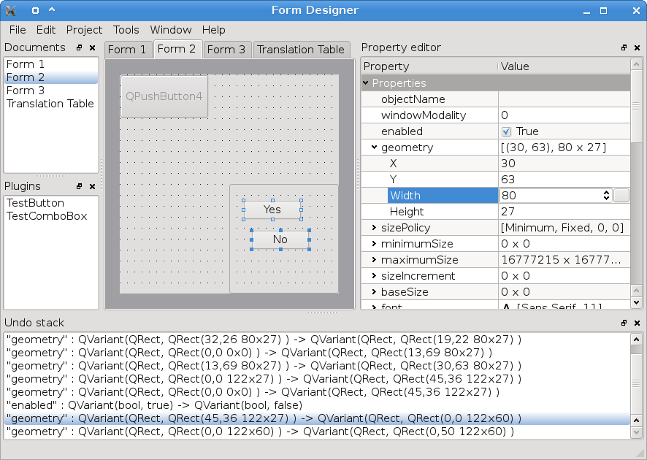
Screenshots 1/2

Slide 5
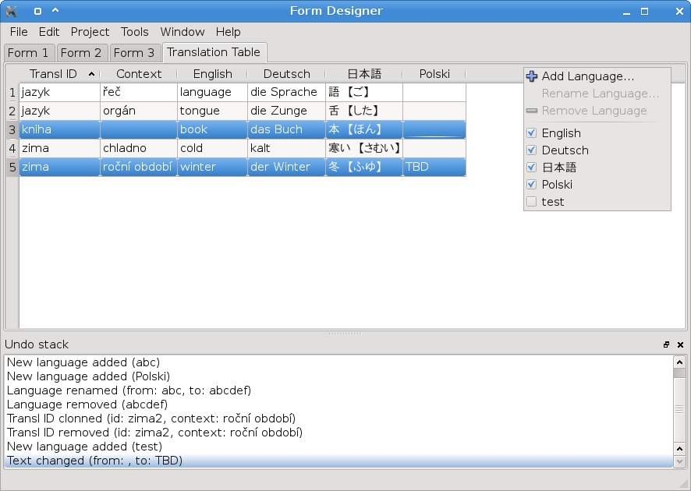
Screenshots 2/2

