Slide 1
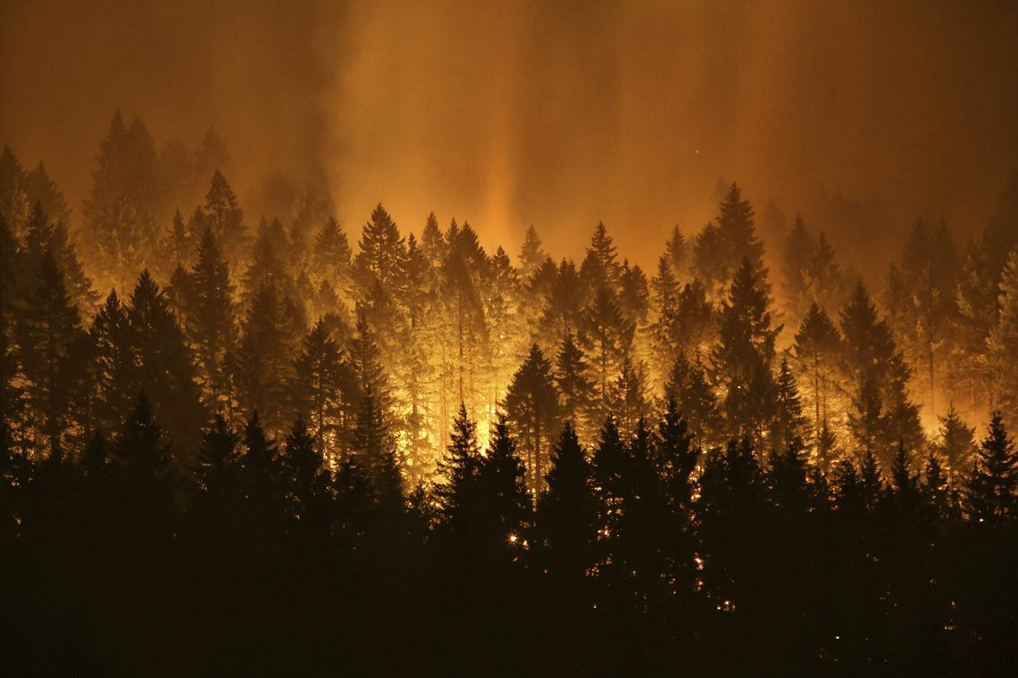
Wildfires in Castilla-La Mancha, Spain
By Tom Hardy & Chantalle Diepmaat
Team Chantalle_Tom
02-02-2018

Slide 2
Objective:
Which regions in Castilla-La Mancha are more prone to wildfires over the years?

Slide 3
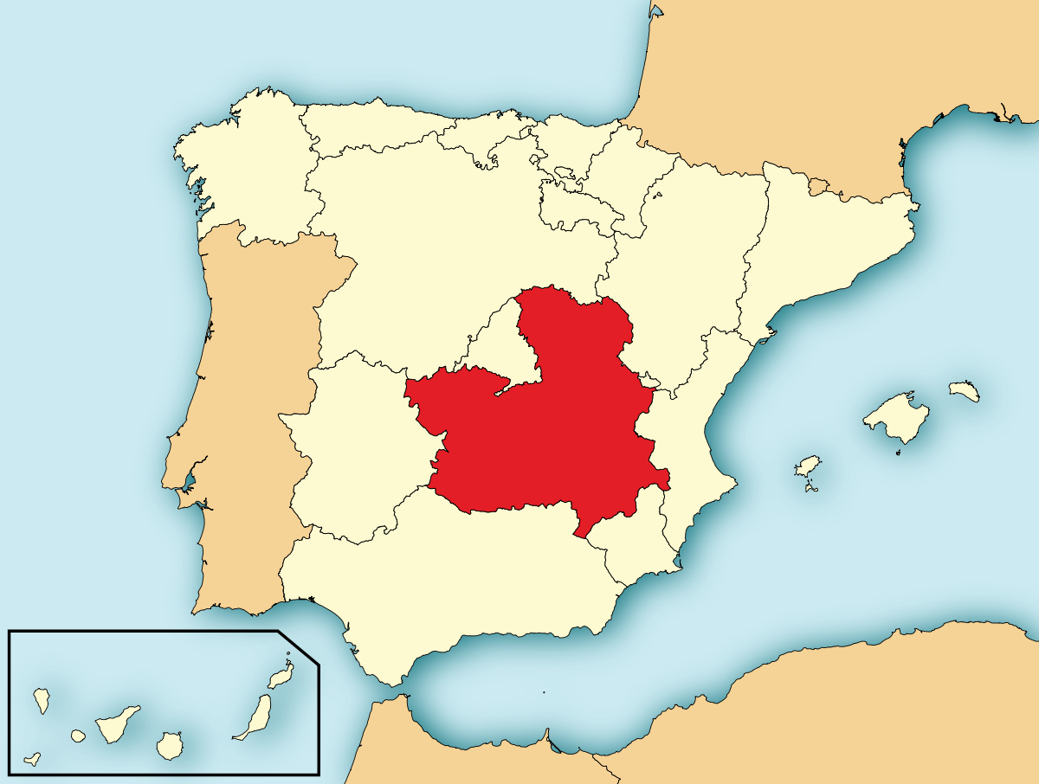
Location: Castilla-La Mancha Spain

Slide 4
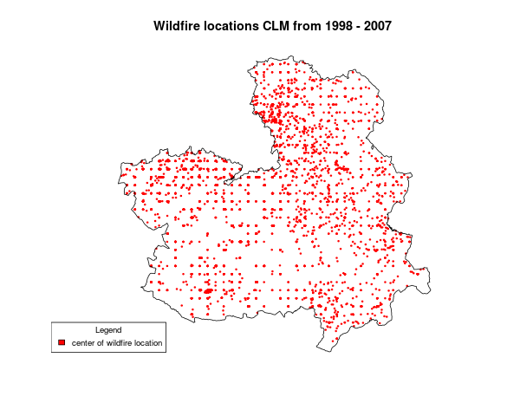
Required datasets: Point data

Slide 5
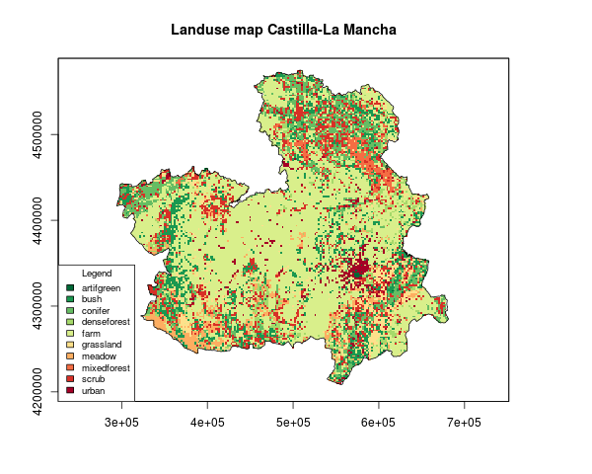
Required datasets: Land use data

Slide 6
Method Kriging
A way to interpolate data
Use a variogram to determine the nugget, sill, and range.
Make a kriged map

Slide 7
Result Time series of risk maps over the years

Slide 8
Conclusions & Discussion:
Middle is more prone to wildfires.
Kriging is not as straightforward
Pre-processing of data is vital
Infinite number of models could be created as input for Kriging.

Slide 9

Questions?

