Slide 1
“How to detect a niche of fraudsters?” by BNP Paribas PF
Advanced Machine Learning – Open Campus SS 2026
Alexander Neumann & Tom Hillekamp

Slide 2
Agenda
Introduction
Literature Review
Dataset Characeristics
Baseline Model
Model Definition and Evaluation
Results
Challenges & Errors
Discussion
Conclusion
Q & A

Slide 3
Introduction Fraud Detection
Find the best way to analyse shopping basket data from a retailer partner in order to detect fraud cases
Problem:
Fraudsters use “Buy now – pay later“ but never pay
Classification – Fraud/Not Fraud
Tabular Data with shopping basket contents, e.g. item type, number of items, prices per item
115.988 samples: ~1.4% fraud
147 columns: 144 are grouped into 6 categories
GOAL
TASK
DATA
Found on ChallengeData: https://challengedata.ens.fr/challenges/104

Slide 4
Literature Review
Source 1: “A numeric-based machine learning design for detecting organized retail fraud in digital marketplaces“
Rebalance data for better results, importance of proper feature choice
Source 2: “A Comprehensive Survey on Imbalanced Data Learning“
Data rebalancing techniques: downsampling, SMOTE, hybrid methods, focal loss
Source 3: “Fraud Detection Models and their Explanations for a Buy-Now-Pay-Later Application“
Comparison of techniques: Random forrest performed the best, use aggregate features
However: not much research concerning basket-level data, often includes user data etc.

Slide 5
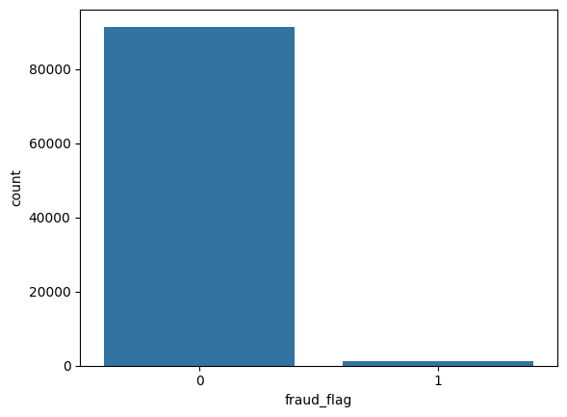
Dataset Characteristics

Slide 6
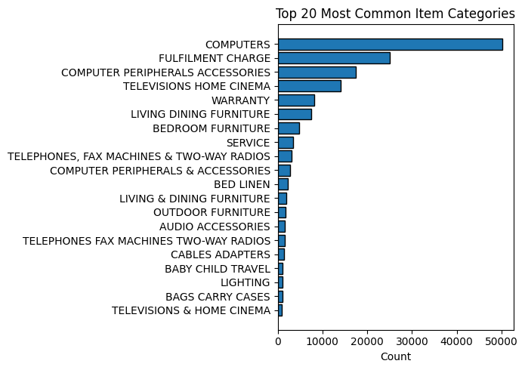
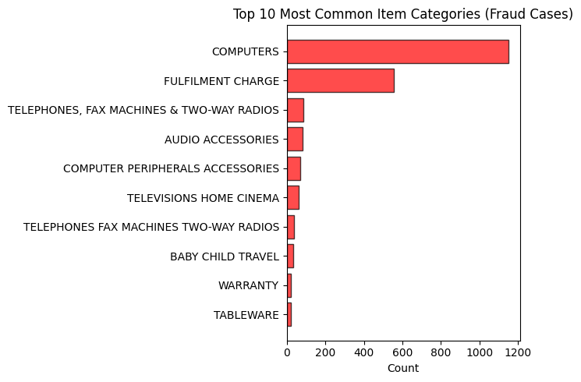
Dataset Characteristics

Slide 7
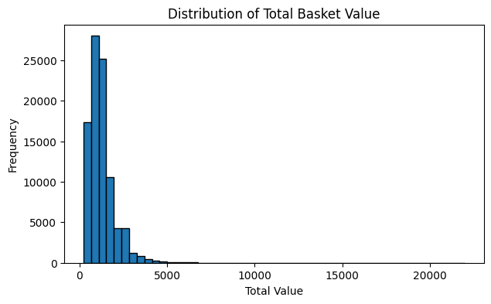
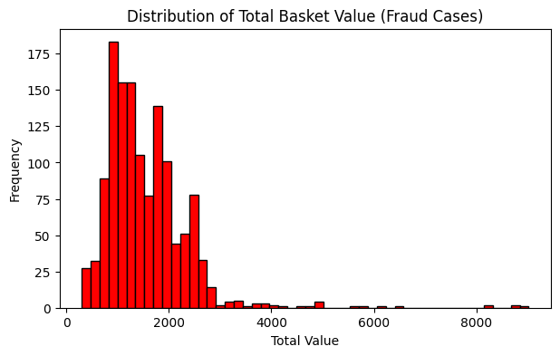
Dataset Characteristics

Slide 8
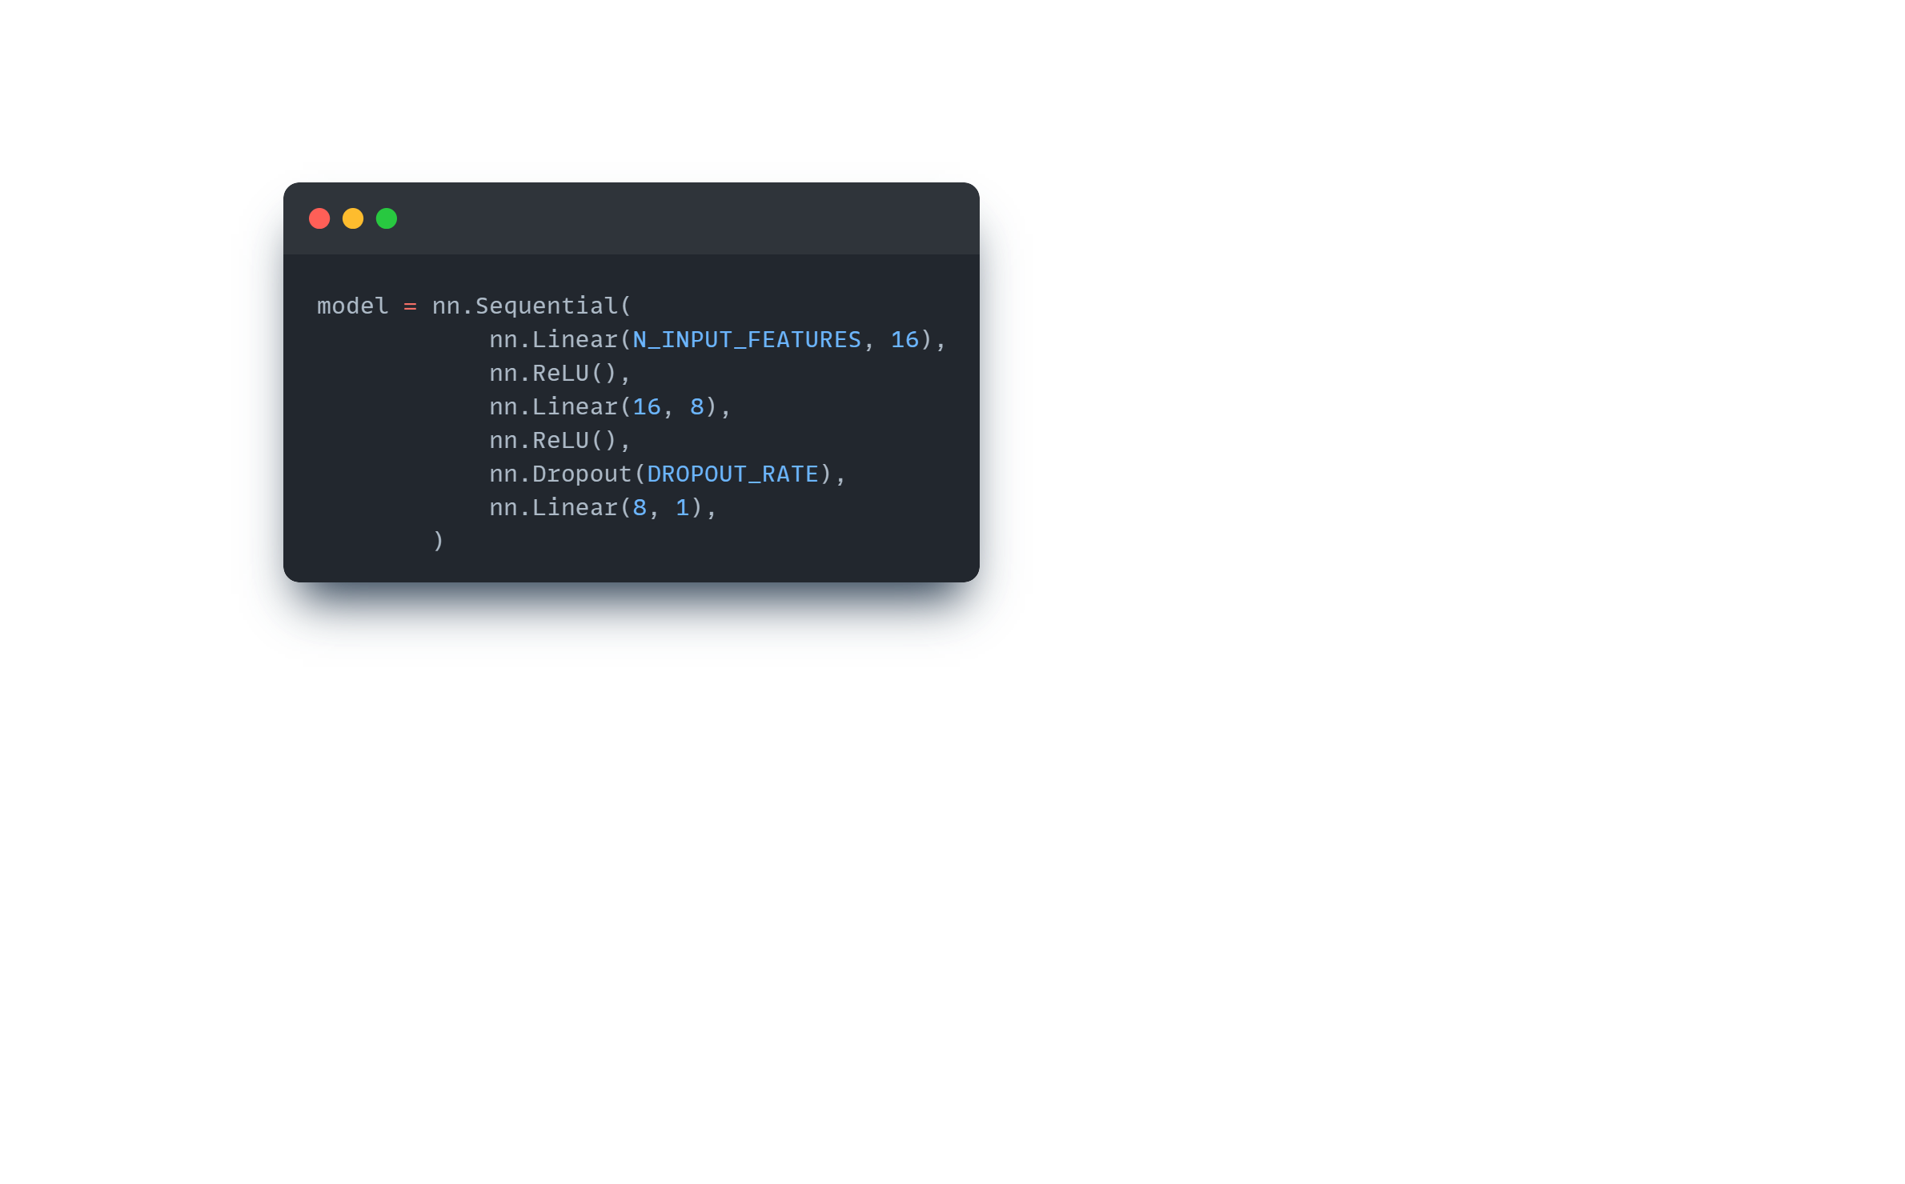
Baseline Model
Simple Neural Network
Evaluation Metric: PR-AUC
Features: Aggregated numerical features
Total number of items in basket
Total value of basket
Maximum item price
Average item price
Number of items from category “Computers“

Slide 9
Baseline Model - Results
5-fold Cross Validation: 0.0543 (+/- 0.0091) PR-AUC
Test Set (split from training data): 0.0510 PR-AUC
Test Set (public leaderboard on ChallengeData): 0.0623 PR-AUC
→ Benchmark 1: 0,017 PR-AUC < Our Baseline Model < Benchmark 2: 0,1574 PR-AUC
Source: https://challengedata.ens.fr/challenges/104

Slide 10
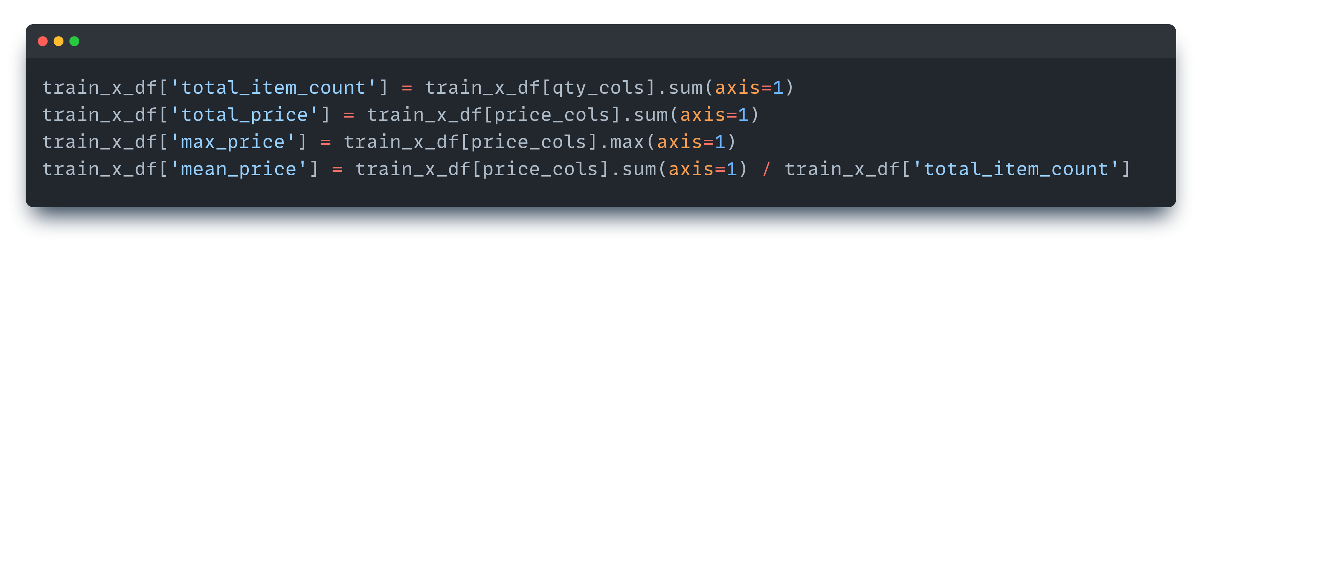
Preprocessing
Feature Engineering (Aggregated Numerical Features)
Categorical Feature Encoding (Example)
Categorical Feature | Numerical Vocabulary
2HP ELITEBOOK 850V6 | 1
2LOGITECH PEBBLE M350 BLUETOOTH MOUSE | 2
The numerically-encoded categorical data can be fed into the model's embedding layers

Slide 11
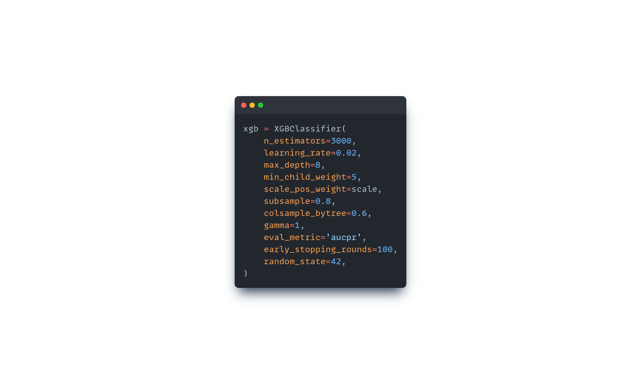
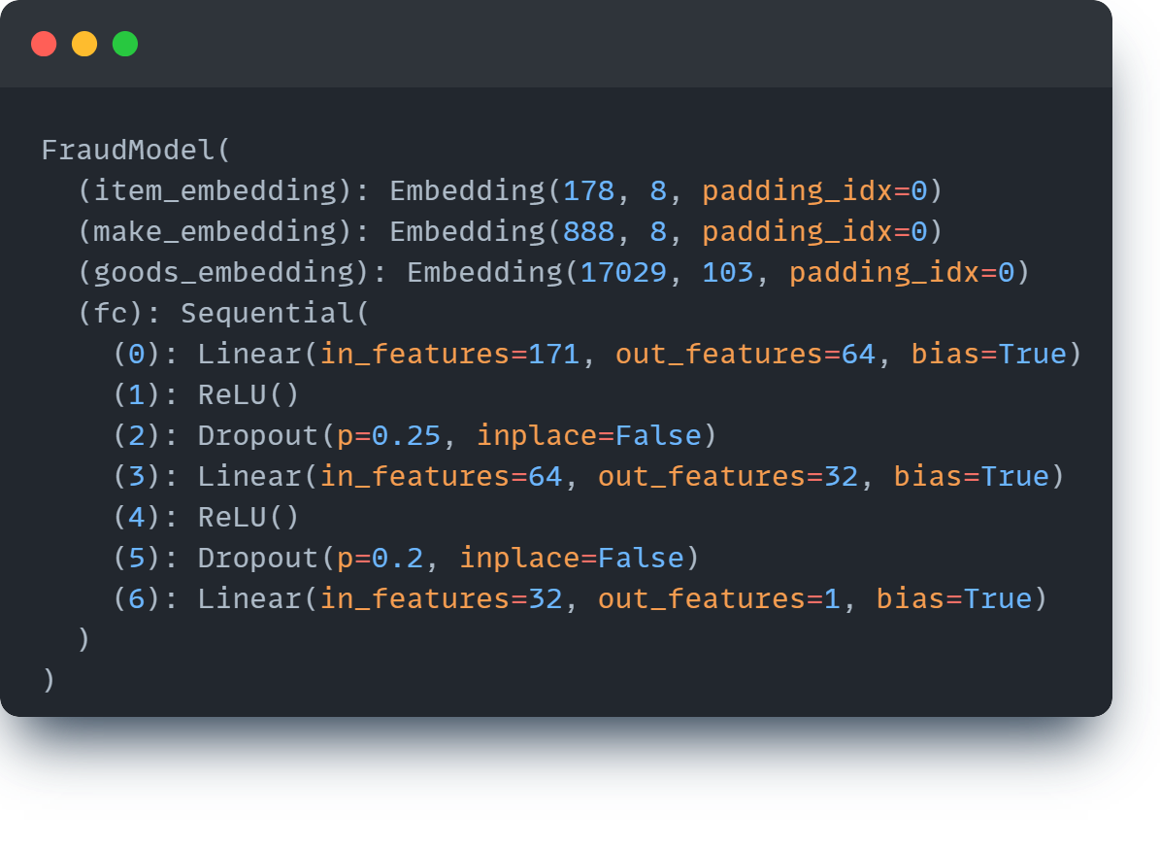
Models to compare
1. Embeddings Model
2. XGBoost

Slide 12
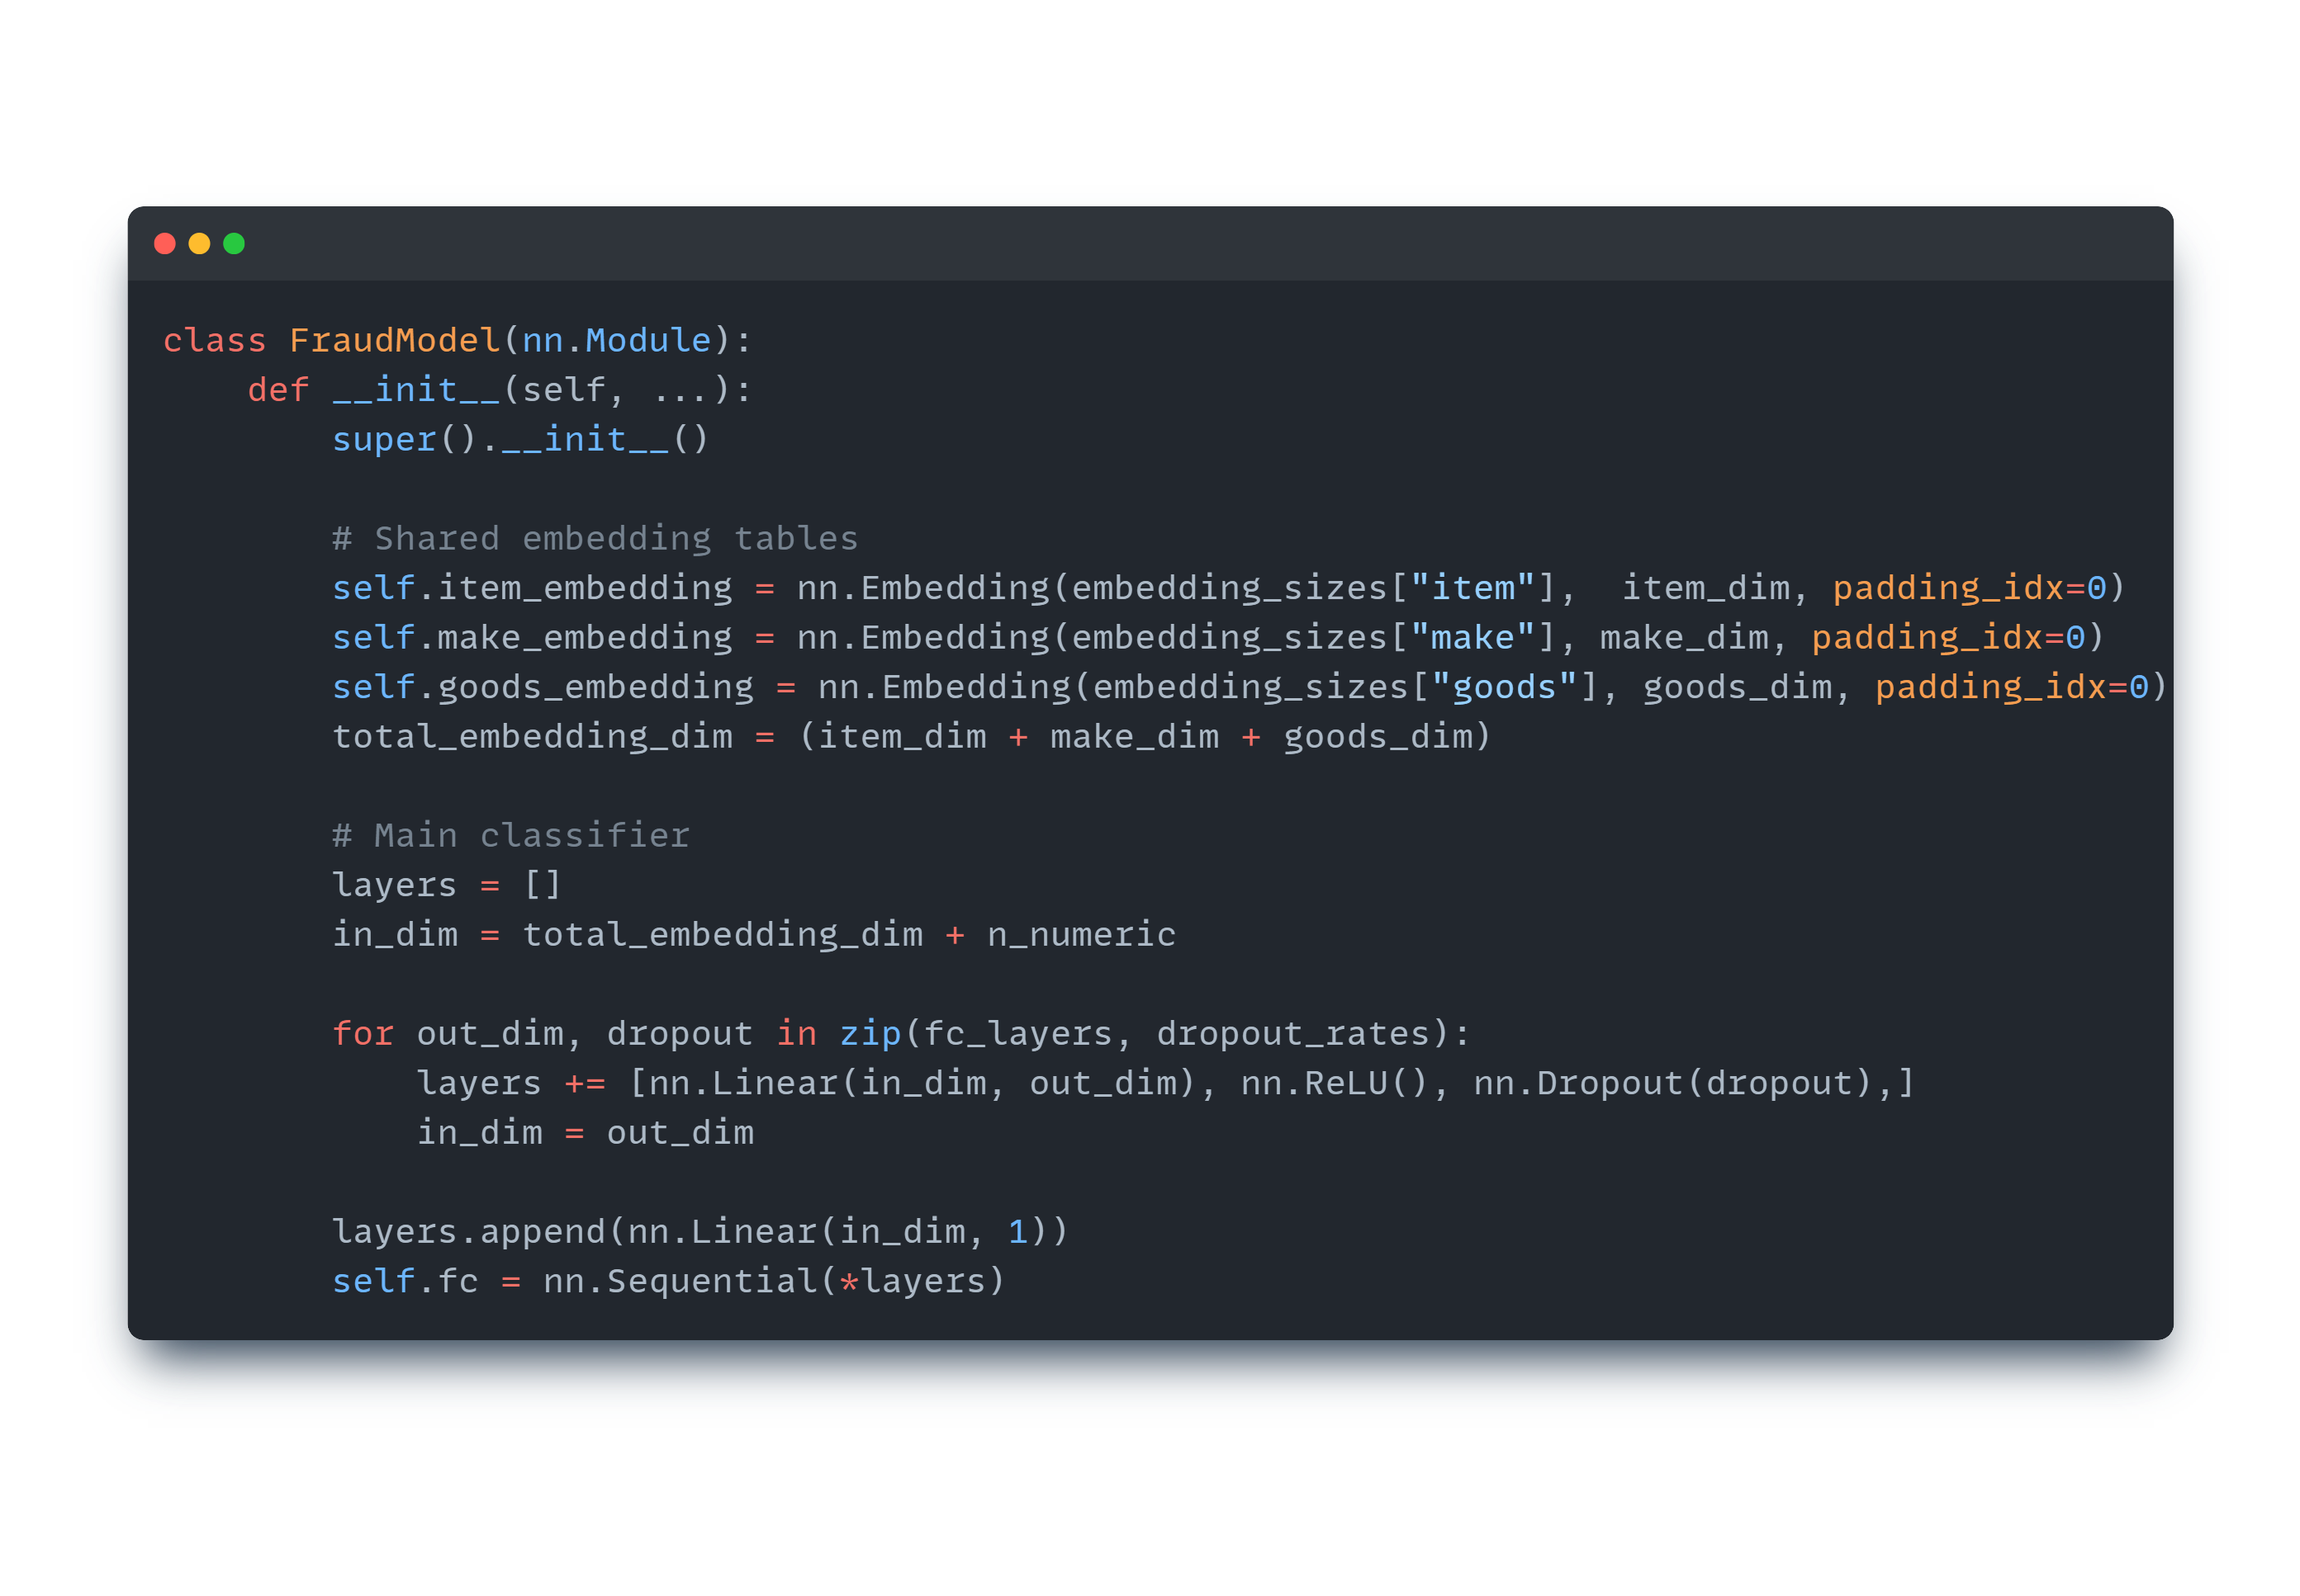
ANN with Embeddings

Slide 13
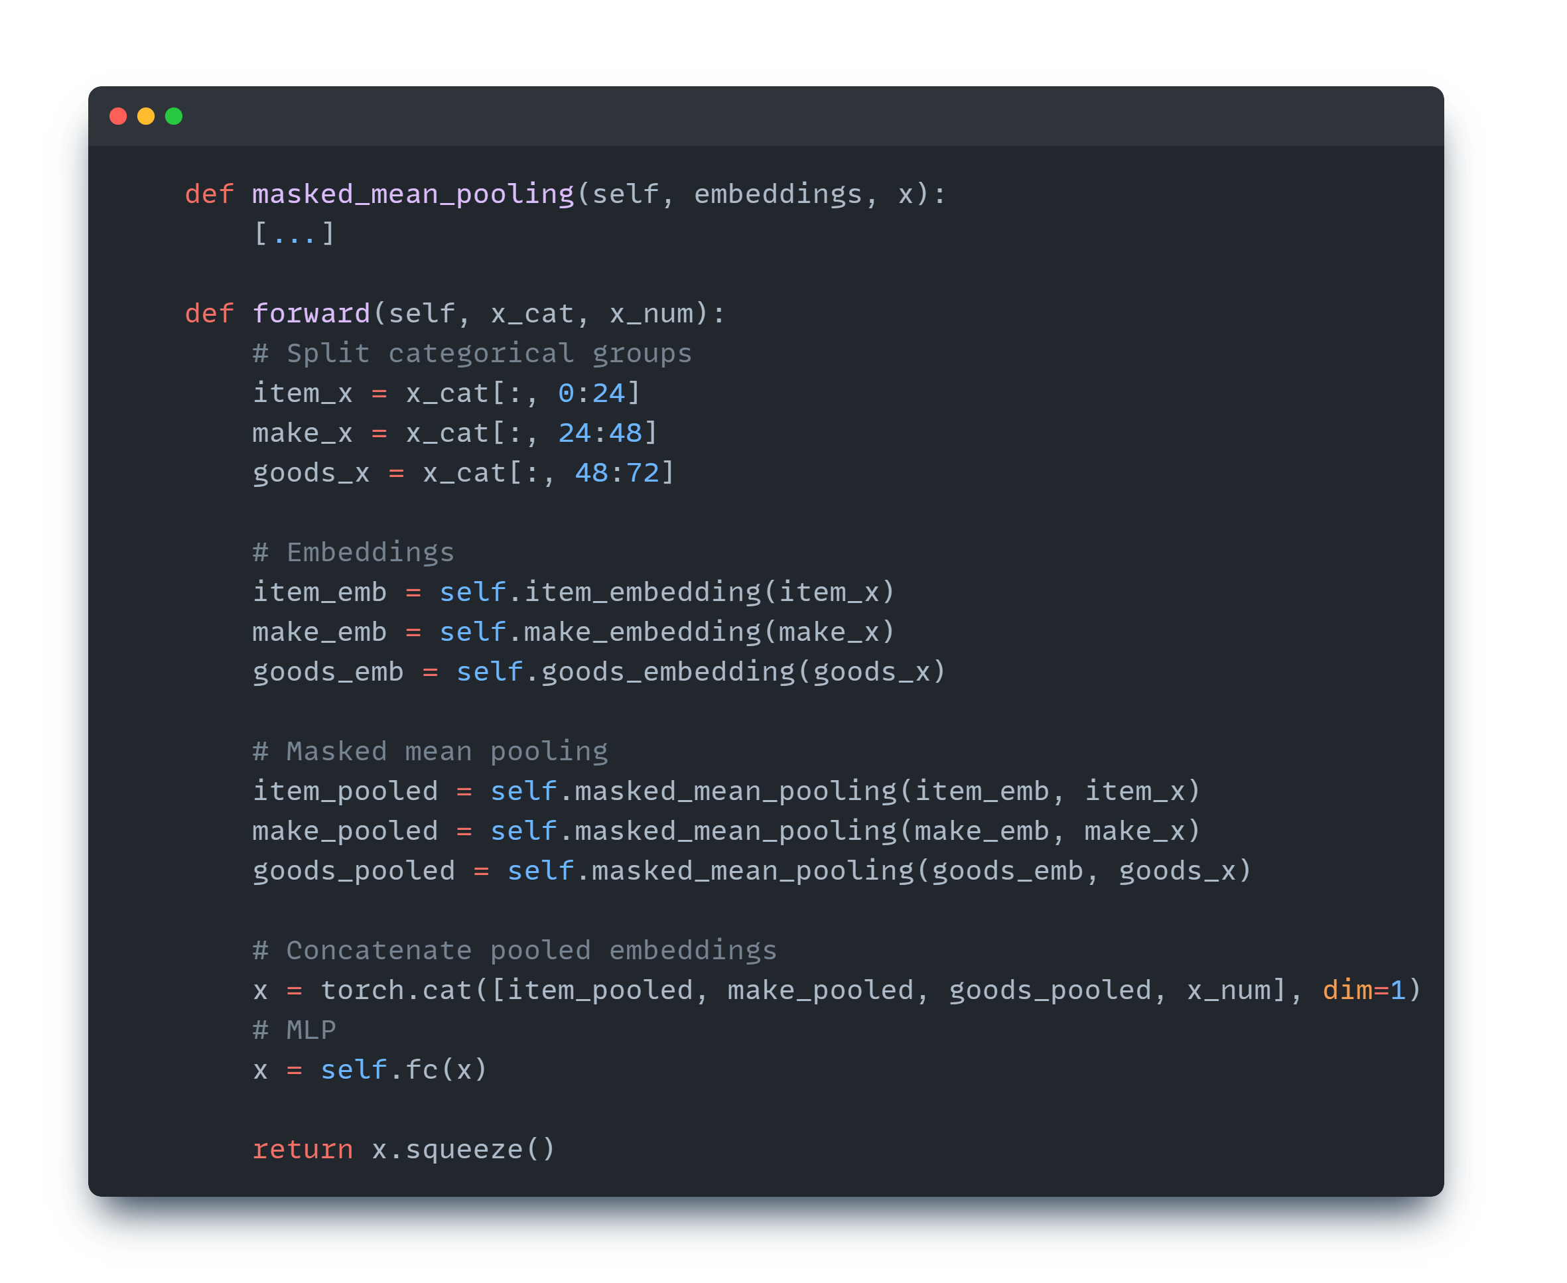
ANN with Embeddings

Slide 14
Results
Challenge Benchmark

Slide 15
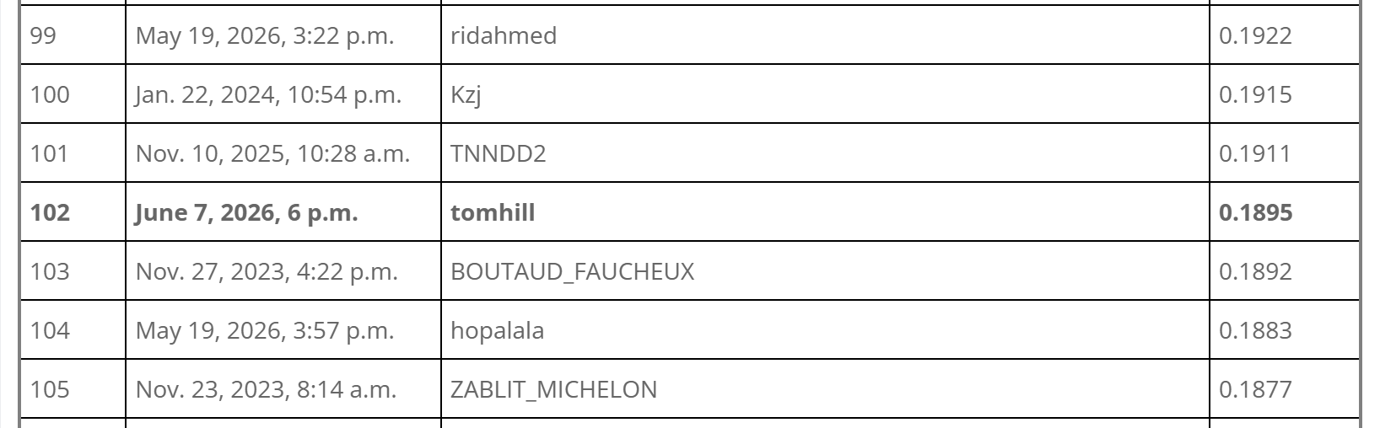
Results

Slide 16
Challenges and Errors
How to deal with the categorical columns in the dataset?
Vocabularies + Embeddings
How to deal with the varying number of items per basket?
Masked Mean Pooling
What parameters to optimize during an Optuna study?
Trial & Error, Minimizing Parameter Space
Improving results of embedding model
Tried Oversampling/Undersampling → no improvements
Hyperparameter Optimization → only small improvements
XGBoost
Ensemble Approach (ANN + XGBoost) → no improvements

Slide 17
Discussion
Embeddings significantly improved the results compared to Baseline
0.06 to 0.17 PR-AUC
Tree-based model performed even better than embedding model
Overfitting of Embedding Model? (Drop in PR-AUC on Test Set)

Slide 18
Conclusion and Future Work
We were able to train a model that performs better than the Benchmark on the Public Test Set
Rank 102: 0.1895 PR-AUC (XGBoost)
Rank 225: Benchmark
Future Work:
Try other tree-based algorithms
Refine embedding approach
Maybe transfer learning?

Slide 19
Thank you! ☺
Q & A

