Slide 1
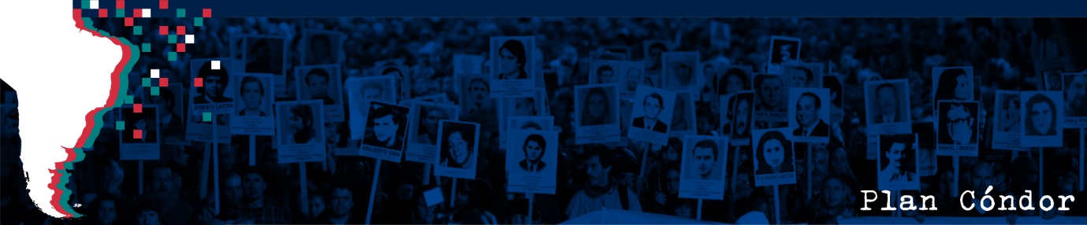
Deconstructing Operation Condor Through Interactive Data
Contemporary issues in the Americas:
Human Rights Data Visualisations

Slide 2
Preface
The following slides showcase three selected data visualisations from the “Operation Condor Interactive Dataverse”- a website I created to compliment and build upon the research of plancondor.org.
I have created the dataverse as an accessible webpage, which is available in-full by clicking the link below. (Please note that these visualisations are only interactive when accessed through the link. In these slides, the visualisations are website screenshots).
https://condorinteractive.netlify.app/

Slide 3
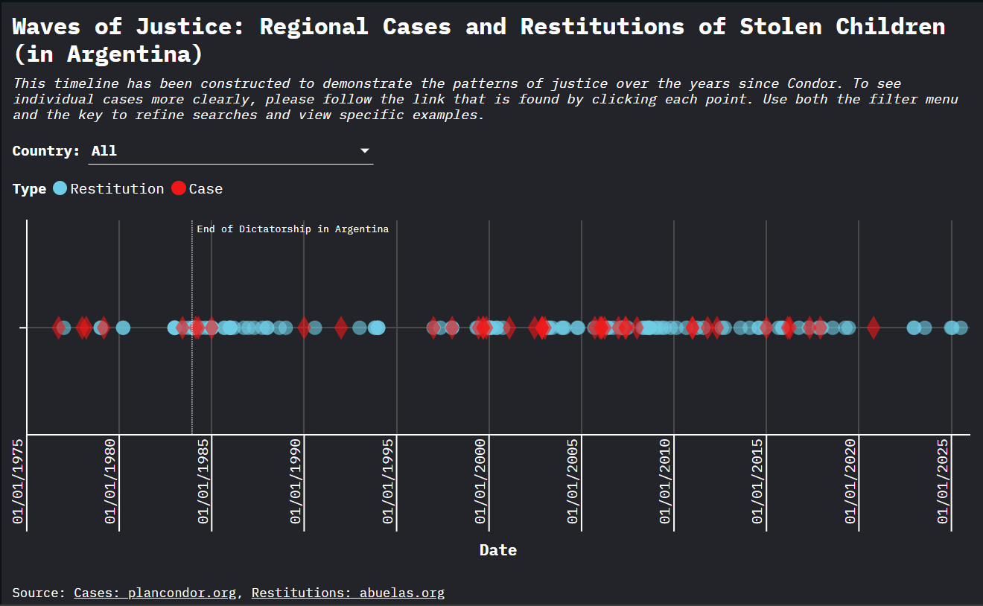
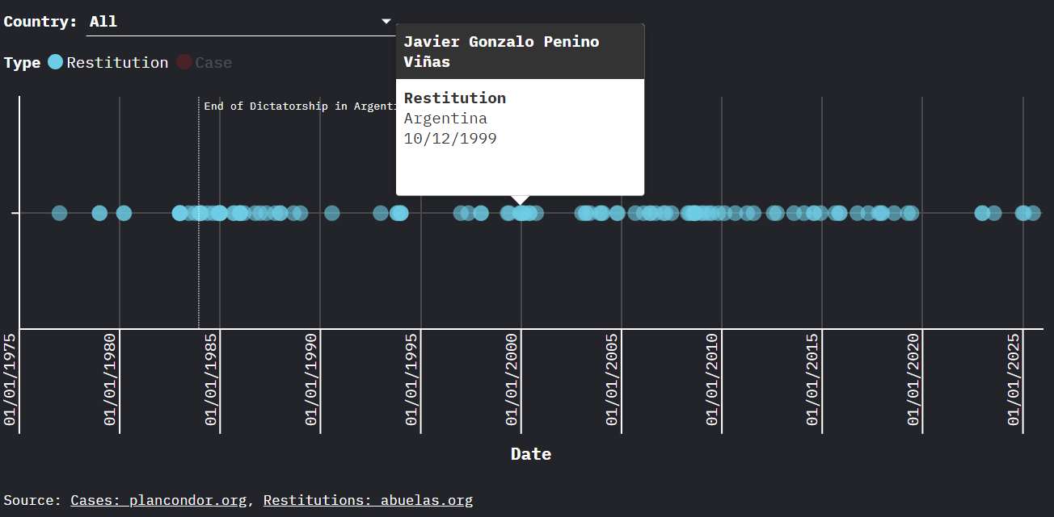
Visualisation 1: Justice through Trials and Restitutions
This visualisation compiles two leading Operation Condor databases- the plancondor.org trials information database and the Abuelas de Plaza de Mayo restitutions list to show the groupings or waves of justice that have occurred through the years since the end of dictatorship.
Links to both websites, as well as individual information, can be found by clicking the individual plot points.
As the visualisation is somewhat crowded, the filter menu and the clickable key aid in providing clarity to the many points on the timeline.

Slide 4
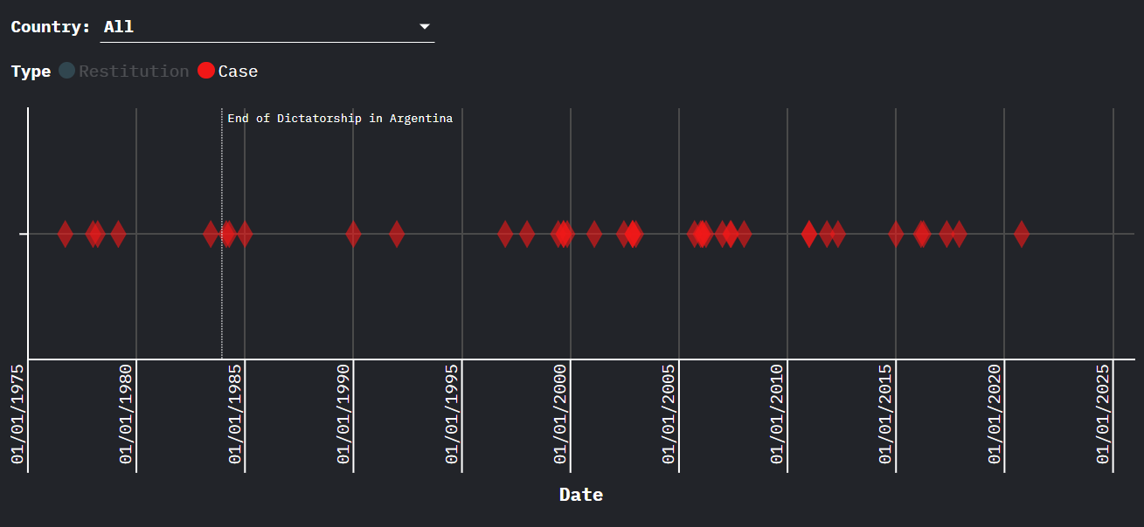
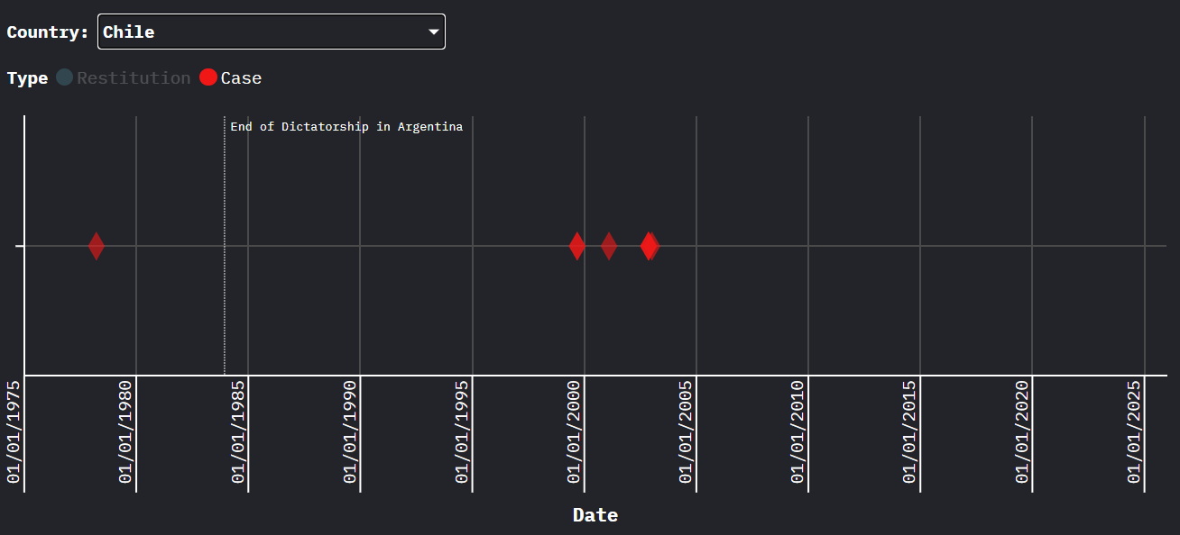
Filtering of visualisation 1

Slide 5
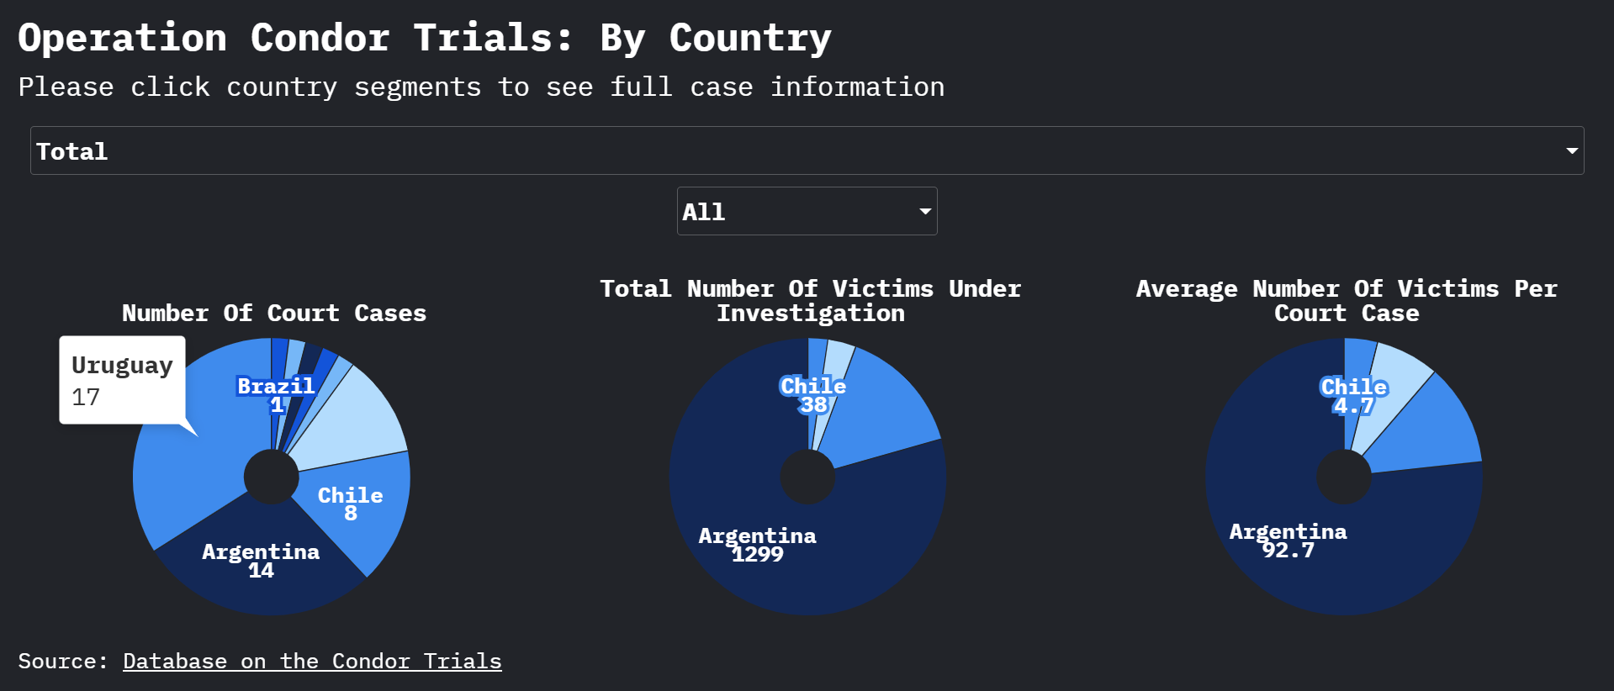
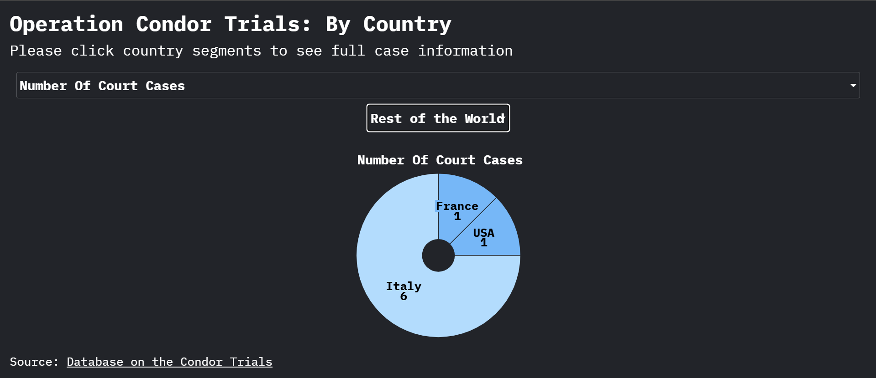
Visualisation 2: Prosecuting Condor in different states
This visualisation illustrates the varying degrees and extents to which different countries have prosecuted Condor-era human rights abuses
The charts are fully interactive through different filters and through finding details of cases by clicking the segments (the link takes the user to the plancondor.org section of case files)

Slide 6
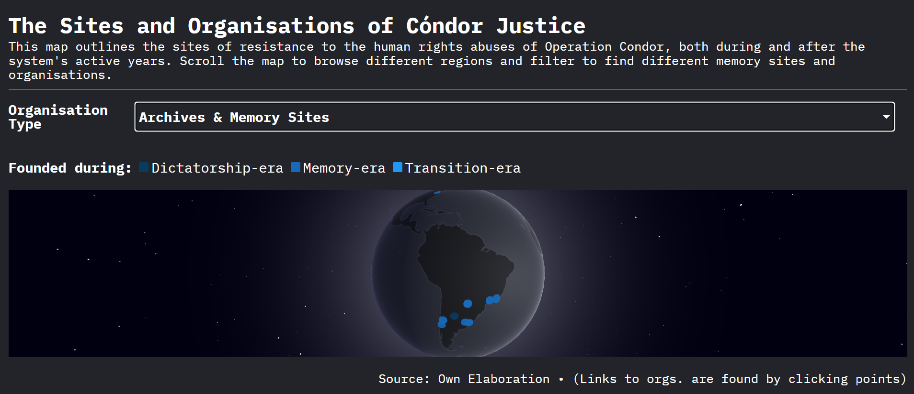
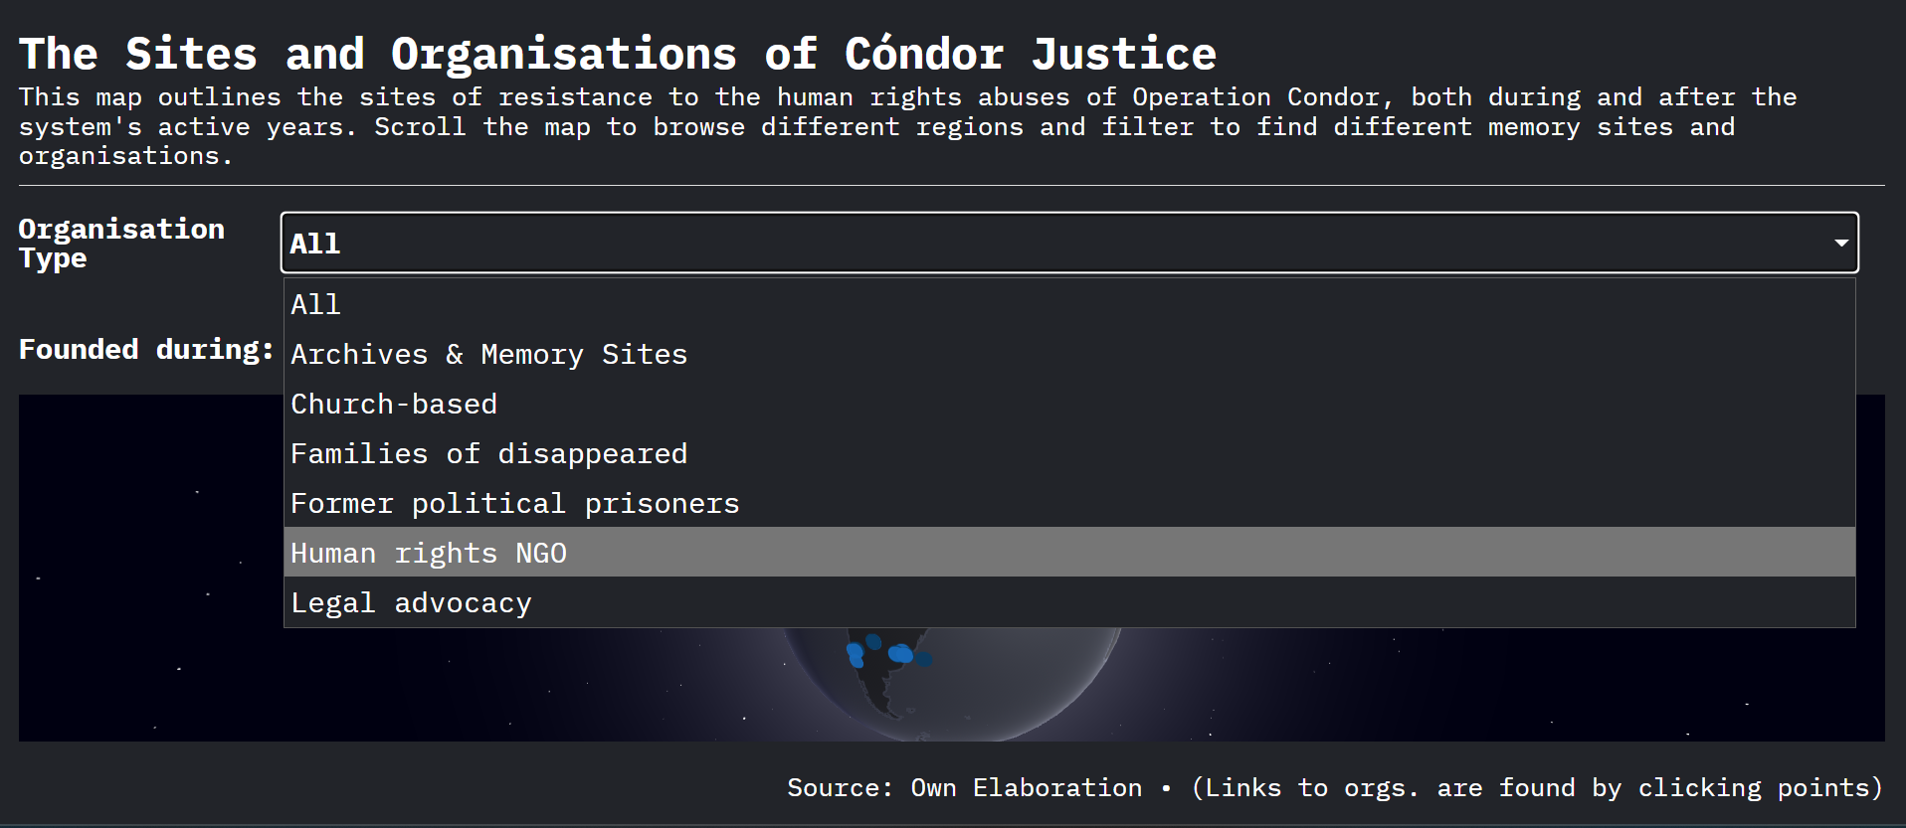
Visualisation 3: Sites of retaliation, resistance and memory
This visualisation illustrates the resistance to human rights abuses through the creation of social organisations, NGOs, governmental memory efforts and archive construction.
Scroll the globe and use the filter tab to explore the organisations, click individual points to find out more information.

