Slide 1
NLP and Named Entity Recognition
Wensheng Lin, Johnathan Zhao, Fasola Ibukunoluwa, Hyunje Sung

Slide 2

Background
What is Natural Language Processing (NLP)?
Natural Language Processing is the ability of computer programs to understand human language when speaking and writing.
Human language is a hard subject for machines to understand because of the many contradictions and exceptions that depend on context. NLP uses machine learning techniques to train models that can understand language rules and properly interpret unfamiliar inputs.
NLP training usually involves segmenting some set training data and tokenizing the sentences into its significant parts. We can then give each word tags that signify its role in a sentence(noun, verb, person, region). Finally we can use algorithms to teach the model common human speech patterns.

Slide 3
Background(cont.)
What is Named Entity Recognition(NER)?
Named Entity Recognition is a task in NLP. The goal of NER is to identify and categorize named entities stated in unstructured text into predefined groups, such as names of people, places, organizations, proper nouns, time, number, etc.
The general trend of NER research can be divided into four stages.
Phase 1: Early methods, such as rule-based approach, dictionary-based approach
Phase 2: Traditional machine learning, such as using HMM, MEMM, and CRF
Phase 3: deep learning, such as CNN-CRF
Phase 4: Semi-supervised learning, Transfer Learning, Attention Model, etc.
Example:
Tony, a student of Stony Brook University, scored 100% in his midterm on March 11,2022.
$Tony^(ENAMEX, name), a student of $Stony Brook University^(ENAMEX, org), scored
$100% ^(NUMEX, percent) in his midterm on $March 11,2022^(TIMEX, date).

Slide 4
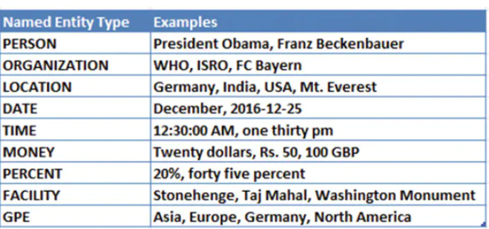

Trial
Text: “Europe is commonly known as the Old Continent. It has countries like England, Sweden, Spain, Scotland, Ireland, Turkey and Poland. They all use the suffix -ish in the adjective form to become English, Swedish, Spanish, Scottish, Irish, Turkish and Polish. The suffix -ish, meaning “born in or of a country,” came into use in Old English until around 1150.”
“The United Nations (UN) is an intergovernmental organization whose stated purposes are to maintain international peace and security, develop friendly relations among nations, achieve international cooperation, and be a centre for harmonizing the actions of nations.[2] It is the world's largest and most familiar international organization.[3] The UN is headquartered on international territory in New York City, and has other main offices in Geneva, Nairobi, Vienna, and The Hague (home to the International Court of Justice).”
This is the classification of Named Entity Recognition in NLTK. GPE usually stands for city, state, country, continent, etc. Facility usually stands for well-known monument or artefact.

Slide 5
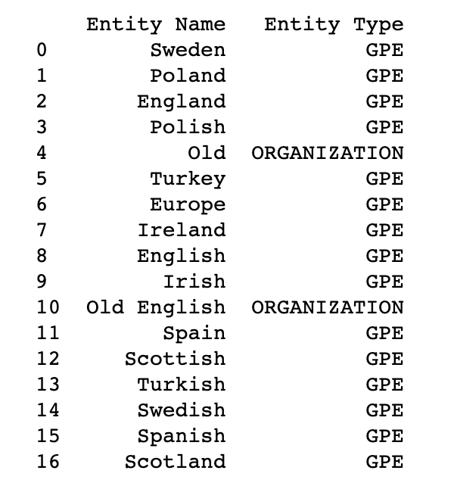
Result 1:
We can see that the NER task is generally well completed and can identify Sweden, Poland, etc. as GPE(Geopolitical Entity), but there are some unsatisfactory aspect. For instance, it wrongly identifies Old/Old English as an ORGANIZATION

Slide 6
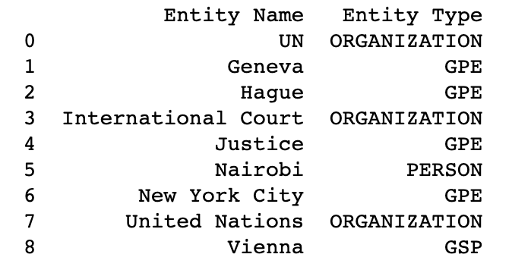
Result 2:
We can see that the NER task is generally well completed and can identify UN as an ORGANIZATION, but it also makes some mistakes. GSP stands for Geographical-Social-Political Entity, an older tag

Slide 7
Our Goal
Using a data set consisting of over 1,200,000 news headlines compiled over 19 years, we will try to create a model that can properly classify the headlines based on their subjects.
Dataset sourced from kaggle:
https://www.kaggle.com/datasets/therohk/million-headlines

Slide 8
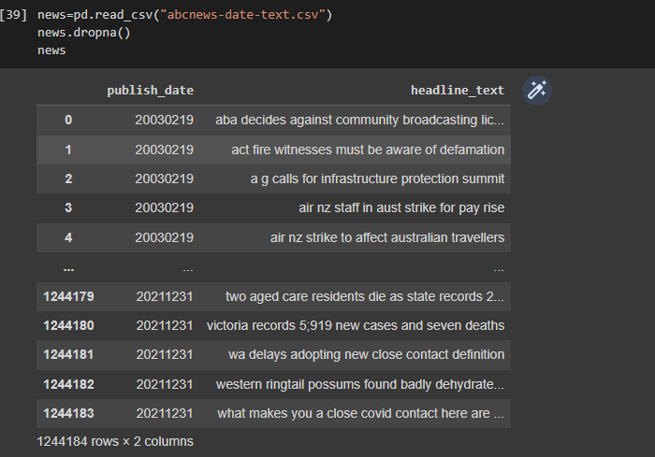
Data Exploration

Slide 9
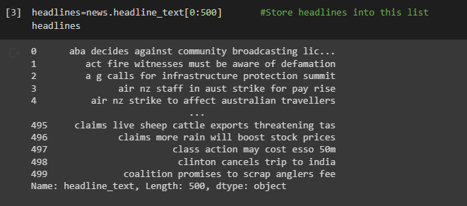
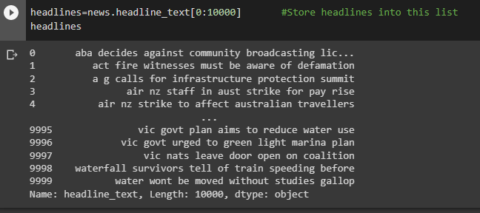
Data Exploration (cont.)
Using first 500 headlines
Using first 10000 headlines

Slide 10
Model Exploration
Assumptions
All headlines are in the English language
All headlines that can be tokenized will be included in the model for training
If the headlines could not be tokenized, then they will be thrown out

Slide 11
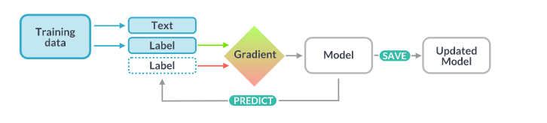
Model Exploration(cont.)
Key Algorithm
We want our model to be able to use the training data to understand context to properly interpret the test data so iteration is important in the training process.
We can compare the results of the initial training process to some reference values and calculate the gradient of the loss which tells us how often the model incorrectly classifies the text. This gradient helps us determine how the model can be changed to improve its accuracy.

Slide 12
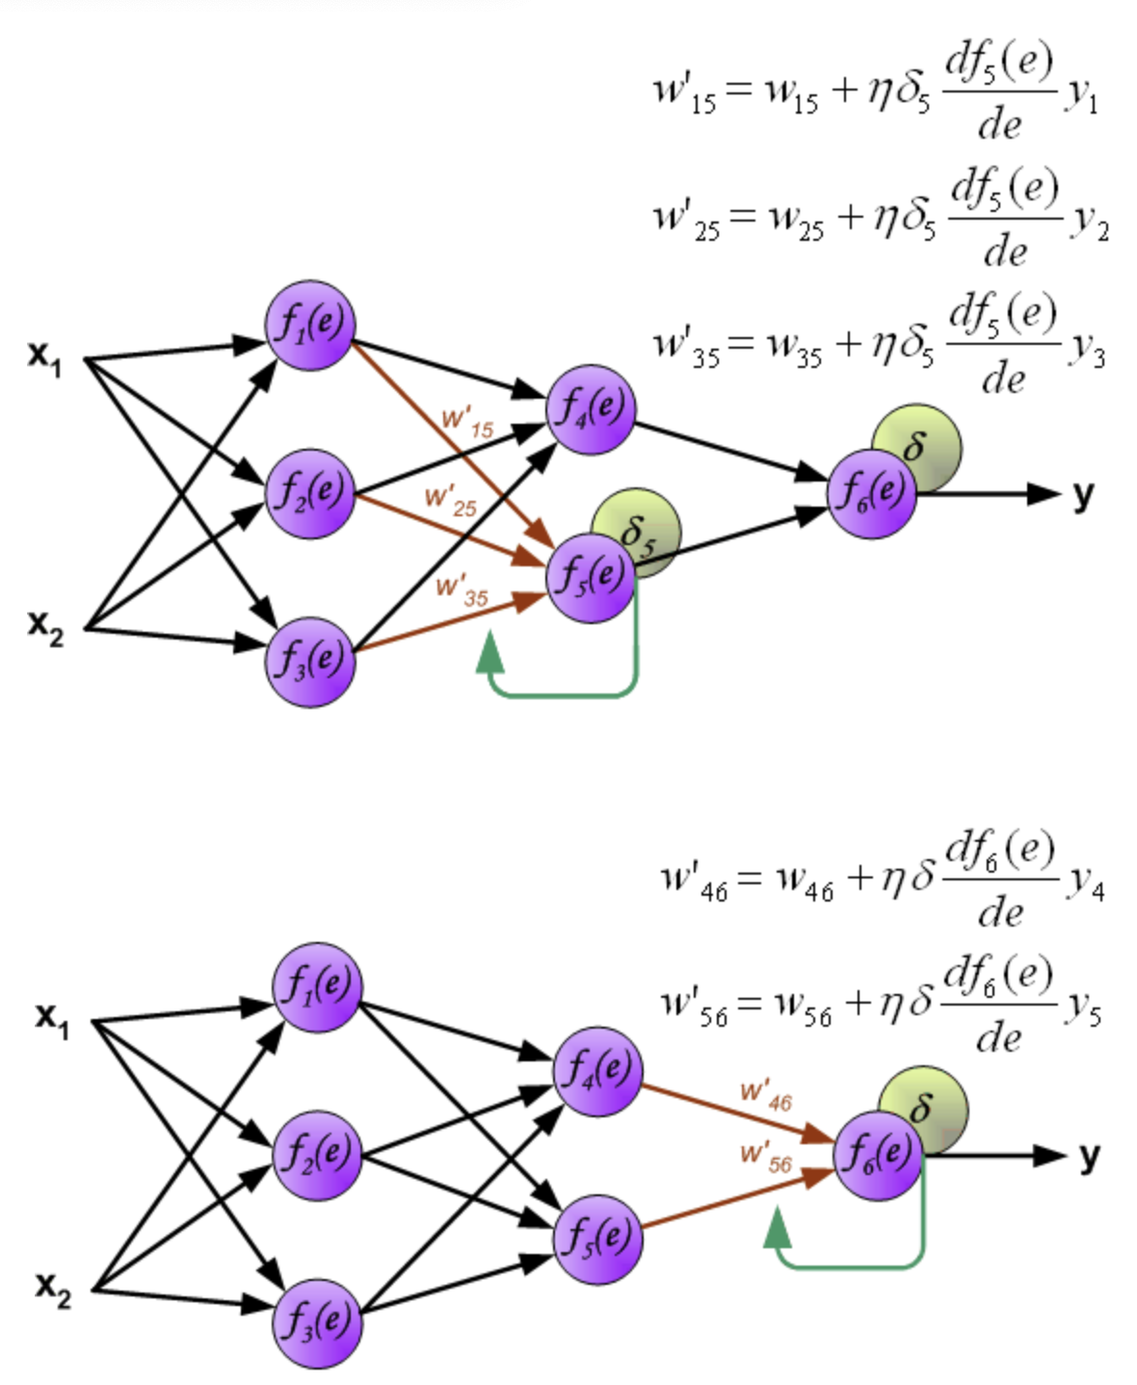
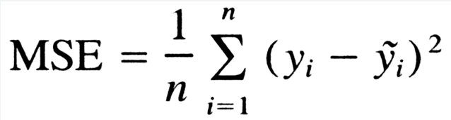
Backpropagation algorithm
A cost function is calculated for one training “session” where we want to minimize the cost.
Cost is the MSE or mean squared error which is the average squared difference between the output of the neural network and the actual data from the training set.
We minimize the cost by calculating the gradient and adjusting the weights and bias of points in the network.

Slide 13
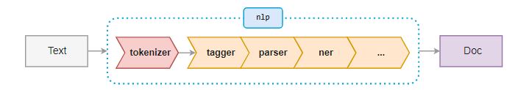
Model Exploration(cont.)
These are some of the processes involved in Named Entity Recognition.
When Interpreting text using spaCy, it is essential to first make it an NLP object.
Tokenizer: Segments the text into separate words, punctuation, etc, based on the rules of the specific language.
Tagger: Assigns part-of-speech tags to each token. Some tags include: NUM(number), SYM(symbol), and ADV(adverb).
Parser: Assigns dependency labels to the tokens. These are similar to the POS tags and include iobj(indirect object), conj(conjuct), nsubj(normal subject).
Ner(Named Entity Recognizer): Labels named entities based on the categories set by the model.
To finalize the process, the text is outputted as a Doc object which contains an array that retains the tags assigned to each token within the text.

Slide 14
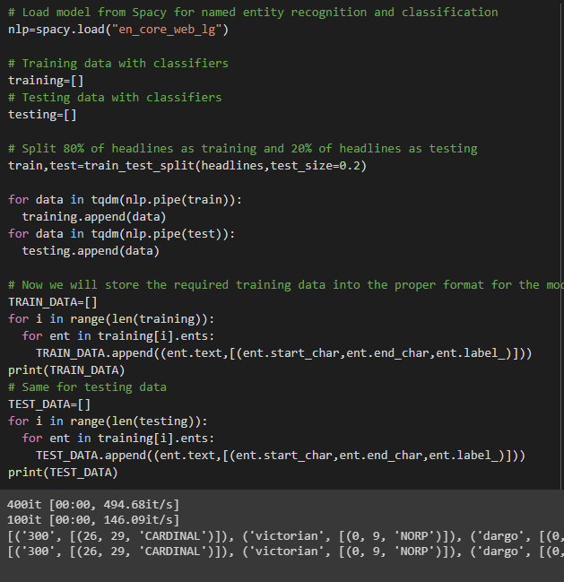
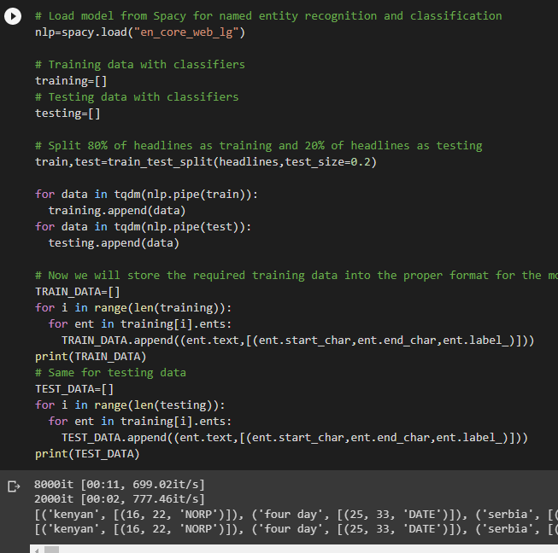
Model Exploration(cont.)
Training Process
500 headlines
10000 headlines

Slide 15
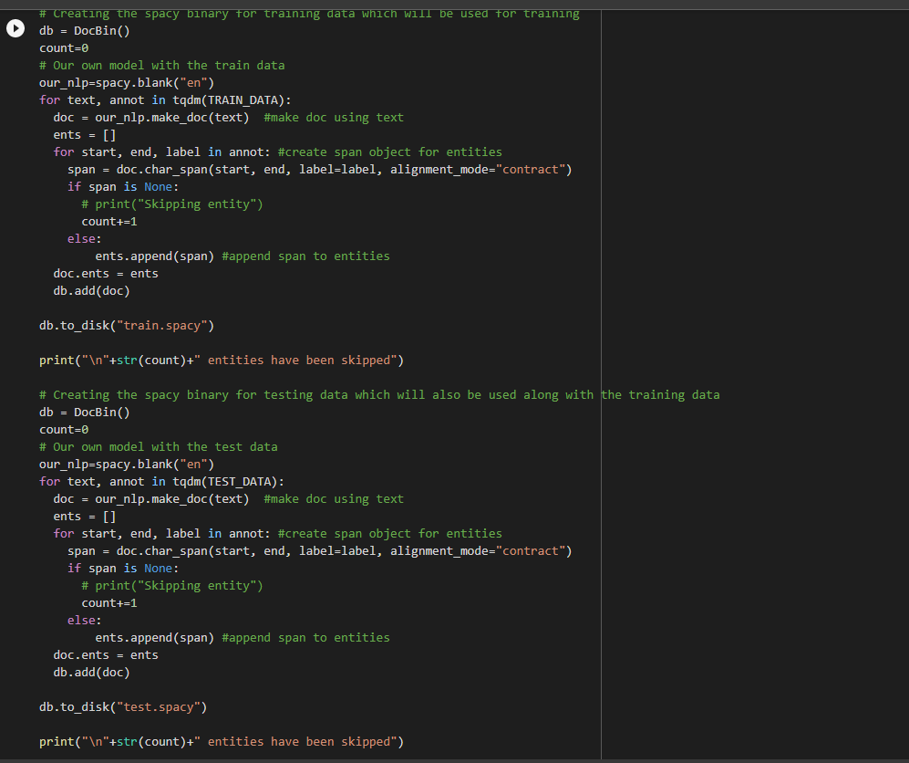

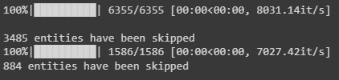
Model Exploration(cont.)
Training Process(cont.)
500 headlines
10000 headlines

Slide 16

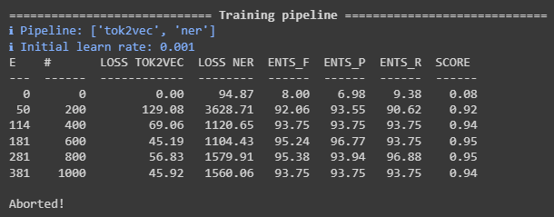
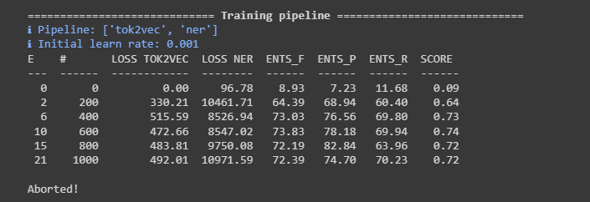
Model Exploration(cont.)
Training Process(cont.)
500 headlines
10000 headlines

Slide 17
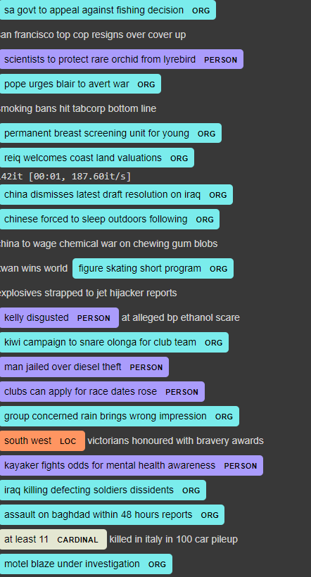
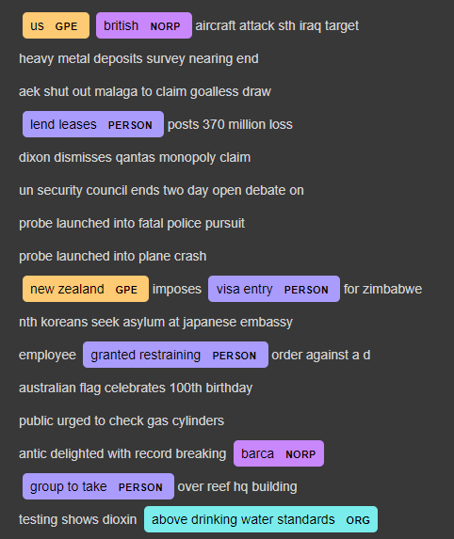
Results
500 headlines
10000 headlines

Slide 18
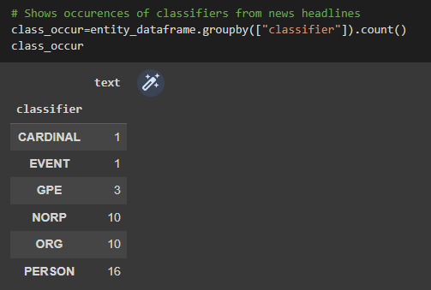
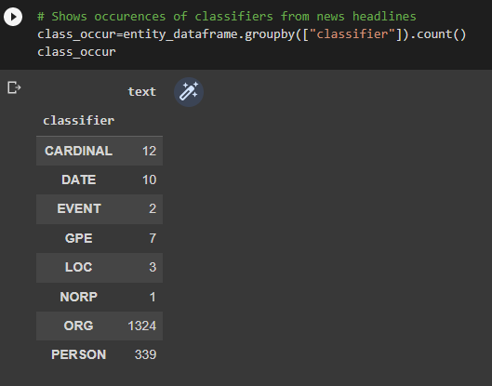
Results (cont.)
500 headlines
10000 headlines

Slide 19
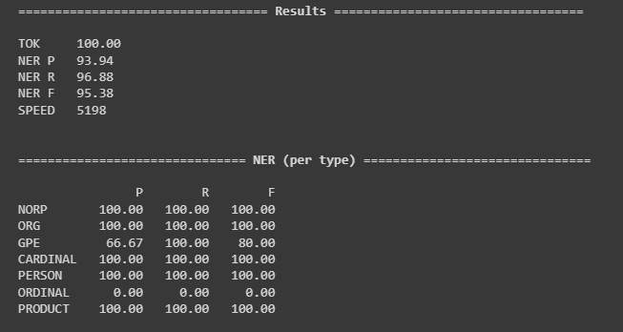
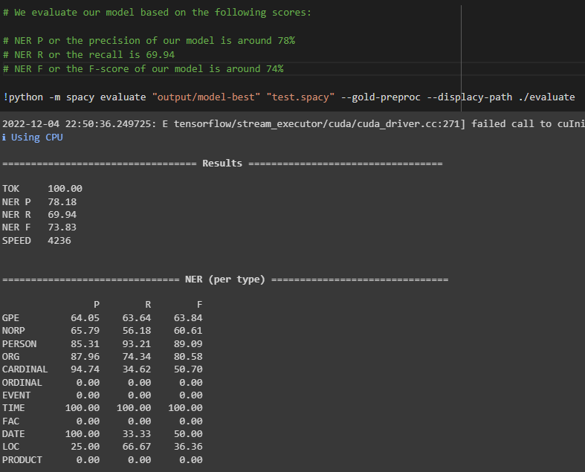
Results (cont.)
500 headlines
10000 headlines

Slide 20


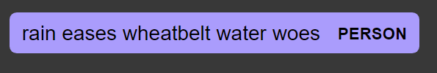
Complications
We noticed a few issues while testing the data:
The machine struggled when classifying acronyms, it classified SA(Saudi Arabia) as an organization rather than as a geopolitical entity. The model also completely failed to recognize Zimbabwe as a GPE.
The model would often classify an entire headline rather than one specific word.

Slide 21
Conclusion:
The model seemed to demonstrate little understanding of human speech. When running the trials with a smaller training set it was able to more accurately categorize the test data. On the other hand, when we tried using 10,000 headlines for the trial data, the machine favored the ORG category and would incorrectly categorize many tokens.

Slide 22
Thank you!

