Slide 1

When I’m at my Best
Agile Delivery Growth Pack
Author: Tom Hoyland | Version 0.4
 | When I’m Working at my Best | When I’m Learning at my Best
1. I’m like [what]…
2. I’m [where]
3. I’m with [who]
4. This happens just [before]
5. This happens next [after]
6. Others will notice this by…
7. And I would like others to…
Questions inspired by Clean Set Up, by Caitlin Walker.

Slide 2
When I Need Support
Agile Delivery Growth Pack
Author: Tom Hoyland | Version 0.4
 | Others will …
See …
Hear …
And Notice …
And when they do, I would like them to …
Questions inspired by Clean Set Up, by Caitlin Walker.

Slide 3
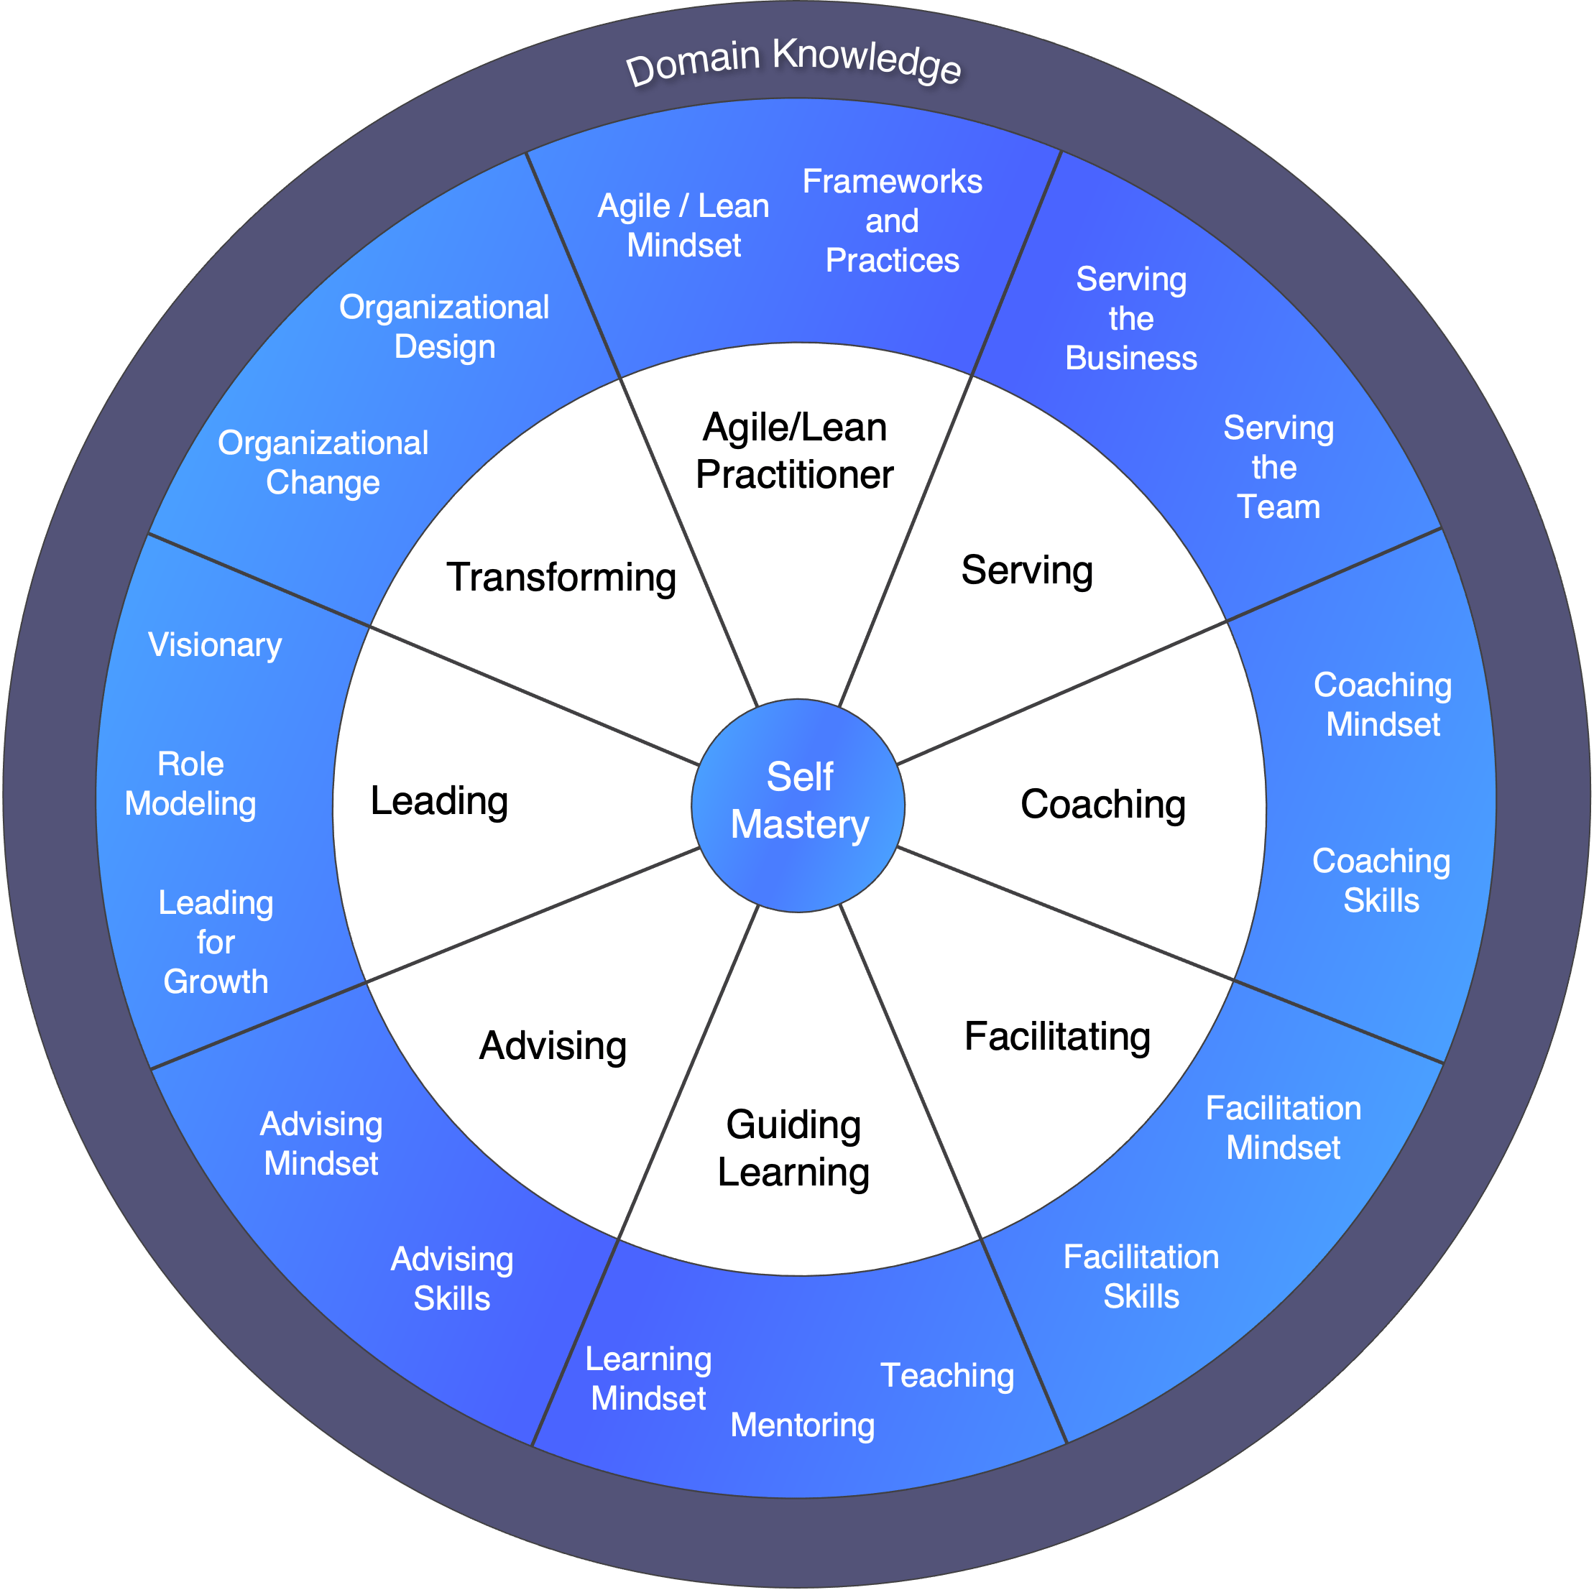
Growth within the Profession
Agile Delivery Growth Pack
Author: Tom Hoyland | Version 0.4
Think about your growth in the Agile Profession. Mark on the wheel where you think you are now and the areas where you’d like to develop and invest your energy further.
Where I think I am now
Where I’d like to develop and invest my energy further
Agile Coaching Growth Wheel. (n.d.). Agile Coaching Growth Wheel. [online] Available at: https://agilecoachinggrowthwheel.org/.
‌

Slide 4
Growth outside the Profession
Agile Delivery Growth Pack
Author: Tom Hoyland | Version 0.4
If you’d like to grow outside of the Agile Profession, let’s explore that together!
Things I’d like to lean into more … | New Things I’d like to explore …

Slide 5
What would you like to have happen?
Agile Delivery Growth Pack
Author: Tom Hoyland | Version 0.4
I could do all these things, but this is what I’m going to try …
Ideas & Actions | What’s Next | In Progress | Blocked | Done | Abandoned
Scrum Alliance – CSP-SM
Clean Updates
Clean Language
ICF - PCC
Your
Investment
ICagile Facilitation
Your
Experiment

Slide 6
Sync Up Template
Agile Delivery Growth Pack
Author: Tom Hoyland | Version 0.4
From DD-MON-YY to DD-MON-YY
I’d like …
A Decision
To Discuss
Support On
To Be Heard
Where I invested my energy since last time…
Profession &
Community
I did a bit of this…
A mix of…
Some of this…
A bit of that…
Delivery
Team
Business
Impact

