Slide 1


Agile Growth Pathway
TL;DR / Overview
Career Levels of an Agile Practitioner
Background
Agile Growth Pathway
Getting Started
Origin Story – How We Got Here
While structured around a scenario at Generic Inc., the Agile Growth Pathway is designed as a flexible resource for all. Use it as a pathway to follow on your own, a foundation to adapt, or inspiration to create something similar in your teams, communities, or organisations. Feel free to adopt, adapt, or disassemble it to best support your unique goals in agile professional development.
Agile Growth Pathway
Author: Tom Hoyland | Version 1.7

Slide 2
1. TL;DR / Overview
At Generic Inc, we’ve developed a career growth pack and pathway for Agile Practitioners and People Managers, based on an industry-recognised competency model to support professional development. The pack is complemented by tools and templates proven effective across various teams and organisations.
This resource is designed to be lightweight and user-friendly, supporting colleagues at all experience levels in enhancing self-awareness and identifying the skills and resources needed to grow as agile professionals at our company and beyond.
Skip to the Agile Growth Pathway
Agile Growth Pathway
Author: Tom Hoyland | Version 1.7

Slide 3
2.1. Career Levels of an Agile Practitioner
Generic Inc. consists of multiple divisions with agile delivery colleagues distributed throughout. Within each division, the Agile Practitioner career path is standardised and includes multiple levels, enabling colleagues to deepen their expertise or broaden their scope through people management responsibilities.
Colleagues can join Generic Inc. at various levels based on their experience, with pathways to deepen their practice or transition into people management and leadership roles.
Each division is typically led by a Head of Practice, who oversees the growth and development of both Practitioners and People Managers, ensuring alignment across teams and maintaining a high standard of agile practice and delivery.
ℹ️ The term ‘Agile Practitioner’ is used here as a role term, similar to Individual Contributor, and should not be confused with the ‘Agile/Lean Practitioner’ stance as defined in the Agile Coaching Growth Wheel.
Agile Growth Pathway
Author: Tom Hoyland | Version 1.7

Slide 4
2.2. Career Levels of an Agile Practitioner
Associate Agile Practitioner – An entry-level role focused on foundational skills in agile practices and delivery support.
Agile Practitioner – A fully established practitioner who independently supports teams and contributes to agile delivery.
Senior Agile Practitioner – An experienced professional demonstrating advanced agile competencies, often guiding teams and mentoring associates.
Agile Practitioner People Manager – A role focused on both agile practice and people management, overseeing the development and performance of practitioners within a team.
Principal Agile Practitioner – A highly skilled expert responsible for leading strategic agile practices and developing agile maturity across teams.
Head of Practice – This senior role oversees groups of Agile Practitioner People Managers and their practitioners, shaping agile delivery practices, managing talent development, and ensuring alignment with the organisation’s strategic goals.
Agile Growth Pathway
Author: Tom Hoyland | Version 1.7

Slide 5
2.3. Career Levels of an Agile Practitioner
Pathways for Progression:
Practice-Focused Path: Practitioners focused on deepening expertise can progress towards the Principal Agile Practitioner level, leading high-impact initiatives and influencing strategic decisions.
People Management Path: Practitioners interested in leadership can transition to the Agile Practitioner People Manager role, with opportunities to manage teams, ultimately progressing towards the Head of Practice role.
It's Not Linear: Practitioners can move between roles as their goals evolve. A Principal Agile Practitioner can transition into People Management, and vice versa, to align their career with their growth and aspirations.
Agile Practitioner People Manager
Associate Agile Practitioner
Agile Practitioner
Senior Agile Practitioner
Head of Practice
Principal Agile Practitioner
Agile Growth Pathway
Author: Tom Hoyland | Version 1.7

Slide 6
3.1. Background - Common Questions
Common Questions from Agile Practitioners:
"How am I doing right now? What’s expected of me?"
"Where should I focus my energy and efforts to grow and develop?"
"What’s the difference between Role A and Role B?"
"I’m currently in Role X but want to move toward Role Y. What could I develop to help me get there?”
Common Questions from People Managers and Heads of Practice:
"I want to develop Person X but am unsure of the best courses to recommend."
"How can I encourage my team to articulate their development needs?"
"My team is strong in Competency A but needs growth in Competency B to improve service quality."
"I’d like my team to apply their certifications and theoretical knowledge practically."
Agile Growth Pathway
Author: Tom Hoyland | Version 1.7

Slide 7
3.2. Background - What’s Changed
Over recent years, the following resources have become widely available, providing greater support for agile practitioners:
Aligned Role Descriptions at Generic Inc. – Define clear expectations for individuals and roles within the organisation.
Agile Delivery Growth Pack – Allows practitioners to assess their current skills, track time and energy allocation, and plan their professional growth.
Human API – A tool and facilitated event enabling individuals and teams to articulate their needs for optimal performance.
Agile Coaching Growth Wheel (ACGW) – An industry-recognised guide outlining key competencies for agile professionals.
Community-Developed tools and practices have also been adopted and used within Generic Inc:
Co-Piloting – Practitioners pair to transfer skills, share knowledge, and build resilience by leveraging the expertise of the community and colleagues to create learning experiences.
Find a Facilitator – An internal tool allowing teams to request and be matched with independent facilitators, helping Agile Practitioners stay engaged with their teams while others hone facilitation skills.
ACGW + Courses and Certs – A resource hub with relevant training, certifications, and resources for practitioners planning their professional development.
Community Menu – A repository of colleague-led workshops and courses fostering skill development and knowledge sharing across teams.
Agile Growth Pathway
Author: Tom Hoyland | Version 1.7

Slide 8
3.3. Background - Capability Development
Investing in the skills, capabilities, and careers of Agile Practitioners and People Managers is crucial for increasing adaptability, resilience, and growth. Supporting their development not only helps to shorten the lead time to value but also unlocks greater potential across teams, leaders, and the organisation.
As practitioners grow, so does the value they bring. They amplify the capabilities of those around them, becoming accelerators for delivery, collaboration, and innovation - shaping the organisations they serve today and the ones they will build tomorrow.
Empowered with clear career plans, supportive networks, and the right resources, practitioners drive change, enhance team performance, and help create resilient, high-performing organisations.
Agile Growth Pathway
Author: Tom Hoyland | Version 1.7

Slide 9
3.4. Background - The Opportunity
Wouldn’t it be beneficial if Agile Practitioners and Agile Practitioner People Managers had a clear way to understand where they are on their journey, envision their next steps, and create a pathway for growth within the company? Imagine supporting colleagues to grow and develop in a focused way, with tailored resources and experiences that not only help them thrive but also drive the company’s growth and success.
And wouldn’t it be even better if they had a resource to prepare and support their development, enabling them to make a greater impact wherever their journey takes them?
The next slide compiles existing templates, tools, and resources into one central place – introducing the “Agile Growth Pathway.”
ℹ️ This pathway is designed to equip practitioners with transferable skills across various contexts and organisations. Work with your People Manager and mentor to align it with your role, team and context.
Agile Growth Pathway
Author: Tom Hoyland | Version 1.7

Slide 10
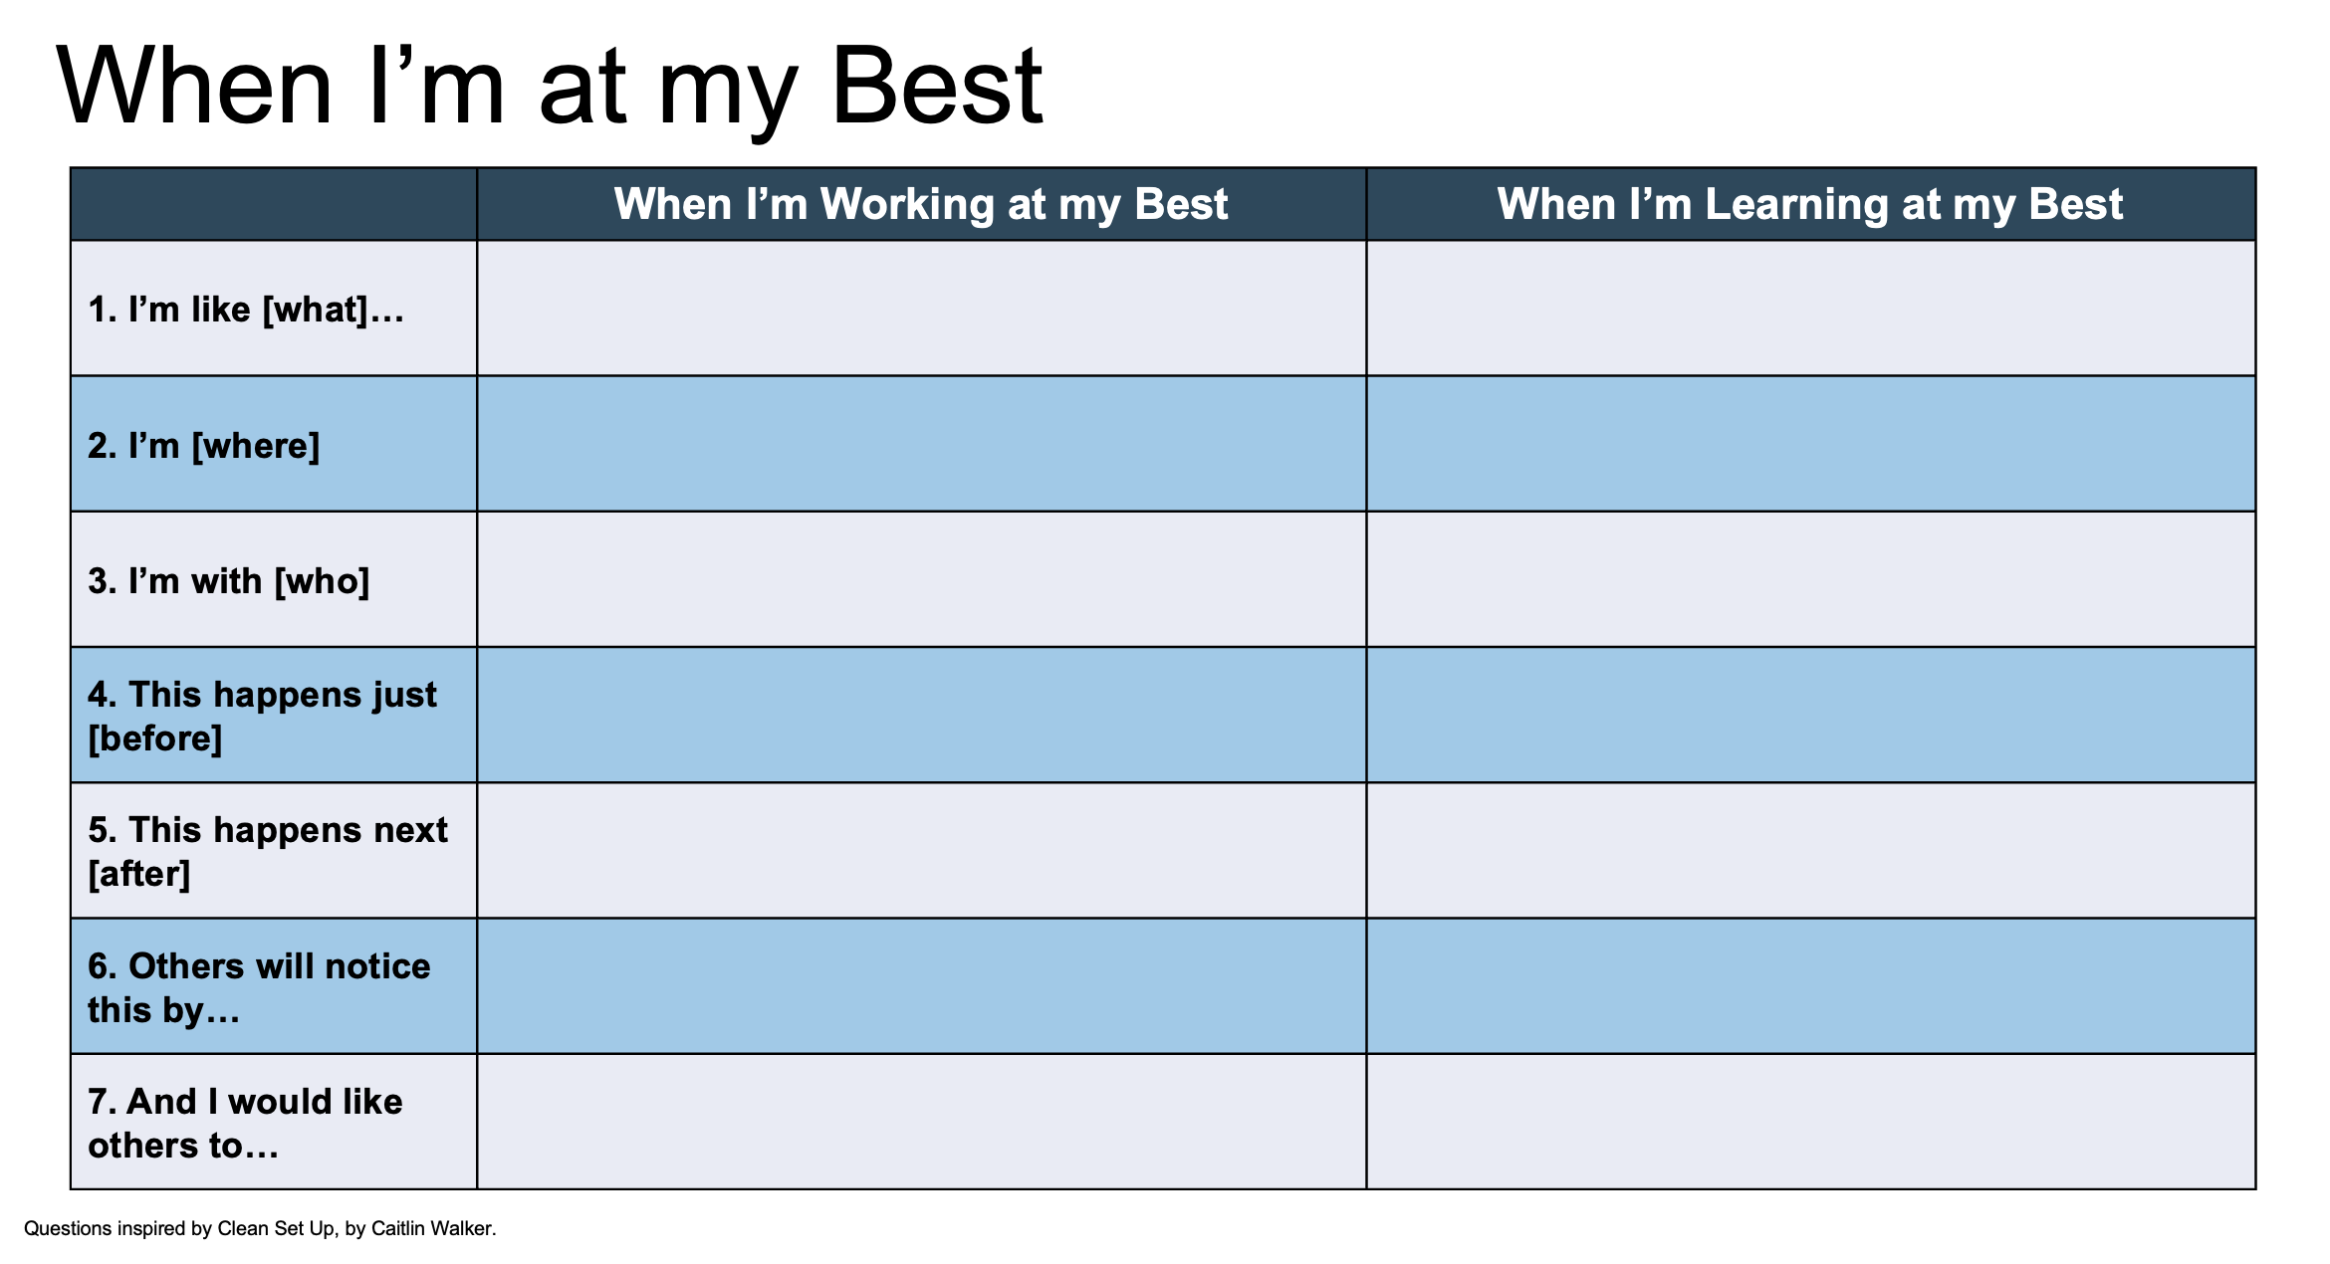
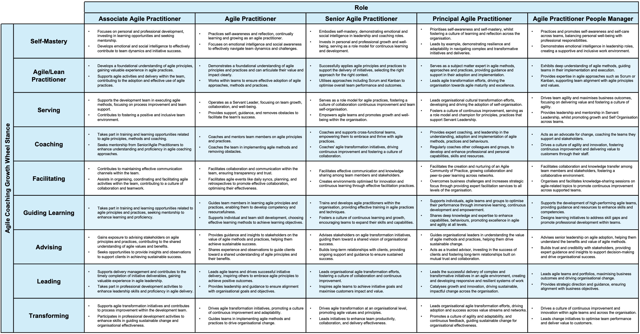
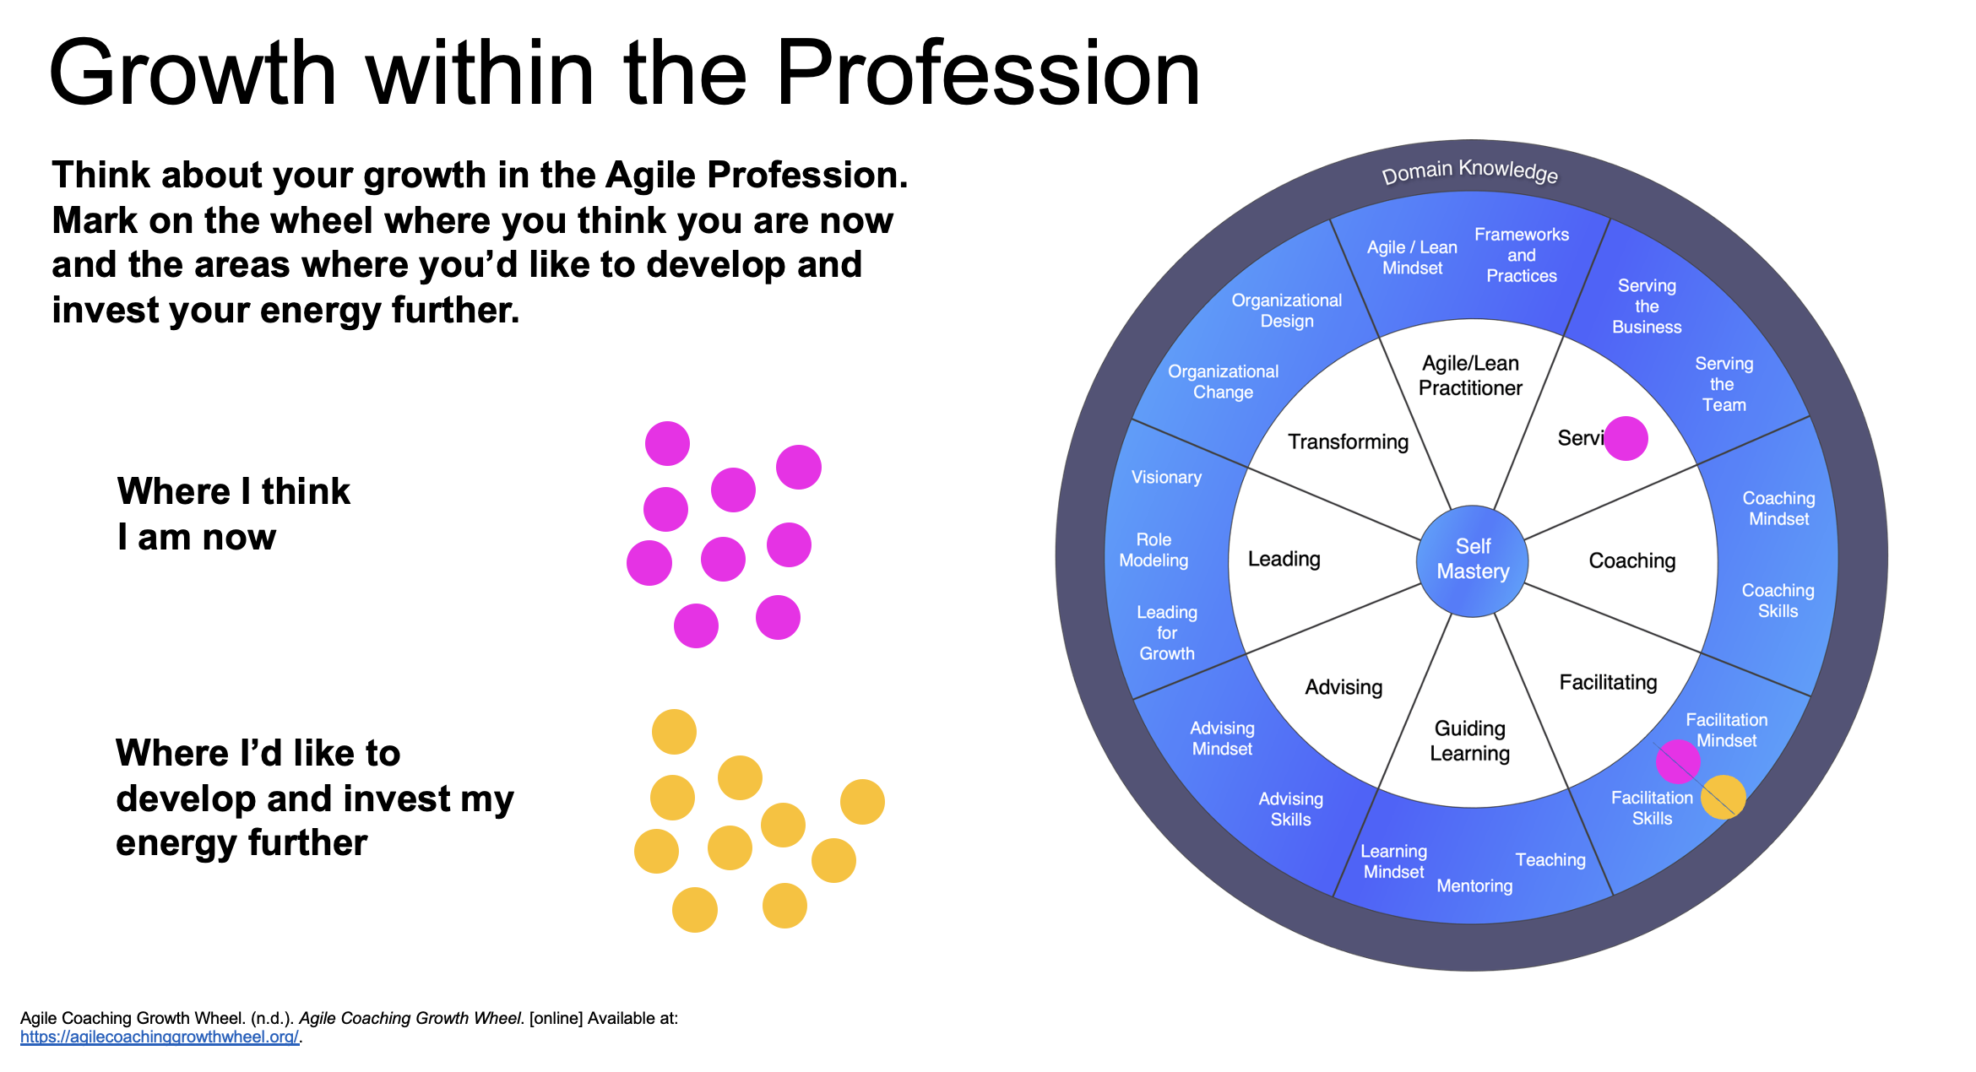
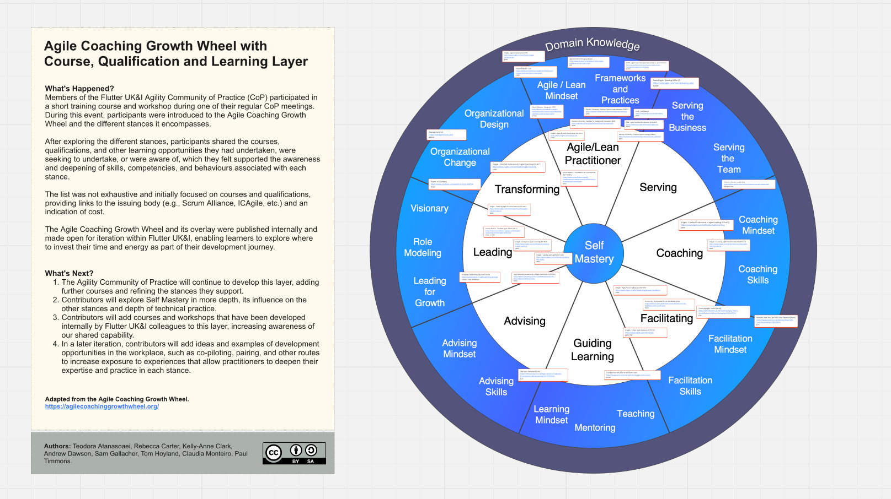
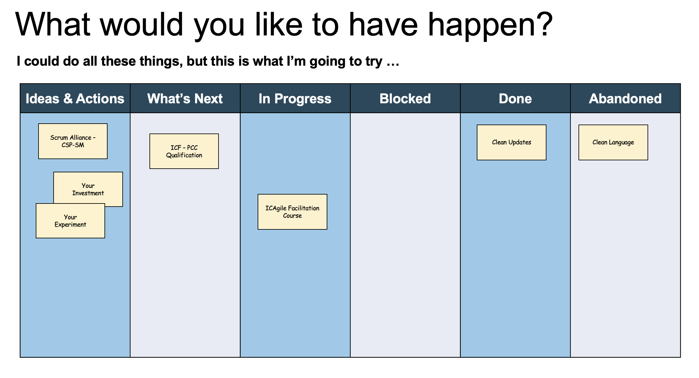
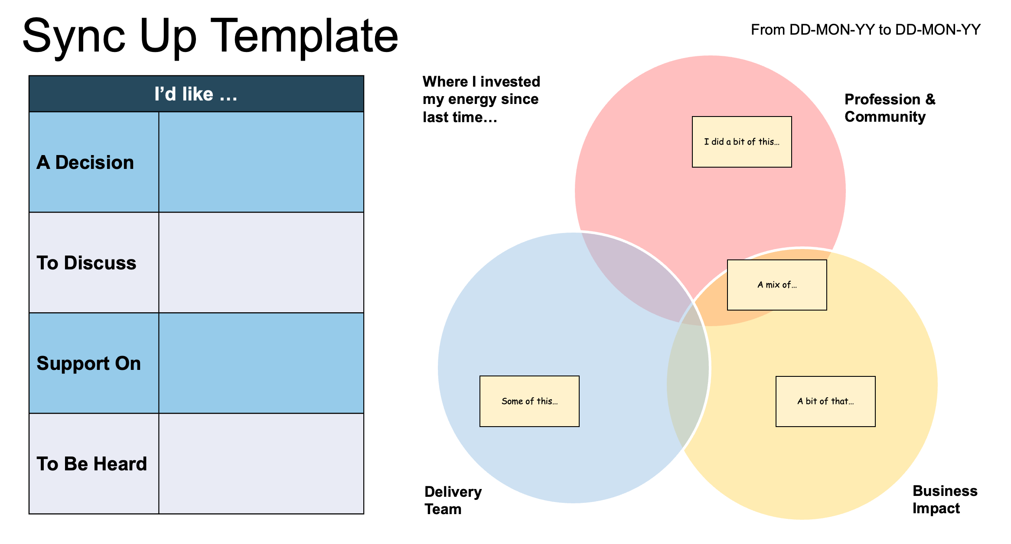
4. Agile Growth Pathway
Self-Awareness & Mastery
Orient Before Navigating
Focus Your Development
Find Courses & Resources
1
2
3
4
Understand what you need to be at your best, what you need from People Managers and colleagues. There are lots of tools out there to help you.
Agile Growth Pack (Slide 1+2)
Understand where you are now, review where you’d like to progress to or what skills to deepen. Set yourself a goal, discuss it with your manager or mentor.
Agile Practitioner Role & Stance Matrix
Increase your focus by assessing where you (and others) think you are now and immediate development areas. A Johari Window can be useful here.
Agile Growth Pack (Slide 3)
Identify courses, qualifications, books and resources to support your growth in your development area(s). Consider a coach or mentor too.
ACGW + Courses & Resources
Build and Execute a Plan
Track Progress and Energy
Reflect, Pivot, or Persist
See How Far You've Come
5
6
7
8
Build a Development Plan to help you get there, with courses, certificates, experiences and opportunities to grow. Think about how you’ll get feedback.
Agile Growth Pack (Slide 5)
Use the Sync Up to track where you are spending your time, if you’re getting what you need to grow, and if this is contributing to your Development Plan.
Agile Growth Pack (Slide 6)
Use this again to reflect on how your skills and capabilities have developed and changed. Get feedback from others, review how you are learning and growing.
Agile Growth Pack (Slide 3)
Use this again to review your progress, where you’d like to move next, if you’ve got the skills, capability and support system in place to make it happen.
Agile Practitioner Role & Stance Matrix
Agile Growth Pathway
Author: Tom Hoyland | Version 1.7

Slide 11
5.1. Getting Started - Get Your Resources
To begin using the Agile Growth Pathway, ensure you have access to the following resources, saving them in your personal folders:
Agile Growth Pack 📁
Me “at My Best” (Slides 1-2) 📝
Growth Within the Profession Wheel (Slide 3) 📝
Build a Plan (Slide 4) 📝
Sync Up Template (Slide 6) 📝
Agile Coaching Growth Wheel, Courses, and Resources 🌍
Agile Practitioner Role & Stance Matrix ℹ️
ℹ️ These resources can be unbundled as needed and shared with People Managers if that aligns with your personal growth journey.
Agile Growth Pathway
Author: Tom Hoyland | Version 1.7

Slide 12
5.2. Getting Started - Using the Pathway
Self-Awareness & Mastery: Reflect on your needs using tools like “Me at My Best” or Human API. Identify what support you need from your People Manager.
Orient Before Navigating: Assess where you are and where you’d like to go. Set a clear goal and discuss it with your People Manager using the Agile Practitioner Role & Stance Matrix.
Focus Your Development: Identify your focus areas with the Agile Coaching Growth Wheel. Consider using tools like the Johari Window for additional insights.
Find Courses & Resources: Explore relevant training through the ACGW + Courses & Certs tool. Leverage resources like Find a Facilitator or Co-Piloting to develop and practice skills, especially when you prefer hands-on learning "in the work" or encounter budget constraints.
Build and Execute a Plan: Create a plan, outlining the courses, certifications, and experiences you need. Use the Agile Growth Pack for structure.
Track Progress and Energy: Use the Sync Up Template to monitor alignment with your development plan.
Reflect, Pivot, or Persist: Regularly reassess your growth using the Agile Coaching Growth Wheel, gathering feedback and considering adjustments to your plan.
See How Far You've Come: Revisit the Role & Stance Matrix to evaluate progress and determine your next steps, ensuring you have support for future challenges.
Agile Growth Pathway
Author: Tom Hoyland | Version 1.7

Slide 13
6. Origin Story - How We Got Here
The following slides outline the method and process by which the Agile Growth Pathway and its resources were developed.
Agile Growth Pathway
Author: Tom Hoyland | Version 1.7

Slide 14
6.1. What We Did - Role & Stance Matrix
Role Comparison: We used AI to quickly compare and identify distinctions across roles within the Agile Practitioner to Agile Practitioner People Manager/Principal career levels to create a basic matrix. We made a conscious decision to exclude the Head of Practice role from this exercise.
Aligning Role Descriptions with Stances: We then matched Role Descriptions to the Agile Coaching Growth Wheel (ACGW) stance definitions to expand the matrix.
Agile Practitioner Role & Stance Matrix: The resulting matrix illustrates how practitioners can evolve stances and competencies, helping colleagues to identify focus areas for deepening or broadening their skills.
⚠️ The matrix does not imply that acquiring a specific number of competencies guarantees promotion. It is designed to illustrate different competency levels across roles, helping practitioners reflect on, broaden, or deepen their expertise.
ℹ️ The matrix is based on the characteristics and role requirements of Generic Inc. Users of the Agile Growth Pathway can adapt or create a similar matrix tailored to the roles and levels within their organisation.
Agile Growth Pathway
Author: Tom Hoyland | Version 1.7

Slide 15
6.2. Agile Practitioner Role & Stance Matrix
 |  | Role
 |  | Associate Agile Practitioner | Agile Practitioner | Senior Agile Practitioner | Principal Agile Practitioner | Agile Practitioner People Manager
Agile Coaching Growth Wheel Stance | Self-Mastery | Focuses on personal and professional development, investing in learning opportunities and seeking mentorship. Develops emotional and social intelligence to effectively contribute to team dynamics and initiative success. | Practices self-awareness and reflection, continually learning and growing as an agile practitioner. Focuses on emotional intelligence and social awareness to effectively navigate team dynamics and challenges. | Embodies self-mastery, demonstrating emotional and social intelligence in leadership and coaching roles. Invests in personal and professional growth and well-being, serving as a role model for continuous learning and development. | Prioritises self-awareness and self-mastery, whilst fostering a culture of learning and reflection across the organisation. Leads by example, demonstrating resilience and adaptability in navigating complex and transformative initiatives and deliveries. | Practices and promotes self-awareness and self-care across teams, balancing personal well-being with professional responsibilities. Demonstrates emotional intelligence in leadership roles, creating a supportive and inclusive work environment.
 | Agile/Lean Practitioner | Develops a foundational understanding of agile principles, gaining valuable experience in agile practices. Supports agile activities and delivery within the team, contributing to the adoption and effective use of agile practices. | Demonstrates a foundational understanding of agile principles and practices and can articulate their value and impact clearly. Works within teams to ensure effective adoption of agile approaches, methods and practices. | Successfully applies agile principles and practices to support the delivery of initiatives, selecting the right approach for the right context. Utilises approaches including Scrum and Kanban to optimise overall team performance and outcomes. | Serves as a subject matter expert in agile methods, approaches and practices, providing guidance and support in their adoption and implementation. Leads agile transformation efforts, driving the organisation towards agile maturity and excellence. | Exhibits deep understanding of agile methods, guiding teams in their implementation and execution. Provides expertise in agile approaches such as Scrum or Kanban, supporting team alignment with agile principles and values.
 | Serving | Supports the development team in executing agile methods, focusing on process improvement and team support. Contributes to fostering a positive and inclusive team environment. | Operates as a Servant Leader, focusing on team growth, collaboration, and well-being. Provides support, guidance, and removes obstacles to facilitate the team's success. | Serves as a role model for agile practices, fostering a culture of collaboration continuous improvement and team self-organisation. Empowers agile teams and promotes growth and well-being within the organisation. | Leads organisational cultural transformation efforts, developing and driving the adoption of self-organisation. Fosters a culture of continuous improvement, serving as a role model and champion for principles, practices that support Servant Leadership. | Drives team agility and maximises business outcomes, focusing on delivering value and fostering a culture of agility. Provides leadership and mentorship in Servant Leadership, whilst promoting growth and Self Organisation across teams.
 | Coaching | Takes part in training and learning opportunities related to agile principles, methods and coaching. Seeks mentorship from Senior/Agile Practitioners to enhance understanding and proficiency in agile coaching approaches. | Coaches and mentors team members on agile principles and practices. Coaches the team in implementing agile methods and removing obstacles. | Coaches and supports cross-functional teams, empowering them to embrace and thrive with agile practices. Coaches' agile transformation initiatives, driving continuous improvement and fostering a culture of collaboration. | Provides expert coaching, and leadership in the understanding, adoption and implementation of agile methods, practices and behaviours. Regularly coaches other colleagues and groups, to develop and enhance professional and personal capabilities, skills and resources. | Acts as an advocate for change, coaching the teams they support and stakeholders. Drives a culture of agility and innovation, fostering continuous improvement and delivering value to customers through their staff.
 | Facilitating | Contributes to maintaining effective communication channels within the team. Assists in organising, coordinating and facilitating agile activities within the team, contributing to a culture of collaboration and teamwork. | Facilitates collaboration and communication within the team, ensuring transparency and trust. Facilitates agile events like daily syncs, planning, and retrospectives to promote effective collaboration, optimising their effectiveness. | Facilitates effective communication and knowledge sharing among team members and stakeholders. Creates environments optimised for innovation and continuous learning through effective facilitation practices. | Facilitates the creation and nurturing of an Agile Community of Practice, growing collaboration and peer-to-peer learning across networks. Overcomes business challenges and increases strategic focus through providing expert facilitation services to all levels of the organisation. | Facilitates collaboration and knowledge transfer among team members and stakeholders, fostering a collaborative environment. Organises and facilitates knowledge-sharing sessions on agile-related topics to promote continuous improvement across supported teams.
 | Guiding Learning | Takes part in training and learning opportunities related to agile principles and practices, seeking mentorship to enhance learning and proficiency. | Guides team members in learning agile principles and practices, enabling them to develop competency and resourcefulness. Supports individual and team skill development, choosing effective learning methods to achieve learning objectives. | Trains and develops agile practitioners within the organisation, providing effective training in agile practices and techniques. Fosters a culture of continuous learning and growth, encouraging teams to expand their skills and capabilities. | Supports individuals, agile teams and groups to optimise their performance through immersive learning, continuous development and empowerment. Shares deep knowledge and expertise to enhance capabilities, behaviours, promoting excellence in agile and agility at all levels. | Supports the development of high-performing agile teams, providing guidance and resources to enhance skills and competencies. Designs learning initiatives to address skill gaps and promote professional development within teams.
 | Advising | Gains exposure to advising stakeholders on agile principles and practices, contributing to the shared understanding of agile values and benefits. Seeks opportunities to provide insights and observations to support clients in achieving sustainable success. | Provides guidance and insights to stakeholders on the value of agile methods and practices, helping them achieve sustainable success. Shares experience and observations to guide clients toward a shared understanding of agile principles and their benefits. | Advises stakeholders on agile transformation initiatives, guiding them toward a shared vision of organisational success. Builds long-term relationships with clients, providing ongoing support and guidance to ensure sustained success. | Guides organisational leaders in understanding the value of agile methods and practices, helping them drive sustainable change. Acts as a trusted advisor, investing in the success of clients and fostering long-term relationships built on mutual trust and collaboration. | Advises senior leadership on agile adoption, helping them understand the benefits and value of agile methods. Builds trust and credibility with stakeholders, providing expert guidance and insights to support decision-making and drive organisational success.
 | Leading | Supports delivery management and contributes to the timely completion of initiative deliverables, gaining valuable experience in agile leadership. Takes part in professional development activities to enhance leadership skills and proficiency in agile delivery. | Leads agile teams and drives successful initiative delivery, inspiring others to embrace agile principles to achieve positive outcomes. Provides leadership and guidance to ensure alignment with organisational goals and objectives. | Leads organisational agile transformation efforts, fostering a culture of collaboration and continuous improvement. Inspires agile teams to achieve initiative goals and maximise customers impact and value. | Leads the successful delivery of complex and transformative initiatives in an agile environment, creating and developing responsive and resilient systems of work Catalyses growth and innovation, driving sustainable, impactful change across the organisation. | Leads agile teams and portfolios, maximising business outcomes and driving organisational change. Provides strategic direction and guidance, ensuring alignment with business objectives.
 | Transforming | Supports agile transformation initiatives and contributes to process improvement within the development team. Participates in professional development activities to enhance skills in guiding sustainable change and organisational effectiveness. | Drives agile transformation initiatives, promoting a culture of continuous improvement and adaptability. Guides teams in implementing agile methods and practices to drive organisational change. | Drives agile transformation at an organisational level, promoting agile values and principles. Leads initiatives to enhance team productivity, collaboration, and delivery effectiveness. | Leads organisational agile transformation efforts, driving adoption and success across value streams and networks. Promotes a culture of agility and adaptability, and continuous feedback, guiding sustainable change for organisational effectiveness. | Drives a culture of continuous improvement and innovation within agile teams and across the organisation. Leads change initiatives to optimise team performance and deliver value to customers.
Agile Growth Pathway
Author: Tom Hoyland | Version 1.7

Slide 16
6.3. Combining Ingredients
The Agile Growth Pathway brings together several resources to support Agile Practitioner career development:
Me at My Best and Human API: Understand and optimise your personal performance needs as a foundation for growth.
Agile Practitioner Role & Stance Matrix: Identify your current role and aspirations.
Agile Delivery Growth Pack: Track energy, development needs, and the support you require.
ACGW + Courses and Certs: Find resources to deepen or broaden your expertise.
Supportive Networks: Use Communities of Practice, Co-Piloting, and Find a Facilitator to create practice opportunities and share knowledge.
Existing Role Descriptions: These remain valuable from an HR perspective.
This resulted in the content on this slide
Agile Growth Pathway
Author: Tom Hoyland | Version 1.7

