Slide 1
CS1 – Task9
Team Rot
Software Engineering

Slide 2
Client
Architectural design patterns
Webbrowser (CSS, Javascript, PDF)
Cookies (login, Passwort, Sprache, Suchabfrage)
Jetty WebAppserver
Server
Vaadin UI
Health-Monitor
DB

Slide 3
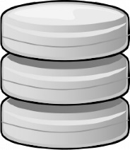
Software architecture (Vaadin)
Webbrowser
View
Controller
Model
Database
Institutionen Behandlungen Patienten
getAll(institutions,treatments, patients)
request
getData
setData
generateList()
Output(Statistik)
response

Slide 4
Herzlichen Dank!

