Slide 1
CS1 – Task9
Team Rot

Slide 2
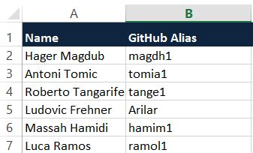
Project team

Slide 3
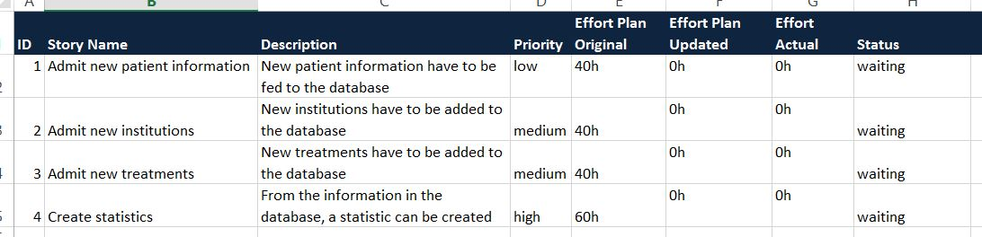
Product backlog

Slide 4
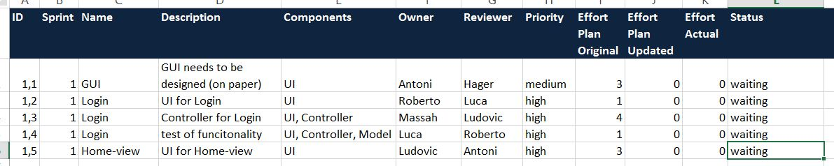
Sprint backlog

Slide 5
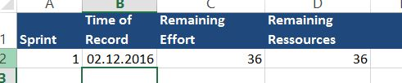
Burndownchart

Slide 6
Herzlichen Dank!

