Slide 1
CS1 – Task7
Team Rot

Slide 2
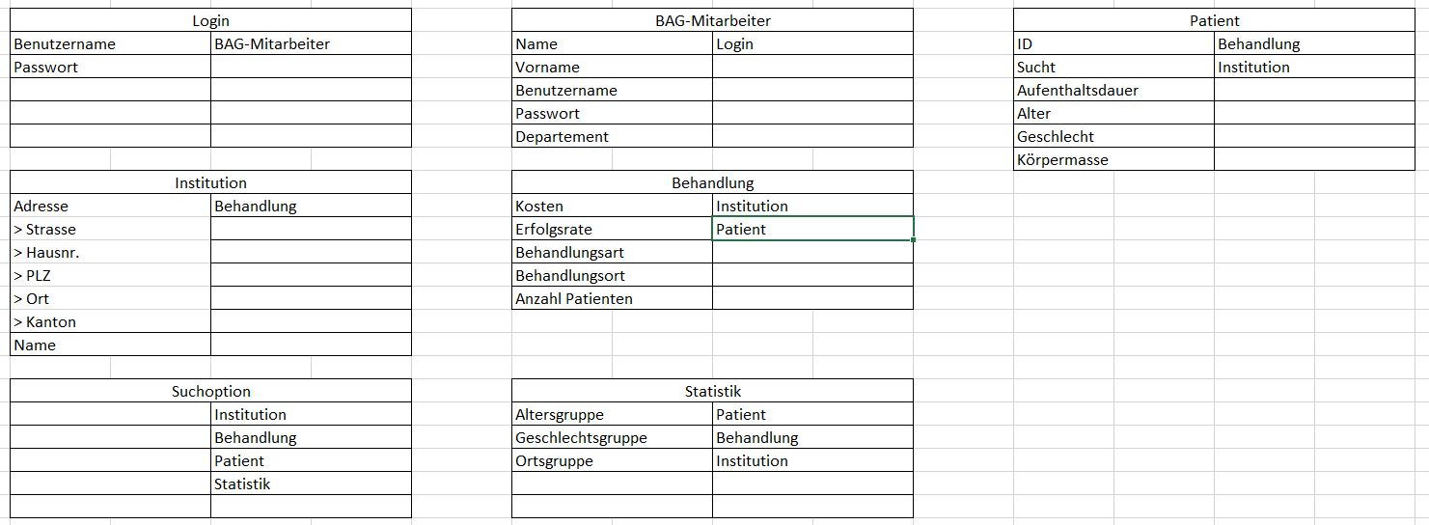
Crc-Cards

Slide 3
UML Domain Model

Slide 4
Sequence diagram – user update

Slide 5
Sequence diagram – system alerts

Slide 6
Herzlichen Dank!

