Slide 1
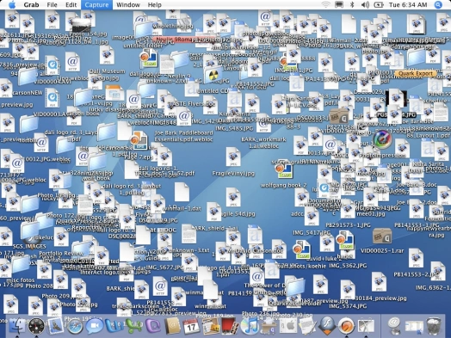
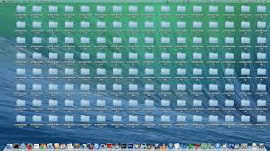
File Type Organizer Tomie Allen
File organizer is a python program that organizes your files into folders by file type.
Organization 🖥️
Organizes your files in folders based on file type
Reduce Clutter 📊
Eliminate unorganized downloads
Time Saving 🕒
Organize your files within seconds!

