Slide 1
Mandate
An AI agent that can prove it's allowed to spend,
without saying who it works for.
Private spending authorization on Midnight · Built by tminus1sec · Wave 2, October 2026
Notes:
Mandate lets an owner give an AI agent a budget, and lets anyone the agent buys from check it's authorized and within that budget, without learning who the owner is.

Slide 2
Agents are starting to spend money
01
To trust an agent today, a seller has to know whose card or account is behind it. Every agent purchase becomes a record of who is buying what.
1
2
3
Who is behind it
What they're doing
A permanent log
The company or person the agent works for, on every purchase.
Five executives booked to one city says something. So does an agency's client list.
Every agent purchase becomes a trail tied to a real identity.
Visa, Mastercard and Google's AP2 all let owners cap an agent's spending. None of them hide who the owner is from the seller.
Mandate · Midnight Buildathon Wave 2
2

Slide 3
What Mandate does
02
Principal
Agent
Seller
Registers an agent and sets a per-period cap for a spending category.
→
Holds one secret key. Proves every spend in a single zero-knowledge proof.
→
Calls exercise() and gets one answer: valid, or refused.
In one proof, the agent shows:
It is currently authorized by the real principal, for this category, and not revoked
This request has not been used before (a nullifier stops replays)
This period's spend plus this amount stays within the cap
If any check fails, the proof can't be built. Nothing is submitted and nothing is paid.
Mandate · Midnight Buildathon Wave 2
3

Slide 4
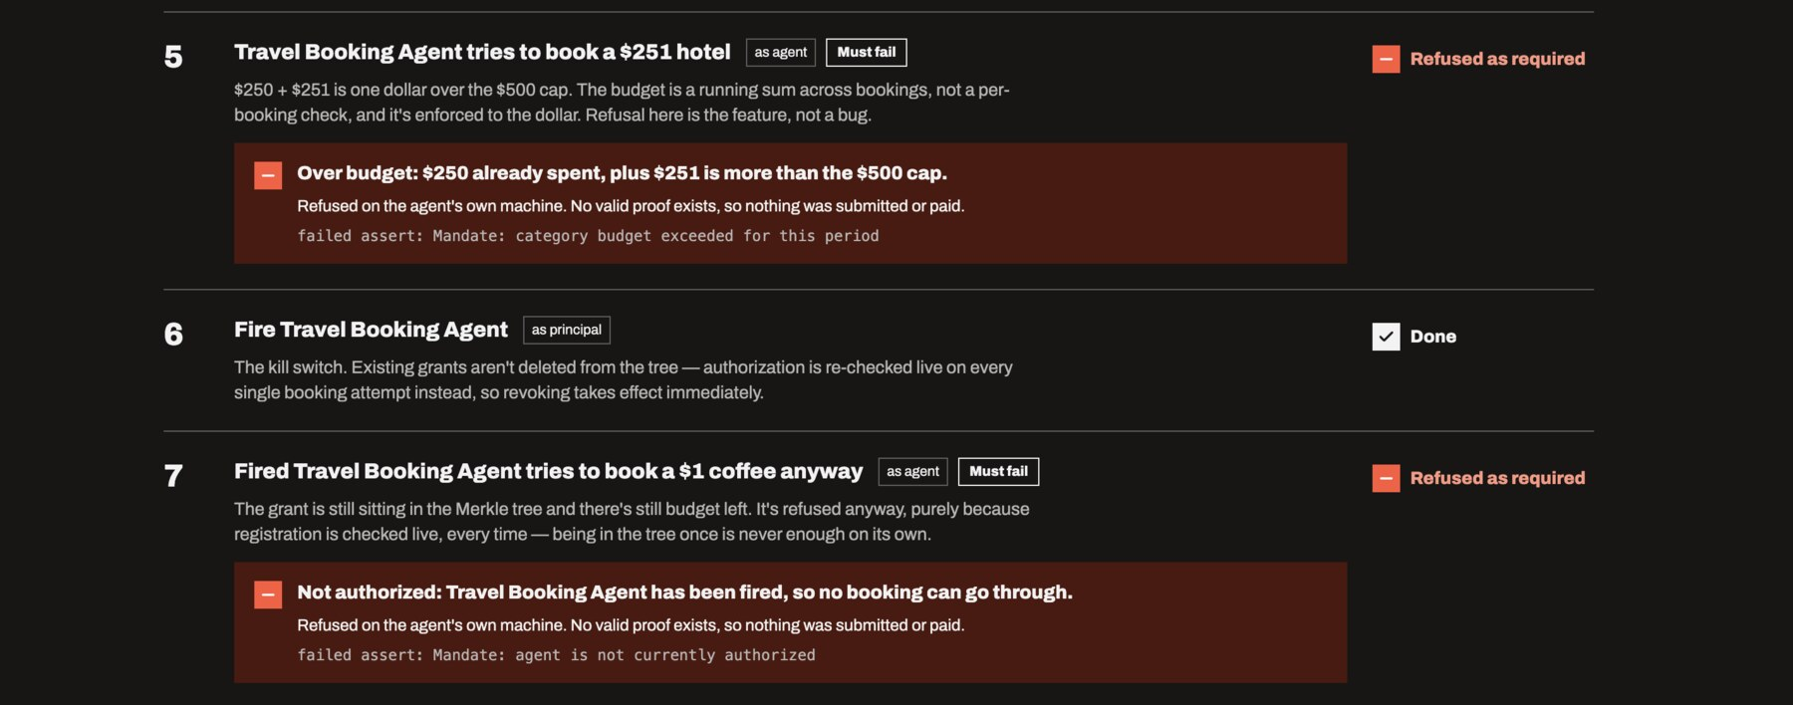
A correct refusal is the product
03
The real run on Midnight Preprod. Book a $250 flight, then try a $251 hotel on a $500 budget. Fire the agent, then try a $1 coffee.
Mandate · Midnight Buildathon Wave 2
4

Slide 5
What Midnight sees, and what it never sees
04
On the public ledger
Never on the ledger
The agent's pseudonym (a hash of its key), on every spend
Who the principal is (only a hash is stored)
Each category's cap, as a plain number
The agent's real name
Running totals and the amount of each spend
What a category means ("travel")
Counts: grants issued, times exercised, active agents
Who the agent bought from
Honest version: the budget numbers are public. What Mandate hides is who they belong to and what they're for.
Mandate · Midnight Buildathon Wave 2
5

Slide 6
Lose the laptop, keep the setup
05
On chain, the agent is only a hash. The mapping back to "Travel Booking Agent, $500" is encrypted in the browser and stored on Cascade, Lumera's decentralized storage.
88139
Cascade action, recorded run (Sep 30)
AES-256-GCM in the browser; key derived from a Keplr signature
Restored and decrypted from the command line: two separate crypto implementations agree
The contract works the same with or without it
88119
Cascade action, earlier run (Sep 17)
15
backup-crypto tests
Mandate · Midnight Buildathon Wave 2
6

Slide 7
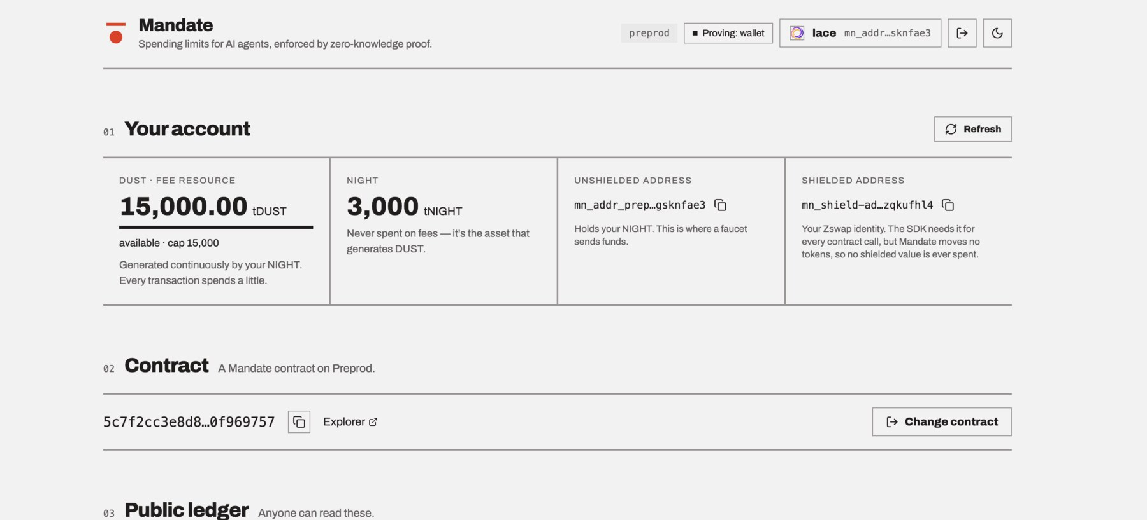
It runs, and you can check it
06
7 / 7
40
1
walkthrough steps behave
as designed on Preprod
automated tests passing
(18 contract · 15 crypto · 7 UI)
"times exercised" after the run.
The 2 refusals never touched the chain
Contract on Midnight Preprod
49ef1c9bec0a…c19d55b9
Wallet-delegated proving through the DApp Connector (Lace, 1AM). Keys never leave the wallet.
Mandate · Midnight Buildathon Wave 2
7

Slide 8
Honest limits
07
The budget is public
One agent's calls are linkable
Caps, running totals and amounts are plain numbers. Private budgets (commitments) are on the roadmap.
The live revocation check discloses the agent's pseudonym every call. Not its real identity.
Circuit names show the purpose
No real money moves yet
registerAgent, exercise, revokeAgent… tell a reader this is agent authorization.
Mandate authorizes spending. Settlement through a payment rail comes later.
Mandate · Midnight Buildathon Wave 2
8

Slide 9
First market: travel booking agents
08
$1.71T
Why travel first
An agency's client list is its business. Its AI agent should be able to book for a client without the hotel or airline learning which company the client is.
business travel spend, 2026 (GBTA)
30%
Same contract, other skins
Company purchasing and procurement
AI dev teams paying for APIs
Ad agencies spending client budgets
DAO and grant programs
of travel bookings by AI agents by 2030 (IDC)
Consumers are slower: about 2% of US consumers say they'd let an agent book fully on its own today (Skift).
Mandate · Midnight Buildathon Wave 2
9

Slide 10
Roadmap
09
Wave 2 · now
Wave 3
After
Working app on Preprod
Refusal-first UI and no-wallet demo
Cascade lost-device backup
Talk to independent travel agencies
Unlinkable agents: revoke inside the Merkle tree, drop the public pseudonym check
Private budgets: committed caps and totals
A second skin: procurement or API spend
One-line verifier SDK for booking engines and payment rails
Pair with AP2 / x402 so the payment carries the proof
Midnight Build Club, if selected
Mandate · Midnight Buildathon Wave 2
10

Slide 11
Check it yourself
Try it, no wallet
tomiin.github.io/midnight-mandate
Source (Apache-2.0)
github.com/tomiin/midnight-mandate
Contract, Preprod
49ef1c9bec0a0e5e8ab6214184842ea15b6d68c50b6654d12e7ebedfc19d55b9
Cascade backup
action 88139 (earlier run: contract 5c7f2cc3…, action 88119)
tminus1sec · Midnight Buildathon Wave 2

