Slide 1
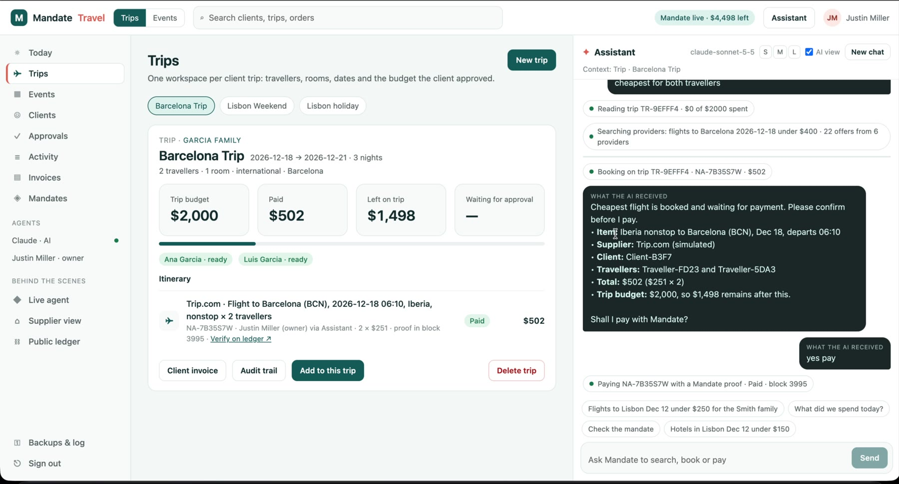
Mandate Travel
AI agents that pay inside a budget they can’t break
Every payment carries a zero-knowledge proof on Midnight: the agent is authorized and within budget. Who the agency or client is stays private.
A flight booked by the AI and paid with a Mandate proof (block 3995)
Midnight Buildathon · Wave 3
github.com/tomiin/midnight-mandate
Demo: youtu.be/TmcFZa4_jSI
Notes:
Mandate Travel: a travel agency back office where an AI agent books and pays inside a budget enforced by a Midnight contract.

Slide 2
Letting an AI pay is the hard part
1
2
3
Control
Privacy
Proof
An owner can’t hand an AI the company card. Limits must hold even if the AI is wrong, confused or manipulated.
Every booking leaks who the clients are, where they go and what they spend: to the AI provider, processors and suppliers.
Clients and suppliers need to check that a payment was allowed and made, without being handed the agency’s books.
Today the choice is an AI that can’t pay, or an AI with a card and no guardrails.

Slide 3
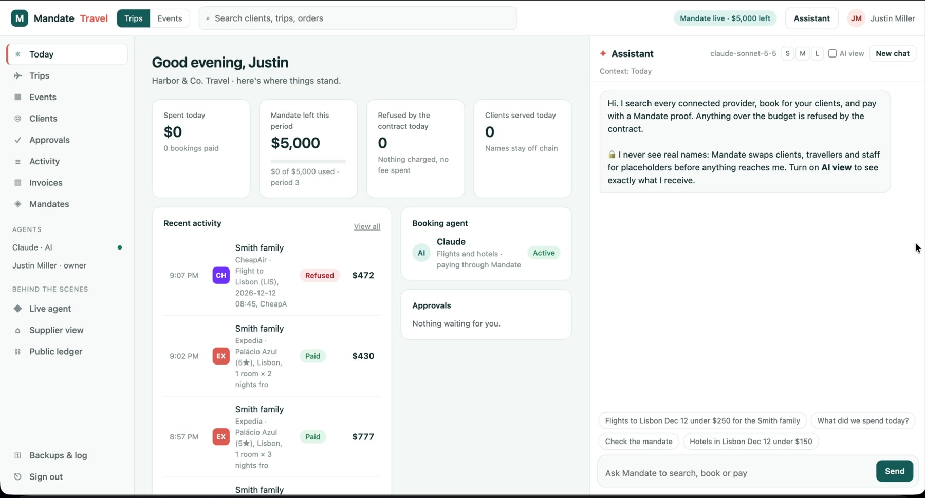
Mandate: a spending limit the contract enforces
✓
Hard limit on Midnight
The Mandate contract refuses any payment over budget or from a revoked agent.
✓
A human says yes
Every payment needs a person’s approval. Over a trip’s budget, it waits in Approvals.
✓
The AI never sees names
A privacy proxy swaps client and traveller names for placeholders before anything leaves the agency.
The agency’s back office: trips, approvals, invoices, mandates and the assistant in one place.
✓
Anyone can verify
A public page checks any payment against the ledger. No wallet, no sign-in.

Slide 4
How a payment works on Midnight
1
2
3
4
5
Owner sets the mandate
AI books
Human says yes
ZK proof
Ledger records it
Registers the agent and a limit per period, on chain
Searches providers through the privacy proxy
Over a trip budget → Approvals
exercise(category, amount, orderRef) proven on the agency’s machine
paidOrders[orderRef] = amount; a second payment is refused
Public on the ledger
Private, never on chain
An authorized agent paid order-ref X amount Y
Limits and running totals per period
Revocations, checked at spend time
Which agency or client the payment was for
The agent’s secret key and grant: local witness data used only inside the proof
Names, passports, the rest of the booking

Slide 5
What’s new in Wave 3
1
Order-bound payments
2
Travel back office
3
AI assistant + MCP/REST
Contract upgrade: each proof is tied to one order; paying it twice is refused
Clients, trips with client-approved budgets, Approvals for anything over
Books and pays after a human yes; any AI can plug in via MCP or OpenAPI
4
Privacy proxy + AI view
5
Public Verify page
6
Encrypted backups
Names become placeholders; the AI view shows exactly what the AI received
Recomputes the order reference in the browser and reads the ledger
Records sealed with the owner’s passphrase, stored on Lumera Cascade

Slide 6
The AI booked and paid, and never saw a name
$502
flight for two, paid with a Mandate proof in block 3995
Client-B3F7
what the AI saw instead of “Garcia family”
✓ ✓
proof: agent authorized and within budget
Watch the full walkthrough: youtu.be/TmcFZa4_jSI

Slide 7
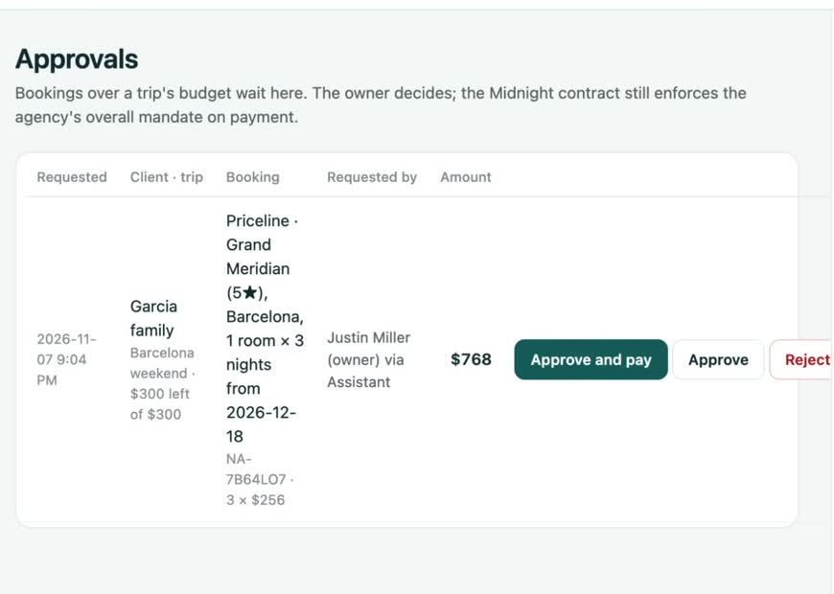
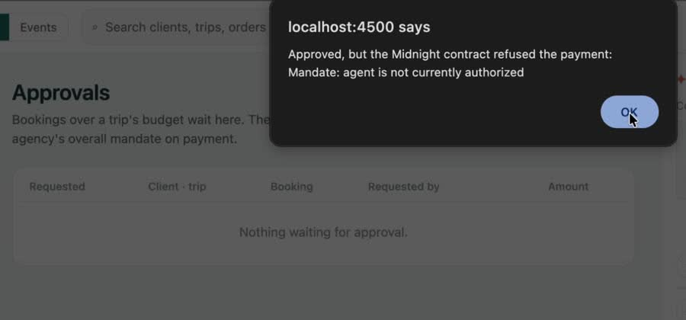
Limits hold, even when someone says yes
Agent revoked → refused by the contract. Even after the owner approved, the Midnight contract refused the payment. Nothing was submitted or charged.
Over budget → Approvals. A $768 hotel on a $300 trip waits for the owner. The AI can’t pay it.

Slide 8
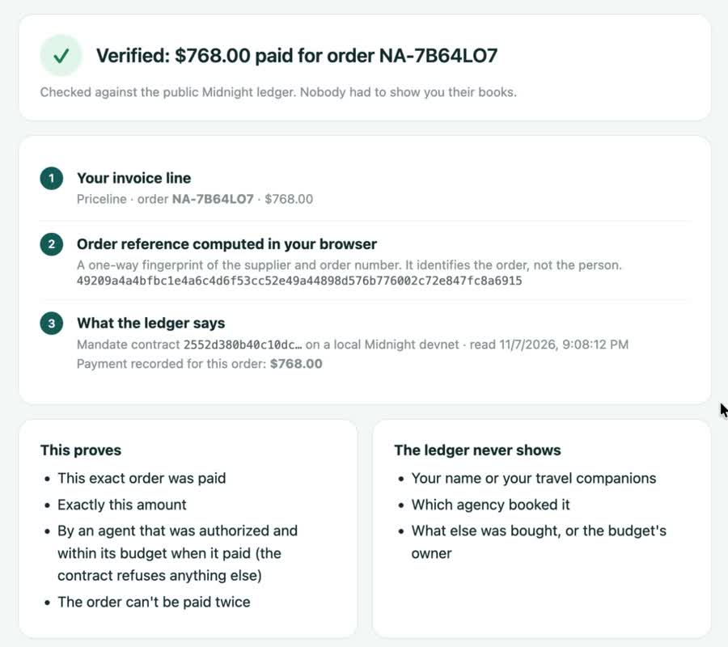
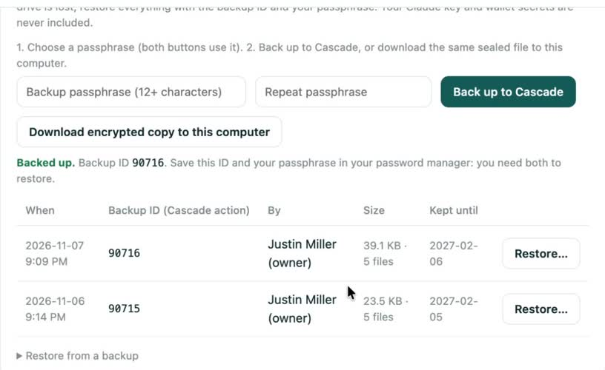
Public proof, private records
Backups: the agency’s records are sealed with the owner’s passphrase on their machine, then stored on Lumera Cascade (backup 90716). Cascade only holds scrambled data.
Verify: the client’s browser recomputes the order reference and reads the public ledger: $768.00 paid for order NA-7B64LO7. No wallet, no names.

Slide 9
Tested in code and end to end
21
20
CI
E2E
contract tests
agent tests
on every push
local Midnight network
Compact simulator: budgets, revocation, grants, order binding
Budget → Approvals, no double pay, privacy proxy
GitHub Actions runs both suites
Full flow recorded in the demo video
End-to-end run (Nov 7, local Midnight network)
Flight $502 booked by the AI and paid with a Mandate proof (block 3995)
Hotel $768 over the trip budget → Approvals → approved and paid
Agent revoked → next payment refused by the contract; agent reinstated
Verify ✓ $768.00 from the public ledger · encrypted backup to Cascade (90716)

Slide 10
Who buys it and how it makes money
$1.71T
Open core
Per seat
Lite is Apache 2.0, so the money and privacy code is auditable
Commercial edition: team roles, security centre, audit chain
business travel spend in 2026 (GBTA forecast). AI agents are starting to book it.
Per booking
Enterprise
First customers
Small fee per paid booking, grows with use
Self-hosted, single sign-on, audit exports
Independent agencies and home-based advisors
Next: corporate travel desks, event and group travel
Later: any “let the AI pay” case where the buyer is sensitive
Pilots: 2–3 agencies free in Q1 2027. We measure time saved, Approvals used and what they’d pay before setting prices.

Slide 11
Roadmap
Wave 4
Wave 5
2027
Close the privacy gaps
Real money, real suppliers
Platform
Unlinkable agents (revoke in the Merkle tree)
Private budgets as commitments
Ledger 9 stack, redeploy on Preview
Contract-to-contract checkout
Pilot with 2–3 agencies
One real booking source
Settlement: stablecoin or card/bank rail
External review of contract and proxy
Hosted pilots and a case study
Private composability as Midnight ships it
Storage-agnostic encrypted backups
Mandate as a reusable spending-policy contract
Beyond travel: procurement, ad spend

Slide 12
Thank you
Honest limits
Runs on a local Midnight network for the demo
Travel providers are simulated and labelled
Budget amounts are public; who they belong to is not
Mandate proves spending; moving the money comes next
Not yet externally audited
Code (Apache 2.0): github.com/tomiin/midnight-mandate
Demo video: youtu.be/TmcFZa4_jSI
Judge walkthrough: docs/WAVE3.md
Built for the Midnight Buildathon on AKINDO

