Slide 1
ENEL 300 Instructor Presentation & Demo
Learning community 7, Group 1

Slide 2
First a Demo

Slide 3
What we hoped to learn
Practical electronics design
  Board layouts.
  Application of class work in real-world usage (eg, transistors, signals, filters).
  Designing somthing from the “ground-up”
Embedded software
  Usage and theory of important protocals (I2C, SPI).
  Debugging.
  Program profiling.
Engineering soft skills
  Team organization (eg, agile and scrum methods).
  Marketing.
  Entrepreneurship.
  Patents and trademarks.

Slide 4
What we hoped to learn
Practical electronics design
  Board layouts.
  Application of class work in real-world usage (eg, transistors, signals, filters).
  Designing somthing from the “ground-up” (sort of)
Embedded software
  Usage and theory of important protocals (I2C, SPI).
  Debugging.
  Program profiling.
Engineering soft skills
  Team organization (eg, agile and scrum methods).
  Marketing.
  Entrepreneurship.
  Patents and trademarks.

Slide 5
Pre COVID-19 technical details

Slide 6
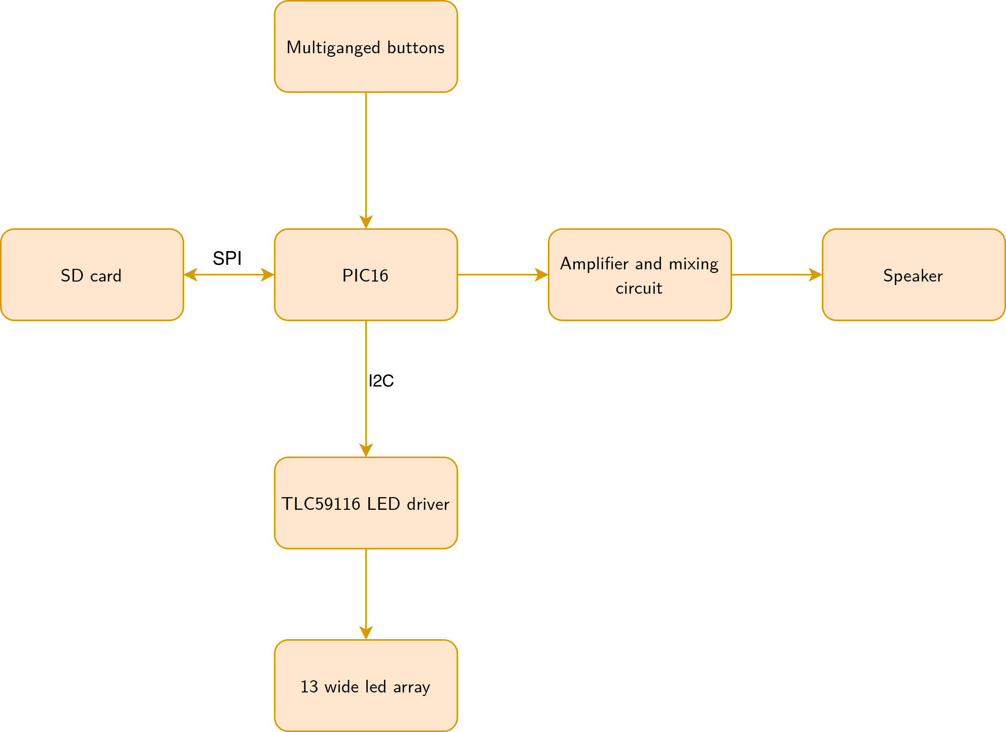
Overview

Slide 7
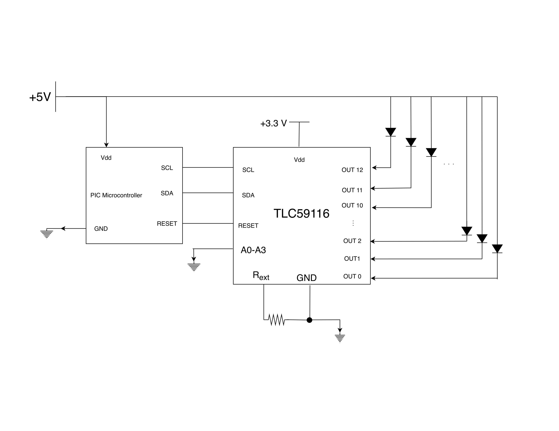
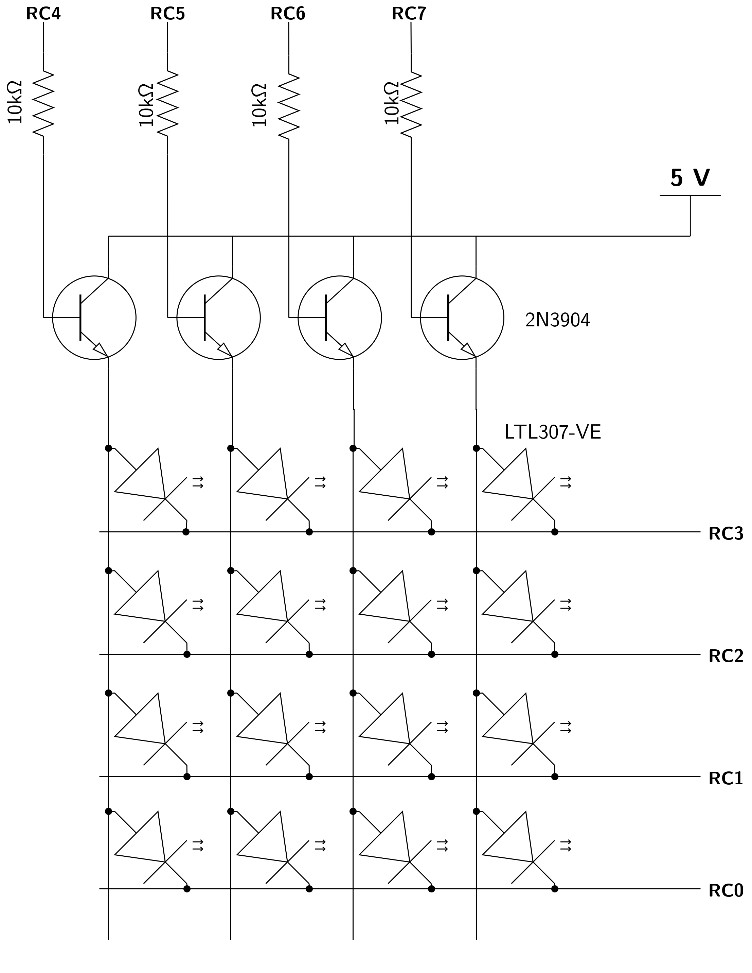
LED driver
Old:
New:
750 ohm

Slide 8
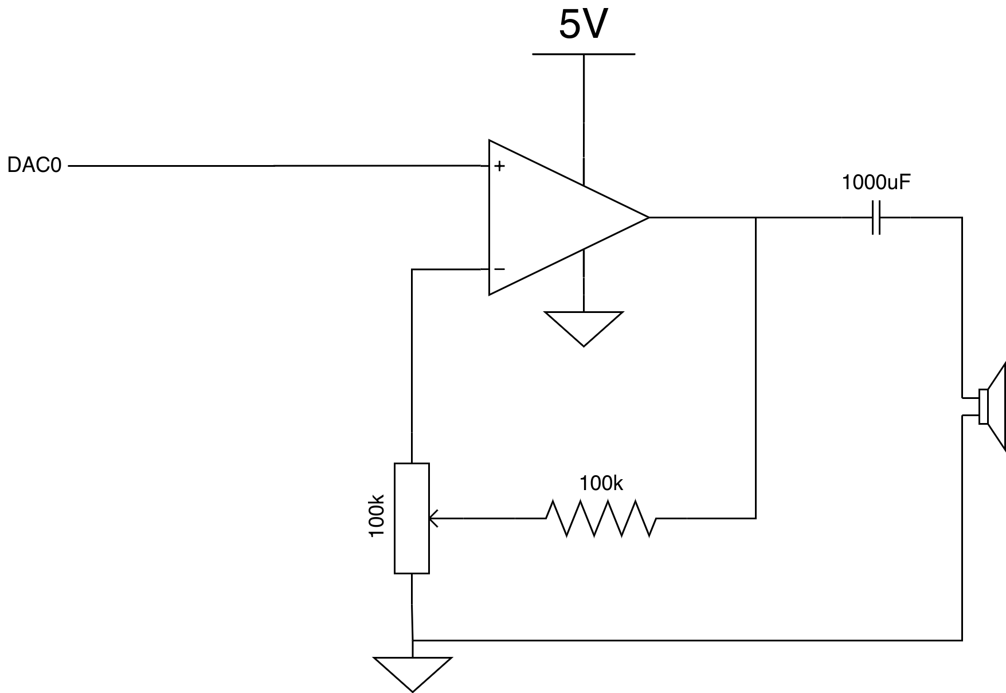
Amplifier curcit

Slide 9
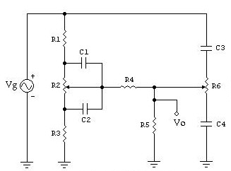
Filters
No “real” filtering done using circuits.
Why?
  Efficiency:
  Cost.
  We already have an MCU that we are doing signal processing with for effects, so the added complexity is minimal.

Slide 10
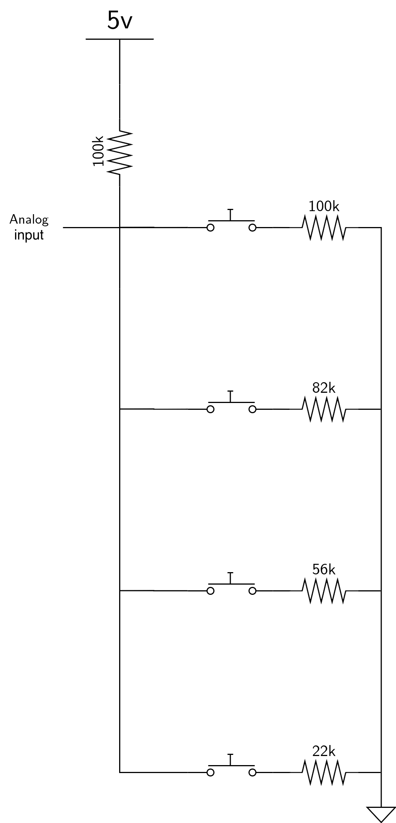
Buttons
Very simple resistor ladder circuit to detect push buttons.
  Uses ADC to get a unique voltage for which buttons are pressed.
  Would need 3 of these circuits in total for all of our buttons.
Saves space by allowing multiple buttons per input pin.
Planned to use capacitive touch button in the final product, but never implemented due to COVID-19.

Slide 11
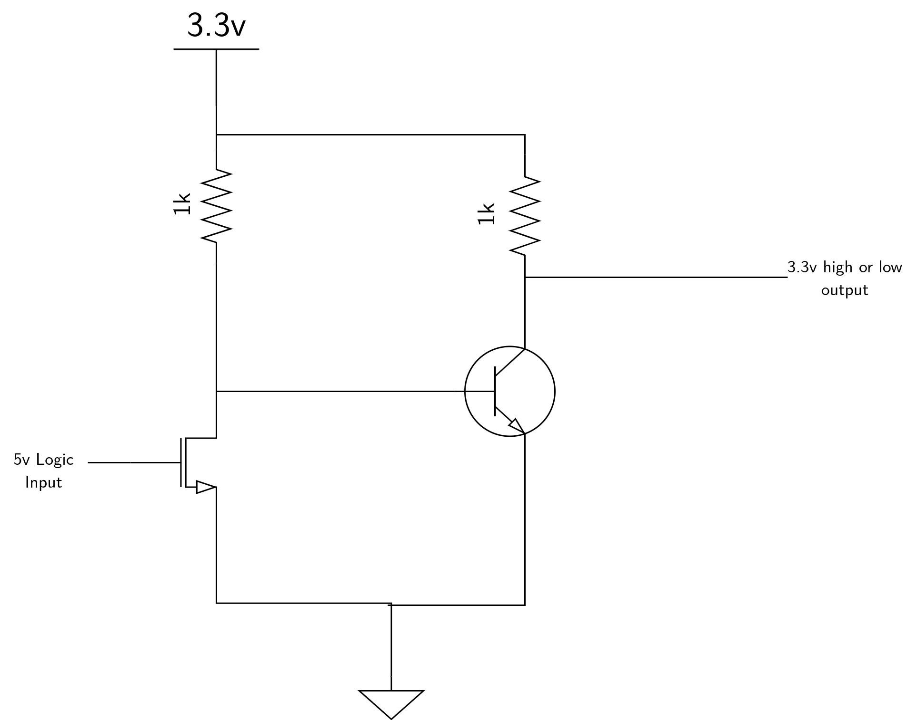
SD Interface
Simple level shifter I designed to take the PICs 5v and convert it to the 3.3v needed by an SD card.
Completely unnecessary because it turns out the SD card breakout board provided already has this feature.
If used we would need several of these circuits (the SD card needs more than 1 3.3v input).

Slide 12
Post COVID-19 technical details

Slide 13
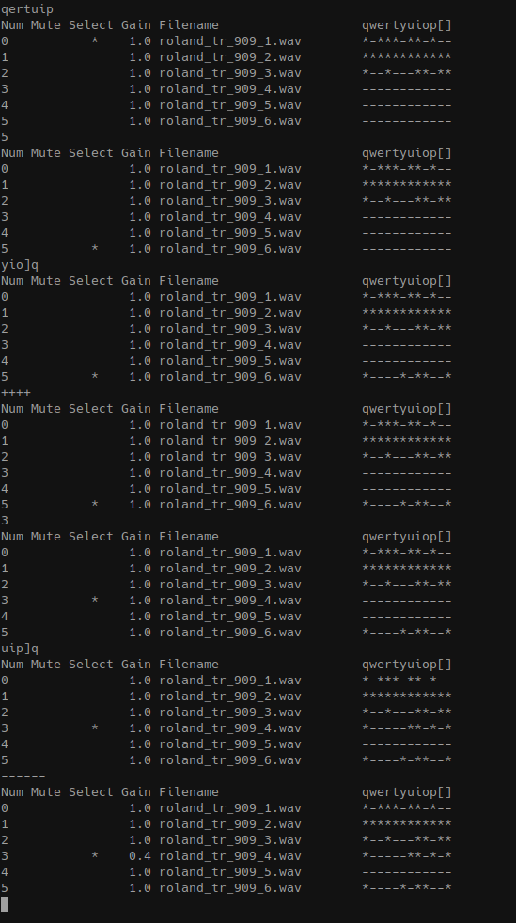
For the post-COVID prototype we decided to continue working on our earlier C prototype. Currently, we use PortAudio for the underlying audio framework, libsndfile to open “.wav” audio files, and Nuklear for the GUI framework.

Slide 14
For our post COVID-19 we settled on a few important requirments for our software emulation:
Have a graphical interface.
Allow users to use their own custom samples in a “.wav” format.
Support for basic audio effects.
Low resource requirements.
Support for exporting to .wav files.

Slide 15
Audio data structures
Portaudio uses a “callback” based method of getting samples to the sound card.
  The library calls a “callback” function asynchronously in order to get samples. Happens many times per second.
    Callback function is given a big struct filled with the raw audio samples for each instrument, which ticks each instrument is active on, and into about effects to each insturment.
  Big disadvantage of making timing between our main loop and our audio loop very difficult.
  Big advantage is that it is very similar to how a PIC would generate timer interrupts.
Need to buffer audio ahead of time because of this method.

Slide 16
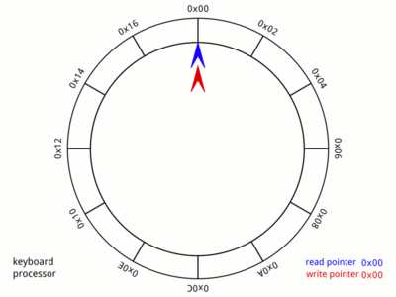
Audio data structures
Typically, people use a circular buffer:
We did not. Which is because I tested out the circular buffer my code looked like:
While (1) {
….
writetoqueue(samples);
….
}

Slide 17
Audio data structures cont.
Instead we just use a bunch of flat arrays. We malloc ahead of time and just loop over samples over and over withing the callback function.
Massively simplifies timing issues – we have no timing code in our main loop.
Makes certain things very difficult (eg. effects like echos, exporting songs to .wav files).
These arrays are filled with float values that we pulled from the users .wav files.

Slide 18
Config file parsing
A very simple method is to just #define which .wav files we want to load.
  Very user-hostile.
  Impossible to change drum-sets without restarting the application.
The choice of samples is easy to change in the software using a very simple configuration file format we came up with:
#it even supports comments
#syntax is key: “value”
kick: "saxophone.wav"
snare: "wavs/compurhythm_78_2.wav"
shaker: "wavs/compurhythm_78_3.wav"
hat: "wavs/compurhythm_78_4.wav"
bell: "wavs/compurhythm_78_5.wav"
bell_alt: "wavs/compurhythm_78_6.wav"
Written by me – not done using an external library.
Allows for users to quickly add any samples they want.

Slide 19
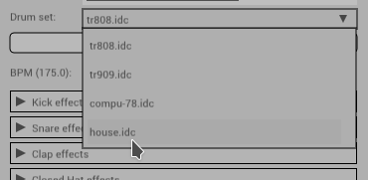
Config file parsing continued
Our program is smart enough to load many configuration files at once. At startup it search for all files in the form “*.wav” and adds them to an internal database of config files.
  Allows users to have many custom drum-sets and switch between them.

Slide 20
Lessons learned
Technical debt is important.
  Due to a simple choice in the data structure we used for our audio data, we found it harder to add certain feature.
  So in the long run we payed for cutting some corners during our earlier work.
Organization is important for all projects, but especially software.
  Early work was very hard to read. Was just a big 700 line C file.
  Later on we began to abstract functions away and split into header files.
  Learned by trail and error – we fixed many bugs caused by a lack of file orgnaization.
Skills at reading datasheets / practical electronics.
Even simple circuits can be hard to reason about.
  Much of the difficulty in building the transistor circuits was not theory, but how datasheet parameters relate to class topics.

