Slide 1

Algebraic calculator

Slide 2
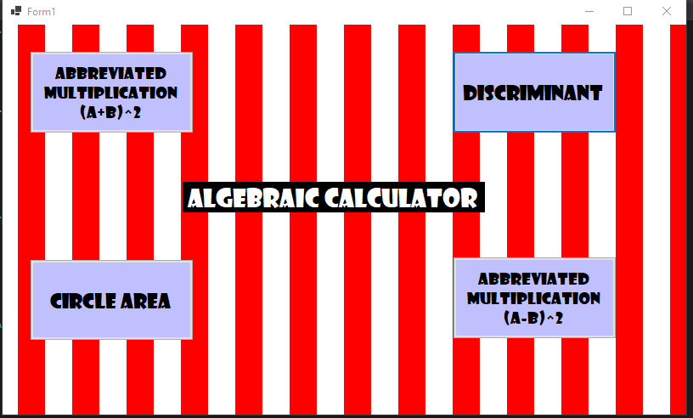
Defining the project and its purpose
Algebraic calculator is a tool, that takes it base on basic math and provides help for those struggling with formulas. It includes those formulas that are foundation for most of the mathematical problems.
This program is a problem-solving assistant that instantly solves simple math problems. It provides homework help anywhere, anytime without the need for a network connection.
The project’s main goal is to create a helpful program that displays multiple algebraic functions

Slide 3
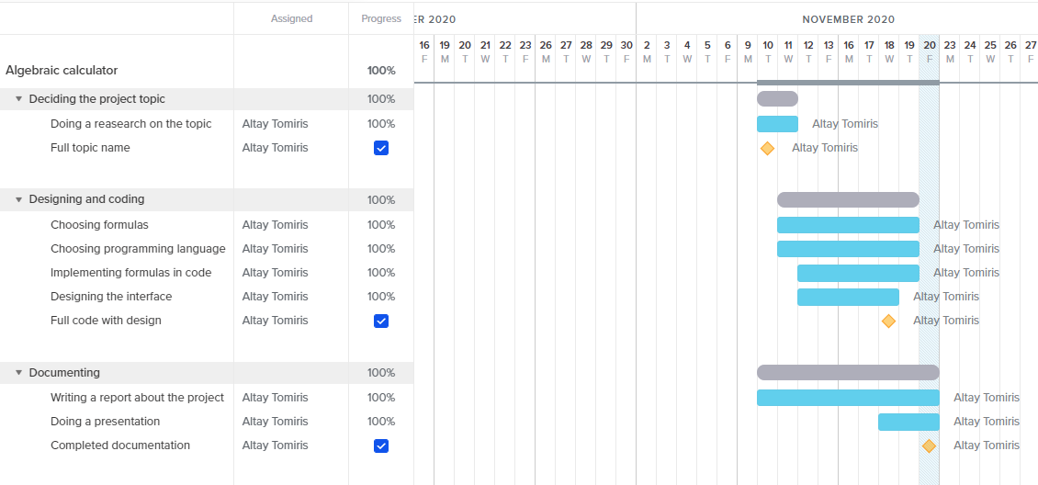
Planning the project
To have a consistent working schedule, a grant chart was created. Dividing the tasks and subtasks for days, it was steadier to complete the project. As every aspect was done, grant chart was marked at 100%.

Slide 4
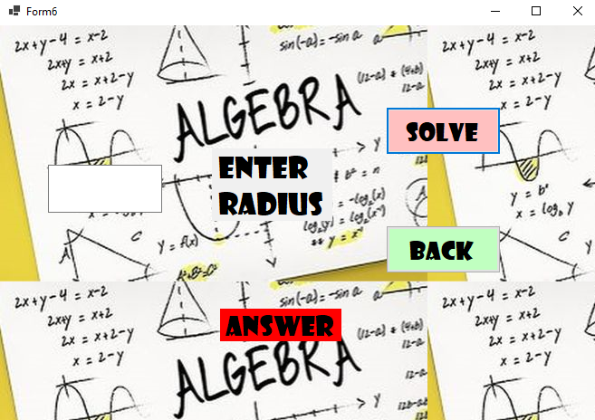
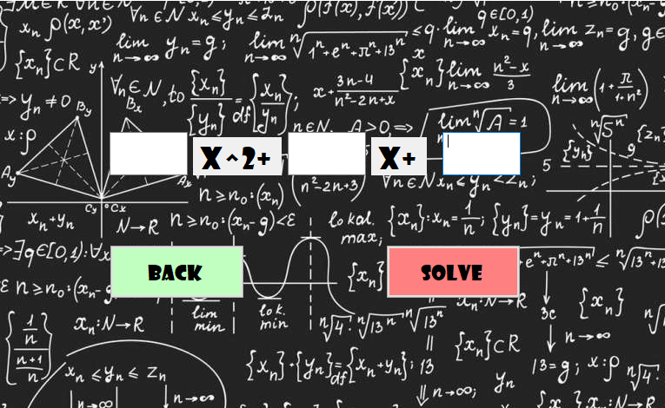
Designing
Having a friendly interface was important to this program, since user-friendly interface is not overly complex, but instead is straightforward, providing quick access to common features or commands. thus it has a pleasing design which makes it clear what the program is about.

Slide 5
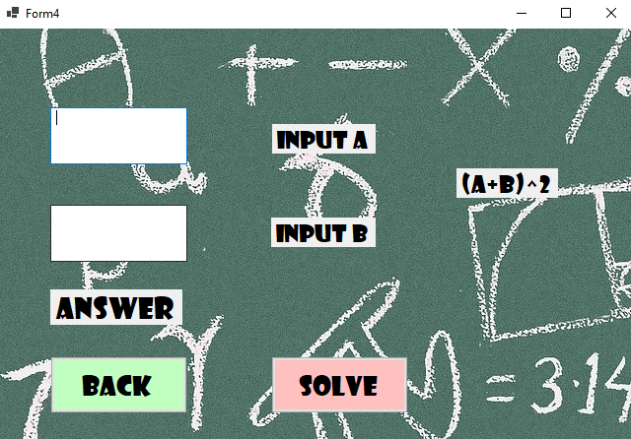
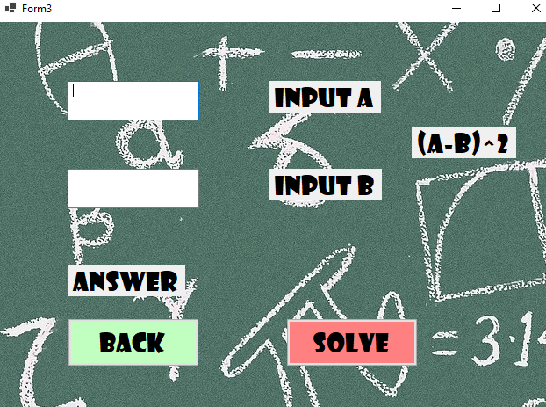
Two types of abbreviated multiplication were added, addition and subtraction. The reason for this is the topic of abbreviated multiplication is very wide and it as more than 20 formulas. However, I chose the most basic ones, as they are the fundamental type of the other formulas

