Slide 1
Adaptive Closed-Loop Home Energy Controller
EE3EPJ INDIVIDUAL FINAL YEAR PROJECT · PROPOSAL
Aim: to design, build and evaluate a low-cost home energy controller that schedules appliances and battery use around half-hourly prices, correcting its plan every half hour from real measurements, and to quantify how much of the best possible saving it achieves compared with planning once a day.
Oluwatomisin Agbaje · 240369394 · Electronic Engineering and Computer Science
Supervisors: Dr Faisal M Shah and Dr Andrew Cross · Aston University · revised 23 October 2026
Notes:
TIME: 0:25 · GOAL: Introduce yourself and land the aim. The handbook marks the aim, so say it clearly.
POINT AT: The aim line under the title.
SAY:
Good morning. I'm Tomi Agbaje, and my project is an adaptive, closed-loop controller for home energy, supervised by Dr Shah and Dr Cross.
The aim is on the screen: to design, build and evaluate a low-cost controller that schedules appliances and battery use around half-hourly prices, corrects itself every half hour from real measurements, and to measure how much of the best possible saving it gets compared with planning once a day.
KEY POINTS IF YOU BLANK: Adaptive, closed-loop · Measures, then re-plans every half hour · Proved on hardware I build
MOVE ON WITH: "So why does this matter?"
WATCH FOR: Don't thank the panel for approving anything; they are independent assessors. Start with your name and the project.

Slide 2
THE PROBLEM AND MY SOLUTION
THE PROBLEM
MY SOLUTION
On one real day on Octopus Agile [1], the 6 pm price was 2.5 times the cheapest overnight price.
1
An AI controller that closes the loop
Forecasts tomorrow’s prices, plans when each load runs, then checks what happened every half hour and re-plans.
2
A 12 V testbed with boards I design
A programmable electronic load, a power-sensing PCB and a switching and protection PCB, plus an LCD, LED price bar and live dashboard.
3
Tested against the perfect plan
Every result is scored against the best possible plan with hindsight, over a year of real data and on the rig.
Octopus Agile, West Midlands, Wednesday 14 January 2026, 48 half-hourly prices including VAT. Source: Octopus Energy public API [1]. Green: the 8 cheapest slots. Orange: the 16:00–19:00 peak.
Washing machines, dishwashers, EV (electric vehicle) chargers and home batteries do not respond to this. Typical smart controls use fixed timers or a single daily plan, and rarely check whether the plan worked.
O. Agbaje · Adaptive Closed-Loop Home Energy Controller · EE3EPJ proposal
2 / 18
Notes:
TIME: 1:00 · GOAL: Make the problem concrete with real numbers, then preview the three parts of the solution.
POINT AT: The graph: bottom axis then side axis, the green bars overnight, the orange peak. Then the three cards on the right.
SAY:
On the left is real data, not an illustration. It's every half-hourly Octopus Agile price for the West Midlands on Wednesday 14 January this year, pulled from Octopus's public API.
Time of day runs along the bottom and price per kilowatt-hour up the side. Overnight it was about 17 pence, the cheapest at half past two. At 6 pm it hit 43 pence: two and a half times as much.
But washing machines, dishwashers, car chargers and home batteries don't respond to that, and typical smart controls use a fixed timer or one plan a day, without checking whether the plan worked.
My solution has three parts. One: an AI controller that closes the loop, so it forecasts, plans, and then checks every half hour and re-plans. Two: a 12-volt testbed I design and build. Three: I test it against the perfect plan, the best you could possibly do with hindsight.
KEY POINTS IF YOU BLANK: Real data: Octopus API, 14 Jan 2026 · 17.3p at 02:30 vs 43.3p at 18:00 = 2.5× · Close the loop · build the rig · score against perfect
MOVE ON WITH: "Here's how the pieces fit together."
WATCH FOR: If asked "why that day?": it is a normal winter weekday, chosen because winter evening peaks are the clearest case. You will use a full year of data in the project.
LIKELY QUESTIONS
Q: What is actually novel here? Smart home energy scheduling already exists.
A: The scheduling idea isn't new. What's new is closing the loop on low-cost hardware: re-planning every half hour from measured energy, and scoring it as a share of the best possible saving while deliberately introducing faults like appliances using more energy than expected.
If pushed: A lot of published scheduling work is evaluated in simulation with the model assumed correct. I measure what happens when the model is wrong, on real hardware, and show how much of the gap the correction closes.
Tip: Don't claim nobody has done anything similar. Claim the specific combination, and say the literature review in weeks 1–4 will pin down the gap with citations.

Slide 3
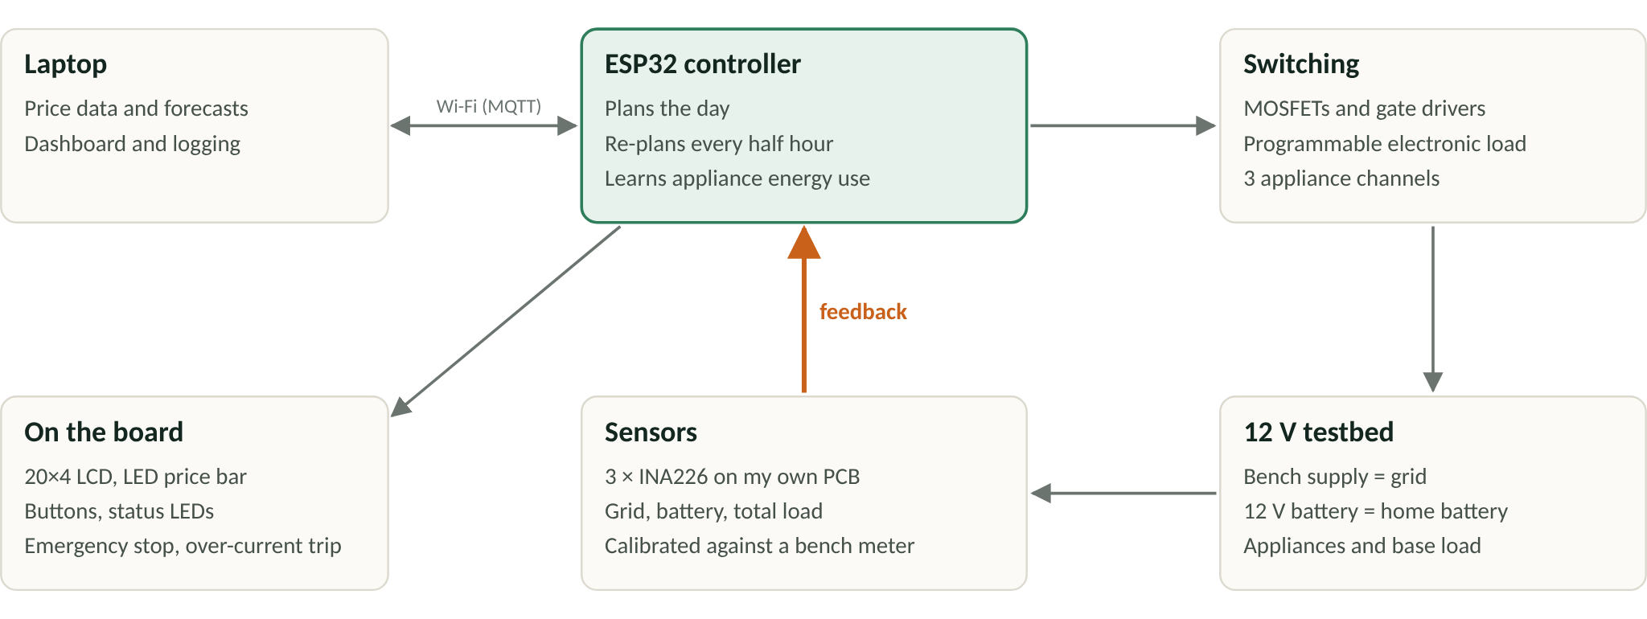
SYSTEM OVERVIEW
O. Agbaje · Adaptive Closed-Loop Home Energy Controller · EE3EPJ proposal
3 / 18
Notes:
TIME: 0:35 · GOAL: Show the whole system once, and make the orange feedback arrow the thing they remember.
POINT AT: Trace the loop with the pointer: laptop, ESP32, switching, testbed, sensors, then up the orange arrow.
SAY:
This is the whole system. The laptop handles the data, forecasts and dashboard over Wi-Fi.
The ESP32 plans the day and sets a programmable electronic load and switches three appliance channels on a 12-volt rig. A bench supply plays the grid and a 12-volt battery plays the home battery.
Three power sensors measure what actually happened and feed it back. That orange arrow is the closed loop, and it's the new part. The board also has its own LCD, LEDs and buttons, so it works without the laptop.
KEY POINTS IF YOU BLANK: Laptop: data, forecasts, dashboard · ESP32: plans and re-plans · Orange arrow = feedback = the novelty
MOVE ON WITH: "All of this runs on open data."
WATCH FOR: Say "it works without the laptop". It answers the reliability question before anyone asks it.
LIKELY QUESTIONS
Q: What happens if the Wi-Fi drops?
A: The board keeps running: it has the last forecast and plan, its own sensors, the LCD and the buttons. It falls back to published or forecast prices it already holds, and I test a Wi-Fi drop on purpose in test T7.

Slide 4
DATA
Dataset | What it contains | What I use it for
Octopus Agile prices (Octopus Energy API) [1] | Half-hourly retail prices, published the day before | Household prices; downloaded live by the ESP32
Elexon Insights Solution [2] | Wholesale prices, national demand, wind output | Inputs for the forecasting model
REFIT, University of Strathclyde [7] | 20 UK homes over about 2 years; whole-house and appliance level | Real household usage replayed on the rig
UK-DALE, Imperial College London [3] | 5 UK homes; whole-house and appliance level | A second dataset to check the results generalise
Carbon Intensity API, NESO (National Energy System Operator) [11] | Half-hourly carbon intensity | Reporting carbon savings alongside cost savings
Open and free to use: public APIs (application programming interfaces) and research datasets published under Creative Commons licences. All data is aligned to UTC (Coordinated Universal Time) half-hour slots, and the final year is held back for testing only.
O. Agbaje · Adaptive Closed-Loop Home Energy Controller · EE3EPJ proposal
4 / 18
Notes:
TIME: 0:30 · GOAL: Show the data is real, free and reproducible, and that testing is honest (final year held back).
POINT AT: Run a finger down the first column, then the green line at the bottom.
SAY:
Every dataset is open and free to use, so there's no cost and anyone can check my results.
Prices come from Octopus and Elexon, real household demand from two university datasets, REFIT and UK-DALE, and carbon intensity from NESO, so I can report carbon saved as well as money.
Everything is lined up to half-hour slots, and the final year is held back purely for testing, so the model never sees it during training.
KEY POINTS IF YOU BLANK: Octopus, Elexon, REFIT, UK-DALE, NESO · Free and reproducible · Final year held back for testing
MOVE ON WITH: "Now the core of it: how the AI works."
WATCH FOR: "Held back for testing" is your defence against data leakage. Say it.
LIKELY QUESTIONS
Q: How do you avoid data leakage?
A: Walk-forward testing: the model only ever uses data from before the day it predicts, and the final year is held back completely until the end.
If pushed: Features like demand and wind come from forecasts that would have been available at the time, not the actual values.

Slide 5
HOW THE AI WORKS: PREDICT, PLAN, CORRECT
STEP 1 · PREDICT
STEP 2 · PLAN
STEP 3 · CORRECT
What will power cost tomorrow?
When should each thing run?
Did it go to plan?
Every half hour it reads the sensors, updates the battery level and remaining tasks, and re-plans the rest of the day
In: past prices, time of day, day of week, demand and wind forecasts [4]
DP (dynamic programming) on the ESP32 compares every possible start time and battery setting
Model: gradient boosting (LightGBM [5]), many small decision trees, each correcting the errors of the one before
It chooses the cheapest plan that still meets every deadline set by the user
It learns each appliance’s real energy use from past runs. Together, the three steps form model predictive control [8].
Out: 48 half-hourly prices
Example: the washing must finish by 7 am. The forecast shows 2–4 am is cheapest, so the wash is scheduled for 2 am. At 2:30 am the sensor shows it is using 20% more energy than expected, so the controller extends the run and moves battery charging to 4 am. A controller that plans only once would carry on and pay more.
O. Agbaje · Adaptive Closed-Loop Home Energy Controller · EE3EPJ proposal
5 / 18
Notes:
TIME: 1:05 · GOAL: Make the AI crystal clear. This slide wins the novelty and complexity marks. Slow down here.
POINT AT: Left to right across the three cards, then the dark example box.
SAY:
The AI works in three steps.
Step one, predict. A gradient-boosting model, LightGBM, takes past prices, the time and day, and demand and wind forecasts, and predicts tomorrow's 48 half-hourly prices. Gradient boosting is lots of small decision trees, each one correcting the errors of the one before.
Step two, plan. Dynamic programming on the ESP32 tries every start time and battery setting and picks the cheapest plan that still meets every deadline the user sets.
Step three is the new part: correct. Every half hour it reads the sensors, updates the battery level and what's left to run, and re-plans the rest of the day. Predict, plan and correct together is model predictive control, a standard idea from control engineering.
Here's an example. The washing has to finish by 7 am. The forecast says 2 to 4 am is cheapest, so it starts at 2. At half two, the sensor shows it's using 20 per cent more energy than expected. So the controller lets it run longer and moves the battery charging to 4 am. A controller that plans once would carry on and pay more.
KEY POINTS IF YOU BLANK: LightGBM forecast → DP plan → re-plan every 30 min · = model predictive control [8] · The 20% example is the whole project in one story
MOVE ON WITH: "Here's how that's split across the software."
WATCH FOR: Expect "is that really AI?". Answer: the forecaster is machine learning; the loop is model predictive control. Together they make decisions under uncertainty from data.
LIKELY QUESTIONS
Q: Is this really AI? Dynamic programming is just optimisation.
A: The planner on its own is optimisation, yes. The AI is the system around it: a machine-learning forecaster plus a controller that learns appliance energy from past runs and corrects itself from measurements. Together that's model predictive control, which is a recognised way of making decisions under uncertainty.
If pushed: I chose an exact optimiser on purpose. It gives a guaranteed best plan for the forecast it's given, so any shortfall can be traced to the forecast or to the disturbance, and I can measure each.
Tip: Agree with the true part first ("the planner on its own is optimisation"), then reframe. Never get defensive about the word "AI".
Q: Octopus publishes Agile prices the day before. Why forecast at all?
A: Fair point. When the published prices are available, the planner uses them. Octopus releases the next day's prices in the afternoon, so decisions made before then, and anything planned beyond the published window, need a forecast. Scenario S3, with published prices withheld, measures exactly what the forecast is worth.
If pushed: The forecaster also makes the method transferable to tariffs and markets where prices aren't published in advance.
Tip: This is the sharpest question you could get. Concede the point, then show the forecast still has a job and that you measure its value. Know it cold.
Q: Why LightGBM rather than an LSTM or another neural network?
A: The inputs are tabular (time of day, day of week, demand and wind), the data set is modest, and gradient boosting is strong on that kind of problem, fast to train and easy to inspect. An LSTM is a stretch goal if time allows.
If pushed: I'll compare against simple baselines (same time yesterday, same time last week) so the 15 per cent improvement target is measured against something meaningful.
Q: Why not reinforcement learning?
A: Reinforcement learning needs a lot of training data, it's hard to guarantee it meets deadlines, and it's hard to explain. Model predictive control gives an exact plan every half hour that always respects the user's deadlines, and it runs on a microcontroller.
If pushed: Reinforcement learning would be an interesting comparison for future work, using the same simulator and the same score.
Tip: Mention "future work" once. It shows awareness without expanding scope.

Slide 6
SOFTWARE
On the laptop · Python
On the ESP32 · C++ on FreeRTOS
Data pipeline: downloads prices and demand from the open APIs, fills gaps and aligns everything to half-hour slots (pandas)
Sensing task (10 times a second): reads the three INA226 sensors and totals the energy used
forecasts, settings
Planner task (every half hour): the DP (dynamic programming) planner re-plans from the latest readings; this is the closed loop
Forecaster: trains the price model (LightGBM) and sends tomorrow’s 48 prices to the ESP32
⇄
Simulator and benchmark: replays a year of data and calculates the perfect plan using LP (linear programming)
Control task: sets the electronic load through the DAC and switches the appliance MOSFETs, with safety cut-offs
readings, status
Dashboard: Mosquitto MQTT broker → logger (SQLite) → Streamlit live graphs, with override and fault buttons
Display task: 20×4 LCD, LED price bar and buttons; keeps working if the Wi-Fi connection drops
MQTT over Wi-Fi [9]
The planner is written once and runs in both the simulator and the firmware, so what I test is exactly what runs on the board. Version control (Git) and unit testing are used throughout, and every tool is free.
O. Agbaje · Adaptive Closed-Loop Home Energy Controller · EE3EPJ proposal
6 / 18
Notes:
TIME: 0:35 · GOAL: Show you have thought about the software architecture, not just the algorithm.
POINT AT: Left column, the MQTT arrows in the middle, the right column, then the line at the bottom.
SAY:
The software splits in two. On the laptop it's Python: a data pipeline, the forecaster, a simulator with the perfect-plan benchmark, and a live dashboard.
On the ESP32 it's C++ on FreeRTOS, in four tasks: sensing ten times a second, the planner every half hour, control with safety cut-offs, and the display. They talk over MQTT, a standard messaging protocol for IoT devices.
The key design choice is that the planner is written once and runs in both the simulator and the firmware, so what I test is exactly what runs on the board.
KEY POINTS IF YOU BLANK: Laptop: Python · board: C++ on FreeRTOS · MQTT between them · One planner, two places = what I test is what runs
MOVE ON WITH: "And this is the hardware it runs on."
WATCH FOR: If asked how one planner runs in both: write it as plain C++ with no hardware calls, then compile it for the ESP32 and wrap it for Python, for example with pybind11. Or keep a Python twin and check the two give identical plans on the same inputs.
LIKELY QUESTIONS
Q: Can dynamic programming really run on an ESP32 every half hour?
A: Yes. It's 48 slots, a few battery levels and a handful of appliance states, which is a small table. My objective sets the limit at under one second and under 100 kilobytes, and I'll measure both in test T6.
If pushed: The ESP32-S3 is dual-core at 240 MHz with 512 KB of SRAM. If memory is tight, I can coarsen the battery levels or plan further ahead in fewer, longer steps.

Slide 7
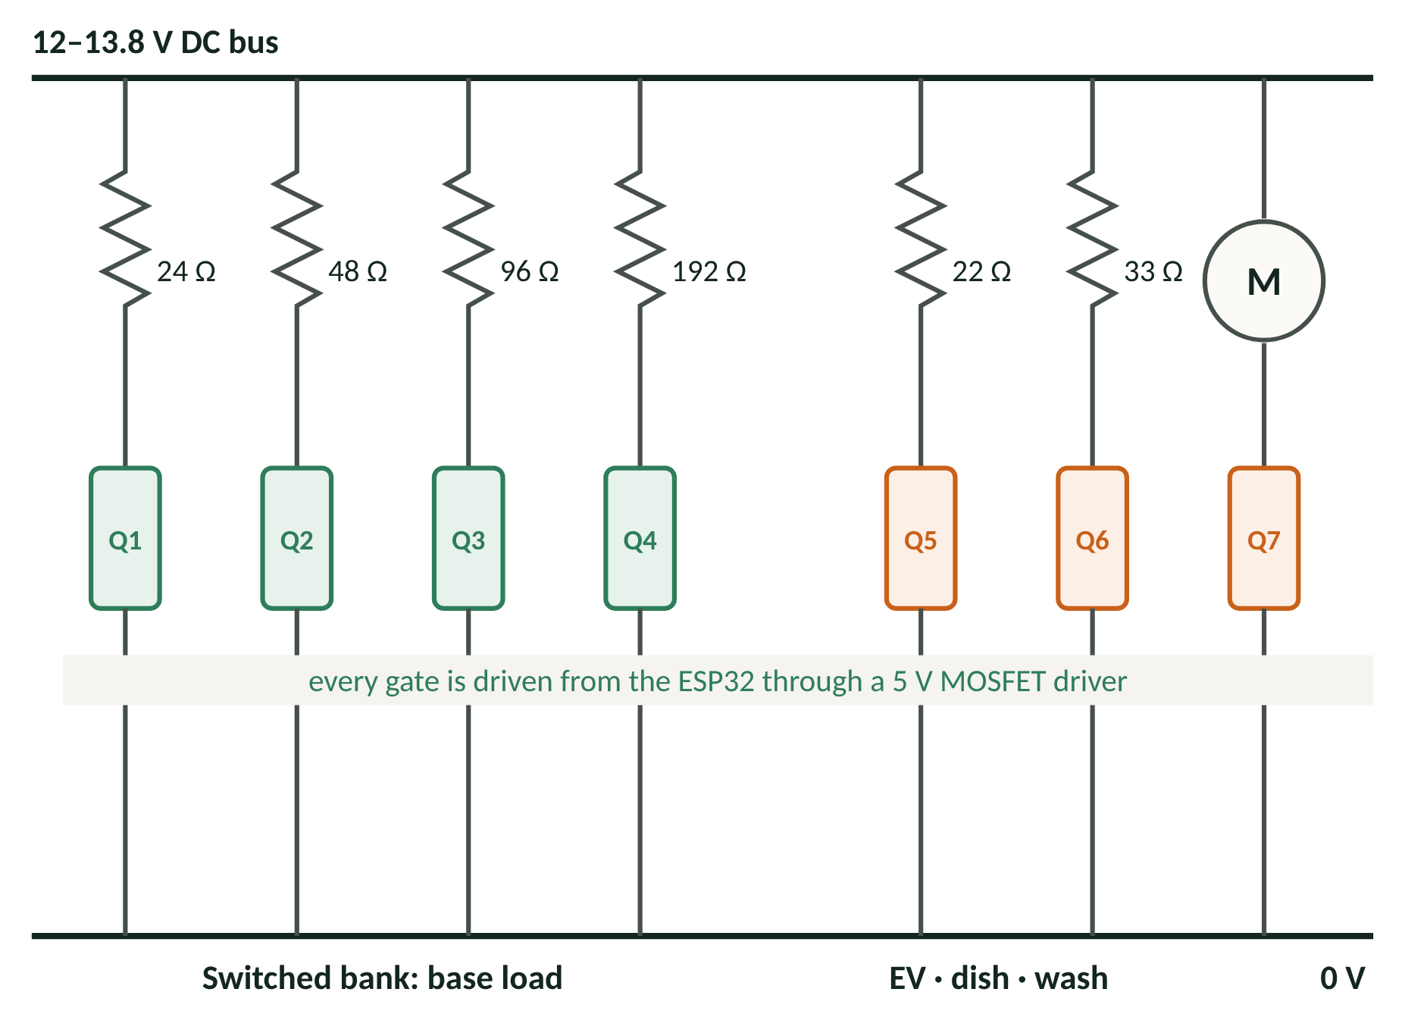
HARDWARE: WHAT I DESIGN AND BUILD
Power-sensing PCB (O2)
– 3 × INA226 [10] with 20 mΩ shunts on the grid, battery and total load
– 16-bit readings every 100 ms over I²C, 0–4 A range
– Calibrated against a bench meter (test T2)
Programmable electronic load (O3)
– Replaces the 16-step resistor bank with smooth 0–0.8 A control
– DAC, op-amp and MOSFET in a feedback loop (next slide)
– Replays a real home’s base load every 30 s
Switching and protection PCB (O4)
– TC4427 gate drivers and IRLZ44N MOSFETs for 3 appliances and the battery
– Hardware over-current trip: comparator and latch, independent of firmware
– Emergency stop and fuses on every source
Bought in, not designed
ESP32-S3 development board; Yuasa NP7-12 battery and charger; 22 Ω load (EV charger), 33 Ω heater (dishwasher) and DC pump (washing machine); 20×4 LCD and LED price bar.
Made at Aston
PCBs designed in Proteus and made in-house (submitted by Tuesday 17:00, ready Thursday); fine-pitch chips fitted on the SMD station. Parts from Aston stock first, then Farnell, RS and Rapid.
Scaling: 1 W on the rig = 250 W in a home; one half-hour slot runs in 30 s, so a day takes 24 minutes. Everything is 13.8 V DC or below; nothing connects to the mains.
O. Agbaje · Adaptive Closed-Loop Home Energy Controller · EE3EPJ proposal
7 / 18
Notes:
TIME: about 1 minute.
SAY: This is the hardware I design and build. There are three boards. First, a power-sensing PCB with three INA226 chips measuring the grid, the battery and the total load every 100 milliseconds. Second, a programmable electronic load, which replays a real home's base load smoothly instead of in 16 steps; I'll show its circuit on the next slide. Third, a switching and protection board: gate drivers and MOSFETs for the appliances and battery, and a hardware over-current trip that works even if the firmware crashes.
The boards are designed in Proteus and made in-house at Aston, with parts from Aston stock or Farnell first. Only the ESP32 board, the battery, the appliance stand-ins and the display are bought in.
KEY POINTS: three boards I design · Proteus and in-house PCBs · hardware protection independent of code.

Slide 8
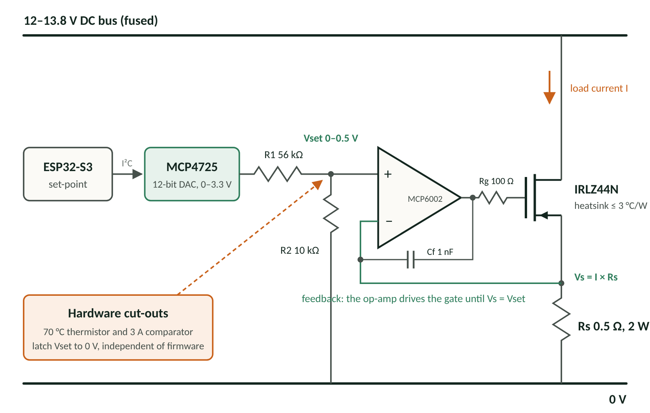
HARDWARE: ELECTRONIC LOAD DESIGN
DESIGN CALCULATIONS
Current: I = Vset ÷ Rs, with Rs = 0.5 Ω
Set-point: a 12-bit DAC (0–3.3 V) divided down to 0–0.5 V gives 0–1 A in 0.24 mA steps
Limit: a 0.8 A firmware cap gives 11 W at 13.8 V (about 2.8 kW in a home)
Heat: up to 11 W in the MOSFET; a heatsink of 3 °C/W or better keeps it near 60 °C, below the 70 °C cut-out
Sense resistor: 0.8² × 0.5 = 0.32 W, so a 2 W resistor runs cool
Stability: 100 Ω gate resistor and 1 nF compensation, checked by step response (T3)
Why not a resistor bank: 4,096 levels instead of 16, and the current does not drift with battery voltage
Fallback: the 4-resistor switched bank, if the load is late
A constant-current sink: the DAC sets Vset, and the op-amp adjusts the MOSFET until the voltage across Rs matches it, so I = Vset ÷ Rs whatever the battery voltage.
O. Agbaje · Adaptive Closed-Loop Home Energy Controller · EE3EPJ proposal
8 / 18
Notes:
TIME: about 1 minute.
SAY: This is the electronic load, the main analogue design in the project. The ESP32 sends a set-point to a 12-bit DAC. A divider scales it to 0 to half a volt, and the op-amp drives the MOSFET until the voltage across the half-ohm sense resistor equals that set-point. So the current is set-point divided by 0.5 ohms, whatever the battery voltage.
That gives 0 to 1 amp in quarter-milliamp steps; I cap it at 0.8 amps, which is 11 watts. The MOSFET dissipates that heat, so it sits on a heatsink of 3 degrees per watt or better, and a thermistor cuts it out at 70 degrees in hardware.
The risk with this circuit is oscillation, because the op-amp is driving the MOSFET's gate capacitance, so there is a gate resistor and a compensation capacitor, and I check the step response on the oscilloscope.
LIKELY QUESTION: Why use the MOSFET in its linear region? Because it acts as a variable resistor under closed-loop control; the heatsink and the safe operating area are checked for 11 W.

Slide 9
SMART OBJECTIVES
 | Objective (specific) | Measure of success | Test | Due
O1 | Data pipeline: download and align at least 2 years of half-hourly prices, demand and household load | Under 1% missing after cleaning; no duplicate slots | T1 | 20 Nov 2026
O2 | Power-sensing PCB: design in Proteus and build 3 INA226 channels (grid, battery, total load) | Current within ±1% and power within ±2% of a bench meter, 0.05–3 A; one reading every 100 ms ± 1 ms | T2 | 27 Nov 2026
O3 | Electronic load: a DAC-controlled constant-current load that replays household base load | 0–0.8 A in steps of 0.25 mA or finer, within ±2% of set-point; settles in under 1 ms; heatsink ≤ 70 °C after 1 hour at 11 W | T3 | 18 Dec 2026
O4 | Switching and protection PCB: MOSFET switching for 3 appliances and the battery, with a hardware over-current trip | Switching edges under 1 µs; trips at 3 A ± 10% within 100 µs; emergency stop cuts every load | T4 | 11 Dec 2026
O5 | Price forecaster: LightGBM model for the half-hourly prices not yet published | At least 15% lower mean absolute error than the best simple baseline on the unseen year | T5 | 29 Jan 2027
O6 | Adaptive controller: DP planner on the ESP32, re-planning every half hour from measurements | Re-plans in under 1 s using under 100 KB; every user deadline met over 30 replayed days | T6 | 26 Feb 2027
O7 | Display and IoT: LCD, LED price bar and buttons on the board; MQTT dashboard on the laptop | Board runs with no laptop; dashboard updates every 1 s; override acts in under 2 s | T7 | 5 Mar 2027
O8 | Evaluation: compare four controllers across five scenarios, in simulation and on the rig | Adaptive beats plan-once in S1–S3 (p < 0.05); rig within ±5% of simulation | T8 | 26 Mar 2027
Each objective has one deliverable, one number and one test (next slide). The three hardware objectives (O2–O4) are finished before Christmas.
O. Agbaje · Adaptive Closed-Loop Home Energy Controller · EE3EPJ proposal
9 / 18
Notes:
TIME: about 45 seconds.
SAY: Following the panel's feedback, each objective is now one deliverable, one number and one named test. Three of the eight are hardware I design: the sensing PCB, the switching and protection PCB and the electronic load, all due before Christmas because they are on the critical path. Then the forecaster, the controller, the display and dashboard, and the evaluation.
KEY POINTS: specific, measurable, tested, dated · three hardware objectives · every number has a test.

Slide 10
TEST PLAN: HOW EACH OBJECTIVE IS VERIFIED
Test | Equipment | Method | Pass mark
T1 Data quality (O1) | Python scripts | Automated report on gaps, duplicates and time-zone alignment | Under 1% missing; no duplicates
T2 Sensing PCB (O2) | Bench supply, calibrated multimeter, oscilloscope | Sweep 0.05–3 A in 10 steps per channel against the meter; toggle a pin each sample and time it on the scope | Current ±1%, power ±2%; 100 ms ± 1 ms
T3 Electronic load (O3) | Multimeter, oscilloscope, thermocouple | Sweep DAC codes against measured current; 0.1 → 0.5 A step on the scope; 1-hour soak at 11 W | ±2% of set-point; settles under 1 ms, overshoot under 10%; ≤ 70 °C
T4 Switching and protection (O4) | Oscilloscope, multimeter, bench supply | Gate rise and fall times on the scope; ramp the current past the trip level; press the emergency stop under load | Edges under 1 µs; trips at 3 A ± 10% within 100 µs; all loads off
T5 Forecaster (O5) | Python | Walk-forward test on the held-out year against same-time-yesterday and last-week baselines | Mean absolute error 15% lower than the best baseline
T6 Controller (O6) | ESP32 timer and memory statistics, rig | Time every re-plan and record peak memory; 30 replayed days with injected faults | Under 1 s, under 100 KB; 100% of deadlines met
T7 Display and IoT (O7) | Dashboard logs, stopwatch | Log MQTT timestamps; press override; unplug the Wi-Fi mid-run | Updates every 1 s; override under 2 s; board keeps running
T8 System evaluation (O8) | Simulator and rig | Four controllers across five scenarios (slide 12) | Adaptive beats plan-once (p < 0.05); rig within ±5%
Equipment: bench power supply, calibrated multimeter, oscilloscope and thermocouple, all standard lab equipment, to be booked with the technician.
O. Agbaje · Adaptive Closed-Loop Home Energy Controller · EE3EPJ proposal
10 / 18
Notes:
TIME: about 1 minute.
SAY: This is how each objective is verified. Every hardware objective is tested with lab equipment against a pass mark. The sensing board is swept from 50 milliamps to 3 amps against a calibrated meter. The electronic load is checked for accuracy, for its step response on the oscilloscope and in a one-hour thermal soak. The protection board is tested by actually pushing the current past the trip level and timing the trip. The software tests are timed and logged, and T8 is the system evaluation on slide 12, scored against the perfect plan on slide 11.
KEY POINTS: one test per objective · real lab equipment · numerical pass marks.

Slide 11
THE BENCHMARK: THE PERFECT PLAN
What it is
The cheapest possible schedule for a day, worked out after the day is over. It takes the actual prices and the energy each appliance actually used, then finds the best start times and battery use with linear programming [6], trying each appliance start time in turn.
WORKED EXAMPLE (ILLUSTRATIVE NUMBERS)
Controller | Daily bill | Saving | Score
Do nothing | £2.00 | 0p | 0%
Fixed timer | £1.60 | 40p | 50%
Plan-once | £1.40 | 60p | 75%
Adaptive (mine) | £1.30 | 70p | 88%
Perfect plan | £1.20 | 80p | 100%
Why it cannot be built
It needs information that does not exist when decisions are made. Prices after 11 pm tomorrow are not published until about 4 pm, and real energy use is only known once an appliance has run, like the wash that used 20% more. A real controller has to decide without seeing the future.
Score = saving ÷ best possible saving. Here the best possible saving is £2.00 − £1.20 = 80p, so mine scores 70p ÷ 80p = 88%.
Think of it as the answer key used to mark the exam, not a student sitting it.
Why I still need it
It gives a fixed 100% mark for every day, season and scenario, so results can be compared fairly, and the gap to 100% shows how much is left to gain.
O. Agbaje · Adaptive Closed-Loop Home Energy Controller · EE3EPJ proposal
11 / 18
Notes:
TIME: about 1 minute.
SAY: Every result is measured against the perfect plan, so it is worth being clear about what that is. It is the cheapest possible schedule for a day, worked out after the day is over, using the prices that actually happened and the energy each appliance actually used.
It cannot be built, because it needs the future. Before about 4 pm, tonight's overnight prices have not been published, and nobody knows in advance that the wash will use 20 per cent more energy. A real controller has to decide without that information.
So the perfect plan is the 100 per cent mark. In this example, doing nothing costs £2 and the perfect plan £1.20, so the most anyone could save is 80p. My controller saves 70p, which scores 88 per cent. The gap between plan-once and mine is what closing the loop is worth.
LIKELY QUESTION: Why not just build the perfect plan? Because it needs information that does not exist at the time. Plan-once is the closest real version: the best plan for the forecast, made once. Mine improves on it by re-planning as the real numbers arrive.

Slide 12
TESTING: SYSTEM EVALUATION
One score: the share of the best possible saving = (do-nothing bill − controller's bill) ÷ (do-nothing bill − perfect-plan bill). Doing nothing scores 0%; the perfect plan, worked out afterwards with hindsight, scores 100%.
Hypothesis: re-planning from measurements captures significantly more of the best possible saving than planning once, and the gap grows as disturbances grow
Controllers: fixed timer (today's homes), plan-once (mine without correction) and adaptive (mine), all on the same days and scored against the perfect plan
Scenarios: S0 as forecast · S1 appliances use 20% more energy · S2 battery capacity 30% lower · S3 published prices withheld, so only the forecast is used · S4 no battery
Data: every day of the held-out year in simulation (365 days × 5 scenarios); 24 rig runs (6 days × 2 controllers × 2 scenarios)
Statistics: paired Wilcoxon signed-rank test (p < 0.05) with bootstrapped 95% confidence intervals
Pass: adaptive beats plan-once in S1–S3, and rig results are within ±5% of simulation on the same days.
O. Agbaje · Adaptive Closed-Loop Home Energy Controller · EE3EPJ proposal
12 / 18
Notes:
TIME: about 1 minute.
SAY: This is the system test. Every controller gets one score: the share of the best possible saving, where doing nothing is 0 and the perfect plan, calculated afterwards with hindsight, is 100 per cent. My hypothesis is that re-planning from measurements captures significantly more than planning once, and that the gap grows as things go wrong.
There are five scenarios: as forecast; appliances using 20 per cent more; a weaker battery; published prices withheld so only the forecast is used, which measures what the forecaster is worth; and no battery at all.
Every day of the held-out year runs in simulation for each scenario, and 24 runs on the rig check the hardware agrees with the simulation within 5 per cent. The comparison is paired, so I use a Wilcoxon signed-rank test with 95 per cent confidence intervals.
KEY POINTS: one score · five scenarios · paired statistics · rig checks simulation.

Slide 13
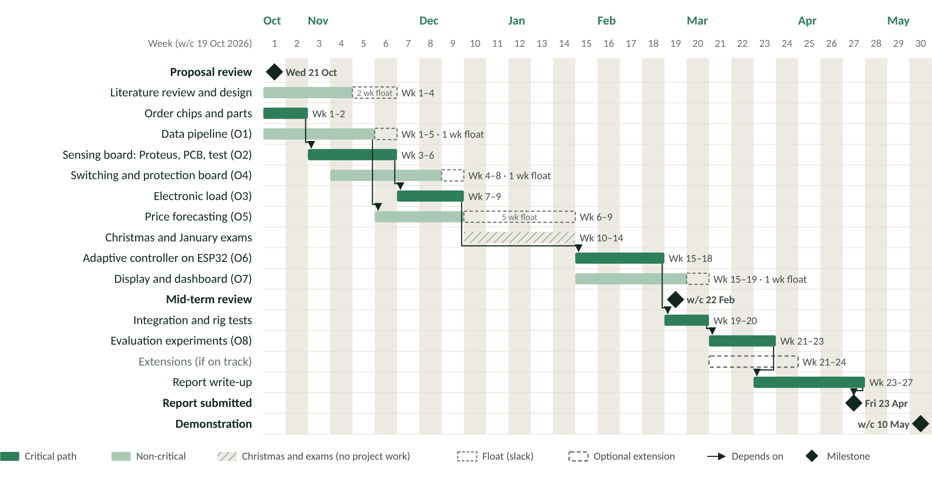
WEEK-BY-WEEK WORK PLAN
O. Agbaje · Adaptive Closed-Loop Home Energy Controller · EE3EPJ proposal
13 / 18
Notes:
TIME: about 45 seconds.
SAY: The dark green bars are the critical path, and it now runs through the boards I design: chips ordered in week 1, the sensing PCB in weeks 3 to 6, then the electronic load, all finished before Christmas. The switching and protection board runs alongside with a week of float. After exams come the controller, integration by the mid-term review, evaluation by 26 March and the report for 23 April. Aston's weekly PCB turnaround is what makes three boards possible before Christmas.

Slide 14
RISK ASSESSMENT AND MITIGATIONS: SAFETY
 |  | BEFORE |  |  |  | AFTER
Hazard or risk | Consequence | L | S | R | Mitigation | L | S | R
Battery short circuit (12 V lead-acid) | Burns, wiring fire | 4 | 3 | 12 | 2 A fuse at the terminal; insulated terminals; technician check before first use; disconnected when unattended | 2 | 2 | 4
Battery overcharge | Gas release, battery damage | 3 | 2 | 6 | Charger limited to 13.8 V and 0.7 A; firmware cut-off at 13.9 V; ventilated bench | 1 | 2 | 2
Electrolyte leak (sealed battery) | Skin or eye irritation | 2 | 2 | 4 | Battery kept upright and inspected before use; lab spill procedure | 1 | 2 | 2
Electronic load or loads overheat | Burns, damaged parts | 4 | 2 | 8 | Heatsink ≤ 3 °C/W; 0.8 A firmware cap; 70 °C thermistor cut-out in hardware; loads below half their rating; hot surfaces labelled | 2 | 2 | 4
Wiring fault, wrong polarity or over-current | Damaged components | 4 | 1 | 4 | Keyed connectors; fused sources; hardware 3 A trip; current-limited supply during bring-up | 2 | 1 | 2
L = likelihood (1 almost impossible – 6 very high) · S = severity (1 negligible – 4 catastrophic; for project risks, the impact on the project) · R = L × S, scored on the university scale in Appendix A of the handbook: 1–5 low, 6–10 reduce where practical, 12–24 must be reduced before work starts. Everything is 13.8 V DC or below; nothing connects to the mains.
O. Agbaje · Adaptive Closed-Loop Home Energy Controller · EE3EPJ proposal
14 / 18
Notes:
TIME: 0:30 · GOAL: Show you used the university risk process properly.
POINT AT: The scale line at the bottom first, then the battery row.
SAY:
I've scored the risks on the university scale from Appendix A of the handbook: likelihood from one to six, severity from one to four.
The biggest safety risk is a battery short circuit, at 12. Under Appendix A that means work can't start until it's reduced, so there's a 2-amp fuse at the terminal, insulated terminals, a technician check and the battery is disconnected when unattended. That brings it down to 4. After mitigation, every safety risk is 4 or below.
KEY POINTS IF YOU BLANK: Appendix A scale: L 1–6 × S 1–4 · Battery short 12 → 4 · Everything ≤ 4 after mitigation
MOVE ON WITH: "The project risks use the same scale."
WATCH FOR: Know why 12 matters: in Appendix A, 12 means work can't start until the risk is reduced. You reduced it.
LIKELY QUESTIONS
Q: Your risk table used a different scale before. Why the change?
A: I rescored it on the university's Appendix A scale so it matches the official risk process. The ranking of the risks didn't change.
Tip: Only comes up if they saw the submitted version. Keep it short.

Slide 15
RISK ASSESSMENT AND MITIGATIONS: PROJECT
 |  | BEFORE |  |  |  | AFTER
Hazard or risk | Consequence | L | S | R | Mitigation | L | S | R
Results look better than they are (data leakage) | Invalid conclusions | 4 | 3 | 12 | Forecasts use past data only; walk-forward testing; final test year held out until the end | 2 | 3 | 6
Scope grows too large | Late or unfinished project | 5 | 3 | 15 | Core, extension and stretch tiers; fixed cut order; weekly check against the plan | 3 | 2 | 6
PCB design error | Board respin, lost week | 3 | 2 | 6 | Breadboard each circuit first; technician review before the Tuesday submission; weekly in-house turnaround | 2 | 1 | 2
Electronic load unstable or late | Base load cannot be replayed | 3 | 3 | 9 | Gate resistor and compensation; step-response test; fallback to the 4-resistor switched bank | 2 | 2 | 4
Subsystems fail to integrate late on | No working demo | 4 | 3 | 12 | Simulator and firmware share the planner code; one channel at a time; full system by mid-term; recorded fallback | 2 | 3 | 6
Parts arrive late | Hardware work delayed | 3 | 2 | 6 | Check Aston stock first; order in week 1 by the Wednesday 17:00 cut-off; software work needs no parts | 2 | 1 | 2
Laptop failure or data loss | Lost work | 3 | 3 | 9 | Git with a remote repository; weekly cloud backup | 1 | 2 | 2
L = likelihood (1 almost impossible – 6 very high) · S = severity (1 negligible – 4 catastrophic; for project risks, the impact on the project) · R = L × S, scored on the university scale in Appendix A of the handbook: 1–5 low, 6–10 reduce where practical, 12–24 must be reduced before work starts. Everything is 13.8 V DC or below; nothing connects to the mains.
O. Agbaje · Adaptive Closed-Loop Home Energy Controller · EE3EPJ proposal
15 / 18
Notes:
TIME: 0:25 · GOAL: Show you can manage the project, not just build it.
POINT AT: The scope row.
SAY:
The highest project risk is scope, at 15, because there are several subsystems. So the project is split into a core, extensions and stretch goals, with a fixed order for cutting things.
Late integration is handled by sharing the planner code and having the whole system working by the mid-term review. After mitigation nothing is above 6.
KEY POINTS IF YOU BLANK: Scope 15 → 6: core, extensions, cut order · Integration by mid-term · Nothing above 6
MOVE ON WITH: "Beyond the engineering, there are wider considerations."
WATCH FOR: Have the cut order ready: LSTM, then the PSO/GA comparison, then appliance recognition, then power-cut mode. The three boards are core and are not cut; the resistor bank is the fallback for the electronic load.
LIKELY QUESTIONS
Q: This looks like a lot for one student. What gets cut if you fall behind?
A: The core stands on its own: the three boards, forecasting, the closed-loop controller, the display and the evaluation. Extensions are only started if I'm on track at the mid-term, and they're cut in a fixed order.
If pushed: The cut order: LSTM, then the particle swarm or genetic algorithm comparison, then appliance recognition, then power-cut mode.
Tip: Have the cut order memorised. Saying it fluently shows control.
NEW SINCE THE REVIEW: two hardware risks. A PCB design error is reduced by breadboarding first and having the technician check the design before Tuesday's submission. If the electronic load is unstable or late, the 4-resistor switched bank is the fallback.

Slide 16
WIDER CONSIDERATIONS
Societal and user need
Lower bills on time-of-use tariffs, without anyone watching prices all day. Works with or without a home battery, and a clear override keeps the user in control.
Equality, diversity and inclusion
Runs stand-alone through the LCD, LEDs and buttons, so no smartphone, app or data plan is needed. Households that struggle with energy costs stand to gain most from cheaper slots.
Environmental impact
Moves demand into cheaper, lower-carbon hours, and the carbon saved is reported from NESO data [11]. Parts are reused after the project and the battery is recycled.
Commercial context
Ofgem’s market-wide half-hourly settlement [14] will bring time-of-use pricing to many more homes. Smart chargers and batteries exist; the gap is low-cost, closed-loop correction.
Codes of practice and standards
MQTT, an OASIS standard [9]; extra-low voltage only, with no mains work; the university risk assessment process; open data used under its licences; IEEE referencing.
Ethics and data protection
No human participants; public datasets only. Any personal smart-meter data is optional, consented and anonymised under UK GDPR [12]. The work follows the Statement of Ethical Principles [13].
O. Agbaje · Adaptive Closed-Loop Home Energy Controller · EE3EPJ proposal
16 / 18
Notes:
TIME: 0:40 · GOAL: Pick up the professional marks: equality, diversity and inclusion; environment; commercial context; standards; ethics.
POINT AT: The highlighted inclusion card first, then sweep across the others.
SAY:
These are the wider considerations. For inclusion, the board works on its own through the LCD, LEDs and buttons, so you don't need a smartphone or an app, and the households that struggle most with energy costs stand to gain most.
Environmentally, cheaper hours are usually lower-carbon hours, and I report the carbon saved. Commercially, Ofgem's half-hourly settlement reform will put many more homes on tariffs like this.
On standards, MQTT is an OASIS standard and everything is extra-low voltage. Ethically there are no human participants, and any personal smart-meter data would be optional, consented and anonymised under UK GDPR.
KEY POINTS IF YOU BLANK: No smartphone needed = inclusive · Carbon reported via NESO · Ofgem settlement reform; MQTT; UK GDPR
MOVE ON WITH: "Finally, cost and where I am now."
WATCH FOR: Inclusion is the card most likely to get a follow-up. Have one concrete example: an older user who prefers buttons and a screen to an app.
LIKELY QUESTIONS
Q: How does this address equality, diversity and inclusion?
A: It doesn't need a smartphone, an app or a data plan: the board works through its screen and buttons. That matters for older users and anyone without a smartphone. Households on tight budgets gain most from cheaper slots but have least time to watch prices, and this does it for them.
If pushed: In the report I'd also consider accessibility of the display: clear text, colour plus position on the LED bar so it doesn't rely on colour vision alone.
Tip: The colour-vision point is a strong extra. Use it if they push.
Q: What are the ethical issues?
A: There are no human participants and I only use public datasets. If I ever used my own smart-meter data, it would be optional, with the bill-payer's consent, anonymised and stored locally under UK GDPR.
If pushed: Wider ethical point: automation must keep the user in control, which is why there's always a manual override.
Q: What is the commercial context?
A: Ofgem's market-wide half-hourly settlement reform will put many more homes on time-of-use pricing. Smart chargers and home batteries exist, but low-cost closed-loop correction is the gap. The controller parts would cost around £10 at volume.
Tip: Say "about £10, an estimate" if they press. Don't overclaim market size.
Q: Which standards or codes of practice apply?
A: MQTT is an OASIS standard. It's extra-low voltage throughout, below 50 V AC or 120 V DC, so there's no mains wiring. I follow the university risk assessment process and use datasets under their licences.
If pushed: For a real product, the UK's product security law for connectable devices would apply: no default passwords and a way to report vulnerabilities.
Q: How does this connect to your interest in Nigeria?
A: One of the extensions is a power-cut mode. Where the grid is unreliable, the same controller can protect the battery and prioritise essential loads during outages. The core is UK-focused because that's where the open price data is.
Tip: Only bring this up if asked or if you have spare seconds. It shows motivation.

Slide 17
RESOURCES, COSTING AND PROGRESS TO DATE
RESOURCES AND COSTING
PROGRESS TO DATE
Controller | 2 × ESP32-S3 development boards (one spare) | £24
Power-sensing PCB | 3 × INA226, 3 × 20 mΩ shunts, connectors | £18
Electronic load | MCP4725 DAC, MCP6002 op-amp, IRLZ44N, 0.5 Ω 2 W resistor, heatsink, thermistor | £20
Switching and protection PCB | 2 × TC4427, 4 × IRLZ44N, comparator, latch, relay, fuses, emergency stop | £28
Battery and power | Yuasa NP7-12, charger, 5 V regulator, diodes | £30
Appliances and display | 22 Ω and 33 Ω loads, DC pump, 20×4 LCD, LED bar, buttons, encoder | £35
Build | PCBs made in-house; wire, terminals, base board | £15
Core total (estimate) |  | ≈ £170
✓ Topic approved; proposal reviewed on 21 October, with the panel’s feedback on objectives, testing and hardware built into this version
✓ Feasibility study written, covering technical, cost, schedule, safety and ethics
✓ Octopus API tested: the slide 2 graph is a live data pull
✓ Parts list costed against Farnell, ready to send to the technician
✓ Safety and project risks assessed on the university scale
Estimates, to be confirmed on Farnell before ordering; under the £200 guideline. Aston stock is checked first, PCBs are made in-house, and the bench supply, meter and oscilloscope come from the lab.
Thank you. Any questions?
O. Agbaje · Adaptive Closed-Loop Home Energy Controller · EE3EPJ proposal
17 / 18
Notes:
TIME: 0:35 · GOAL: Cover resources, costing and progress (all three are on the handbook's list), then close.
POINT AT: The core total, then the progress ticks.
SAY:
The core build costs about £170, inside the £200 guideline, because the sensing and protection boards are built from chips on PCBs made at Aston. The bench supply, meter and oscilloscope come from the lab. All prices are estimates to be confirmed on Farnell.
On progress: the topic is approved, and the panel's feedback from the proposal review is built in, the feasibility study is written, I've already pulled live data from the Octopus API (that's the graph on slide 2), and the parts list is costed against Farnell.
To sum up: a low-cost controller that predicts, plans and corrects itself, tested against the perfect plan on real hardware. Thank you. I'm happy to take any questions.
KEY POINTS IF YOU BLANK: About £170 core, under £200 · Already pulled live API data · One-line summary, then stop
MOVE ON WITH: Stop talking after "questions". Leave this slide up.
WATCH FOR: Leave this slide on screen during questions, not the references: it shows cost and progress while they think.
LIKELY QUESTIONS
Q: What have you actually done so far?
A: The topic is approved and my supervisor's feedback is built in. The feasibility study is written. I've pulled live data from the Octopus API (that's the slide 2 graph). The parts list is costed against Farnell, and the risks are assessed on the university scale.
Tip: Add the Blackboard forms and ethics screening if they're done.

Slide 18
REFERENCES
[1] Octopus Energy, “REST API: endpoints,” developer documentation, docs.octopus.energy, accessed Oct. 2026.
[2] Elexon, “About the Insights Solution service,” elexon.co.uk, accessed Oct. 2026.
[3] J. Kelly and W. Knottenbelt, “The UK-DALE dataset, domestic appliance-level electricity demand and whole-house demand from five UK homes,” Scientific Data, vol. 2, 150007, 2015.
[4] R. Weron, “Electricity price forecasting: a review of the state-of-the-art with a look into the future,” International Journal of Forecasting, vol. 30, no. 4, pp. 1030–1081, 2014.
[5] G. Ke et al., “LightGBM: a highly efficient gradient boosting decision tree,” Advances in Neural Information Processing Systems 30, 2017.
[6] R. Sioshansi, P. Denholm, T. Jenkin and J. Weiss, “Estimating the value of electricity storage in PJM: arbitrage and some welfare effects,” Energy Economics, vol. 31, no. 2, pp. 269–277, 2009.
[7] D. Murray, L. Stankovic and V. Stankovic, “An electrical load measurements dataset of United Kingdom households from a two-year longitudinal study,” Scientific Data, vol. 4, 160122, 2017.
[8] E. F. Camacho and C. Bordons, Model Predictive Control, 2nd ed. London: Springer, 2007.
[9] OASIS, “MQTT Version 5.0,” OASIS Standard, Mar. 2019.
[10] Texas Instruments, “INA226 high-side or low-side measurement, bi-directional current and power monitor with I²C-compatible interface,” datasheet SBOS547.
[11] National Energy System Operator, “Carbon Intensity API,” carbonintensity.org.uk, accessed Oct. 2026.
[12] Data Protection Act 2018 (incorporating the UK General Data Protection Regulation), legislation.gov.uk.
[13] Engineering Council and Royal Academy of Engineering, “Statement of Ethical Principles,” 2017.
[14] Ofgem, “Electricity retail market-wide half-hourly settlement: decision and full business case,” Apr. 2021.
Notes:
Do not present this slide. Leave slide 17 on screen during questions; jump here only if asked (type 18, press Enter).
LIKELY QUESTIONS
Q: Your reference list: some items are not cited on the slides.
A: The slides are a summary. The full proposal document covers the extensions, and those references support them. On the slides, each reference used is cited where it applies.

