Slide 1

Multiobjective optimization of playlists using evolutionary algorithms
Master’s Thesis No.1453
Tomislav Čupić
Supervisor: Assoc. Prof. Marko Đurasević, PhD
8.7.2026

Slide 2
Contents
01
04
02
05
03
06
Problem description
Performance metrics
Playlists, multicriteria optimization
Description of performance metrics
Implementation
Results
Problem setup and implementation
Results and Visualizations
Algorithms
Conclusion
Algorithms implemented in project
Discussion and future work

Slide 3
01
Problem description
Theoretical Background and description of the problem

Slide 4


Problem Description
Playlists
- Music streaming
- Spotify
Automatic playlist generation
- Everyday and discovery playlists
- Optimization problem
Dataset
Kaggle
30 000 songs

Slide 5
Problem Description
Optimization Problem
Evolutionary Algorithm
Multi-objective Optimization
Fitness function
Finding a „good enough” solution
Uses Genetic Operators
Selection
Crossover
Mutation
Finding multiple criteria simultaneosly
Optimal Pareto front

Slide 6
02
Implementation
Setup of the problem

Slide 7
Implementation
FEATURES
Popularity – goal is an everyday playlist
Artist diversity – Summed across the playlist
Coherency – Feature vector (energy, tempo, loudness and positivity)
- Minimized variance
INDIVIDUAL
IMPLEMENTATION
One individual – playlist of 100 songs
Python – numpy, pandas, math
Plots - matplotlib

Slide 8
03
Algorithms
Description of implemented Algorithms

Slide 9
Algorithms
NSGA-II
NSGA-III
MOEA/D
Genetic operators
Non-dominated sorting into fronts
Crowding distance
Extension of the NSGA-II algorithm
Different calculation of Crowding distance
Decomposition into Subproblems
Tchebycheff scalarization
Referent Points

Slide 11
04
Performance metrics
Description of performance metrics

Slide 12
Performance metrics
Hypervolume
Spacing – Distribution of results
Generational distance - Convergence

Slide 13
05
Results
Results and Visualizations

Slide 14
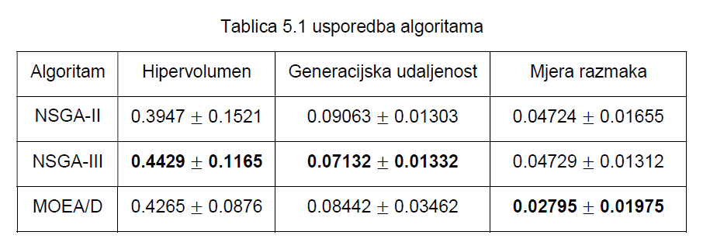
Results and comparison

Slide 15
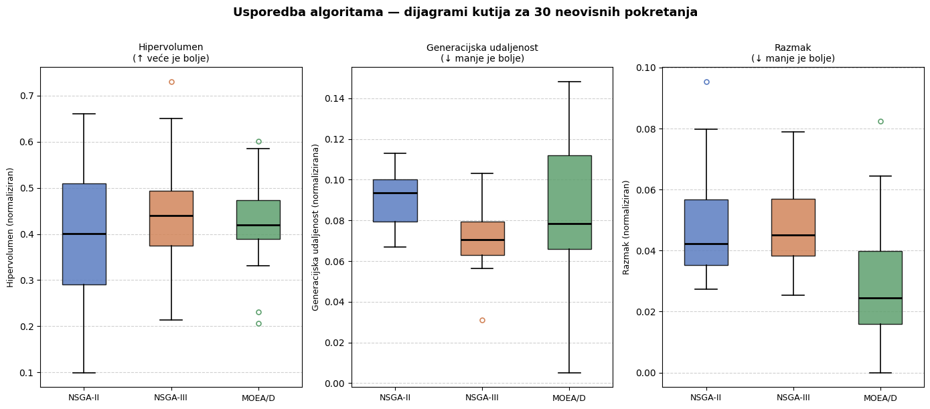

Slide 16
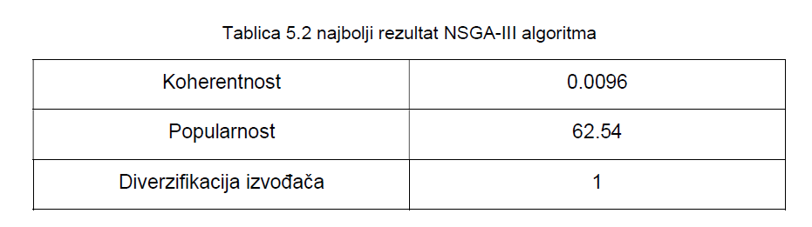
Best result in 30 runs
Very low coherence score and high popularity
Not a single artist has come up twice

Slide 17


Comparison with a Randomly Generated Playlist
NSGA-III
Nasumično generirana
Significantly better coherence
Much better popularity
Artist diversity the only competitive feature
Expected because of randomness
NSGA-III Outperformed the Random Playlist

Slide 18
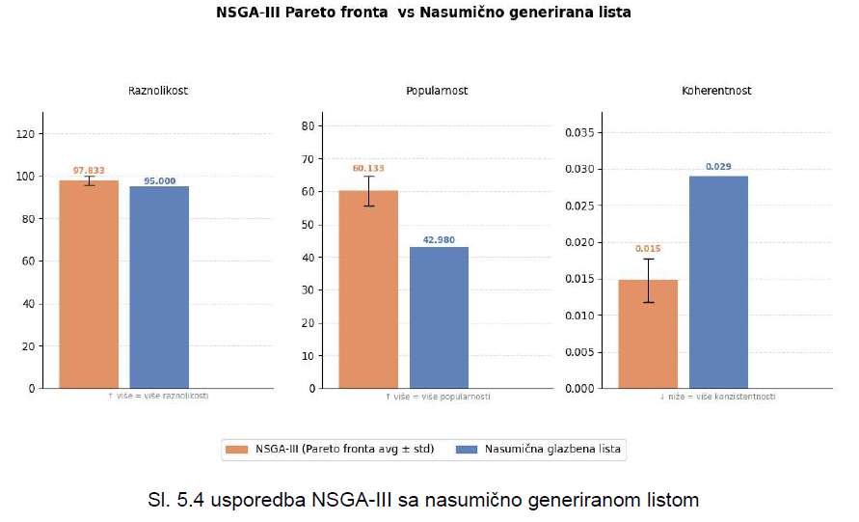

Slide 19
Comparison with a Manually Created Playlist
NSGA-III
Ručno generirana
Significantly better coherence
Much better popularity and diversity
Popularity was competitive
Diversity was competitive
Both inferior to NSGA-III
Playlist size reduced to 65

Slide 21
06
Conclusion
Discussion, future work

Slide 22



Conclusion
Algorithms successfully solved the problem
NSGA-III achieved the best results for Hypervolume and Generational Distance
Algorithms more successfull than Randomly and Manually created playlists

Slide 23
„No free lunch” Theorem
„There is no universally best algorithm for all problems.”
For our problem it is possible to design a better algorithm.

Slide 24
Thanks for listening!
Tomislav Čupić

