Slide 1
Analysis of Algorithms

Slide 2
Outline
• analysis of algorithms
• asymptotic analysis
• big-O
• big-Omega Ω-notation
• big-theta Θ-notation
• asymptotic notation
• commonly used functions
• discrete math refresher
▪ READING:
• GT textbook chapter 4

Slide 3
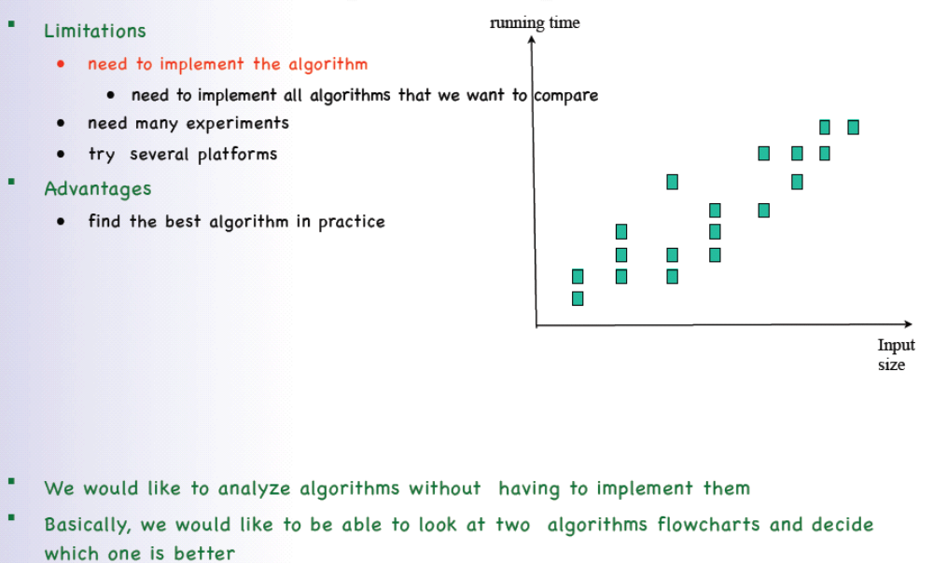
Analysis of algorithms

Slide 4
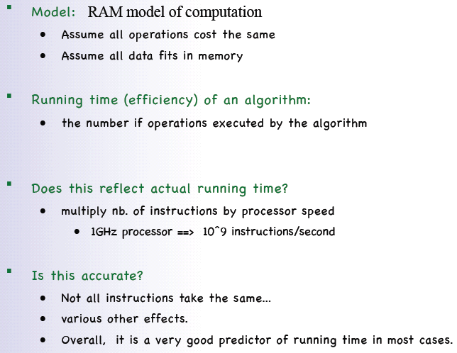
Theoretical analysis

Slide 5
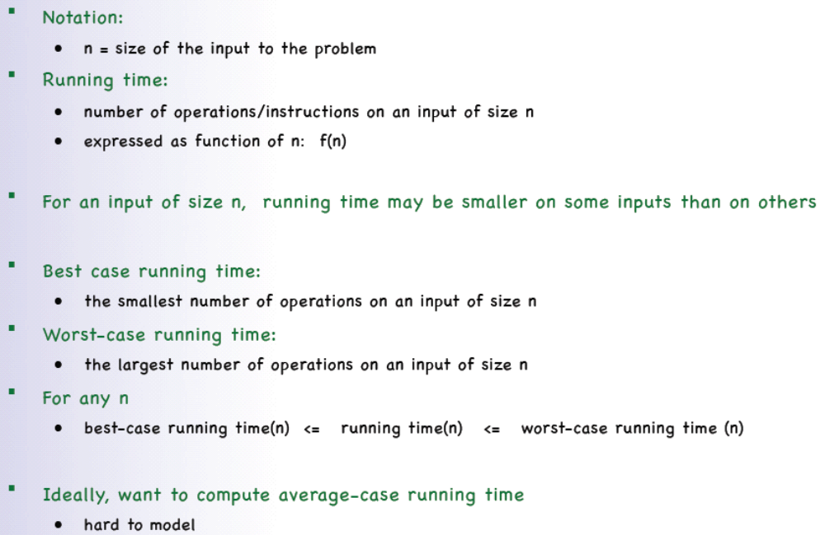
Notations

Slide 6
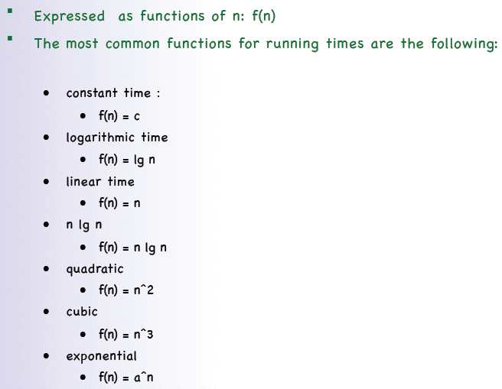
Running time

Slide 7
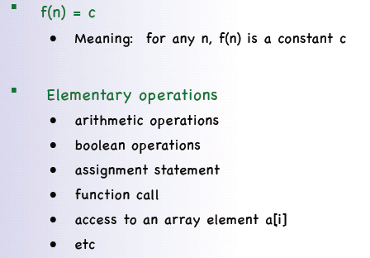
Constant running time O(1)

Slide 8
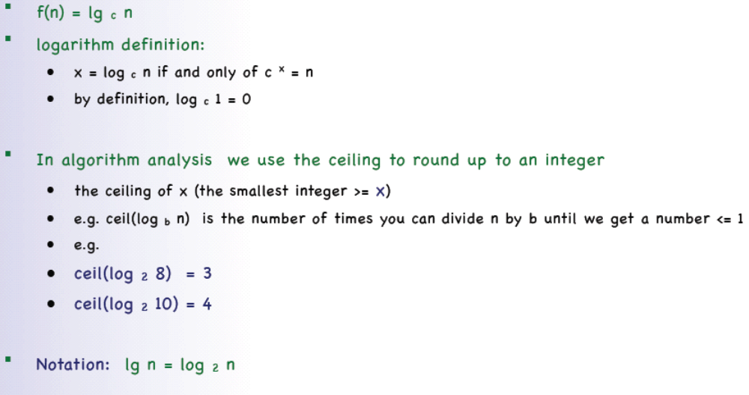
Logarithmic running time

Slide 9
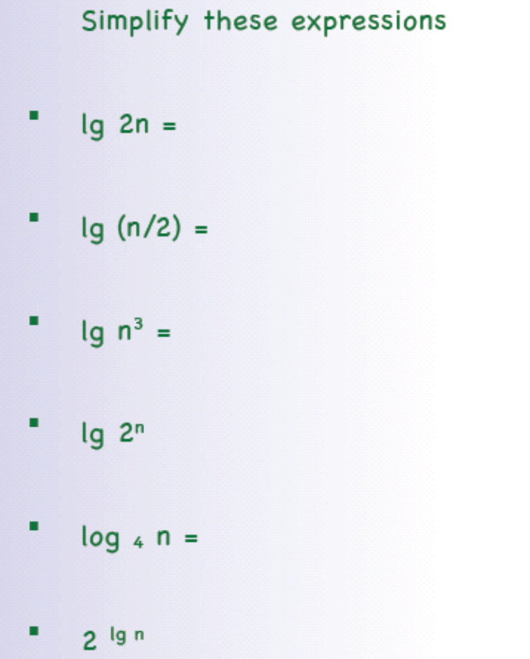
exercise

Slide 10
Answer:
lg 2n = lg n + 1
lg (n/2) = lg n - 1
lg n³ = 3 lg n
lg 2^{n} = n
lg₄ n = lg n / lg 4 = (lg n )/2
2 ^{lg n} = n

Slide 11
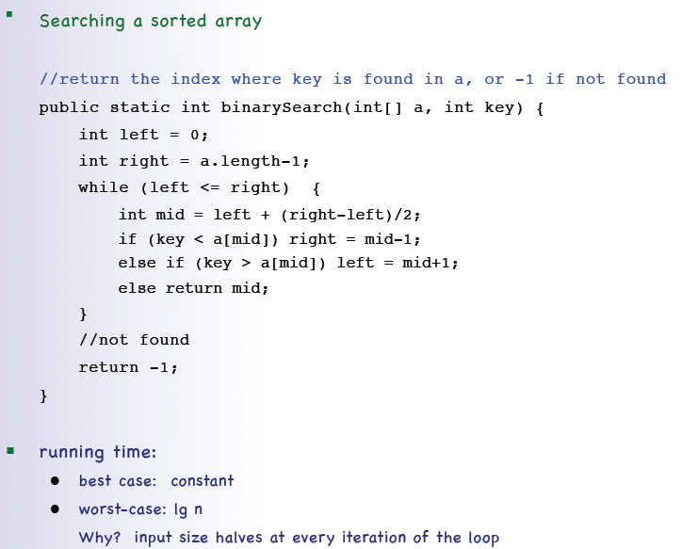
Binary Search

Slide 12
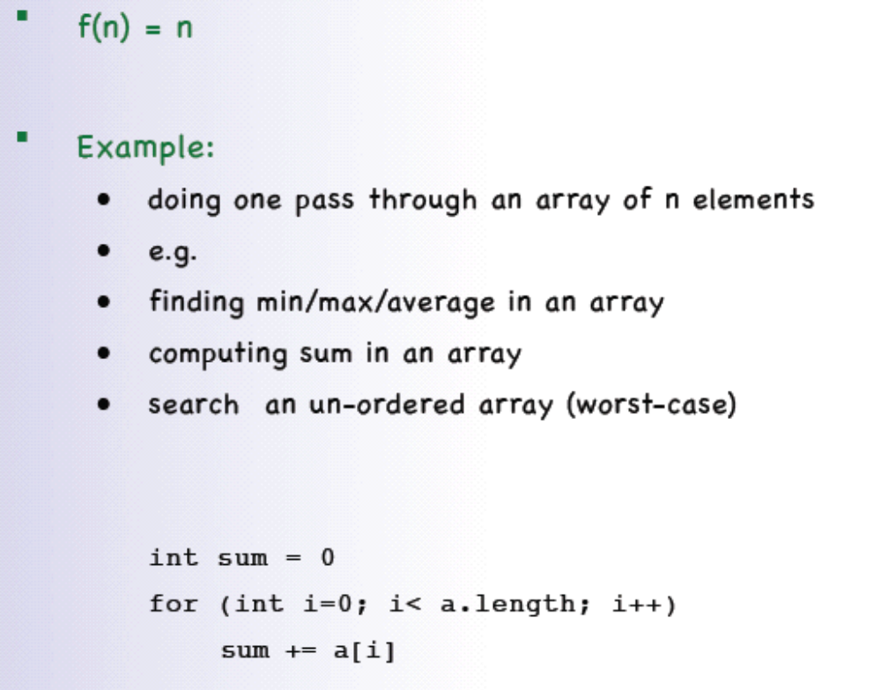
Linear running time example

Slide 13
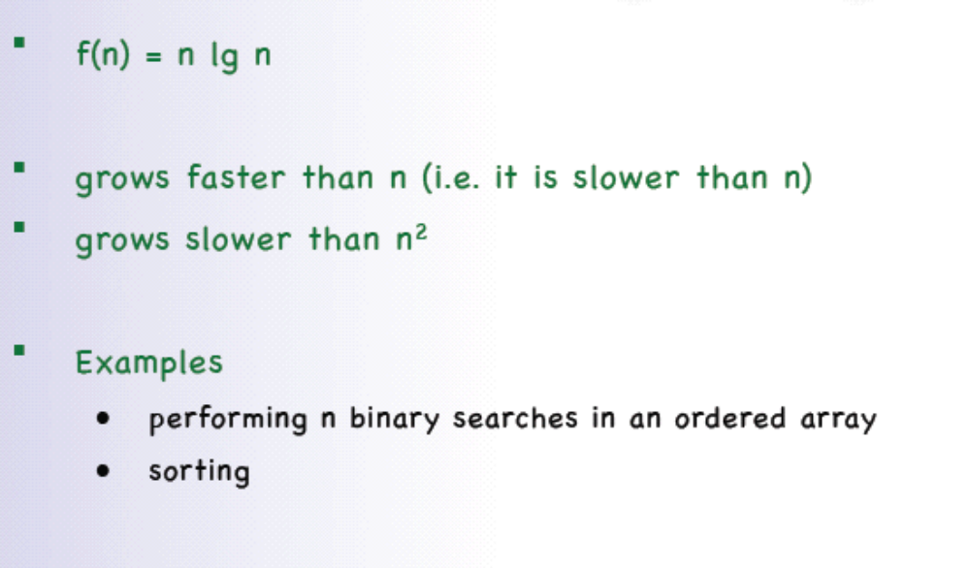
O(n lg n) running time

Slide 14
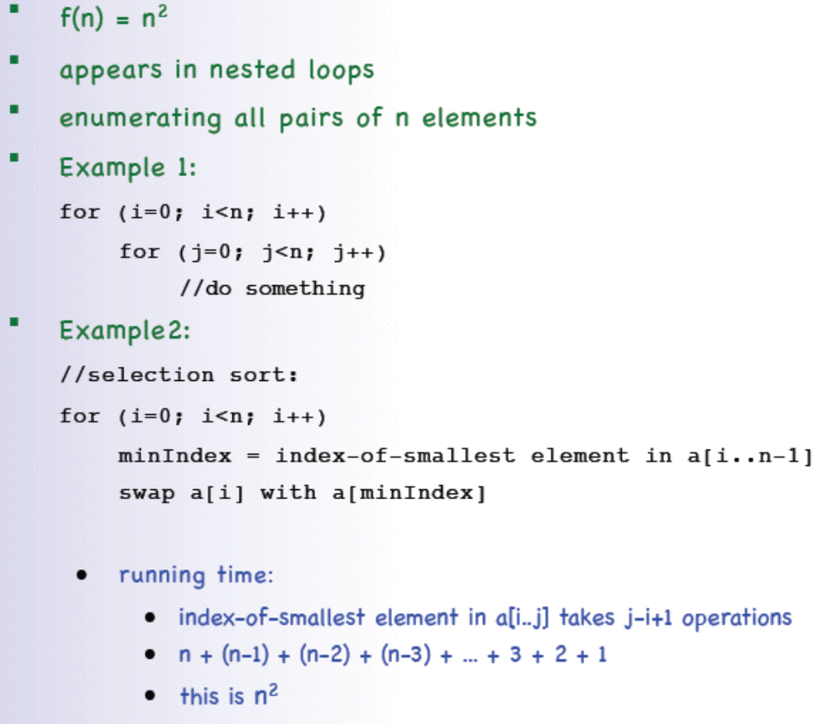
Quadratic running time - O(n²)

Slide 15
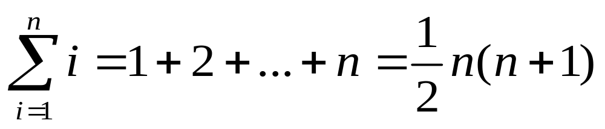
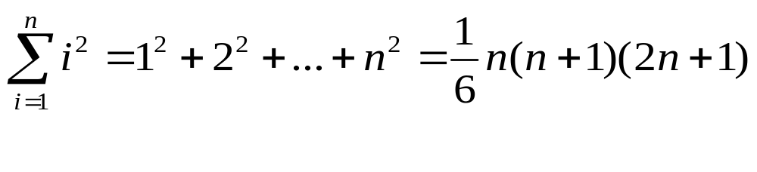
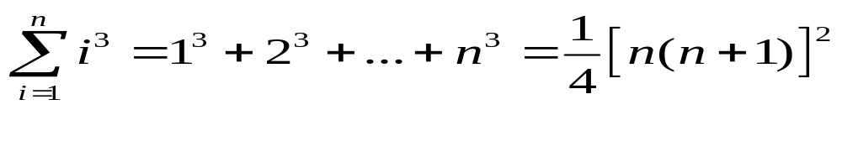
Useful formula

Slide 16
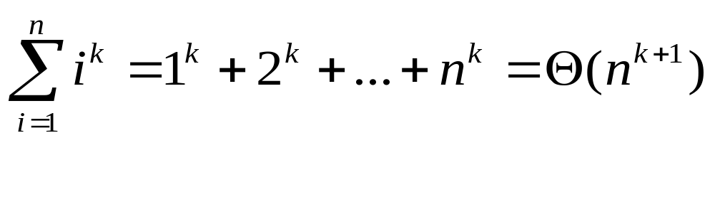
Useful formula

Slide 17
Cubic running time O(n³)
Cubic running time: f(n) = n³
In general, a polynomial running time is:
f(n) = n^{d}, d>0
Examples:
• nested loops

Slide 18
Exponential running time O(2^{n})
Exponential running time: f(n) = a^{n} , a > 1
Examples:
running time of Tower of Hanoi
moving n disks from A to B requires at least 2^{n} moves; which means it requires at least this much time

Slide 19
Comparing Growth-Rates
1 < lg n < n < n lg n < n² < n³ < a^{n}

Slide 20
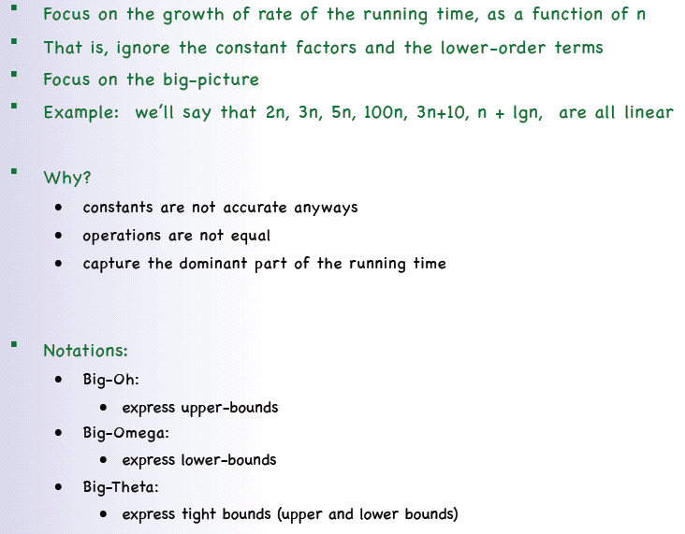
Asymptotic analysis

Slide 21
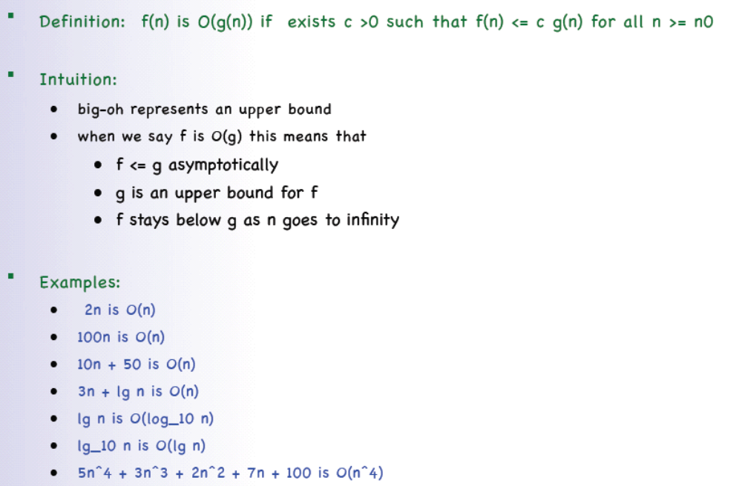
Big-oh O-notation

Slide 22
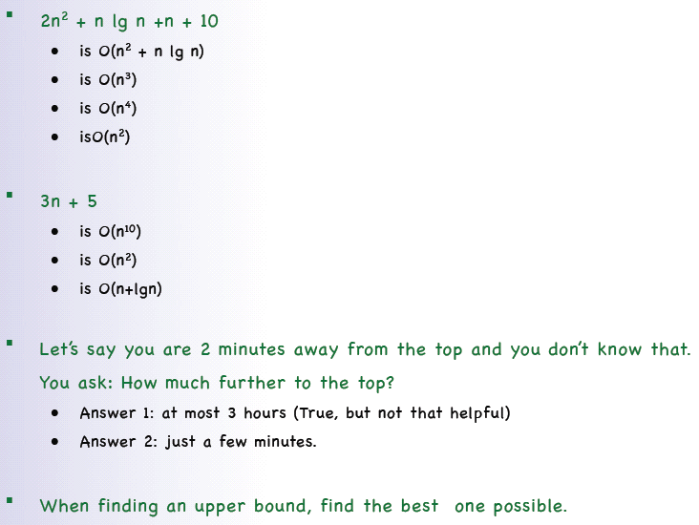
More examples

Slide 23
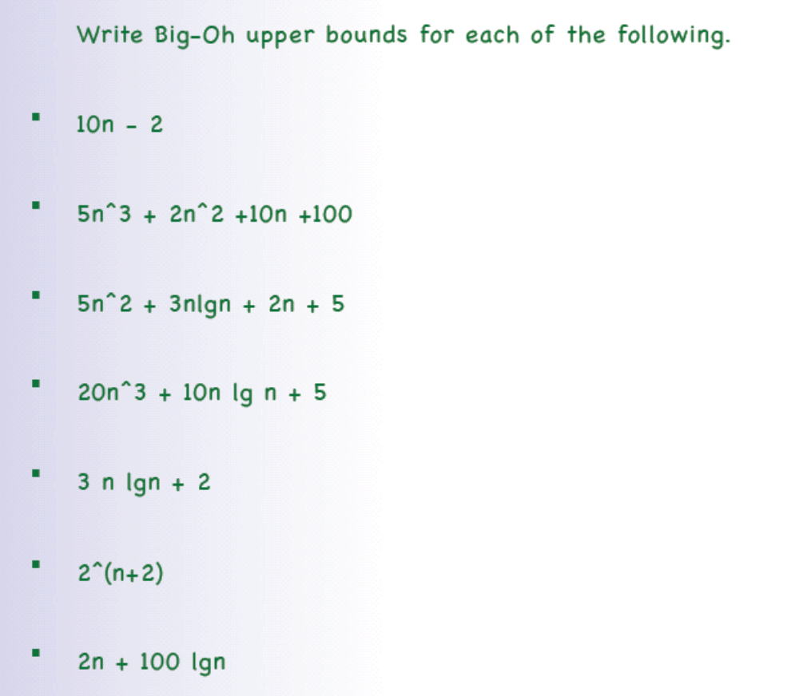
Want more exercises/examples?

Slide 24
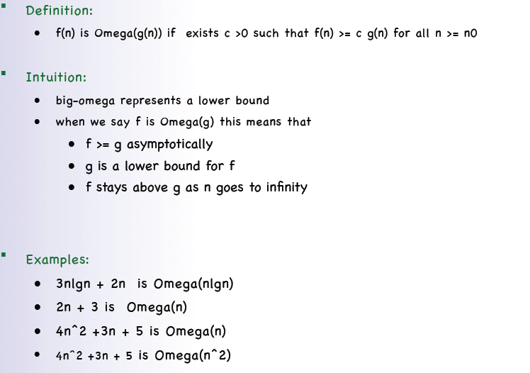
Big-Omega Ω-notation

Slide 25
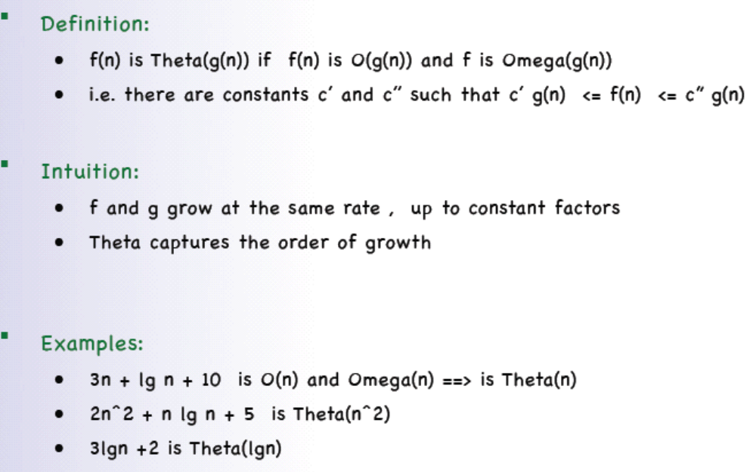
Θ-notation

Slide 26
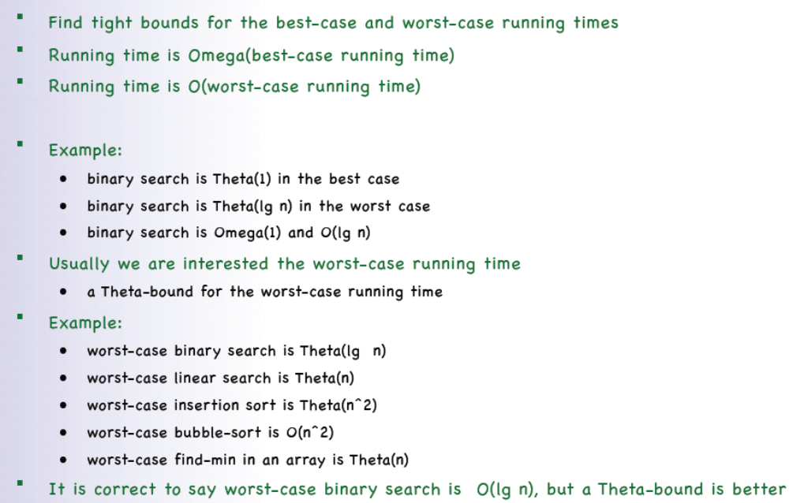
Asymptotic Analysis

Slide 27
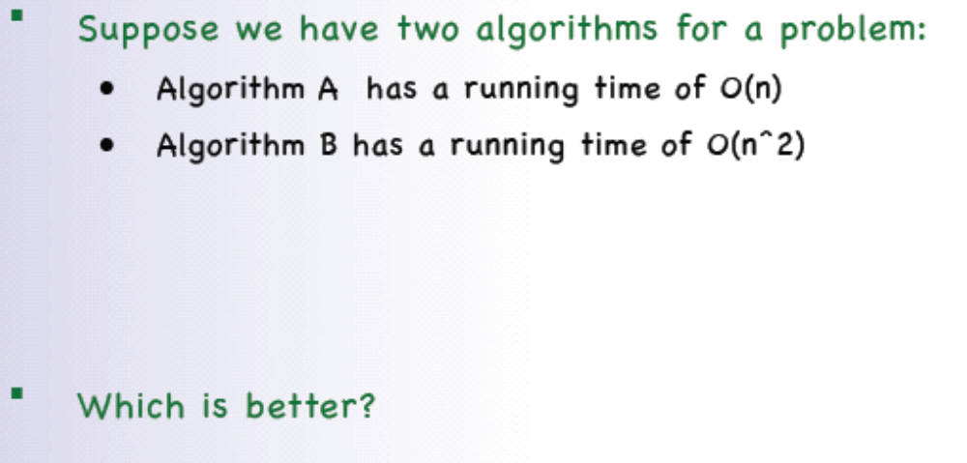
Asymptotic Analysis

Slide 28
Asymptotic Analysis
Actually, we can’t tell.
O(n) and O(2^{n}) only give the upper bounds.
Usually, we tends to say O(n) algorithm is better (runs faster) than O(2^{n}) algorithm.

Slide 29
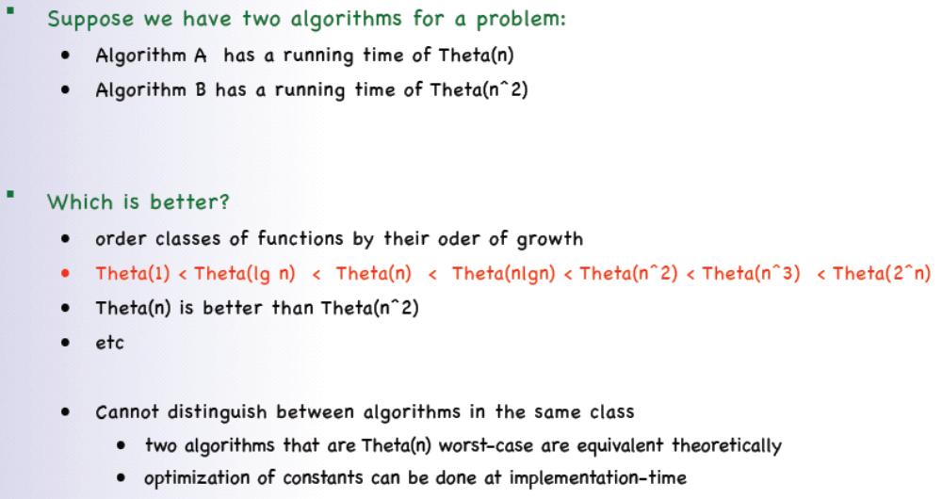
Asymptotic Analysis

Slide 30
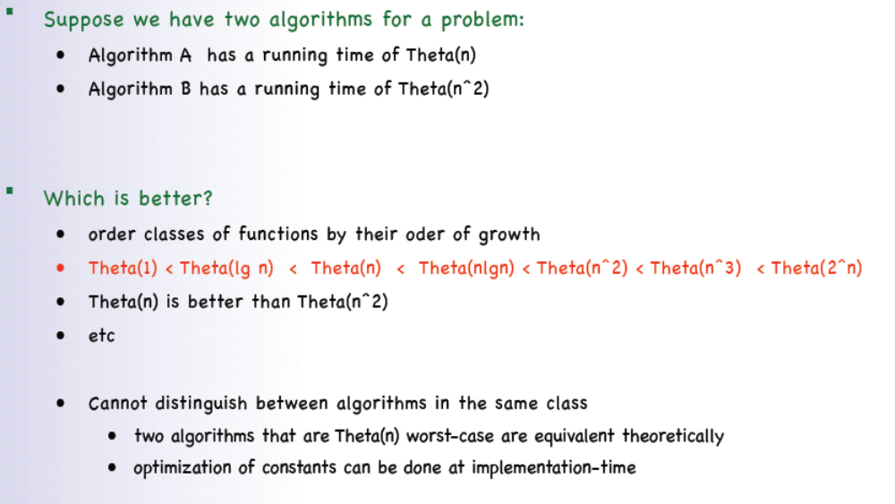
Asymptotic Analysis

Slide 31
Order of growth matters
Example:
• Say n = 10⁹ (1 billion elements)
• 10 MHz computer ==> 1 instruction takes 10⁻⁷sec seconds
• Binary search would take
Θ(lg n) = lg 10⁹ x 10⁻⁷sec = 30 x 10⁻⁷sec = 3 μsec
• Sequential search would take
Θ(n)= 10⁹ x 10⁻⁷sec = 100 seconds
• Finding all pairs of elements would take
Θ(n²)= (10⁹)² x 10⁻⁷sec = 10¹¹ seconds = 3170 years
Imagine how much time it would take for an Θ (n³)-
or Θ (2^{n})- running time algorithm.

Slide 32
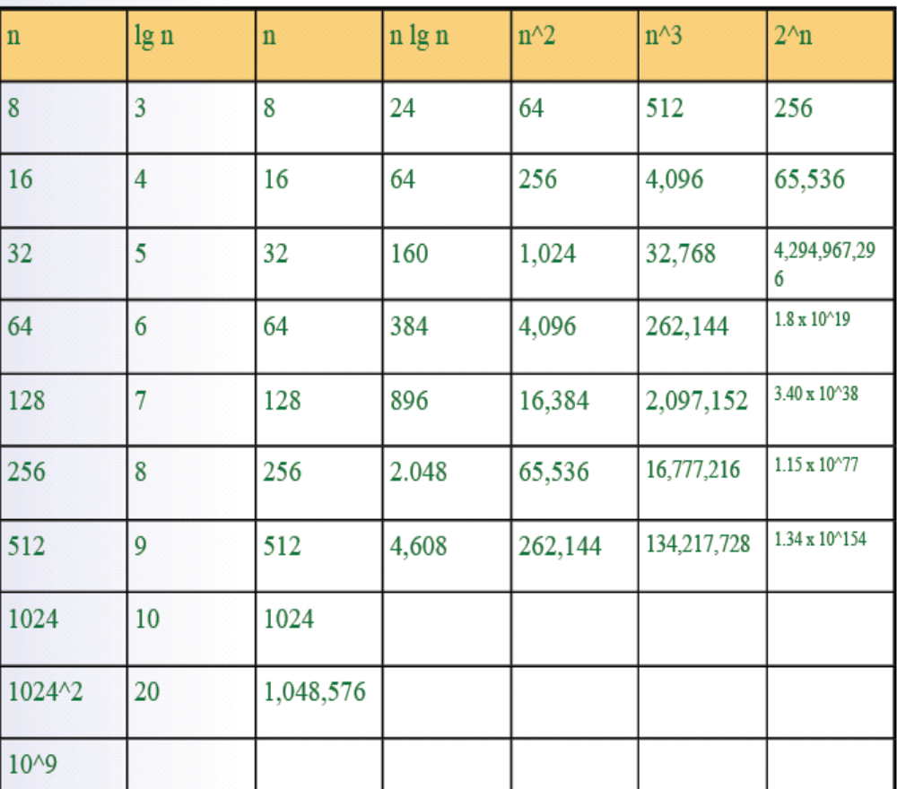
Order of growth matters

Slide 33
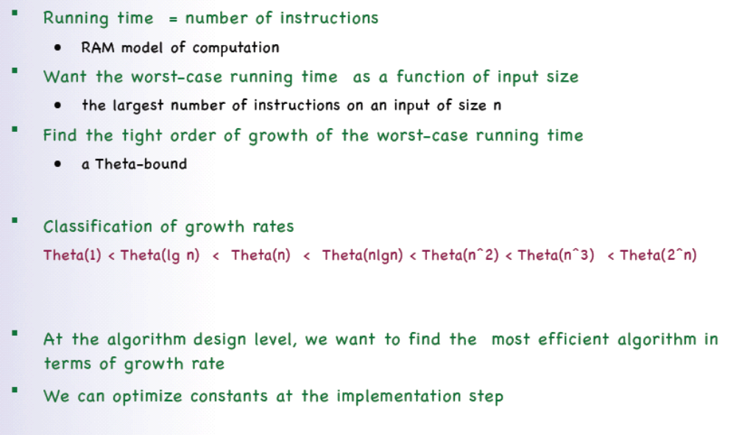
Conclusion

