Slide 1




Linked Lists
Notes:
Sequences

Slide 2
Singly Linked List
A singly linked list is a concrete data structure consisting of a sequence of nodes
Each node stores
  element
  link to the next node
next
elem
node
∅
A
B
C
D

Slide 3
The Node Class for List Nodes
public class Node {
// Instance variables:
private Object element;
private Node next;
/** Creates a node with null references to its element and next node. */
public Node() {
this(null, null);
}
/** Creates a node with the given element and next node. */
public Node(Object e, Node n) {
element = e;
next = n;
}
// Accessor methods:
public Object getElement() {
return element;
}
public Node getNext() {
return next;
}
// Modifier methods:
public void setElement(Object newElem) {
element = newElem;
}
public void setNext(Node newNext) {
next = newNext;
}
}

Slide 4
Singly linked list
public class SLinkedList {
protected Node head; // head node of the list
/** Default constructor that creates an empty list */
public SLinkedList() {
head = null;
}
// ... update and search methods would go here ...
}
Linked Lists

Slide 5
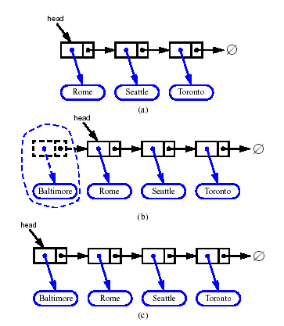
Inserting at the Head
Allocate a new node
Insert new element
Have new node point to old head
Update head to point to new node

Slide 6
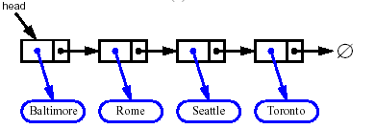


Removing at the Head
Update head to point to next node in the list
Allow garbage collector to reclaim the former first node

Slide 7
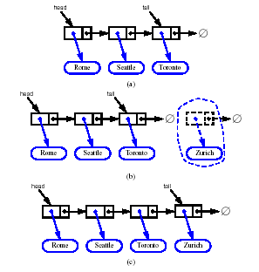
Inserting at the Tail
Allocate a new node
Insert new element
Have new node point to null
Have old last node point to new node
Update tail to point to new node

Slide 8
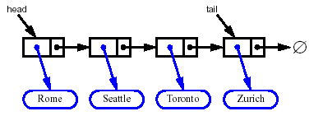
Removing at the Tail
Removing at the tail of a singly linked list is not efficient!
There is no constant-time way to update the tail to point to the previous node

Slide 9
Stack with a Singly Linked List
We can implement a stack with a singly linked list
The top element is stored at the first node of the list
The space used is O(n) and each operation of the Stack ADT takes O(1) time
nodes
t
∅
elements

Slide 10
Queue with a Singly Linked List
We can implement a queue with a singly linked list
  The front element is stored at the first node
  The rear element is stored at the last node
The space used is O(n) and each operation of the Queue ADT takes O(1) time
r
nodes
f
∅
elements

Slide 11
Linked Lists with Header and Trailer Nodes
Simplify insertion and deletion by never inserting an item before first or after last item and never deleting first node
Set a header node at the beginning of the list containing a value smaller than the smallest value in the data set
Set a trailer node at the end of the list containing a value larger than the largest value in the data set

Slide 12
Linked Lists with Header and Trailer Nodes
These two nodes, header and trailer, serve merely to simplify the insertion and deletion algorithms and are not part of the actual list.
The actual list is between these two nodes.

Slide 13
Singly linked list with ‘tail’ sentinel
public class SLinkedListWithTail {
protected Node head; // head node of the list
protected Node tail; // tail node of the list
/** Default constructor that creates an empty list */
public SLinkedListWithTail() {
head = null;
tail = null;
}
// ... update and search methods would go here ...
}
Linked Lists

Slide 14
Inserting at the Tail
Allocate a new node
Insert new element
Have new node point to null
Have old last node point to new node
Update tail to point to new node
Linked Lists

Slide 15
Removing at the Tail
Removing at the tail of a singly linked list cannot be efficient!
There is no constant-time way to update the tail to point to the previous node
Linked Lists

Slide 16
Doubly Linked List
A doubly linked list is often more convenient!
Nodes store:
  element
  link to the previous node
  link to the next node
Special trailer and header nodes
prev
next
elem
node
header
nodes/positions
trailer
elements
Linked Lists

Slide 17
Doubly Linked List
Every node:
  has a next reference variable and a back reference variable
  (except the last node) contains the address of the next node
  (except the first node) contains the address of the previous node
Can be traversed in either direction

Slide 18
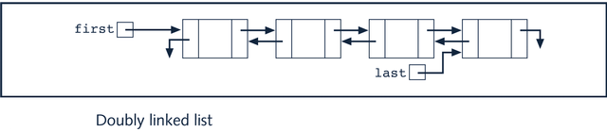
Doubly Linked List

Slide 19
Insertion
We visualize operation insertAfter(p, X), which returns position q
p
A
B
C
p
A
B
q
C
X
p
q
A
B
X
C
Linked Lists

Slide 20
Insertion Algorithm
Algorithm insertAfter(p,e):
Create a new node v
v.setElement(e)
v.setPrev(p) {link v to its predecessor}
v.setNext(p.getNext()) {link v to its successor}
(p.getNext()).setPrev(v) {link p’s old successor to v}
p.setNext(v) {link p to its new successor, v}
return v {the position for the element e}
Linked Lists

Slide 21
Deletion
We visualize remove(p), where p == last()
p
A
B
C
D
A
B
C
p
D
A
B
C
Linked Lists

Slide 22
Deletion Algorithm
Algorithm remove(p):
t = p.element {a temporary variable to hold the return value}
(p.getPrev()).setNext(p.getNext()) {linking out p}
(p.getNext()).setPrev(p.getPrev())
p.setPrev(null) {invalidating the position p}
p.setNext(null)
return t
Linked Lists

Slide 23
Worst-cast running time
In a doubly linked list
  + insertion at head or tail is in O(1)
  + deletion at either end is on O(1)
  -- element access is still in O(n)
Linked Lists

Slide 24
Circular Linked List
A linked list in which the last node points to the first node is called a circular linked list
In a circular linked list with more than one node, it is convenient to make the reference variable first point to the last node of the list

Slide 25
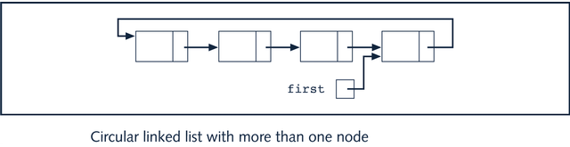
Circular Linked List

Slide 26
Circular Doubly Linked List
header
4
1
2
3
Contains a sentinel node called header whose value is never used.
The declaration of the list begins with the declaration of the header.
Notes:
Sequences

