Slide 1
CSC 383 – Data Structures and Algorithms in Java
Heaps
and Priority Queue

Slide 2
Definition
The binary heap data structure is an array object that can be viewed as a nearly complete binary tree. Each node of the tree corresponds to an element of the array that stores the value in the node. The tree is completely filled on all levels except possibly the lowest, which is filled from the left up to a point.

Slide 3
Max and Min
There are two kinds of heaps – max-heaps and min-heaps
  Max-Heaps: Must satisfy the property that for every node i other than the root, the value of node i is at most the value of its parent.
  Min-Heaps: Must satisfy the property that for every node i other than the root, the value of node i is at least the value of its parent.

Slide 4
Heap Property
So, with heaps, either the minimum or maximum element is at the root of the tree. Why not use an AVL tree and keep these elements at the far left/far right respectively?
Well, to find it would cost logarithmic time (instead of constant) for any node that is along the path from the root to a leaf.

Slide 5
Which are min-heaps?
10
20
10
20
80
10
80
20
80
30
15
40
60
85
99
40
60
85
99
10
50
700
50
700
20
80
10
10
40
60
85
99
20
80
20
80
50
700
40
60
99
40
60

Slide 6
Which are min-heaps?
wrong!
10
wrong!
wrong!
20
10
20
80
10
80
20
80
40
60
85
99
40
60
85
99
30
15
50
700
50
700
10
wrong!
20
80
10
10
40
60
85
99
20
80
20
80
50
700
40
60
99
40
60

Slide 7
Which are Max-Heaps?
30
48
80
10
20
21
10
25
30
14
24
50
33
30
10
17
10
30
35
40
22
28
18
9
7
3
11

Slide 8
Which are Max-Heaps?
wrong!
30
48
80
10
20
21
10
25
30
14
24
50
33
30
10
17
10
30
35
40
22
28
18
9
7
3
wrong!
11

Slide 9
Heap height and runtime
height of a complete tree is always log n, because it is always balanced
  this suggests that searches, adds, and removes will have O(log n) worst-case runtime
  because of this, if we implement a priority queue using a heap, we can provide the O(log n) runtime required for the add and remove operations
n-node complete tree
of height h:
h = ⎣log n⎦
2^{h} ≤ n ≤ 2^{h+1} - 1

Slide 10
Adding to a heap
when an element is added to a heap, it should be initially placed as the rightmost leaf (to maintain the completeness property)
  heap ordering property becomes broken!
10
10
20
80
20
80
40
60
85
99
40
60
85
99
50
700
65
50
700
65
15

Slide 11
Adding to a heap, cont'd.
to restore heap ordering property, the newly added element must be shifted upward ("bubbled up") until it reaches its proper place
  bubble up (aka: "percolate up") by swapping with parent
  how many bubble-ups could be necessary, at most?
10
10
20
80
15
80
40
60
85
99
40
20
85
99
50
700
65
15
50
700
65
60

Slide 12
Adding to a max-heap
same operations, but must bubble up larger values to top
16
16
18
5
11
18
11
16
11
3
18
3
5
3
5

Slide 13
Heap practice problem
Draw the state of the min-heap tree after adding the following elements to it:
  6, 50, 11, 25, 42, 20, 104, 76, 19, 55, 88, 2

Slide 14
The peek operation
10
peek on a min-heap is trivial; because of the heap properties, the minimum element is always the root
  peek is O(1)
  peek on a max-heap would be O(1) as well, but would return you the maximum element and not the minimum one
20
80
40
60
85
99
50
700
65

Slide 15
Removing from a min-heap
min-heaps only support remove of the min element (the root)
  must remove the root while maintaining heap completeness and ordering properties
  intuitively, the last leaf must disappear to keep it a heap
  initially, just swap root with last leaf (we'll fix it)
10
65
20
80
20
80
40
60
85
99
40
60
85
99
700
50
65
700
50
65

Slide 16
Removing from heap, cont'd.
must fix heap-ordering property; root is out of order
  shift the root downward ("bubble down") until it's in place
  swap it with its smaller child each time
    What happens if we don't always swap with the smaller child?
65
20
20
80
40
80
40
60
85
99
50
60
85
99
700
50
700
65

Slide 17
Heap practice problem
Assuming that you have a heap with the following elements to it (from the last question):
  6, 50, 11, 25, 42, 20, 104, 76, 19, 55, 88, 2
Show the state of the heap after remove() has been executed on it 3 times.

Slide 18
Turning any input into a heap
we can quickly turn any complete tree of comparable elements into a heap with a buildHeap algorithm
simply perform a "bubble down" operation on every node that is not a leaf, starting from the rightmost internal node and working back to the root
  why does this buildHeap operation work?
  how long does it take to finish? (big-Oh)
45
6
21
18
14
18
14
60
32
6
21
60
32
45
Notes:
runtime is actually O(N)

Slide 19
Array tree implementation
corollary: a complete binary tree can be implemented using an array (the example tree shown is not a heap)
i
Item
Left
2*i
Right
Pam
Child
Child
1
Pam
2
2
3
2
Joe
4
4
5
Joe
Sue
3
Sue
6
6
7
4
Bob
8
8
9
Bob
Mike
Sam
Tom
5
Mike
10
10
-1
6
Sam
-1
11
-1
7
Tom
-1
13
-1
Ann
Jane
Mary
8
Ann
-1
15
-1
LeftChild(i) = 2*i
RightChild(i) = 2*i + 1
9
Jane
-1
17
-1
10
Mary
-1
19
-1

Slide 20
Array binary tree - parent
i
Item
Parent
i / 2
Pam
1
Pam
-1
0
2
Joe
1
1
Joe
Sue
3
Sue
1
1
4
Bob
2
2
Bob
Mike
Sam
Tom
5
Mike
2
2
6
Sam
3
3
7
Tom
3
3
Ann
Jane
Mary
8
Ann
4
4
9
Jane
4
4
Parent(i) = ⎣ i / 2 ⎦
10
Mary
5
5

Slide 21
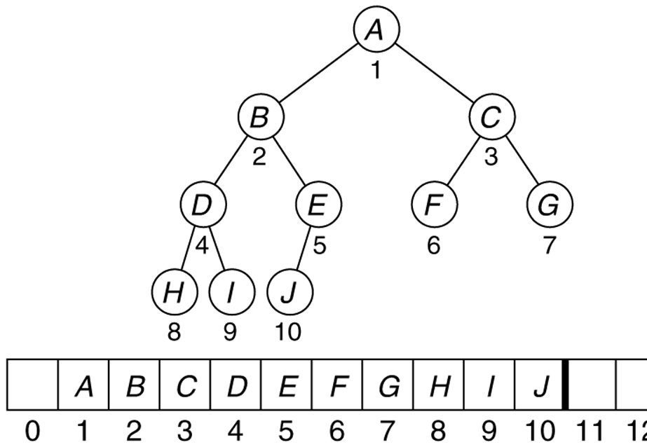
Implementation of a heap
when implementing a complete binary tree, we actually can "cheat" and just use an array
  index of root = 1 (leave 0 empty for simplicity)
  for any node n at index i,
    index of n.left = 2i
    index of n.right = 2i + 1

Slide 22
Advantages of array heap
the "implicit representation" of a heap in an array makes several operations very fast
  add a new node at the end (O(1))
  from a node, find its parent (O(1))
  swap parent and child (O(1))
  a lot of dynamic memory allocation of tree nodes is avoided
  the algorithms shown usually have elegant solutions

