Slide 1
More About Analysis of Algorithms
Topics :
Divide-and Conquer
Recurrence relations
Master Theorem

Slide 2
Divide-and-Conquer
7 2 ⏐ 9 4 → 2 4 7 9
7 ⏐ 2 → 2 7
9 ⏐ 4 → 4 9
7 → 7
2 → 2
9 → 9
4 → 4

Slide 3
Divide-and-Conquer
Divide-and conquer is a general algorithm design paradigm:
  Divide: divide the input data S in two or more disjoint subsets S₁, S₂, …
  Recur: solve the subproblems recursively
  Conquer: combine the solutions for S₁, S₂, …, into a solution for S
The base case for the recursion are subproblems of constant size
Analysis can be done using recurrence equations

Slide 4
Merge-Sort
Merge-sort on an input sequence S with n elements consists of three steps:
  Divide: partition S into two sequences S₁ and S₂ of about n/2 elements each
  Recur: recursively sort S₁ and S₂
  Conquer: merge S₁ and S₂ into a unique sorted sequence
Algorithm mergeSort(S, C)
Input sequence S with n elements, comparator C
Output sequence S sorted
  according to C
  if S.size() > 1
  (S₁, S₂) ← partition(S, n/2)
  mergeSort(S₁, C)
  mergeSort(S₂, C)
  S ← merge(S₁, S₂)

Slide 5
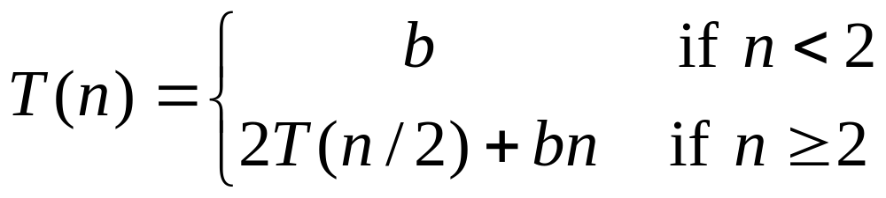
Recurrence Equation Analysis
The conquer step of merge-sort consists of merging two sorted sequences, each with n/2 elements and implemented by means of a doubly linked list, takes at most bn steps, for some constant b.
Likewise, the basis case (n < 2) will take at b most steps.
Therefore, if we let T(n) denote the running time of merge-sort:
We can therefore analyze the running time of merge-sort by finding a closed form solution to the above equation.
  That is, a solution that has T(n) only on the left-hand side.

Slide 6
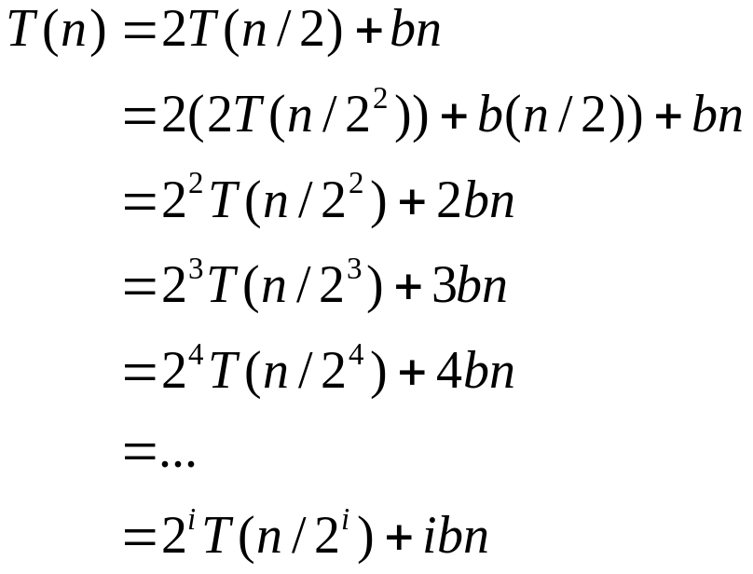

Iterative Substitution
In the iterative substitution, or “plug-and-chug,” technique, we iteratively apply the recurrence equation to itself and see if we can find a pattern:
Note that base, T(n)=b, case occurs when 2^{i}=n. That is, i = log n.
So,
Thus, T(n) is O(n log n).

Slide 7
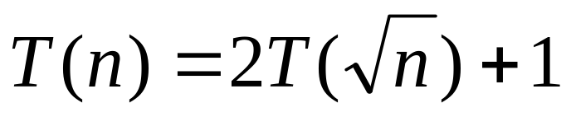
Changing variables
Let n =2^{m}
=> sqrt(n) = 2^{m/2}
We then have T(2^{m}) = T(2^{m/2}) + 1
Let T(n) = T(2^{m}) = S(m)
=> S(m) = S(m/2) + 1
S(m) = Θ (log m) = Θ (log log n)
T(n) = Θ (log log n)

Slide 8
Changing variables
T(n) = 2T(n-1) + 1
Let n = log m, i.e., m = 2^{n}
=> T(log m) = 2 T(log m/2) + 1
Let S(m) = T(log m)
=> S(m) = 2S(m/2) + 1
=> S(m) = Θ(m)
=> T(n) = S(m) = Θ(m) = Θ(2^{n})

Slide 9
Changing variables
T(n) = 2T(n-2) + 1
Let n = log m, i.e., m = 2^{n}
=> T(log m) = 2 T(log m/4) + 1
Let S(m) = T(log m)
=> S(m) = 2S(m/4) + 1
=> S(m) = m^{1/2}
=> T(n) = S(m) = 2^{n/2} = (sqrt(2)) ^{n} = 1.4^{n}

Slide 10
Obtaining bounds
T(n) = T(n/2) + log n
T(n) ∈ Ω(log n)
T(n) ∈ O(T(n/2) + n^{ε})
Solving T(n) = T(n/2) + n^{ε},
we obtain T(n) = n^{ε}, for any ε > 0
So: T(n) ∈O(n^{ε}) therefore T(n) is unlikely polynomial.
In fact T(n) = Θ(log²n)

Slide 11
Obtaining bounds
T(n) = T(n-1) + T(n-2) + 1
T(n) >= 2(T-2) + 1 [1]
T(n) <= 2T(n-1) + 1 [2]
Solving [1], we obtain T(n) >= 1.4^{n}
Solving [2], we obtain T(n) <= 2^{n}
In fact, T(n) = 1.62^{n}

Slide 12
The Recursion Tree
Draw the recursion tree for the recurrence relation and look for a pattern:
depth | T’s | size
0 | 1 | n
1 | 2 | n/2
i | 2^{i} | n/2^{i}
… | … | …
time
bn
bn
bn
…
Total time = bn + bn log n
(last level plus all previous levels)

Slide 13
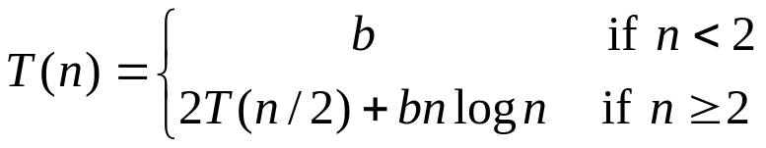
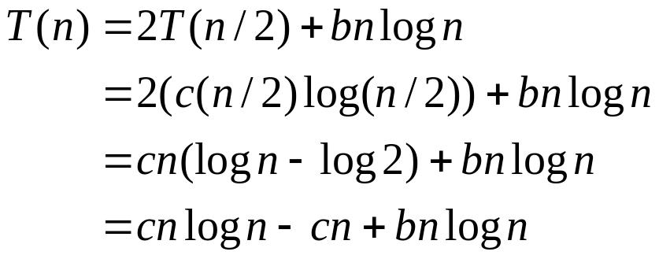
Guess-and-Test Method
In the guess-and-test method, we guess a closed form solution and then try to prove it is true by induction:
Guess: T(n) < cn log n.
Wrong: we cannot make this last line be less than cn log n

Slide 14
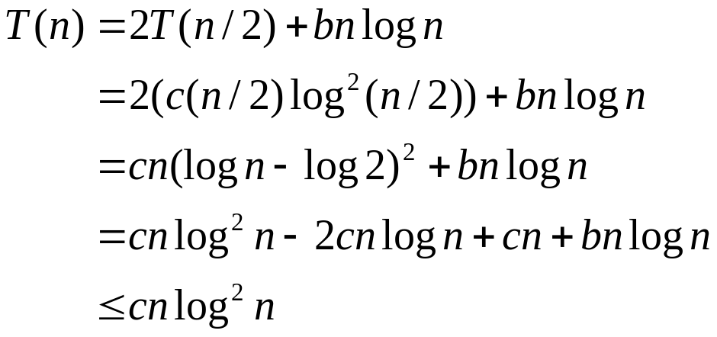
Guess-and-Test Method, Part 2
Recall the recurrence equation:
Guess #2: T(n) < cn log² n.
  if c > b.
So, T(n) is O(n log² n).
In general, to use this method, you need to have a good guess and you need to be good at induction proofs.

Slide 15
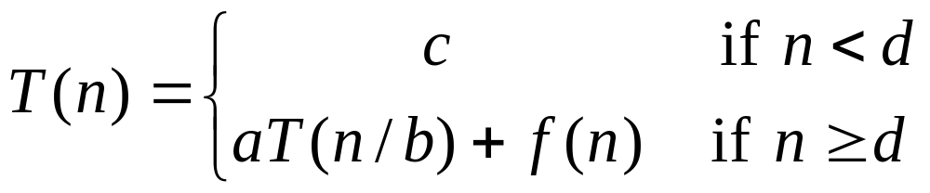
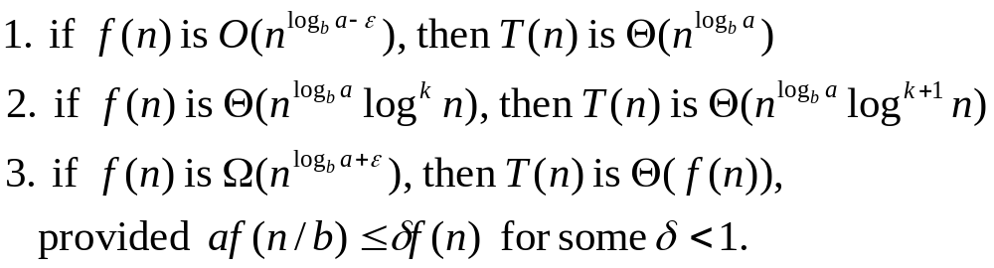
Master Method
Many divide-and-conquer recurrence equations have the form:
The Master Theorem:
for all n≥d

Slide 16

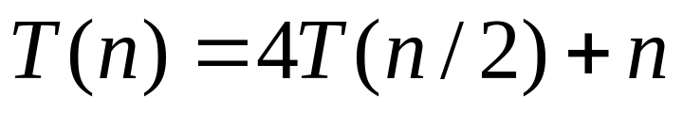
Master Method, Example 1
The form:
The Master Theorem:
Example:
for all n≥d
Solution: log_{b}a=2, so case 1 says T(n) is Θ(n²).

Slide 17
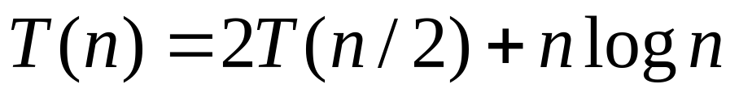
Master Method, Example 2
The form:
The Master Theorem:
Example:
for all n≥d
Solution: log_{b}a=1, so case 2 says T(n) is Θ(n log² n).

Slide 18
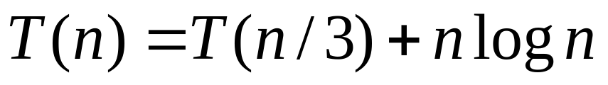
Master Method, Example 3
The form:
The Master Theorem:
Example:
for all n≥d
Solution: log_{b}a=0, so case 3 says T(n) is Θ(n log n).

Slide 19
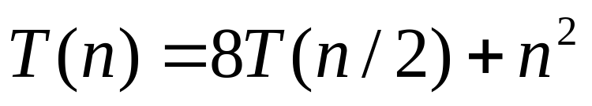
Master Method, Example 4
The form:
The Master Theorem:
Example:
for all n≥d
Solution: log_{b}a=3, so case 1 says T(n) is Θ(n³).

Slide 20
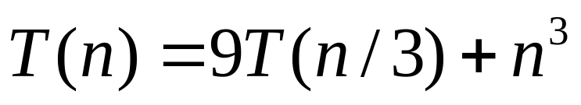
Master Method, Example 5
The form:
The Master Theorem:
Example:
for all n≥d
Solution: log_{b}a=2, so case 3 says T(n) is Θ(n³).

Slide 21
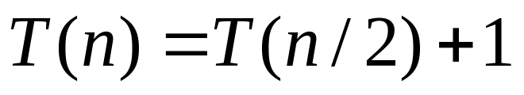
Master Method, Example 6
The form:
The Master Theorem:
Example:
for all n≥d
(binary search)
Solution: log_{b}a=0, so case 2 says T(n) is Θ(log n).

Slide 22
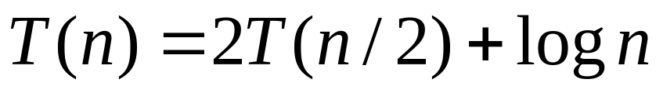
Master Method, Example 7
The form:
The Master Theorem:
Example:
for all n≥d
(heap construction)
Solution: log_{b}a=1, so case 1 says T(n) is Θ(n).

Slide 23
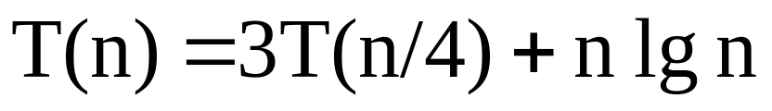
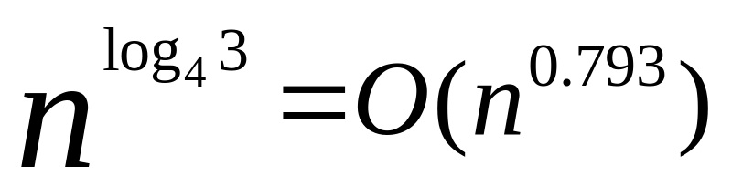
Master Method, Example 8
The form:
The Master Theorem:
Example:
for all n≥d
Solution: a = 3, b=4, thus n^{log}_{b}ª = n^{log}₄³ = O(n^{0.793})
  f (n) = n lg n = Ω(n ^{log43} + ε ) where ε ≈ 0.2 ⇒ Case 3.
  Therefore, T(n) = Θ(f(n)) = Θ(n lg n).

Slide 24
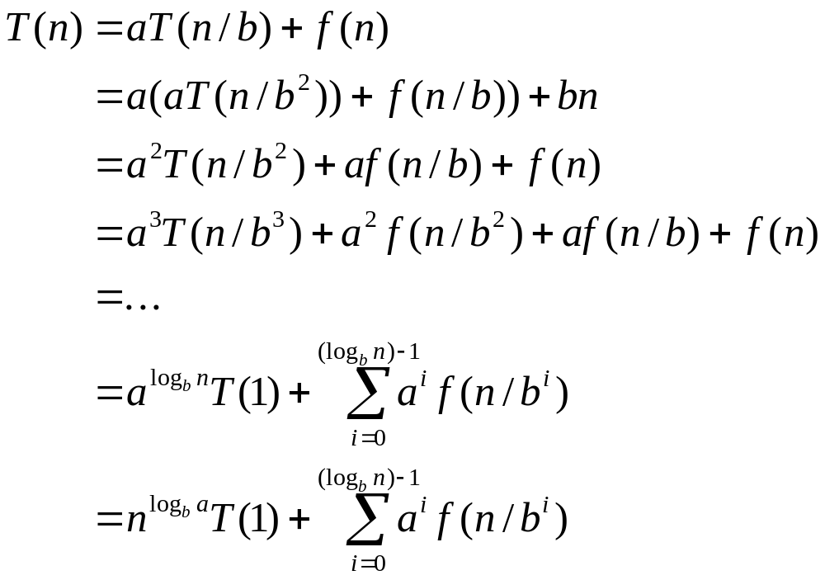
Iterative “Proof” of the Master Theorem
Using iterative substitution, let us see if we can find a pattern:
We then distinguish the three cases as
  The first term is dominant
  Each part of the summation is equally dominant
  The summation is a geometric series

Slide 25
Exception to Master Theorem
T(n) = 2T(n/2)+nlg n;
  a=2,b=2, f(n) =nlg n
  n^{log}bª = n^{log}2² = Θ (n)
  f(n) is asymptotically larger than n^{log}bª , but not polynomially larger because
  f(n)/n^{log}bª = lg n, which is asymptotically less than n^{ε} for any ε>0.
  Therefore,this is a gap between 2 and 3.

Slide 26
Where Are the Gaps
f(n), case 3, at least polynomially larger
n^{ε}
Gap between case 3 and 2
c₁
n^{logba}
f(n), case 2: within constant distances
c₂
n^{ε}
Gap between case 1 and 2
f(n), case 1, at least polynomially smaller
Note: 1. for case 3, the regularity also must hold.
2. if f(n) is lg n smaller, then fall in gap in 1 and 2
3. if f(n) is lg n larger, then fall in gap in 3 and 2
4. if f(n)=Θ(n^{logba}lg^{k}n), then T(n)=Θ(n^{logba}lg^{k+1}n). (as exercise)

Slide 27
The simple format of master theorem
T(n)=aT(n/b)+cn^{k}, with a, b, c, k are positive constants, and a≥1 and b≥2,
O(n^{logba}), if a>b^{k}.
T(n) = O(n^{k}logn), if a=b^{k}.
O(n^{k}), if a<b^{k}.

