Slide 1
Generics and the
ArrayList Class

Slide 2
Introduction to Generics
Beginning with version 5.0, Java allows class and method definitions that include parameters for types
Such definitions are called generics
  Generic programming with a type parameter enables code to be written that applies to any class
14-<number>

Slide 3
The ArrayList Class
ArrayList is a class in the standard Java libraries
  Unlike arrays, which have a fixed length once they have been created, an ArrayList is an object that can grow and shrink while your program is running
In general, an ArrayList serves the same purpose as an array, except that an ArrayList can change length while the program is running
14-<number>

Slide 4
The ArrayList Class
The class ArrayList is implemented using an array as a private instance variable
  When this hidden array is full, a new larger hidden array is created and the data is transferred to this new array
14-<number>

Slide 5
The ArrayList Class
Why not always use an ArrayList instead of an array?
  An ArrayList is less efficient than an array
  It does not have the convenient square bracket notation
  The base type of an ArrayList must be a class type (or other reference type): it cannot be a primitive type
  This last point is less of a problem now that Java provides automatic boxing and unboxing of primitives
14-<number>

Slide 6
Using the ArrayList Class
In order to make use of the ArrayList class, it must first be imported from the package java.util
An ArrayList is created and named in the same way as object of any class, except that you specify the base type as follows:
  ArrayList<BaseType> aList =
  new ArrayList<BaseType>();
Copyright © 2008 Pearson Addison-Wesley. All rights reserved
14-<number>

Slide 7
Using the ArrayList Class
An initial capacity can be specified when creating an ArrayList as well
  The following code creates an ArrayList that stores objects of the base type String with an initial capacity of 20 items
    ArrayList<String> list =
    new ArrayList<String>(20);
  Specifying an initial capacity does not limit the size to which an ArrayList can eventually grow
Note that the base type of an ArrayList is specified as a type parameter
Copyright © 2008 Pearson Addison-Wesley. All rights reserved
14-<number>

Slide 8
Using the ArrayList Class
The add method is used to set an element for the first time in an ArrayList
    list.add("something");
  The method name add is overloaded
  There is also a two argument version that allows an item to be added at any currently used index position or at the first unused position
Copyright © 2008 Pearson Addison-Wesley. All rights reserved
14-<number>

Slide 9
Using the ArrayList Class
The size method is used to find out how many indices already have elements in the ArrayList
    int howMany = list.size();
The set method is used to replace any existing element, and the get method is used to access the value of any existing element
    list.set(index, "something else");
    String thing = list.get(index);
Copyright © 2008 Pearson Addison-Wesley. All rights reserved
14-<number>

Slide 10
Tip: Summary of Adding to an ArrayList
The add method is usually used to place an element in an ArrayList position for the first time (at an ArrayList index)
The simplest add method has a single parameter for the element to be added, and adds an element at the next unused index, in order
Copyright © 2008 Pearson Addison-Wesley. All rights reserved
14-<number>

Slide 11
Tip: Summary of Adding to an ArrayList
An element can be added at an already occupied list position by using the two-parameter version of add
This causes the new element to be placed at the index specified, and every other member of the ArrayList to be moved up by one position
Copyright © 2008 Pearson Addison-Wesley. All rights reserved
14-<number>

Slide 12
Tip: Summary of Adding to an ArrayList
The two-argument version of add can also be used to add an element at the first unused position (if that position is known)
Any individual element can be changed using the set method
  However, set can only reset an element at an index that already contains an element
In addition, the method size can be used to determine how many elements are stored in an ArrayList
Copyright © 2008 Pearson Addison-Wesley. All rights reserved
14-<number>

Slide 13
Constructor Summary
ArrayList()
Constructs an empty list with an initial capacity of ten.
ArrayList(Collection <? extends E> c)
Constructs a list containing the elements of the specified collection, in the order they are returned by the collection's iterator.
ArrayList(int initialCapacity)
Constructs an empty list with the specified initial capacity.

Slide 14
Methods in the Class ArrayList
The tools for manipulating arrays consist only of the square brackets and the instance variable length
ArrayLists, however, come with a selection of powerful methods that can do many of the things for which code would have to be written in order to do them using arrays
Copyright © 2008 Pearson Addison-Wesley. All rights reserved
14-<number>

Slide 15
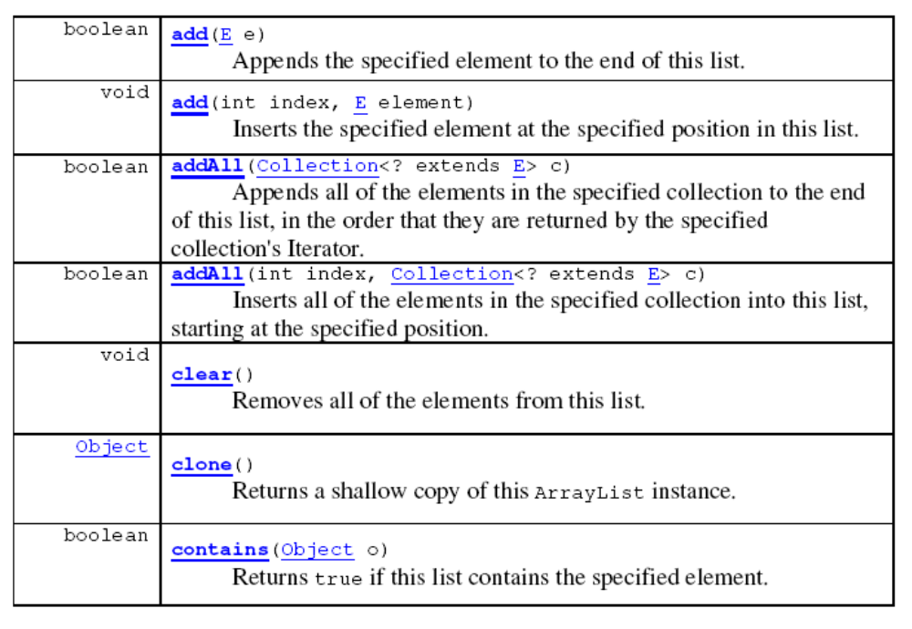
Some Methods in the Class ArrayList

Slide 16
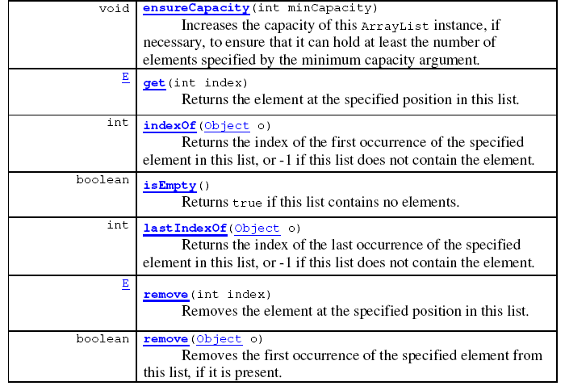
Some Methods in the Class ArrayList

Slide 17
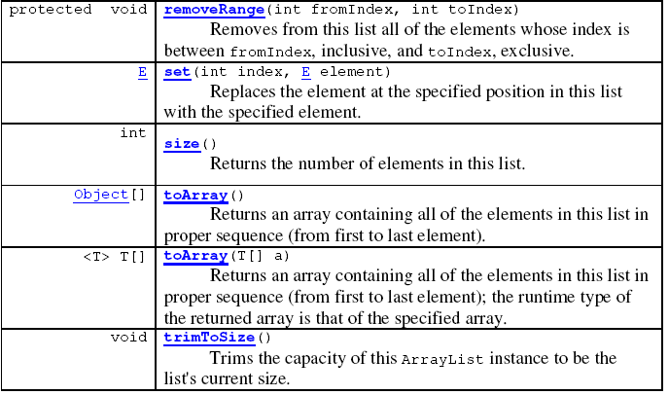
Some Methods in the Class ArrayList

Slide 18
Why are Some Parameters of Type Base_Type and Others of type Object
When looking at the methods available in the ArrayList class, there appears to be some inconsistency
  In some cases, when a parameter is naturally an object of the base type, the parameter type is the base type
  However, in other cases, it is the type Object
This is because the ArrayList class implements a number of interfaces, and inherits methods from various ancestor classes
  These interfaces and ancestor classes specify that certain parameters have type Object
Copyright © 2008 Pearson Addison-Wesley. All rights reserved
14-<number>

Slide 19
The "For Each" Loop
The ArrayList class is an example of a collection class
Starting with version 5.0, Java has added a new kind of for loop called a for-each or enhanced for loop
  This kind of loop has been designed to cycle through all the elements in a collection (like an ArrayList)
Copyright © 2008 Pearson Addison-Wesley. All rights reserved
14-<number>

Slide 20
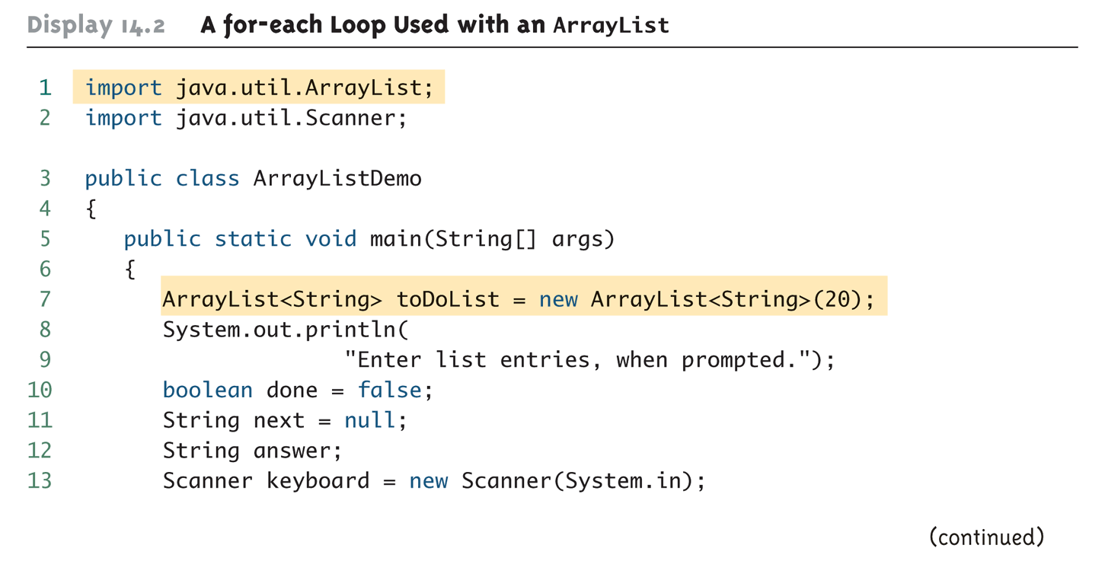
A for-each Loop Used with an ArrayList (Part 1 of 3)
Copyright © 2008 Pearson Addison-Wesley. All rights reserved
14-<number>

Slide 21
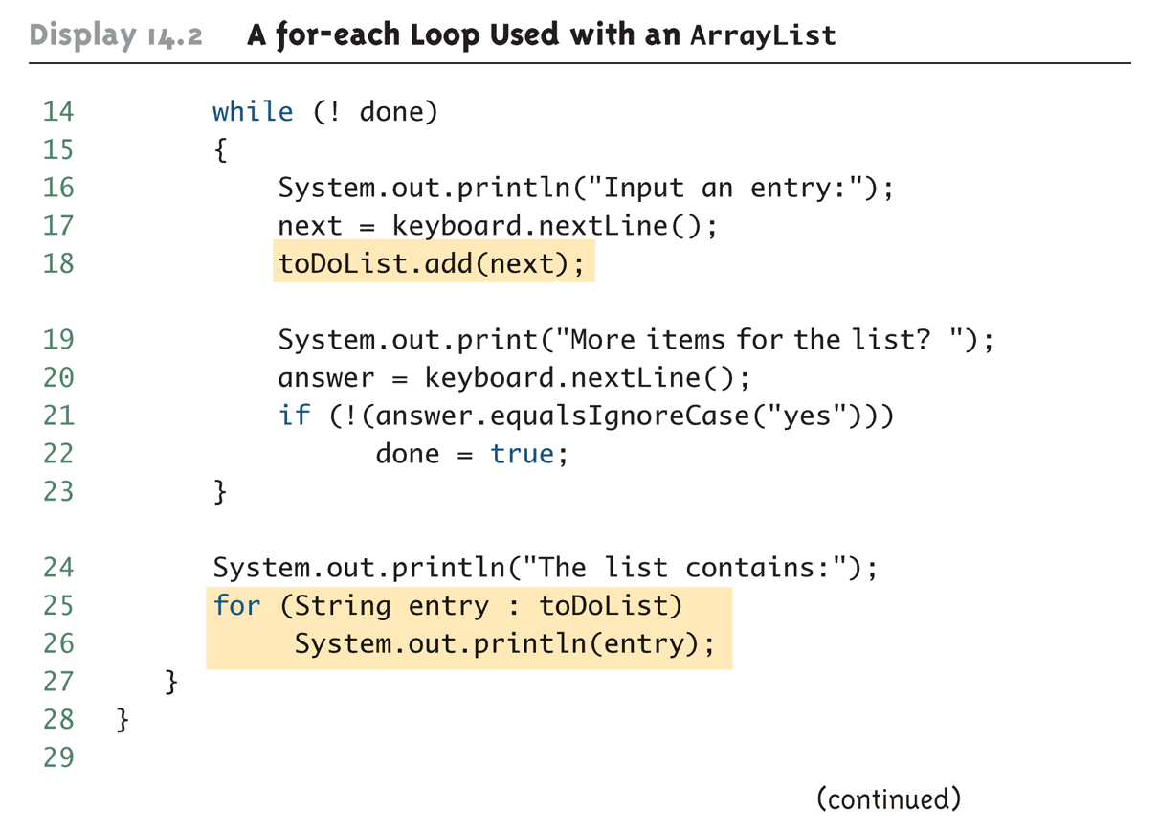
A for-each Loop Used with an ArrayList (Part 2 of 3)
Copyright © 2008 Pearson Addison-Wesley. All rights reserved
14-<number>

Slide 22
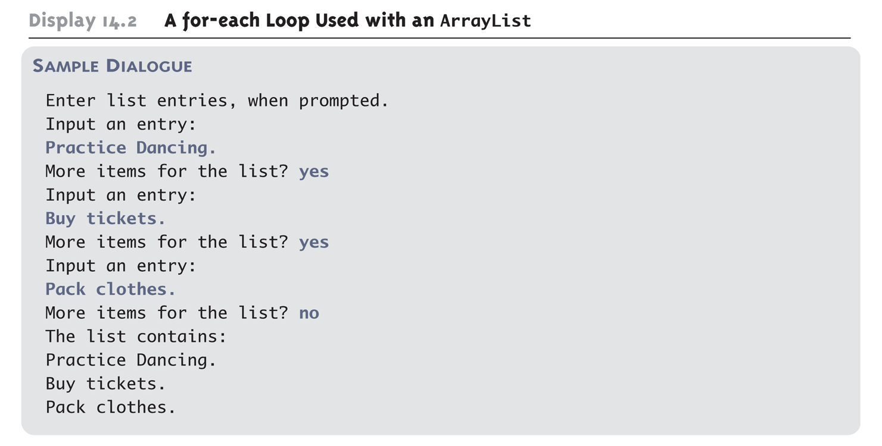
A for-each Loop Used with an ArrayList (Part 3 of 3)
Copyright © 2008 Pearson Addison-Wesley. All rights reserved
14-<number>

Slide 23
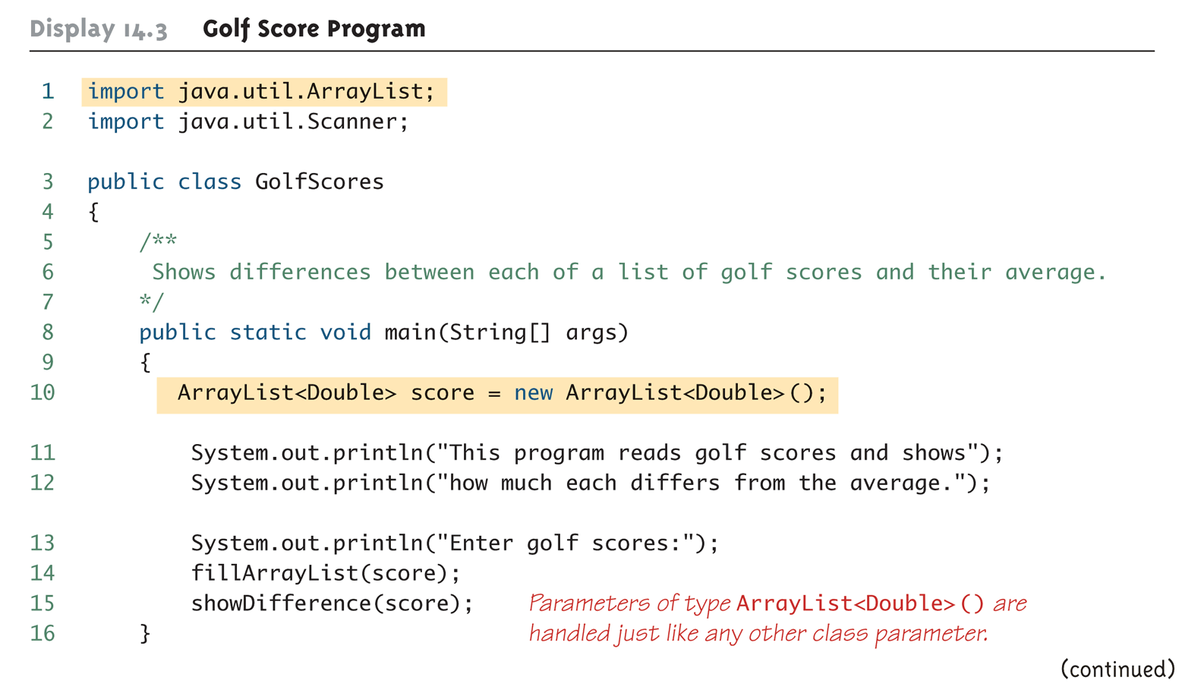
Golf Score Program (Part 1 of 6)
Copyright © 2008 Pearson Addison-Wesley. All rights reserved
14-<number>

Slide 24
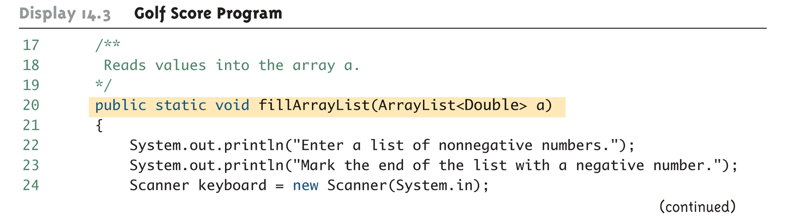
Golf Score Program (Part 2 of 6)
Copyright © 2008 Pearson Addison-Wesley. All rights reserved
14-<number>

Slide 25
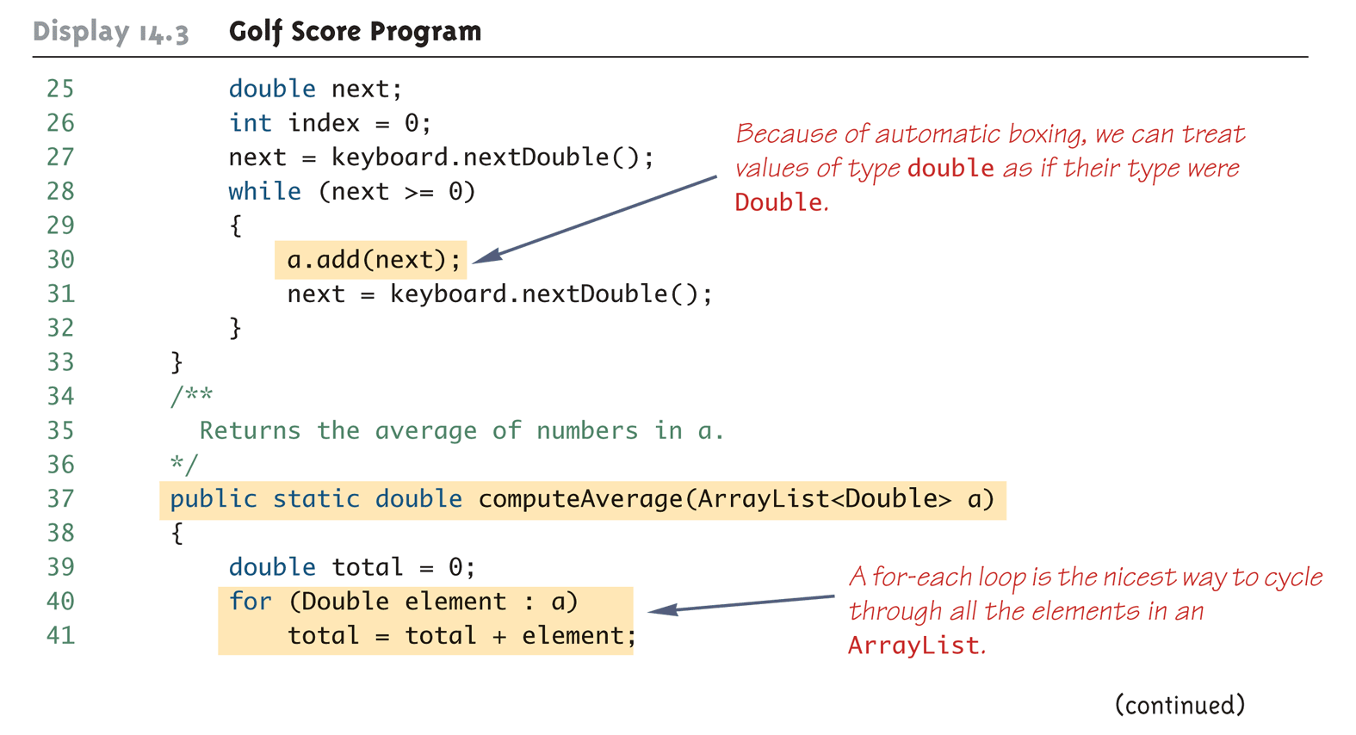
Golf Score Program (Part 3 of 6)
Copyright © 2008 Pearson Addison-Wesley. All rights reserved
14-<number>

Slide 26
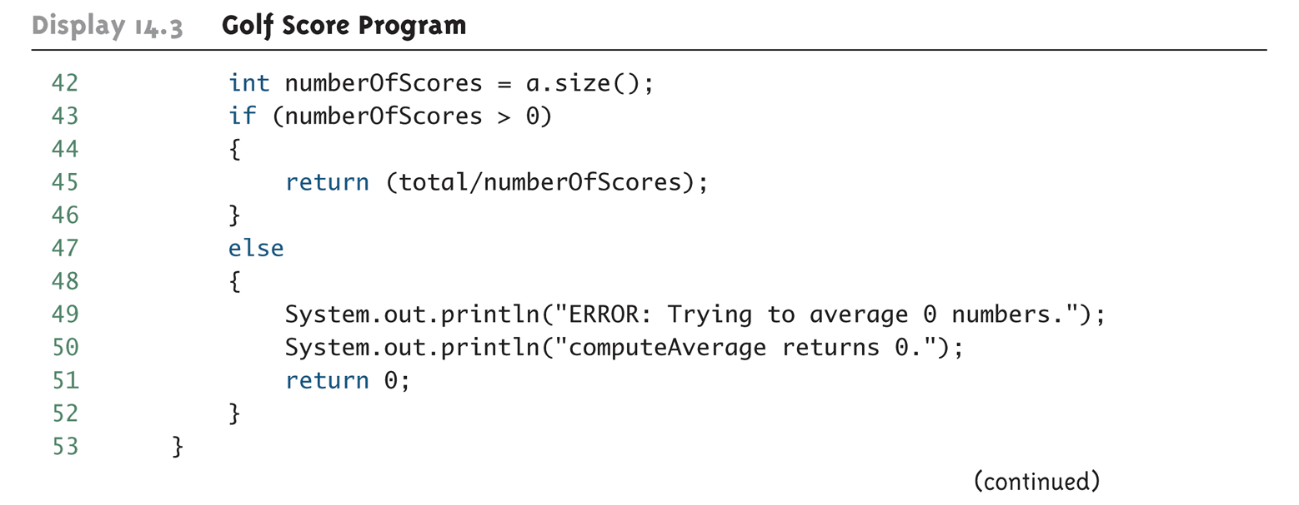
Golf Score Program (Part 4 of 6)
Copyright © 2008 Pearson Addison-Wesley. All rights reserved
14-<number>

Slide 27
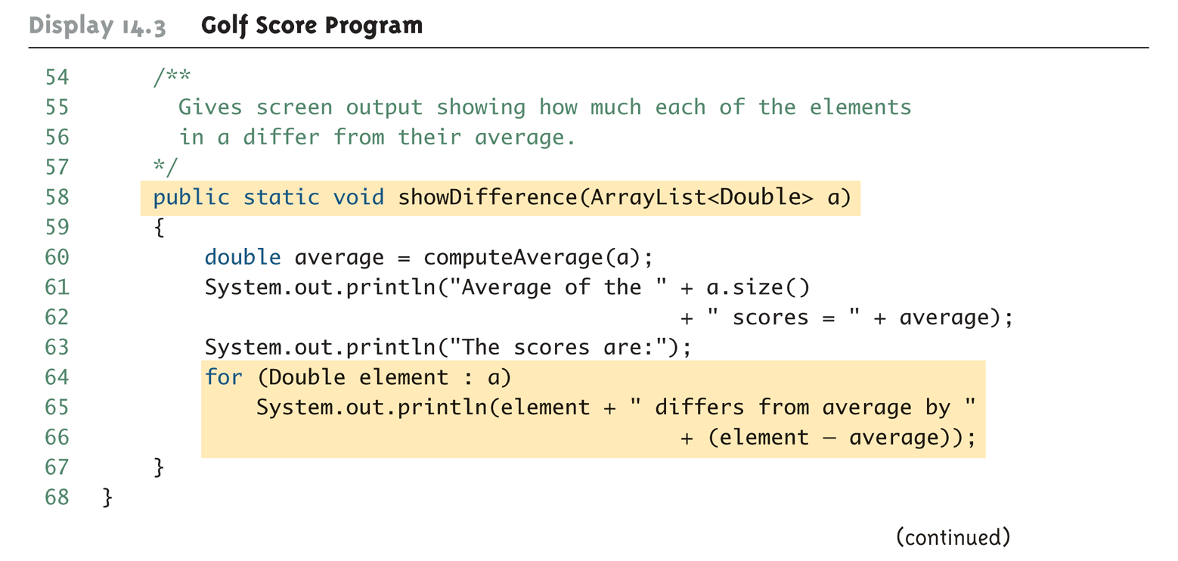
Golf Score Program (Part 5 of 6)
Copyright © 2008 Pearson Addison-Wesley. All rights reserved
14-<number>

Slide 28
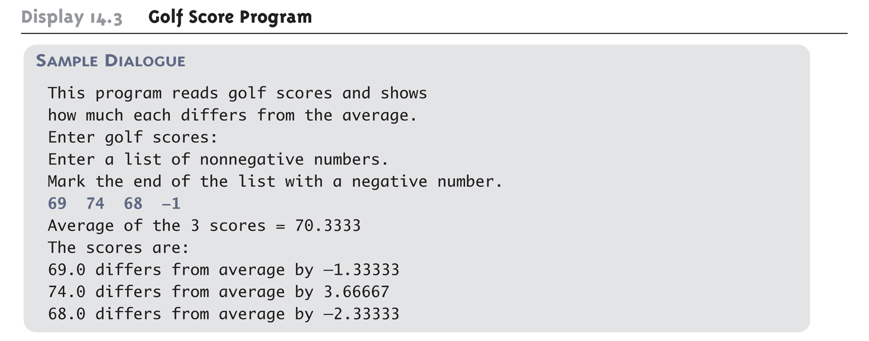
Golf Score Program (Part 6 of 6)
Copyright © 2008 Pearson Addison-Wesley. All rights reserved
14-<number>

Slide 29
Tip: Use trimToSize to Save Memory
An ArrayList automatically increases its capacity when needed
  However, the capacity may increase beyond what a program requires
  In addition, although an ArrayList grows automatically when needed, it does not shrink automatically
If an ArrayList has a large amount of excess capacity, an invocation of the method trimToSize will shrink the capacity of the ArrayList down to the size needed
Copyright © 2008 Pearson Addison-Wesley. All rights reserved
14-<number>

Slide 30
Pitfall: The clone method Makes a Shallow Copy
When a deep copy of an ArrayList is needed, using the clone method is not sufficient
  Invoking clone on an ArrayList object produces a shallow copy, not a deep copy
In order to make a deep copy, it must be possible to make a deep copy of objects of the base type
  Then a deep copy of each element in the ArrayList can be created and placed into a new ArrayList object
Copyright © 2008 Pearson Addison-Wesley. All rights reserved
14-<number>

Slide 31
The Vector Class
The Java standard libraries have a class named Vector that behaves almost exactly the same as the class ArrayList
In most situations, either class could be used
  However the ArrayList class is newer, and is becoming the preferred class
Copyright © 2008 Pearson Addison-Wesley. All rights reserved
14-<number>

Slide 32
Parameterized Classes and Generics
The class ArrayList is a parameterized class
It has a parameter, denoted by Base_Type, that can be replaced by any reference type to obtain a class for ArrayLists with the specified base type
Starting with version 5.0, Java allows class definitions with parameters for types
  These classes that have type parameters are called parameterized class or generic definitions, or, simply, generics
Copyright © 2008 Pearson Addison-Wesley. All rights reserved
14-<number>

Slide 33
Nonparameterized ArrayList and Vector Classes
The ArrayList and Vector classes discussed here have a type parameter for the base type
There are also ArrayList and Vector classes with no parameter whose base type is Object
  These classes are left over from earlier versions of Java
Copyright © 2008 Pearson Addison-Wesley. All rights reserved
14-<number>

Slide 34
Generics
Classes and methods can have a type parameter
  A type parameter can have any reference type (i.e., any class type) plugged in for the type parameter
  When a specific type is plugged in, this produces a specific class type or method
  Traditionally, a single uppercase letter is used for a type parameter, but any non-keyword identifier may be used
Copyright © 2008 Pearson Addison-Wesley. All rights reserved
14-<number>

Slide 35
Generics
A class definition with a type parameter is stored in a file and compiled just like any other class
Once a parameterized class is compiled, it can be used like any other class
  However, the class type plugged in for the type parameter must be specified before it can be used in a program
  Doing this is said to instantiate the generic class
    Sample<String> object =
    new Sample<String>();
Copyright © 2008 Pearson Addison-Wesley. All rights reserved
14-<number>

Slide 36
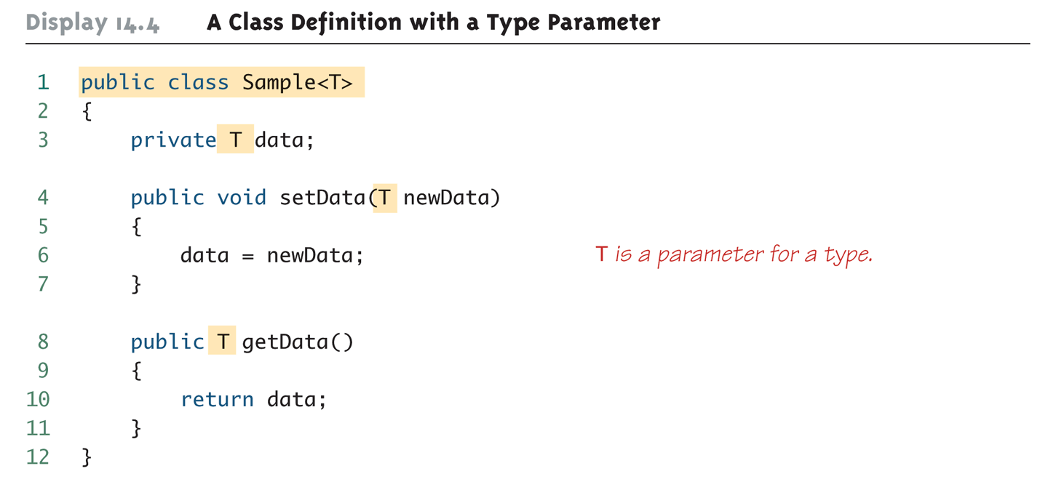
A Class Definition with a Type Parameter
Copyright © 2008 Pearson Addison-Wesley. All rights reserved
14-<number>

Slide 37
Class Definition with a Type Parameter
A class that is defined with a parameter for a type is called a generic class or a parameterized class
  The type parameter is included in angular brackets after the class name in the class definition heading
  Any non-keyword identifier can be used for the type parameter, but by convention, the parameter starts with an uppercase letter
  The type parameter can be used like other types used in the definition of a class
Copyright © 2008 Pearson Addison-Wesley. All rights reserved
14-<number>

Slide 38
Tip: Compile with the -Xlint Option
There are many pitfalls that can be encountered when using type parameters
Compiling with the -Xlint option will provide more informative diagnostics of any problems or potential problems in the code
  javac –Xlint Sample.java
Copyright © 2008 Pearson Addison-Wesley. All rights reserved
14-<number>

Slide 39
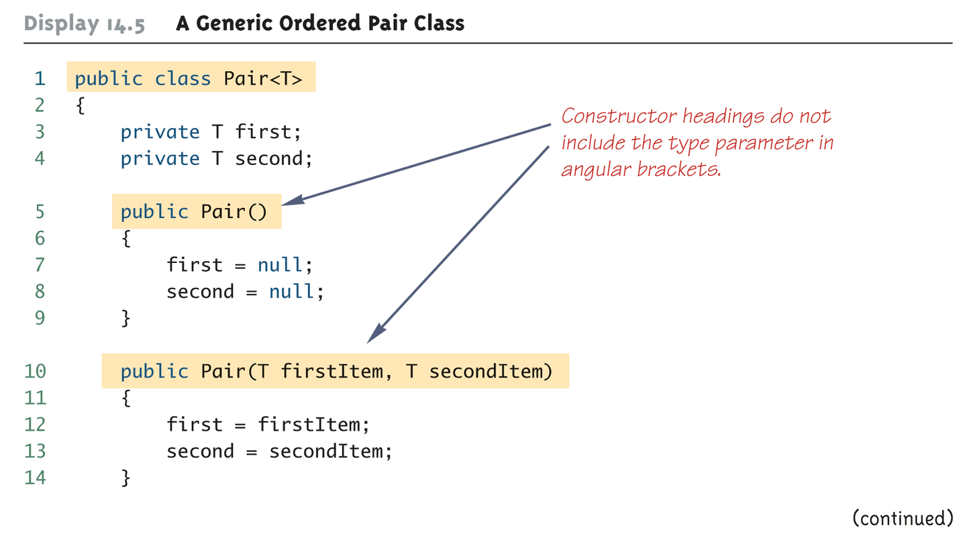
A Generic Ordered Pair Class (Part 1 of 4)
Copyright © 2008 Pearson Addison-Wesley. All rights reserved
14-<number>

Slide 40
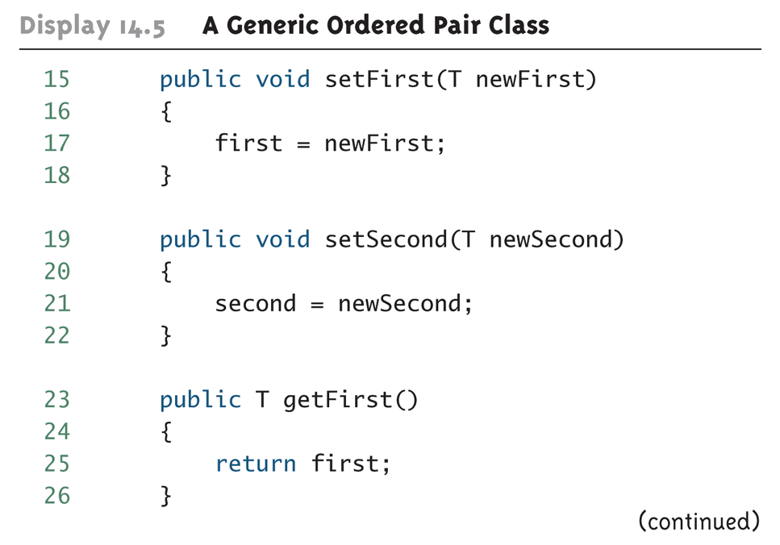
A Generic Ordered Pair Class (Part 2 of 4)
Copyright © 2008 Pearson Addison-Wesley. All rights reserved
14-<number>

Slide 41
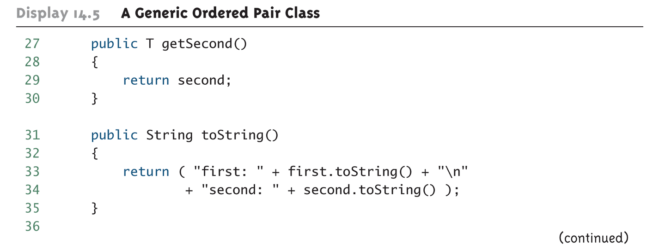
A Generic Ordered Pair Class (Part 3 of 4)
Copyright © 2008 Pearson Addison-Wesley. All rights reserved
14-<number>

Slide 42
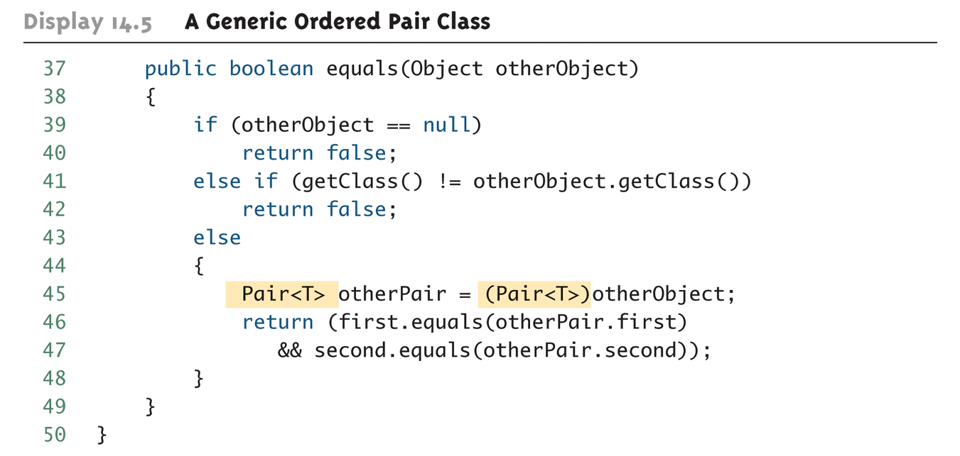
A Generic Ordered Pair Class (Part 4 of 4)
Copyright © 2008 Pearson Addison-Wesley. All rights reserved
14-<number>

Slide 43
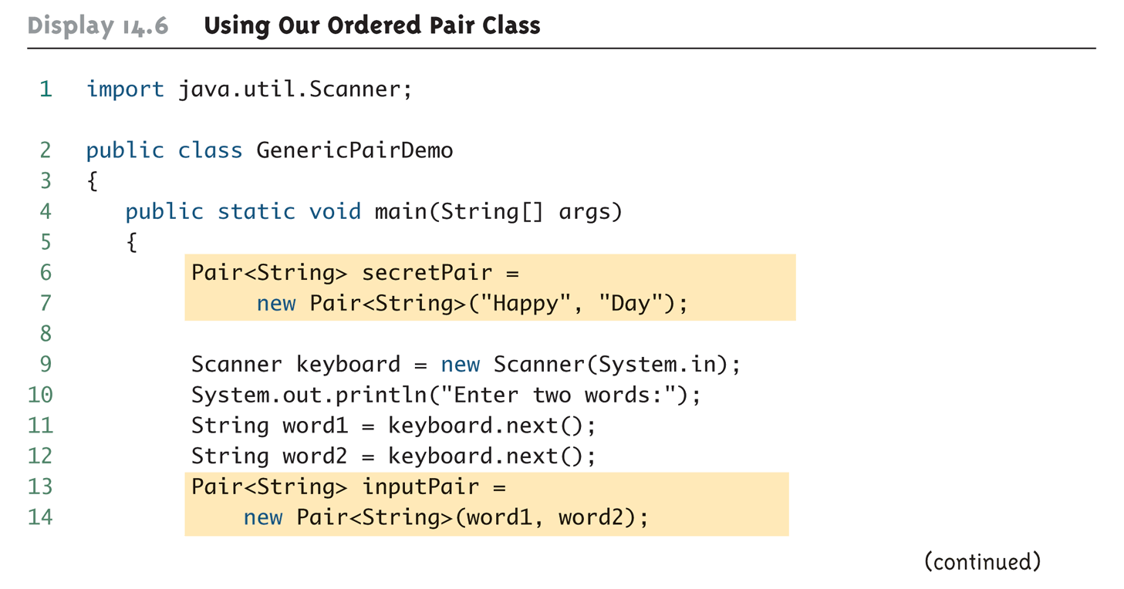
Using Our Ordered Pair Class (Part 1 of 3)
Copyright © 2008 Pearson Addison-Wesley. All rights reserved
14-<number>

Slide 44
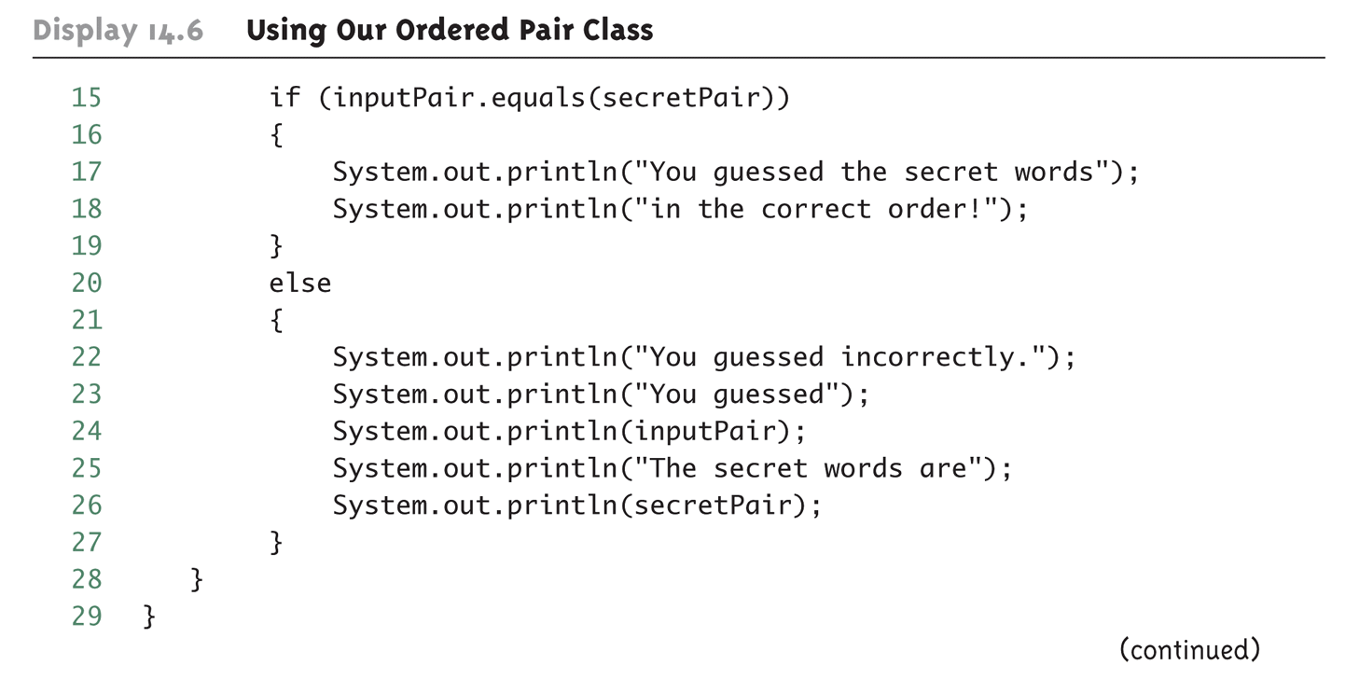
Using Our Ordered Pair Class (Part 2 of 3)
Copyright © 2008 Pearson Addison-Wesley. All rights reserved
14-<number>

Slide 45
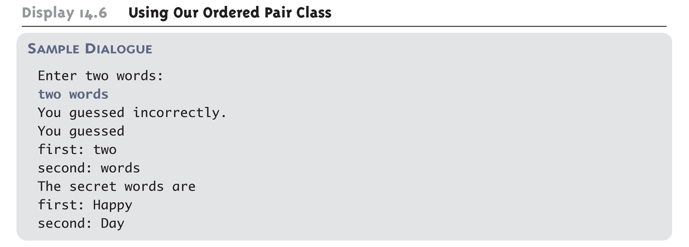
Using Our Ordered Pair Class (Part 3 of 3)
Copyright © 2008 Pearson Addison-Wesley. All rights reserved
14-<number>

Slide 46
Pitfall: A Generic Constructor Name Has No Type Parameter
Although the class name in a parameterized class definition has a type parameter attached, the type parameter is not used in the heading of the constructor definition
    public Pair<T>()
A constructor can use the type parameter as the type for a parameter of the constructor, but in this case, the angular brackets are not used
    public Pair(T first, T second)
However, when a generic class is instantiated, the angular brackets are used
    Pair<String> pair =
    new Pair<STring>("Happy", "Day");
Copyright © 2008 Pearson Addison-Wesley. All rights reserved
14-<number>

Slide 47
Pitfall: A Primitive Type Cannot be Plugged in for a Type Parameter
The type plugged in for a type parameter must always be a reference type
  It cannot be a primitive type such as int, double, or char
  However, now that Java has automatic boxing, this is not a big restriction
  Note: reference types can include arrays
Copyright © 2008 Pearson Addison-Wesley. All rights reserved
14-<number>

Slide 48
Pitfall: A Type Parameter Cannot Be Used Everywhere a Type Name Can Be Used
Within the definition of a parameterized class definition, there are places where an ordinary class name would be allowed, but a type parameter is not allowed
In particular, the type parameter cannot be used in simple expressions using new to create a new object
  For instance, the type parameter cannot be used as a constructor name or like a constructor:
    T object = new T();
    T[] a = new T[10];
Copyright © 2008 Pearson Addison-Wesley. All rights reserved
14-<number>

Slide 49
Pitfall: An Instantiation of a Generic Class Cannot be an Array Base Type
Arrays such as the following are illegal:
  Pair<String>[] a =
  new Pair<String>[10];
  Although this is a reasonable thing to want to do, it is not allowed given the way that Java implements generic classes
Copyright © 2008 Pearson Addison-Wesley. All rights reserved
14-<number>

Slide 50
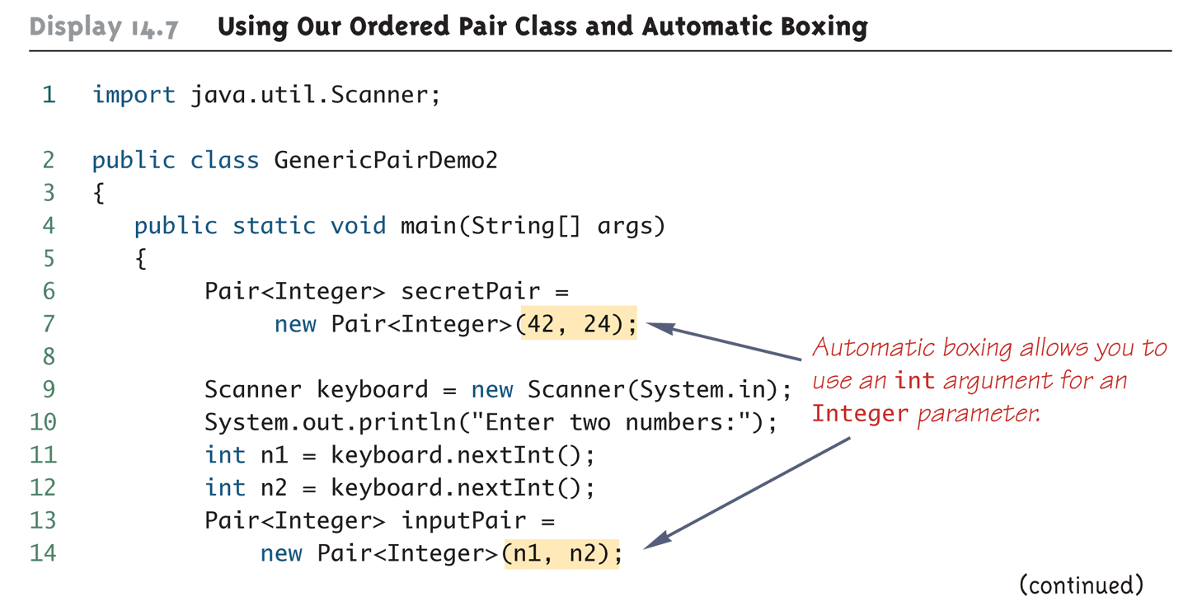
Using Our Ordered Pair Class and Automatic Boxing (Part 1 of 3)
Copyright © 2008 Pearson Addison-Wesley. All rights reserved
14-<number>

Slide 51
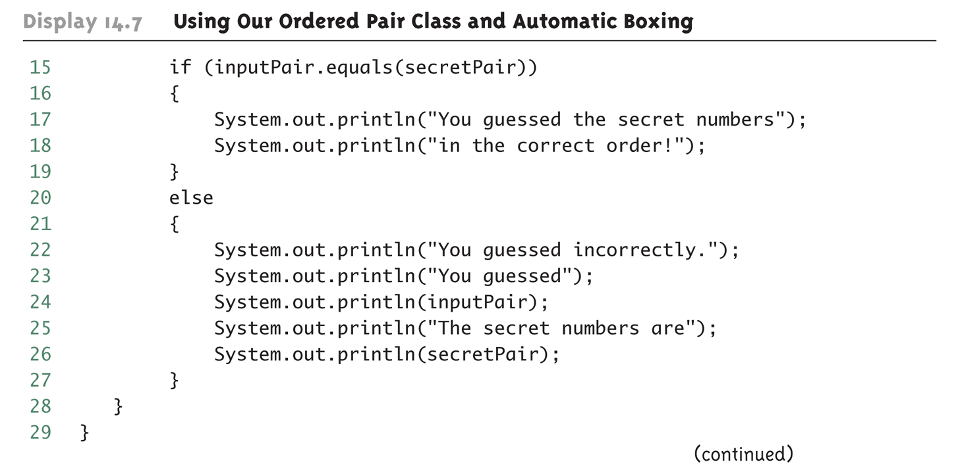
Using Our Ordered Pair Class and Automatic Boxing (Part 2 of 3)
Copyright © 2008 Pearson Addison-Wesley. All rights reserved
14-<number>

Slide 52
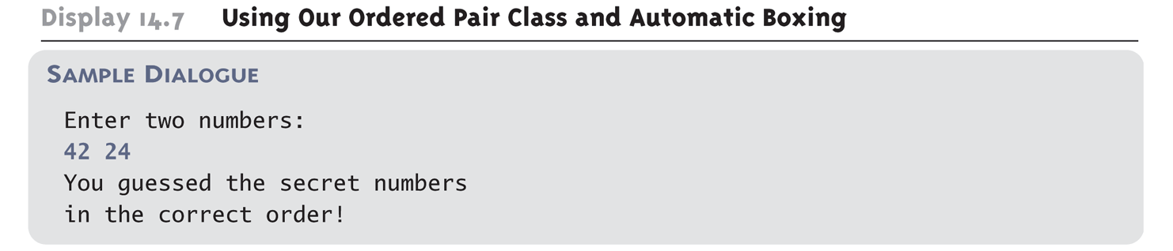
Using Our Ordered Pair Class and Automatic Boxing (Part 3 of 3)
Copyright © 2008 Pearson Addison-Wesley. All rights reserved
14-<number>

Slide 53
Pitfall: A Class Definition Can Have More Than One Type Parameter
A generic class definition can have any number of type parameters
  Multiple type parameters are listed in angular brackets just as in the single type parameter case, but are separated by commas
Copyright © 2008 Pearson Addison-Wesley. All rights reserved
14-<number>

Slide 54
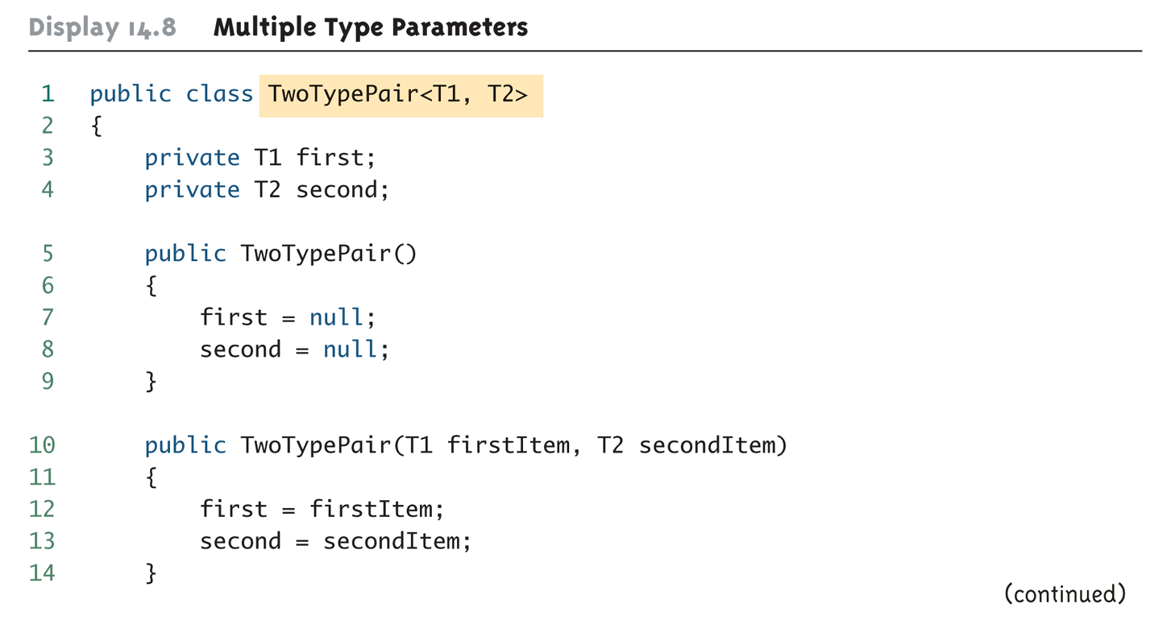
Multiple Type Parameters (Part 1 of 4)
Copyright © 2008 Pearson Addison-Wesley. All rights reserved
14-<number>

Slide 55
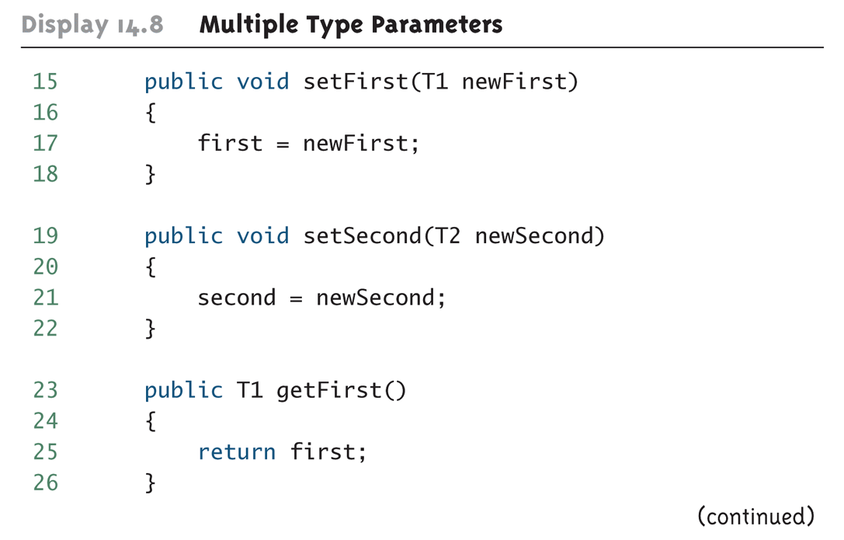
Multiple Type Parameters (Part 2 of 4)
Copyright © 2008 Pearson Addison-Wesley. All rights reserved
14-<number>

Slide 56
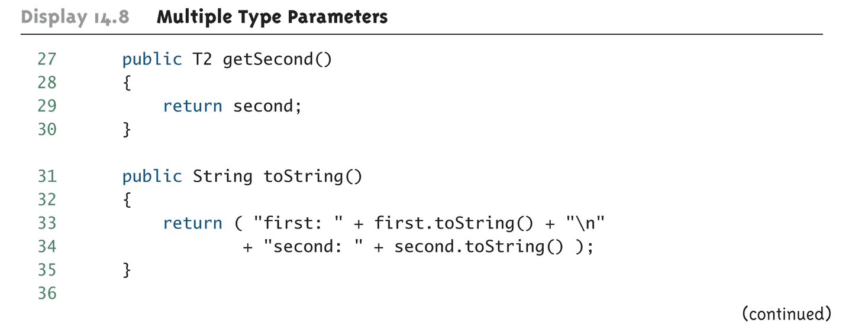
Multiple Type Parameters (Part 3 of 4)
Copyright © 2008 Pearson Addison-Wesley. All rights reserved
14-<number>

Slide 57
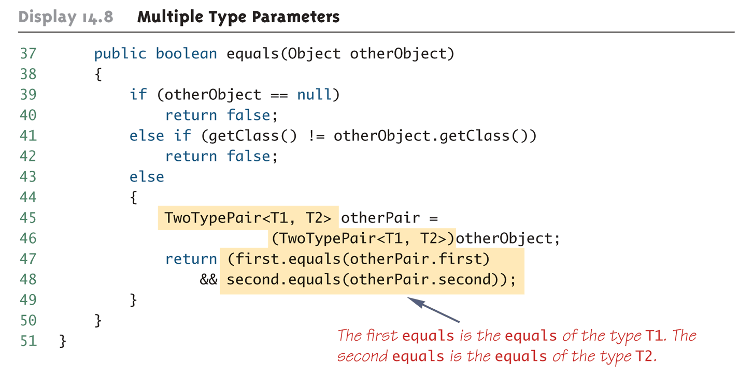
Multiple Type Parameters (Part 4 of 4)
Copyright © 2008 Pearson Addison-Wesley. All rights reserved
14-<number>

Slide 58
Pitfall: A Generic Class Cannot Be an Exception Class
It is not permitted to create a generic class with Exception, Error, Throwable, or any descendent class of Throwable
  A generic class cannot be created whose objects are throwable
    public class GEx<T> extends Exception
  The above example will generate a compiler error message
Copyright © 2008 Pearson Addison-Wesley. All rights reserved
14-<number>

Slide 59
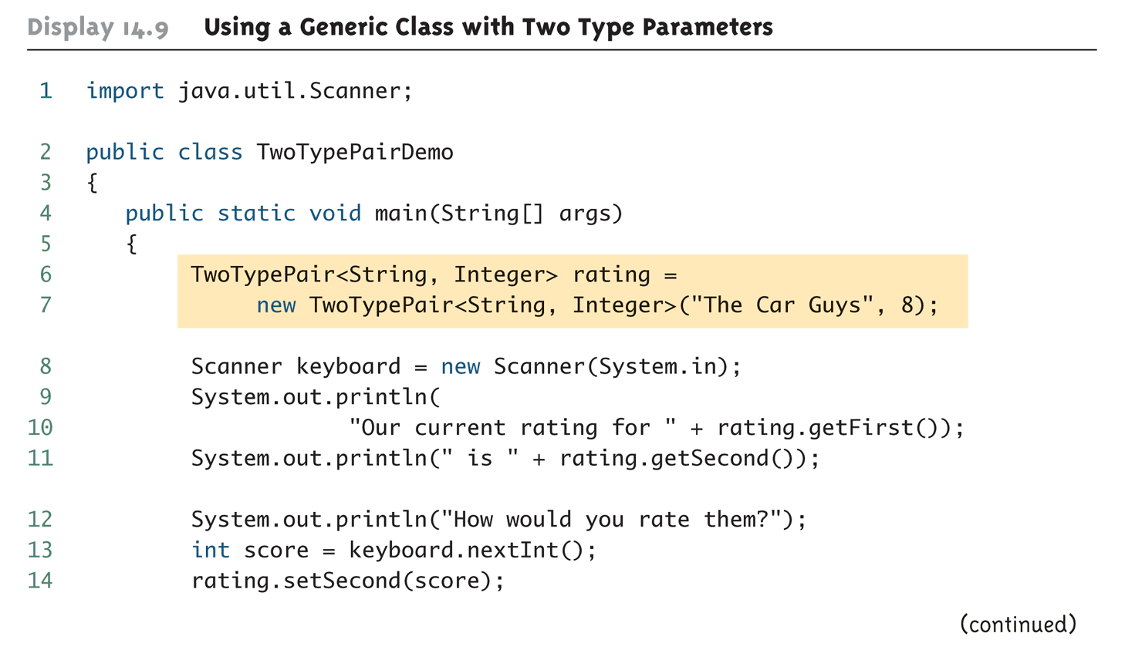
Using a Generic Class with Two Type Parameters (Part 1 of 2)
Copyright © 2008 Pearson Addison-Wesley. All rights reserved
14-<number>

Slide 60
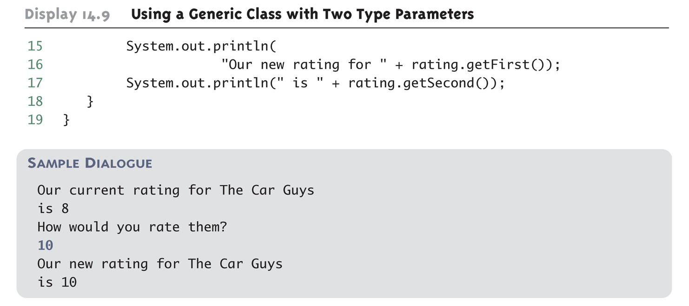
Using a Generic Class with Two Type Parameters (Part 2 of 2)
Copyright © 2008 Pearson Addison-Wesley. All rights reserved
14-<number>

Slide 61
Bounds for Type Parameters
Sometimes it makes sense to restrict the possible types that can be plugged in for a type parameter T
  For instance, to ensure that only classes that implement the Comparable interface are plugged in for T, define a class as follows:
    public class RClass<T extends Comparable>
  "extends Comparable" serves as a bound on the type parameter T
  Any attempt to plug in a type for T which does not implement the Comparable interface will result in a compiler error message
Copyright © 2008 Pearson Addison-Wesley. All rights reserved
14-<number>

Slide 62
Bounds for Type Parameters
A bound on a type may be a class name (rather than an interface name)
  Then only descendent classes of the bounding class may be plugged in for the type parameters
  public class ExClass<T extends Class1>
A bounds expression may contain multiple interfaces and up to one class
If there is more than one type parameter, the syntax is as follows:
  public class Two<T1 extends Class1, T2 extends Class2 & Comparable>
Copyright © 2008 Pearson Addison-Wesley. All rights reserved
14-<number>

Slide 63
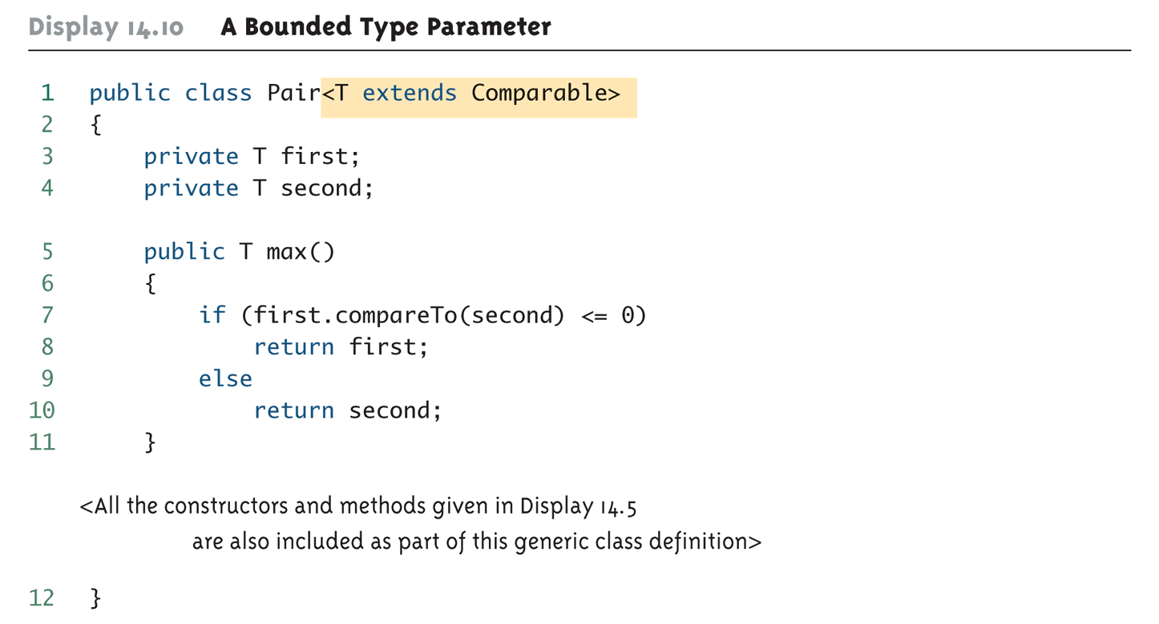
A Bounded Type Parameter
14-<number>

Slide 64
Tip: Generic Interfaces
An interface can have one or more type parameters
The details and notation are the same as they are for classes with type parameters
14-<number>

Slide 65
Generic Methods
When a generic class is defined, the type parameter can be used in the definitions of the methods for that generic class
In addition, a generic method can be defined that has its own type parameter that is not the type parameter of any class
  A generic method can be a member of an ordinary class or a member of a generic class that has some other type parameter
  The type parameter of a generic method is local to that method, not to the class
14-<number>

Slide 66
Generic Methods
The type parameter must be placed (in angular brackets) after all the modifiers, and before the returned type
  public static <T> T genMethod(T[] a)
When one of these generic methods is invoked, the method name is prefaced with the type to be plugged in, enclosed in angular brackets
  String s = NonG.<String>genMethod(c);
14-<number>

Slide 67
Inheritance with Generic Classes
A generic class can be defined as a derived class of an ordinary class or of another generic class
  As in ordinary classes, an object of the subclass type would also be of the superclass type
Given two classes: A and B, and given G: a generic class, there is no relationship between G<A> and G<B>
  This is true regardless of the relationship between class A and B, e.g., if class B is a subclass of class A
14-<number>

Slide 68
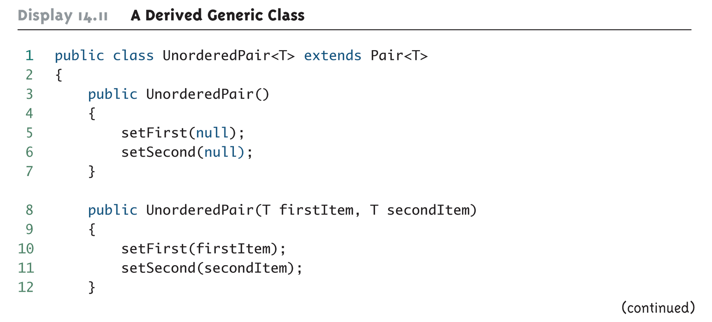
A Derived Generic Class (Part 1 of 2)
Copyright © 2008 Pearson Addison-Wesley. All rights reserved
14-<number>

Slide 69
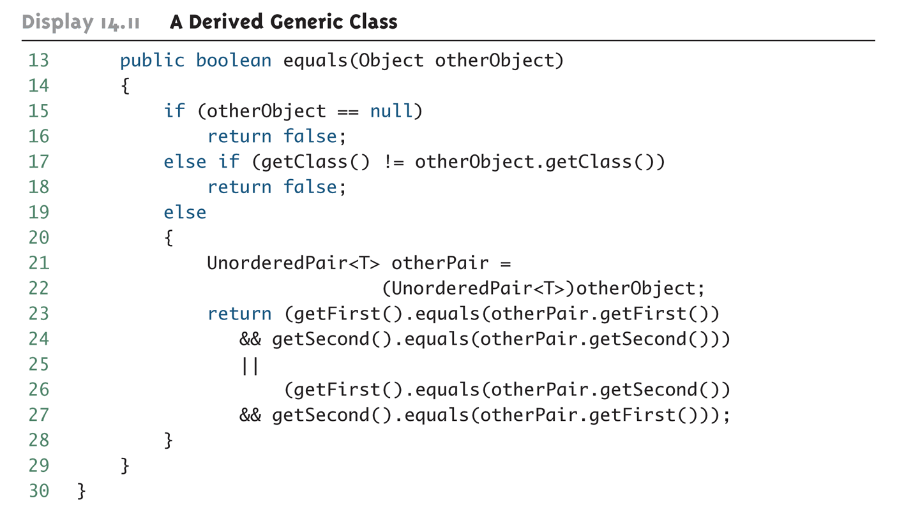
A Derived Generic Class (Part 2 of 2)
14-<number>

Slide 70
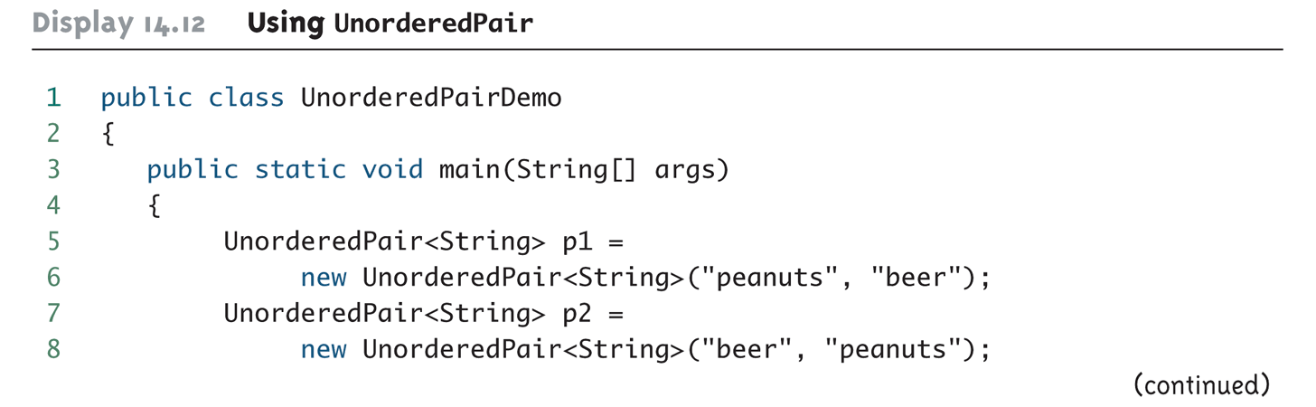
Using UnorderedPair (Part 1 of 2)
14-<number>

Slide 71
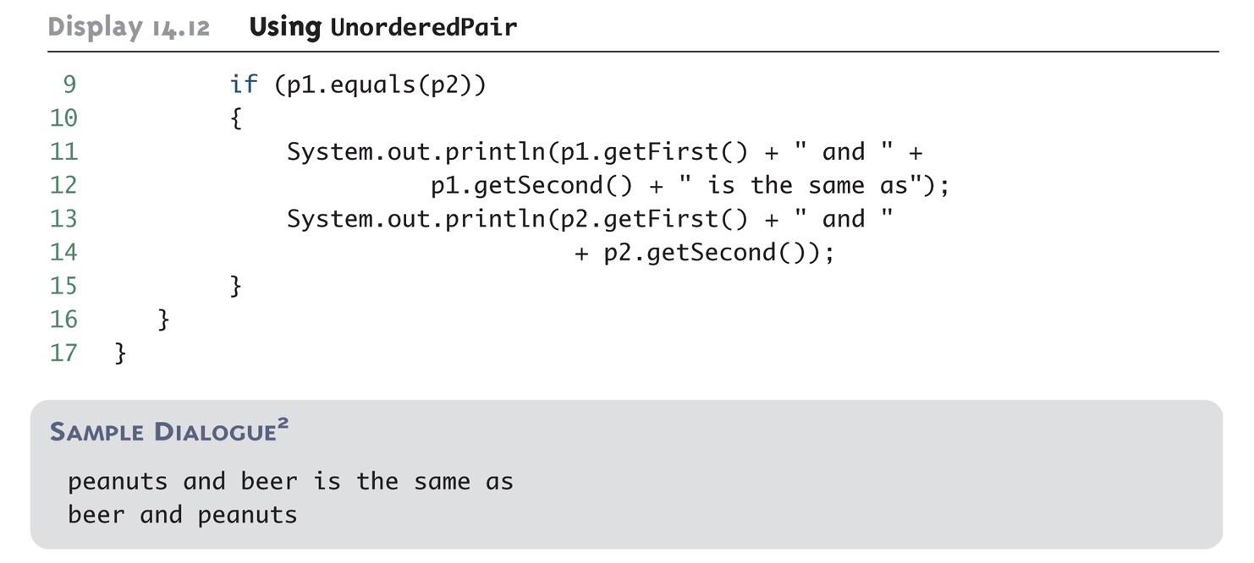
Using UnorderedPair (Part 2 of 2)
14-<number>

