Slide 1
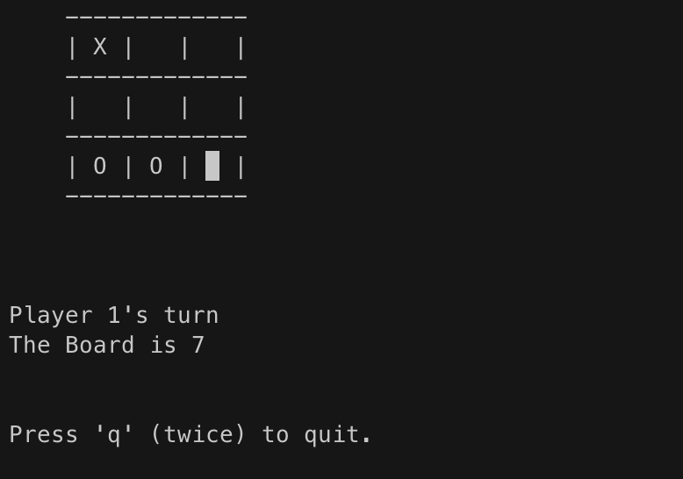
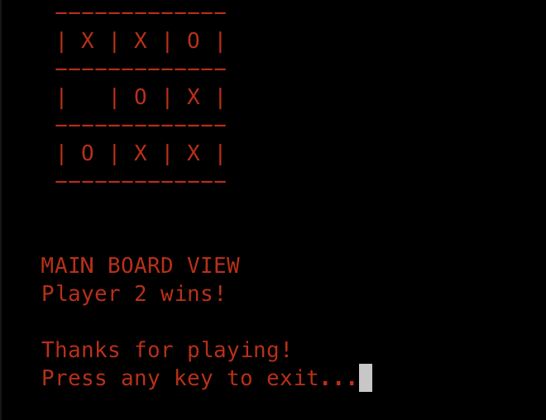
Computer Science 210 Tic-Tac-Ception
A (school appropriate) picture goes here.
Tomis Hamilton
M6

Slide 2
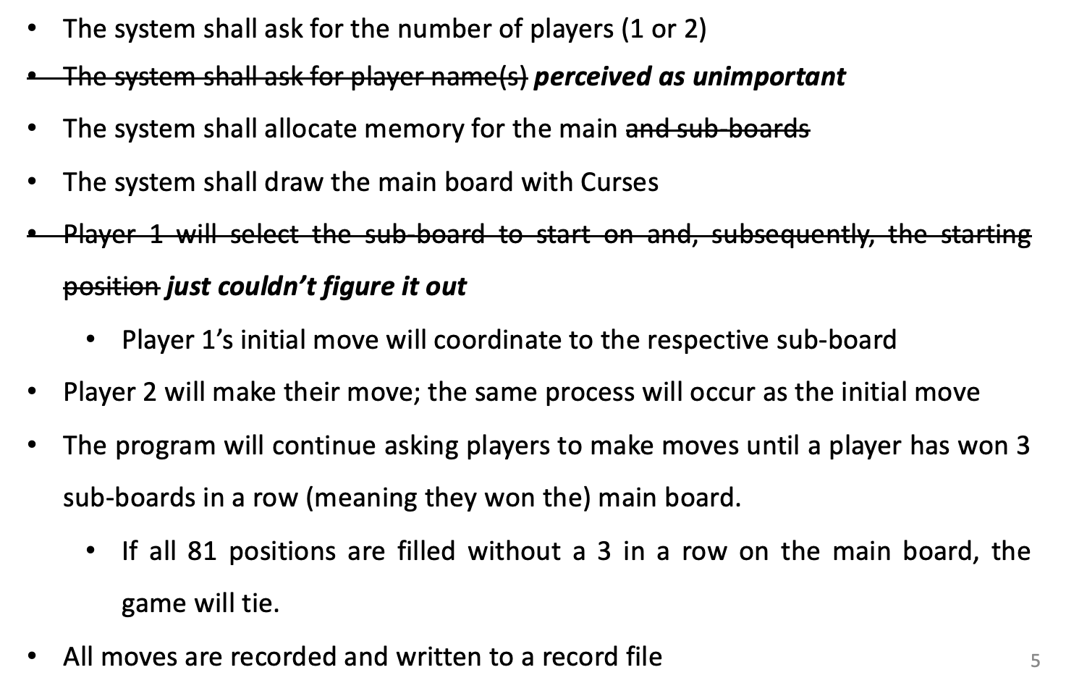
Project Summary
This project seeks to replicate Ultimate Tic-Tac-Toe
- It’s Tic-Tac-Toe within itself

Slide 3
Core Functionality
Basic Programming Skills (pick 5 of the 6)
Pointer use with dynamic memory (malloc and free)
Pointers as a key component of a data structure
Processing of Array Data
File I/O
Structs
String manipulation
Advanced Programming Skills (pick 1 of the 5)
2D Arrays (dynamic size)
Recursion
Linked List (or some other advanced data structure)
A GUI (xwindows for Ubuntu)
Some other advanced skill (approve with your instructor)

Slide 4
Project Evaluation
What went well?
Early display of board with ncurses
Solved major input issue
Adding additional, unplanned features
Test cases
What went wrong?
Had a major roadblock: wrong board was updating on user input
Unable to properly display the full (9x9) board properly
Functions are almost completely different than the original design
Unable to implement starting board selection

Slide 5
Estimates vs. Reality
INSTRUCTIONS: Fill out the table.
 | Estimate from Design | Actual
# of Lines (Main Program): | N/A (main) 600 (functions) | 68 (main) 621 Lines (functions)
# of Lines (Test Bench): | 70 Lines | 132 Lines
# of Hours: | 6 Hours | >24 Hours
What do you think the biggest challenge will be? | Using ncurses library | Properly updating the board with user inputs

Slide 6
Live Demo

