Slide 1
Computer Science 210 Final Project Design
C3C Tomis Hamilton
M6

Slide 2
Documentation Statement
None

Slide 3
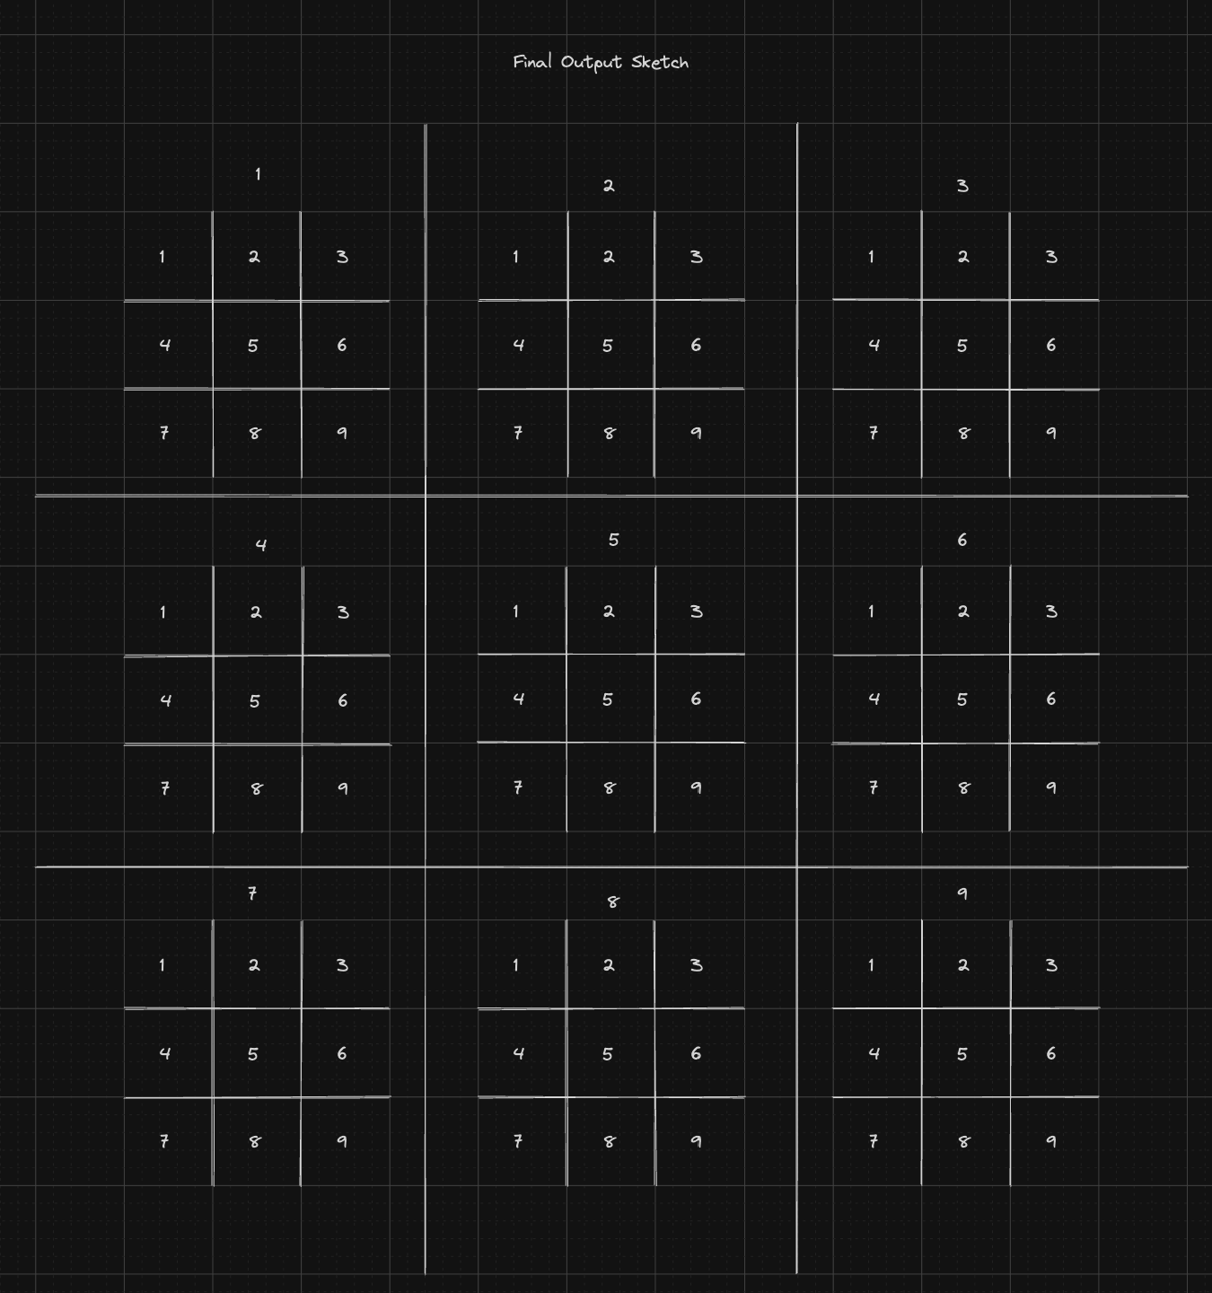
User Interface Sketch

Slide 4
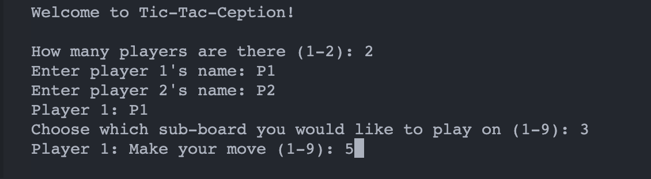
User Interface Sketch cont.
Terminal Display of Game Initialization

Slide 5
Functional Requirements
INSTRUCTIONS: This is a bulleted list of items explaining what your program shall do.
The system shall ask for the number of players (1 or 2)
The system shall ask for player name(s) perceived as unimportant
The system shall allocate memory for the main and sub-boards
The system shall draw the main board with Curses
Player 1 will select the sub-board to start on and, subsequently, the starting position just couldn’t figure it out
Player 1’s initial move will coordinate to the respective sub-board
Player 2 will make their move; the same process will occur as the initial move
The program will continue asking players to make moves until a player has won 3 sub-boards in a row (meaning they won the) main board.
If all 81 positions are filled without a 3 in a row on the main board, the game will tie.
All moves are recorded and written to a record file

Slide 6
Functional Decomposition
Copy and paste the below table for each function in your program
You will definitely need multiple slides for this section
Function: | main()
Description: | Starts the program
Inputs: | Nothing
Returns: | Nothing
Function: | createBoard()
Description: | Creates the game boards
Inputs: | None
Returns: | A pointer to the array of structs (sub-boards)
Function: | playerMove(Struct* board)
Description: | Asks the player which square of the board to play on
Inputs: | The sub-board of the main struct to play on
Returns: | An int of square the player made a move on

Slide 7
Functional Decomposition cont.
Function: | checkWin(Struct* board)
Description: | Checks for a win or tie on the sub-boards and main board (3 in a row)
Inputs: | The subBoard to check
Returns: | The winner of the board (1 or 2); if no winner then tie (0)
Function: | updateBoard(Struct* board)
Description: | Refreshes board to display current data
Inputs: | Struct for main board
Returns: | Nothing (is void)
Function: | displayBoard()
Description: | Draws the board display with the ncurses library
Inputs: | The board and sub-board to display
Returns: | Nothing (is void)

Slide 8
Structure Chart
INSTRUCTIONS: This is a diagram explaining how functions in your program will call/use each other.
main()
createBoard()
Winner?
displayBoard()
updateBoard()
No
Yes
End program
playerMove()
checkWin()

Slide 9
Estimates
INSTRUCTIONS: Fill out the table.
# of Lines (Main Program): | ~600 Lines
# of Lines (Test Bench): | ~70 Lines
# of Hours: | ~6 Hours
What do you think the biggest challenge will be? | Utilizing the Ncurses Library to display the game properly with user input.

