Slide 1
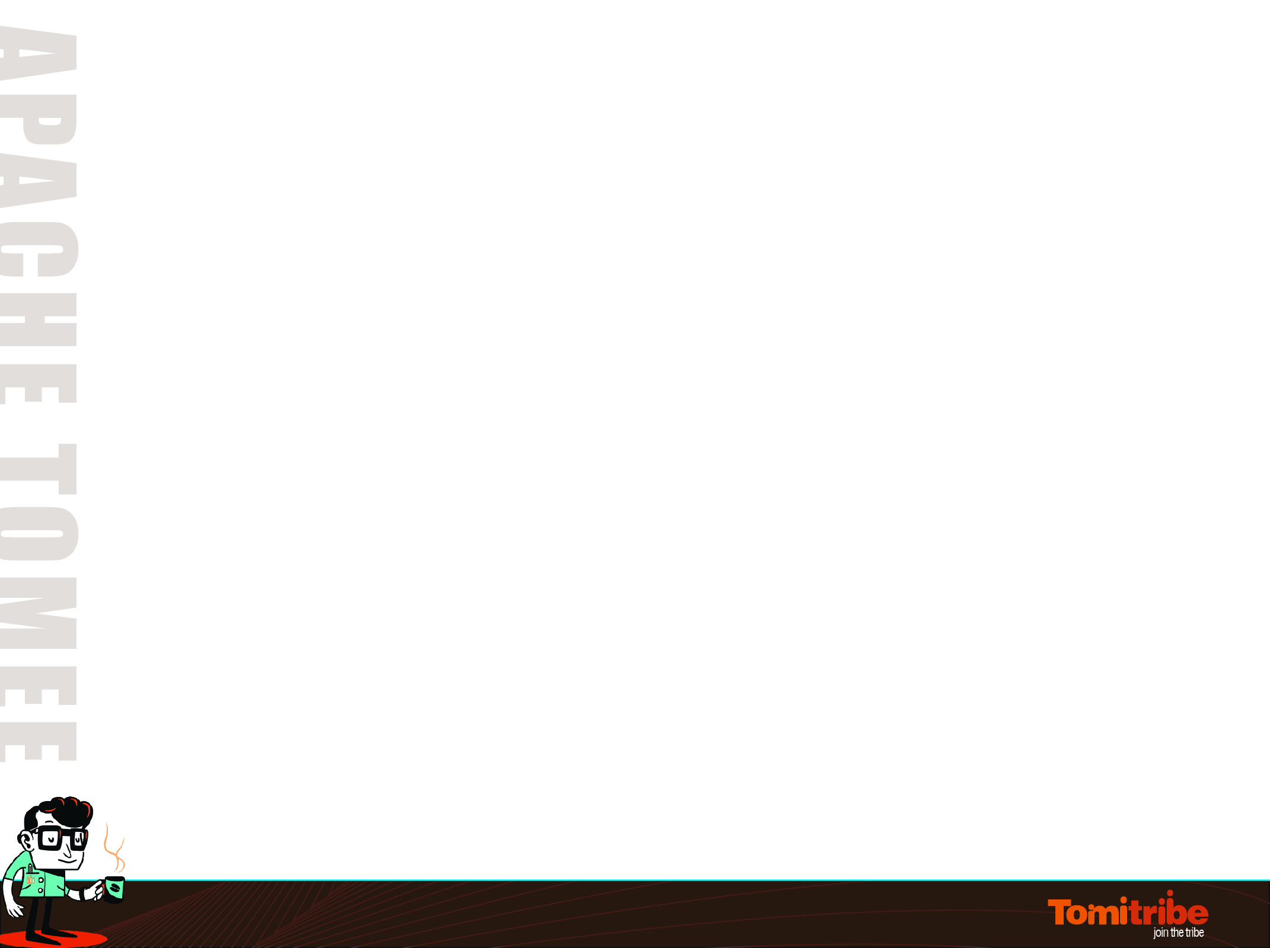
Apache Tomcat to Apache TomEE in 1 to n Steps
Andy Gumbrecht
@AndyGeeDe
#TomEE
Project - https://github.com/tomitribe/tomcat_to_tomee
@AndyGeeDe | #TomEE

Slide 2
Is Apache TomEE for Me?
Kathryn Janeway
Jonathan Archer
James T. Kirk
Jean-Luc Picard
Benjamin Sisko
You Yourchoice
The new guy who is going to die (The one in the red top!)
@AndyGeeDe | #TomEE

Slide 3
Apache Tomcat, Naked
A legacy application, maybe yours...
JSP
The scary stuff everyone said
was the next big thing...
Servlets
Apache Tomcat
@AndyGeeDe | #TomEE

Slide 4
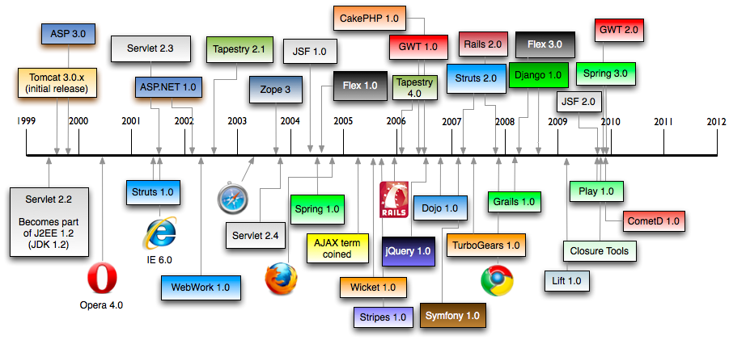
Which one did you pick?
@AndyGeeDe | #TomEE

Slide 5
TomEE opens doors...
A legacy application, maybe yours...
JSP
CDI
JSF
JPA
Servlets
JMA
EJB
JTA
JSTL
JAAS
JACC
Servlets
Apache Tomcat
@AndyGeeDe | #TomEE

Slide 6
'Status quo' - EE6
@AndyGeeDe | #TomEE

Slide 7
'Status quo' - EE6
@AndyGeeDe | #TomEE

Slide 8
Is Apache TomEE for Me?
Main bullet
  Sub-bullet
Main bullet
  Sub-bullet
@AndyGeeDe | #TomEE

