Slide 1
Andy Gumbrecht
@AndyGeeDe
http://www.tomitribe.com
Apache Tomcat to Apache TomEE
in 1 to n Steps
A guide on opening the doorway to Java EE in Apache TomEE
from an Apache Tomcat perspective
Project - https://github.com/tomitribe/tomcat_to_tomee

Slide 2
Is Apache TomEE for Me?
Kathryn Janeway
Jonathan Archer
James T. Kirk
Jean-Luc Picard
Benjamin Sisko
You Yourchoice
The new guy who is going to die (The one in the red top!)

Slide 3
A Look at Apache Tomcat
A legacy application, maybe yours...
JSP
The scary stuff everyone said
was the next big thing...
Servlets
Apache Tomcat

Slide 4
A Look at Apache TomEE
A legacy application, maybe yours...
JSP
CDI
JSF
JPA
Servlets
JMA
EJB
JTA
JSTL
JAAS
JAAC
Servlets
Apache Tomcat

Slide 5
A Look at Apache TomEE
A Legacy Application, Maybe Yours...
JSP
CDI
WS
REST
Servlets
JPA
EJB
JMS
JTA
Apache Tomcat
More...

Slide 6
Maintaining 'Status quo' - EE6
Latin phrase meaning 'the existing state of affairs'
JSR-245 JavaServer Pages 2.2
JSR-344 JavaServer Faces 2.2
JSR-341 Expression Language 3.0
JSR-339 The Java API for RESTful Web Services 2.0
JSR-340 Java Servlet 3.1
JSR-250 Common Annotations for Java Platform 1.1
JSR-318 Interceptors 1.1
JSR 346 Contexts and Dependency Injection for Java EE 1.1
JSR-345 Enterprise JavaBeans 3.2
JSR-322 Java EE Connector Architecture 1.7
JSR-338 Java Persistence 2.1
JSR-907 Java Transaction API 1.2
JSR-343 Java Message Service 2.0
JSR-349 Bean Validation 1.1
EJB Entity Beans Support
JAX-RPC 1.1 Support
JAXR 1.0
Java EE Application Deployment 1.2

Slide 7
Moving on, 'Tempora mutantur'
Latin phrase meaning 'times change'
JSR-245 JavaServer Pages 2.2
JSR-344 JavaServer Faces 2.2
JSR-341 Expression Language 3.0
JSR-339 The Java API for RESTful Web Services 2.0
JSR-340 Java Servlet 3.1
JSR-250 Common Annotations for Java Platform 1.1
JSR-318 Interceptors 1.1
JSR 346 Contexts and Dependency Injection for Java EE 1.1
JSR-345 Enterprise JavaBeans 3.2
JSR-322 Java EE Connector Architecture 1.7
JSR-338 Java Persistence 2.1
JSR-907 Java Transaction API 1.2
JSR-343 Java Message Service 2.0
JSR-349 Bean Validation 1.1
EJB Entity Beans Support
JAX-RPC 1.1 Support
JAXR 1.0
Java EE Application Deployment 1.2

Slide 8
Focus on the Future – EE7, EE8
Roadmap EE7
JSR 356 - Java API for WebSockets
JSR 353 - Java API for JSON Processing (JSON-P)
JSR 352 - Batch Applications for the Java Platform
JSR 236 - Concurrency Utilities for Java EE
JSR-299 - CDI Portable Extensions
Roadmap EE8
JCache (JSR-107)
Java API for JSON Binding (JSR-TBD)
Java Configuration (JSR-TBD)

Slide 9
Still Thinking “Is it for Me”?
Jakarta Tomcat, aka Apache Tomcat is quite old (1999)
It is basically just a Web Server and Servlet Container
Tomcat extension is Ad-hoc at best
Old is good! Apache Tomcat is a very stable platform
Tomcat is 'the' platform upon which Apache TomEE sits
Apache TomEE is not in competition with Apache Tomcat
Apache TomEE is the opposite of Ad-hoc, it's certified
Notes:
End of Deepspace Nine, beginning Voyager

Slide 10
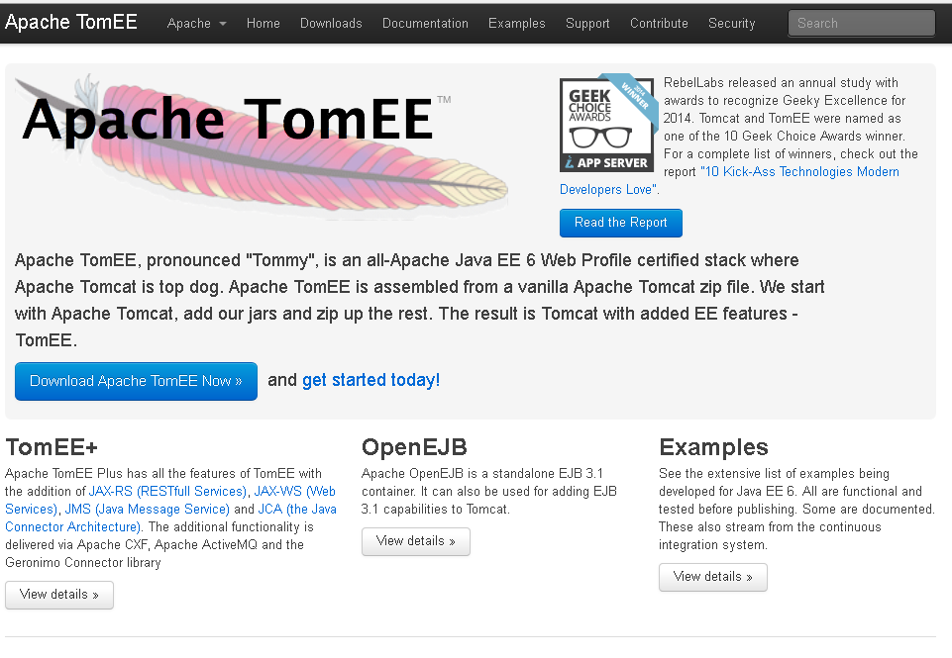

Slide 11
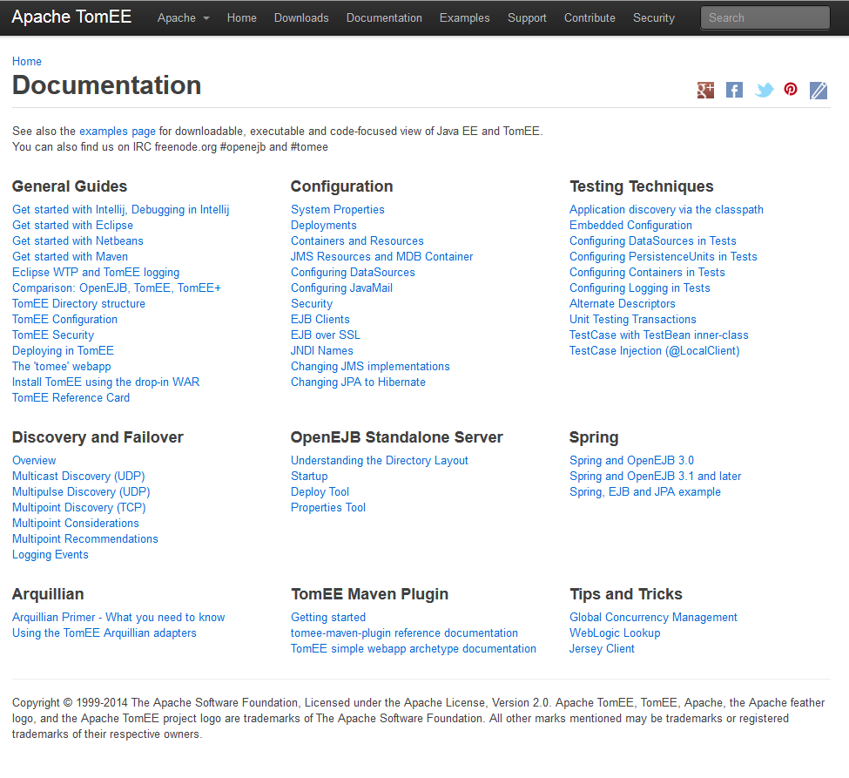

Slide 12
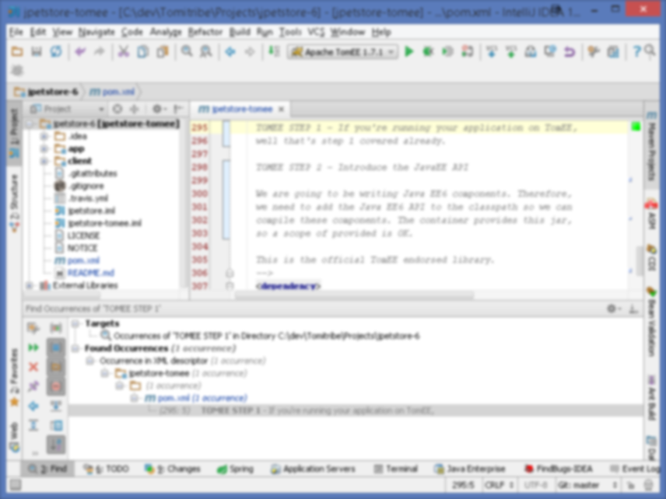
Enough already, it's code time...

Slide 13
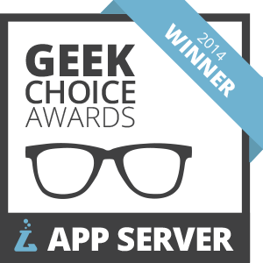


A Winning Choice

Slide 14
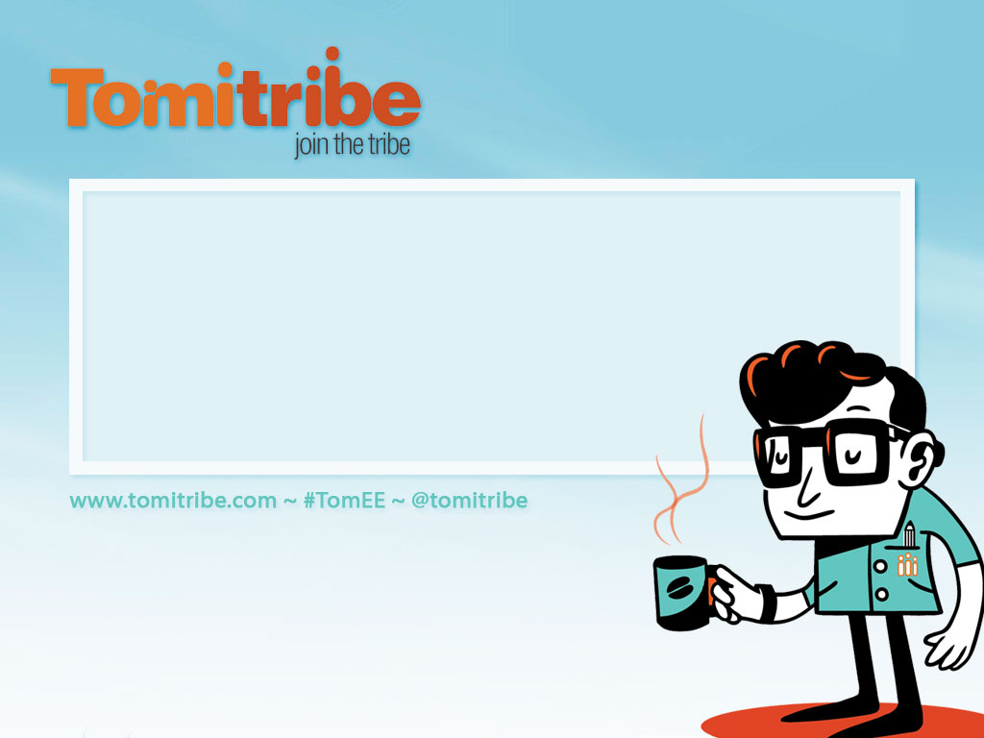
Andy Gumbrecht agumbrecht@tomitribe.com
@AndyGeeDe
Tomitribe Corporation
Leading Open Source Enterprise Service
Support Provider for Apache TomEE

Slide 15
Who are the tribe?
Tomitribe Corporation founded in Spring 2013
CEO David Blevins – Project lead on Apache- TomEE, OpenEJB and Geronimo projects. Member of the EJB 3.0 / 1 / 2 and Java EE 6 / 7 and 8 expert groups
Employees are Apache TomEE / OpenEJB developers
OpenWebBeans, DeltaSpike, Camel, CXF, Sirona, BatchEE and CREST committers
Community leaders

