Slide 1
Querying Sql Databases in R
Tom Jemmett MBCS AMIMA
Senior Healthcare Analyst thomas.jemmett@nhs.net GitHub: tomjemmett Twitter: @tom_jemmett

Slide 2
Who here use some kind of database server?
thomas.jemmett@nhs.net / @tom_jemmett

Slide 3
Packages needed
tidyverse (includes the DBI package)
odbc (works great if you have the required odbc drivers installed)
Packages designed for specific databases, i.e. RSQLite
RStudio have a fantastic database resource website for how to connect to specific database servers and what packages you need https://db.rstudio.com/databases/
We’re going to cover using the dplyr syntax for querying Sql databases, but check https://db.rstudio.com/getting-started/database-queries if you want to see how to write queries in RMarkdown Documents or directly query databases
thomas.jemmett@nhs.net / @tom_jemmett

Slide 4
Connect to a Server
First you need to connect to your server. For example, if you are connecting to a Microsoft SQL Server Database with Integrated (Windows) Authentication:
con <- DBI::dbConnect(odbc::odbc(),
"Driver" = "SQL Server",
"server" = "Server Name",
"Database" = "DB Name")
Replace the server name and database name as appropriate. If you need to connect to different database engines, or you need to connect with a username and password then have a look at
https://db.rstudio.com/best-practices/drivers/
https://db.rstudio.com/best-practices/managing-credentials/
thomas.jemmett@nhs.net / @tom_jemmett

Slide 5
tbl()
The tbl function works as a bridge between a table in the database and R
ae <- tbl(con, "ae_attendances")
ae <- tbl(con,
dbplr::in_schema("dbo","ae_attendances"))
ae <- tbl(con,
sql("SELECT * FROM dbo.ae_attendances"))
thomas.jemmett@nhs.net / @tom_jemmett

Slide 6
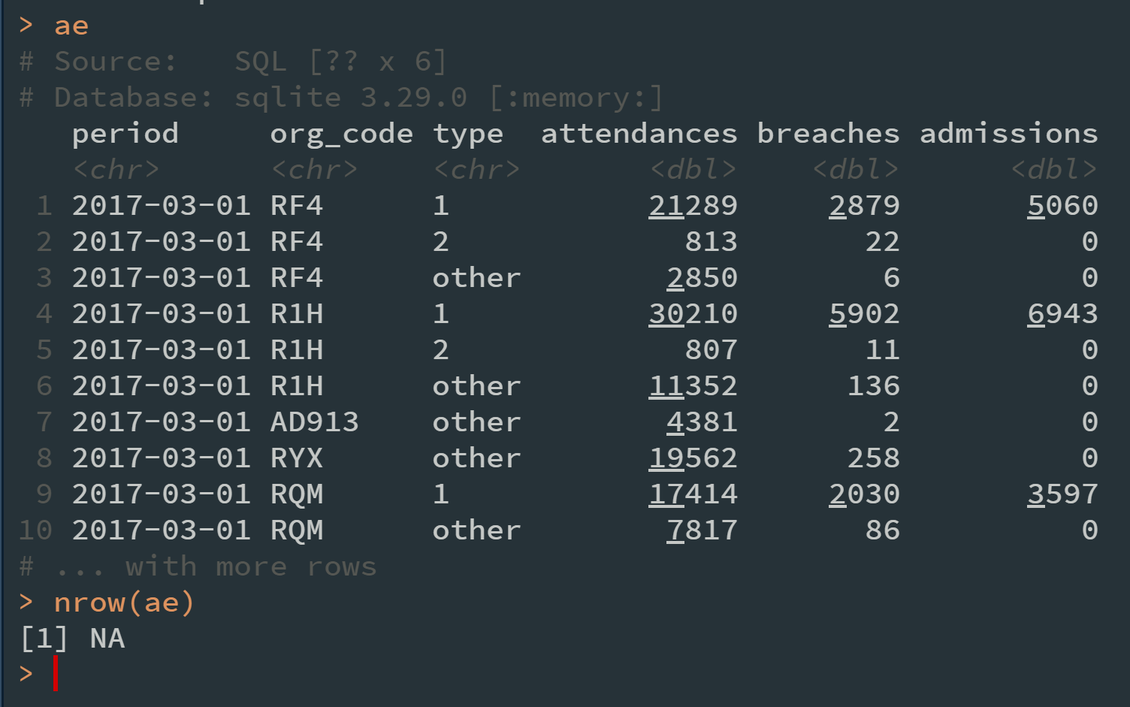
How many rows does our table have?
tbl() returns what looks like a tibble, so what happens when we inspect the ae object?
thomas.jemmett@nhs.net / @tom_jemmett

Slide 7
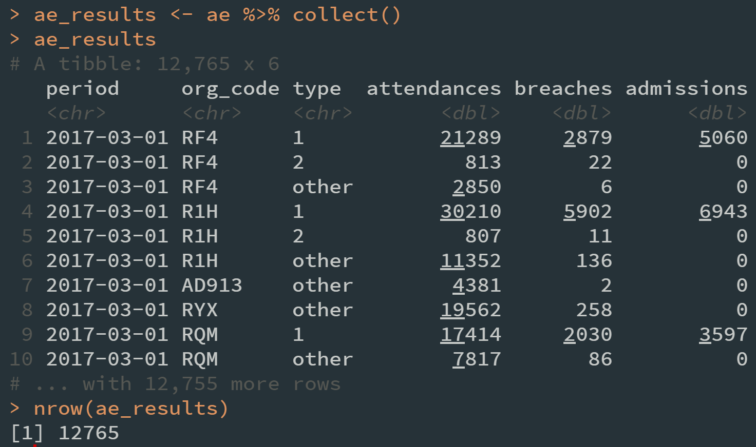
Lazy Evaluation
dplyr will be as lazy as possible with database queries – that is it’s going to wait until you really ask to see the data before executing the query. If you want to force an immediate execution of your query, you need to use collect():
ae_results <- ae %>% collect()
thomas.jemmett@nhs.net / @tom_jemmett

Slide 8
Word of warning on lazy evaluation
If you don’t collect the data, then the following code will run the query on the server twice!
print(ae)
print(ae)

Slide 9
Using a table in a dplyr pipeline
You can pipe a table to all of your favourite dplyr verbs like group_by, mutate, summarise, and even the more complex functions like summarise_if, mutate_at etc.
ae_summary <- ae %>%
group_by(period) %>%
summarise_at(vars(attendances:admissions),
sum,
na.rm = TRUE)
dplyr is able to translate R functions like sum or mean that have Sql equivalents, but if there isn’t an equivalent you will need to call collect() first.
thomas.jemmett@nhs.net / @tom_jemmett

Slide 10
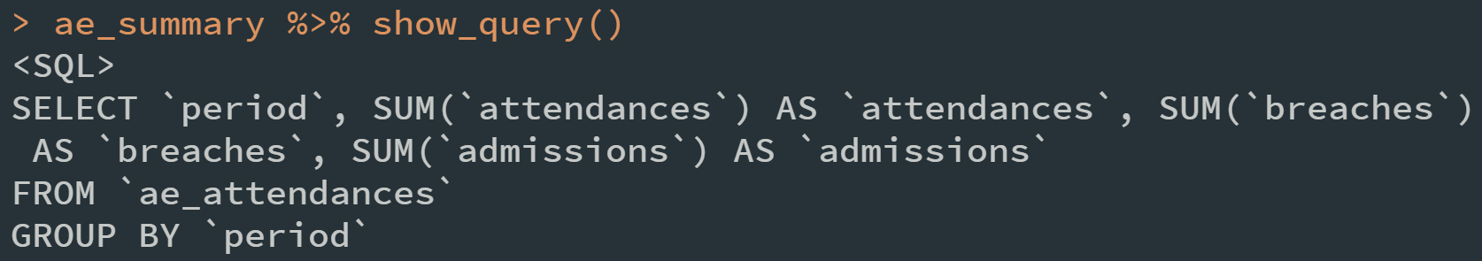
Checking the Sql query
If you want to see what Sql dplyr has created you can use the show_query() function.
Using show_query() regularly is a good idea to ensure that dplyr isn’t creating any particularly bad Sql.
thomas.Jemmett@nhs.net / @tom_jemmett

Slide 11
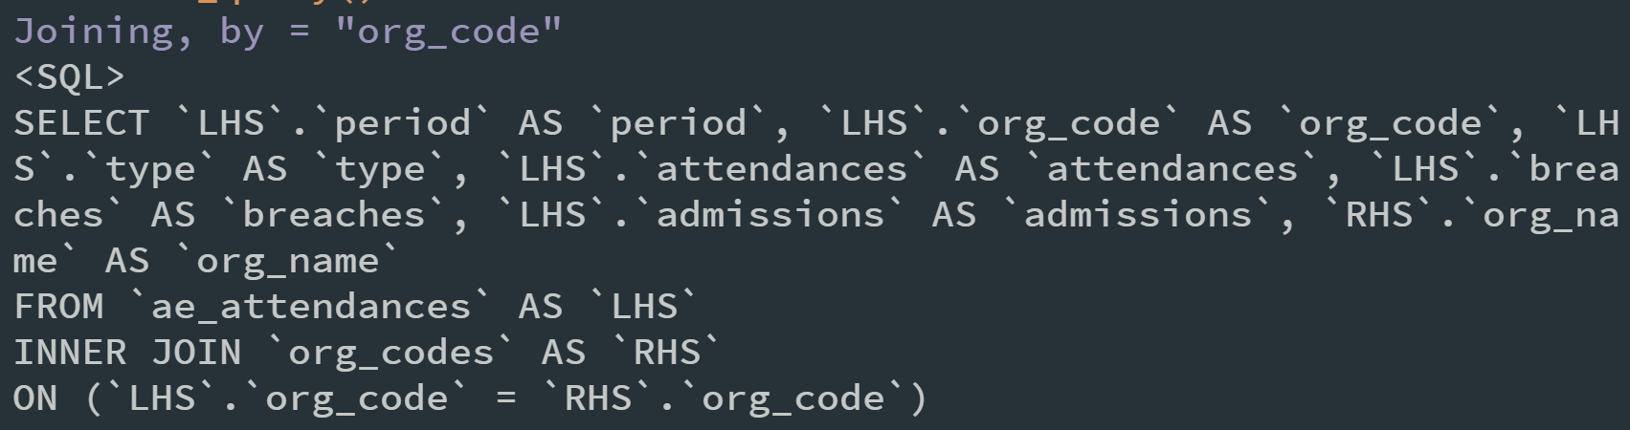
You can join multiple tables together
If you have multiple tables that you need to use together you can use the *_join functions from dplyr:
ae %>%
inner_join(tbl(con, "org_codes")) %>%
show_query()
thomas.jemmett@nhs.net / @tom_jemmett

Slide 12
Thanks!
Tom Jemmett MBCS AMIMA
Senior Healthcare Analyst thomas.jemmett@nhs.net GitHub: tomjemmett Twitter: @tom_jemmett

