Slide 1
JFROG
Golden Image compliance
From layer forensics to governed provenance
What JFrog can do today — and the tiered path forward
Notes:
They know Golden Images and the rename/FROM gap. This meeting is the path: honest today, MVP next, AppTrust as the control plane.

Slide 2
CURRENT STATE
Today, lineage is a layer-diff exercise
The only way to determine lineage today is comparing image layer diffs (DiffIDs) against a Golden Image catalog. That can reconstruct ancestry after rename. It is also a custom, labor-intensive process — and Artifactory has no native report for Golden Image compliance.
Golden prefix present
sha256:9f2a…c1
sha256:7b40…e9
sha256:1c88…aa
▪
Build and maintain a Golden DiffID catalog
▪
Extract and match layers for every candidate image
No overlap
▪
Treat "no match" as inconclusive (squash, rebase, FROM scratch ) — not a clean fail
sha256:44d0…31
sha256:0aef…5c
Forensic. Not a product report.
Evidence Collection | Build Info | AppTrust
Notes:
Acknowledge it works for scoping what is already in Artifactory. Be explicit: this is not something you click in the UI. It is engineering time, edge cases, and no promote hook.

Slide 3
Three tiers. Same question. Better answers over time.
Do not wait for the last tier to start capturing provenance.
TIER 1
TIER 2
TIER 3
Today — forensics
Near term — MVP
Future — governance
Layer-diff matching against the Golden catalog. Scopes the backlog. Custom, slow, not governed.
Use Evidence and Build Info on every publish. Provenance becomes queryable metadata in Artifactory.
AppTrust consumes that same metadata and enforces Golden Image policy at promote/release.
Each tier builds on the last. You do not throw away Evidence when AppTrust turns on.
Notes:
Frame as a program, not a rip-and-replace. Tier 1 is honesty about today. Tier 2 is the recommendation to start. Tier 3 is the enterprise-grade end-state. Next three slides answer their questions in their words.

Slide 4
Your questions — what JFrog can say today
What can JFrog tell us today about the upstream/base image source for container images already stored or pulled through Artifactory?
Today: digest, ordered layers, and whatever Build Info or Evidence was already published. Artifactory does not retain the original FROM name, and it has no native report of upstream/base source or Golden Image compliance. Stored locals: custom layer-diff against a Golden catalog. Pulled-through remotes: path of the cached artifact only — that is not lineage for a derived app image.
Can JFrog determine whether a derived image originally came from an Acme Golden Image if the image was renamed, retagged, or pushed to another repository?
Yes for renamed or retagged images in Artifactory — digest and layer chain do not change, so a Golden layer prefix can still match. Partially if pushed to another repository: another Artifactory Docker local, query by digest; ACR/ECR (or any registry outside Artifactory) only if that same digest is re-pushed here. Evidence does not follow a new name — look up by digest.
What are the gaps or limitations Acme should expect with historical images already built without required metadata?
Acme should expect no queryable provenance : no FROM, no Evidence, no useful Build Info. The only option is labor-intensive layer-diff, which is inconclusive after squash, rebase, or FROM scratch — not a clean "not Golden." Images that never entered Artifactory are out of scope unless they are re-pushed.
Notes:
Read the question as written, then the answer. Do not skip 'pulled through,' 'Acme Golden Image,' or 'another repository.'

Slide 5
Your questions — how we distinguish, and what to capture next
Can JFrog distinguish Golden Image usage from non-Golden Image usage using repository path, digest, image layers, build info, SBOM, or OCI metadata?
Partially — signal by signal. Repository path: no (teams publish to their own repos). Digest: identity key, not Golden by itself. Image layers: yes (Golden DiffID prefix; heuristic). Build info: yes, if CI recorded the base. SBOM: no (package inventory ≠ base image). OCI metadata: weak (history/commands, not repo/name:tag of the parent).
What metadata or build information must be captured going forward to make lineage tracking reliable?
Digest-pinned FROM. Build Info on every jf docker push / build-publish. Signed Evidence on the image digest: child digest, immediate base name + digest, preferably root_golden_digest (or a walk to the Acme Golden catalog). Name and tag are not enough.
What is the minimum viable solution JFrog recommends for current-state discovery, and what is the long-term solution for governance and enforcement?
Current-state discovery (MVP): Evidence + Build Info on new publishes so Artifactory can be queried; layer-diff only to scope historical images that have no metadata. Long-term governance and enforcement: AppTrust / Unified Policy promote gates that require that same derived-from-Golden Evidence. Same metadata. Stronger control.
Notes:
Card 1 must name all six signals. Card 3 must answer both halves: discovery MVP and long-term enforcement.

Slide 6
Your questions — what this solution does not cover yet
Can JFrog report on non-Golden Images and identify whether they came from mirrored public repositories?
Partially. Report on non-Golden Images: yes — classify as not derived from the Acme Golden catalog (no layer prefix / no Golden Evidence). Identify whether they came from mirrored public repositories: no, not as a first-class finding for derived app images. That needs a mirror catalog or remote-cache join, which is not this path.
Can JFrog identify images that are outdated, EOL, or not refreshed within a given timeframe?
No — not in this lineage solution. JFrog cannot identify outdated, EOL, or unrefreshed images from Golden Image provenance work. Do identity first (Golden vs not). Freshness/EOL is a later discussion (golden versions, artifact age, Xray/Catalog).
Notes:
Answer both verbs in card 1: report on non-Golden vs identify mirrored public origin. Card 2 is a clean no.

Slide 7
MVP: capture provenance with what you already have
Evidence and Build Info are existing JFrog capabilities. Use them so Artifactory can be queried for lineage instead of reverse-engineering layers.
▪
Build Info — publish with jf docker push --build-name/--build-number so the image is tied to a build, not only a tag
CI pin FROM @sha256
↓
▪
Evidence — signed lineage on the digest: child image, immediate base, preferably root Golden digest
Build Info + Evidence
▪
Query — look up provenance by package/digest in Artifactory; rename no longer orphans the story
↓
query by digest
This is the system of record for new publishes. Layer diffs remain a backstop for images that never got metadata.
Notes:
MVP is operational efficiency: stop paying the layer-diff tax on every new image. Historical images without metadata stay in the forensic bucket. Multi-hop: walk parent Evidence or store root_golden_digest on every hop.

Slide 8
Future state: AppTrust as enterprise governance
AppTrust does not replace Evidence or Build Info. It governs them.
→
→
Evidence + Build Info
AppTrust / Unified Policy
Promote
already on the package, queryable in Artifactory
derived-from-golden required entry gate, block mode
pass → PreProd / Prod
fail → stop
Same predicates. Promote-time enforcement. No re-architecture of the CI contract.
Notes:
Ideal end-state: Golden Image compliance is a gate, not a spreadsheet. AppTrust reads Evidence at promote. Present → move. Missing → block. If Evidence only names an intermediate, require a walk or root_golden_digest in CI — do not try to recurse the golden catalog inside the gate.

Slide 9
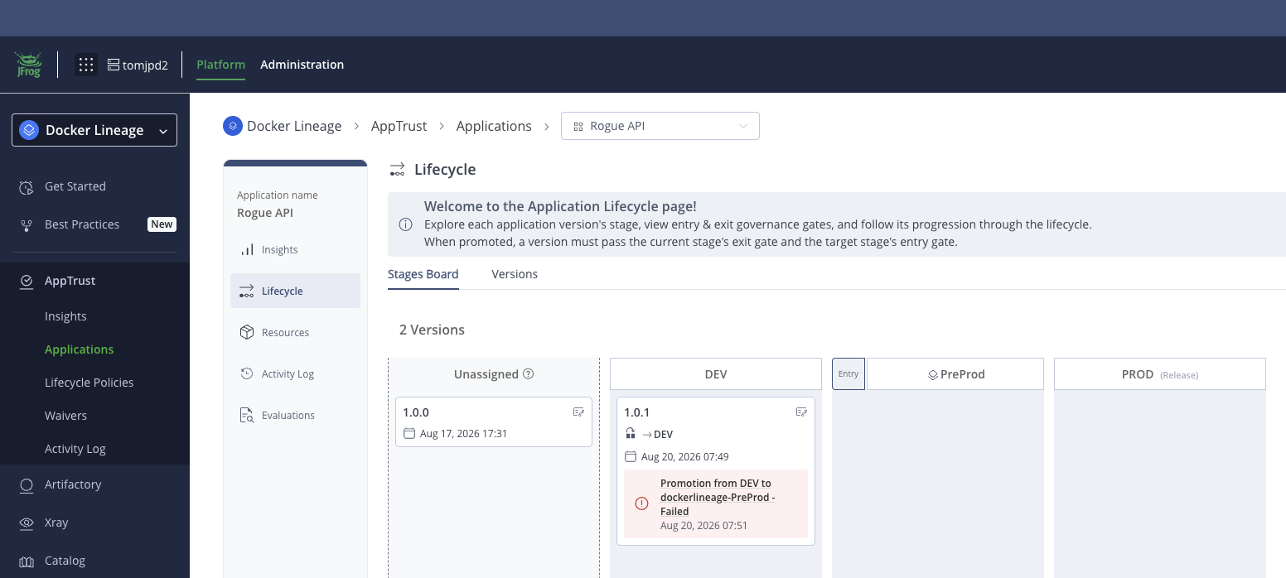
The gate reads the Evidence you already attached
Near term: teams query Evidence / Build Info
Future: AppTrust blocks promote unless that Evidence is on the version
[PLACEHOLDER: Gate Screenshot]
No second provenance model
AppTrust / Unified Policy dry-run — derived-from-golden pass vs fail. Replace this box with the live gate screenshot before customer delivery.
Notes:
Drop the tomjpd2 PreProd dry-run here: payments-api pass, rogue-api fail. Same Evidence the MVP slide just described.

Slide 10
Start capturing. Govern when ready.
NOW
NEXT
LATER
Layer diffs only to scope the existing estate. No native compliance report.
Evidence + Build Info on every image publish. Query provenance in Artifactory.
AppTrust gates on that same metadata. Enterprise Golden Image enforcement.
Forensics for the past. Evidence for the record. AppTrust for the control plane.
Notes:
Ask for agreement on the MVP CI contract first. AppTrust is the destination, not the admission ticket.

