Slide 1
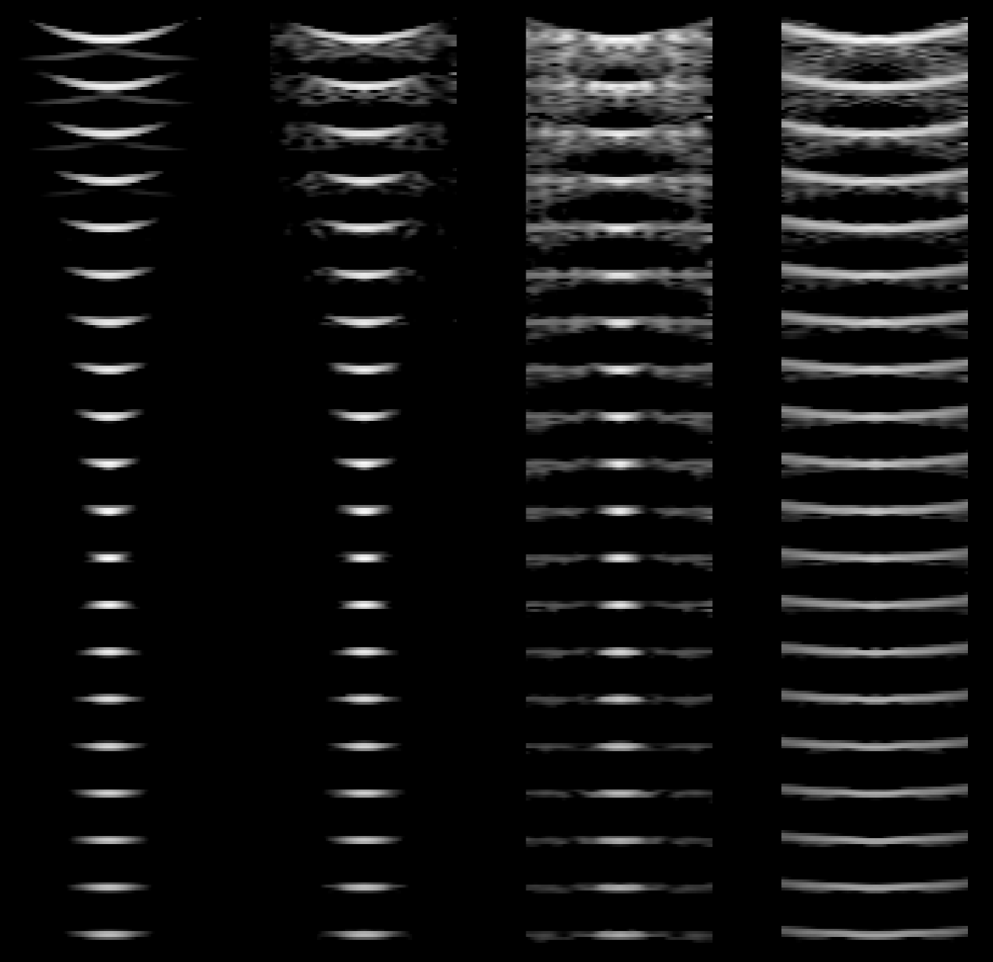
PSF with increasing minimum quantization values
none
λ/10
λ/2
λ
15
30
Depth (mm)
45
60
75
90
Transmit focus (7cm)
105

Slide 2
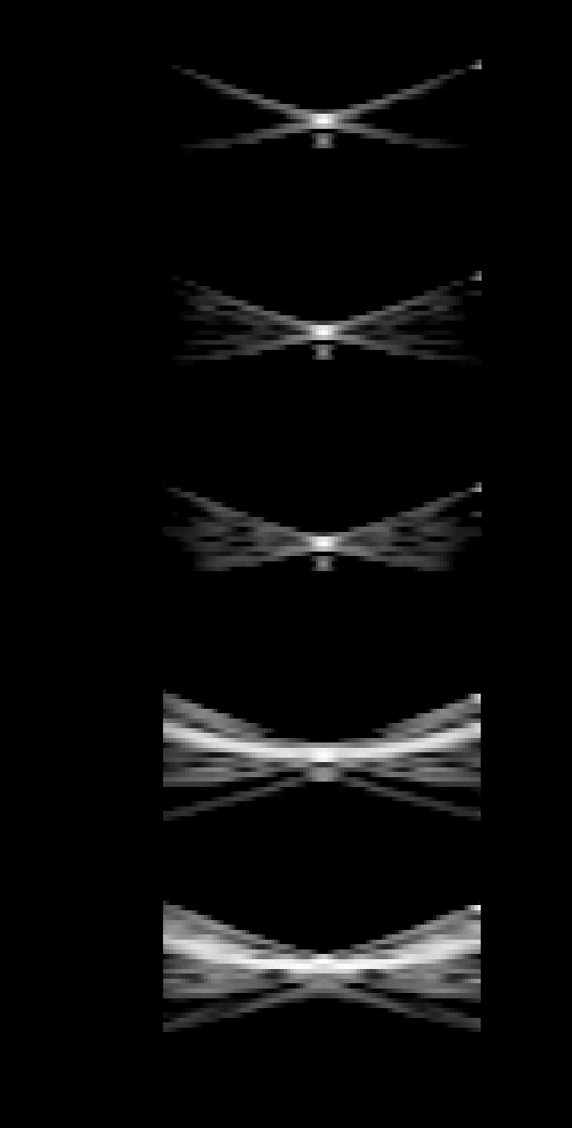
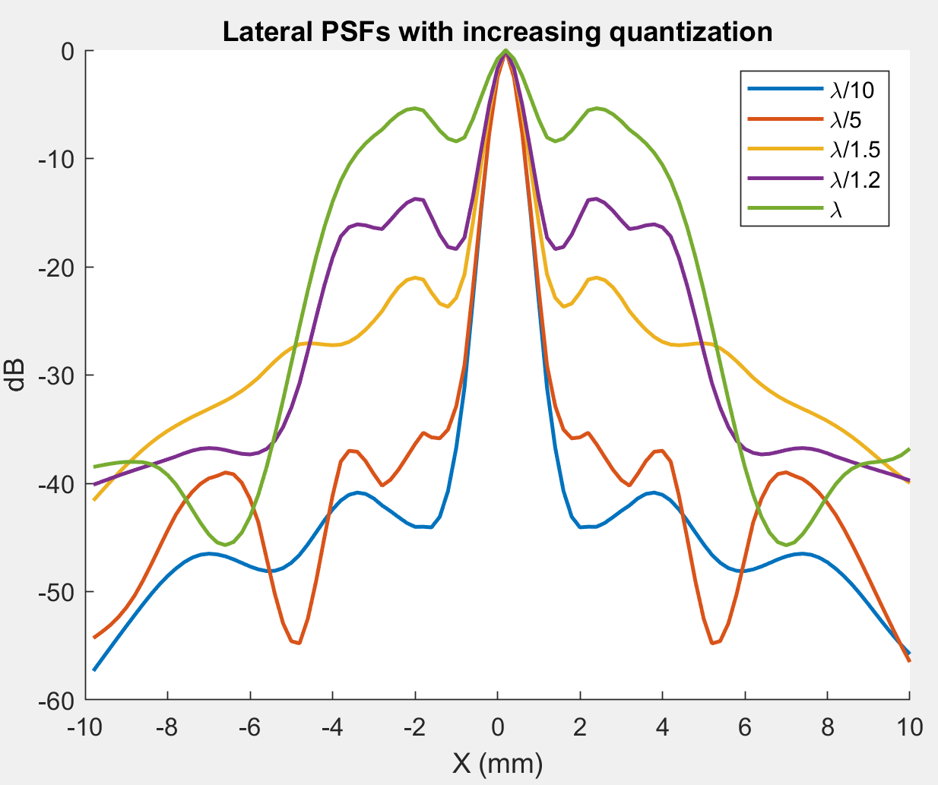
PSFs at 5 Quantization values
λ/20
λ/10
λ/5
λ/1
2 λ

Slide 3
f0=3e6; % Transducer center frequency [Hz]
fs=100e6; % Sampling frequency [Hz]
c=1540; % Speed of sound [m/s]
lambda=c/f0; % Wavelength [m]
width=lambda; % Width of element
element_height=5/1000; % Height of element [m]
kerf=0.1/1000; % Kerf [m]
focus=[0 0 70]/1000; % Fixed focal point [m]
N_elements=128; % Number of physical elements
N_active=64; % Number of active elements
xmit_N_active=128; % Number of active transmit elements for constant F#
rec_N_active=128; % Number of active receive elements for constant F#
60 dB dynamic range displayed

