Slide 1
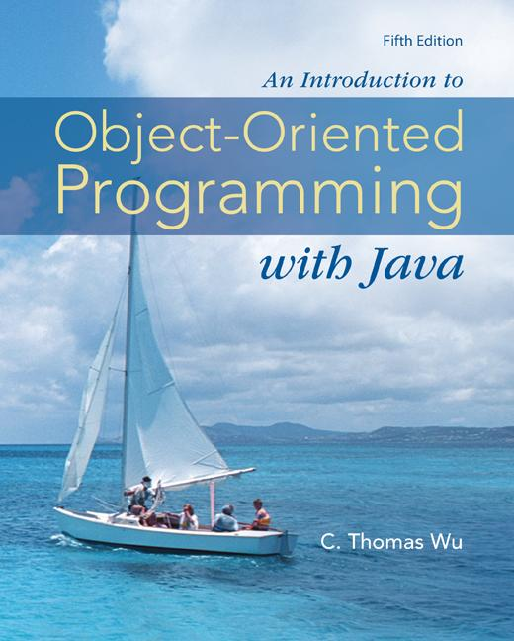
Chapter 0
Introduction to Computers
and
Programming Languages
©The McGraw-Hill Companies, Inc. Permission required for reproduction or display.
Animated Version
Chapter 0 - <number>
Notes:
Introduction to OOP with Java 4th Ed, C. Thomas Wu
© The McGraw-Hill Companies, Inc.

Slide 2
Chapter 0 Objectives
After you have read and studied this chapter, you should be able to
  State briefly a history of computers.
  Name and describe five major components of the computer.
  Convert binary numbers to decimal numbers and vice versa.
  State the difference between the low-level and high-level programming languages.
©The McGraw-Hill Companies, Inc. Permission required for reproduction or display.
Chapter 0 - <number>
Notes:
Introduction to OOP with Java 4th Ed, C. Thomas Wu
© The McGraw-Hill Companies, Inc.

Slide 3
A History of Computers
Charles Babbage is credited as the father of computer. Although never actually built, he proposed the computing machines called Difference Engine and Analytical Engine that possessed the core characteristics of today’s computers.
Ada Lovelace, who wrote demonstration programs for Analytical Engine, is credited as the first programmer.
The first modern computer was built by Atanasoff of Iowa State University in the late 1930s.
An electromechanical computer MARK I was built by Howard Aiken of Harvard.
The first completely electronic computer ENIAC I was built by Mauchly and Eckert of the University of Pennsylvania.
©The McGraw-Hill Companies, Inc. Permission required for reproduction or display.
Chapter 0 - <number>
Notes:
Introduction to OOP with Java 4th Ed, C. Thomas Wu
© The McGraw-Hill Companies, Inc.
Computers affect our lives 24 hours per day, 7 days a week.
Charles Babbage is credited with inventing a precursor to the modern computer. In 1823 he received a grant from the British government to build a mechanical device he called the Difference Engine. The machine was not completed. Technology was not there to build the machine.
Babbage worked on even more ambitious machine he called Analytical Engine. One unique feature of Analytical Engine is its programmability. Although the Analytical Engine was never built, its demonstration program was written by Ada Lovelace, a daughter of the poet Lord Byron.
In the late 1930s John Atanasoff of Iowa State University, with his graduate student Clifford Berry, built the prototype of the first automatic electronic calculator.
At around the same time, Howard Aiken of Harvard University was working on the Automatic Sequence-Controlled Calculator, known more commonly as MARK I.

Slide 4
Computer Architecture
Output
Devices
RAM
CPU
Commu-
nication
Devices
Storage
Devices
Input
Devices
©The McGraw-Hill Companies, Inc. Permission required for reproduction or display.
Chapter 0 - <number>
Notes:
Introduction to OOP with Java 4th Ed, C. Thomas Wu
© The McGraw-Hill Companies, Inc.
A typical computer today has five basic components: RAM, CPU, storage devices, I/O (input/output) devices, and communication devices.
Random access memory (RAM) is a repository for both program instructions and data manipulated by the program during execution. RAM is divided into cells with each cell having a unique address.
The central processing unit (CPU) is the brain of a computer. The CPU is the component that executes program instructions by fetching an instruction (stored in RAM), executing it, fetching the next instruction, executing it, and so on until it encounters an instruction to stop.
Input/output (I/O) devices allow communication between the user and the CPU. Input devices such as keyboards and mice are used to enter data, programs, and commands in the CPU. Output devices such as monitors and printers are used to display or print information.
Storage devices such as disk and tape drives are used to store data and programs. Secondary storage devices are called nonvolatile memory, while RAM is called volatile memory.
A communication device connects the personal computer to a network. The most common communication device for computers at home and small offices is the modem. A communication device for connecting a computer to a LAN is a network interface card (NIC).

Slide 5
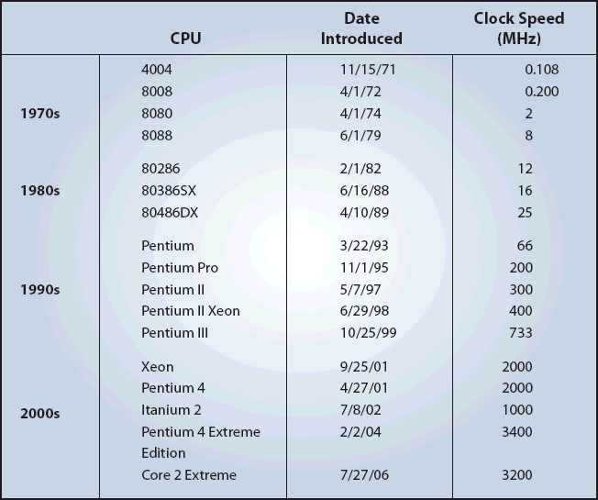
Progress of CPU Speed
For more information on Intel CPUs, click Intel Museum
©The McGraw-Hill Companies, Inc. Permission required for reproduction or display.
Chapter 0 - <number>
Notes:
Introduction to OOP with Java 4th Ed, C. Thomas Wu
© The McGraw-Hill Companies, Inc.

Slide 6
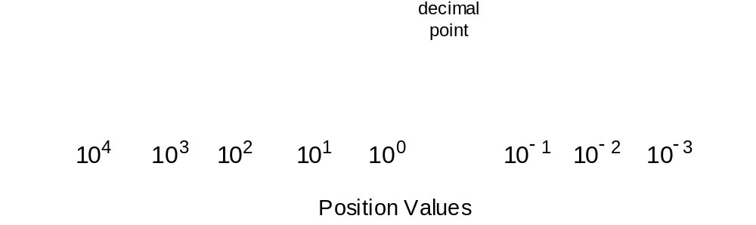
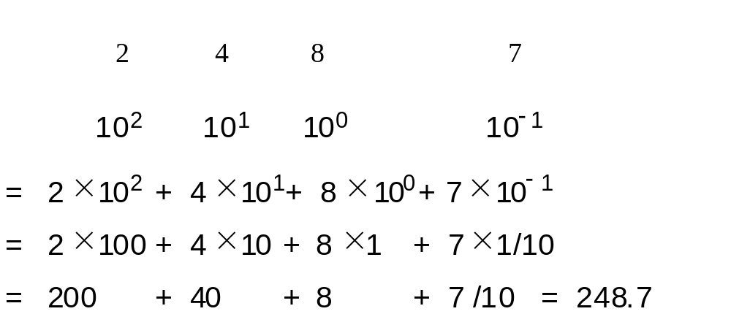
Decimal Number Representation
How the decimal number is represented.
Example:
©The McGraw-Hill Companies, Inc. Permission required for reproduction or display.
Chapter 0 - <number>
Notes:
Introduction to OOP with Java 4th Ed, C. Thomas Wu
© The McGraw-Hill Companies, Inc.
Unlike Roman numerals, a position of a digit in a decimal system is significant. A digit 8, for example, in one’s position means 8, while the digit in ten’s position means 80.

Slide 7
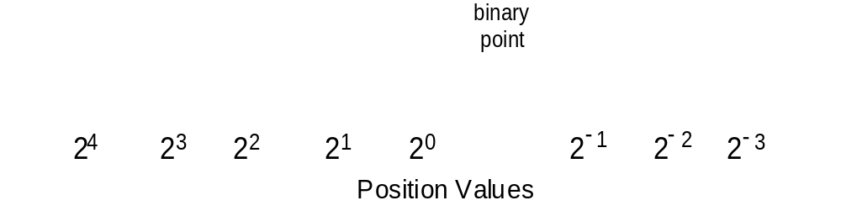
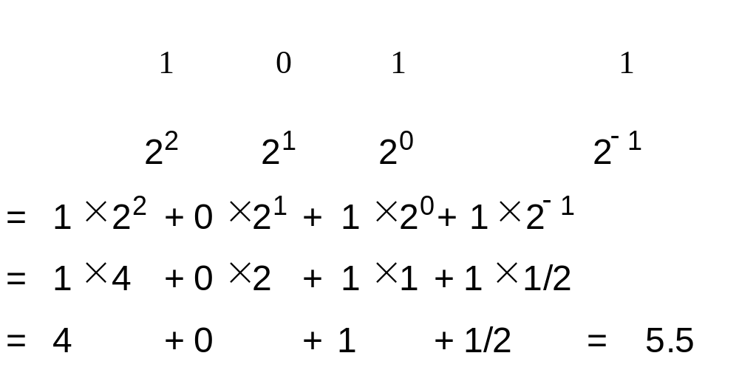
Binary Number Representation
How the binary number is represented.
Example:
©The McGraw-Hill Companies, Inc. Permission required for reproduction or display.
Chapter 0 - <number>
Notes:
Introduction to OOP with Java 4th Ed, C. Thomas Wu
© The McGraw-Hill Companies, Inc.
Binary number system works almost exactly as the decimal system. The only difference is the base. With the decimal system, we use base 10, and with the binary number system, the base is 2. Binary system works just fine with electronic computers because 0 can be represented by electricity being off and 1 can be represented by electricity being on.
Incidentally, one of the reasons for Babbage’s difficulties in building his machines was his decision of using the decimal system. It made the architecture too complex.

Slide 8
Programming Languages
Three levels of programming languages:
  Machine Languages
      Machine language instructions are binary coded and very low level.
  Assembly Languages
      Assembly language allows symbolic programming. Requires an assembler to translate assembly programs into machine programs.
  High-level Languages
      High-level language provides a very high conceptual model of computing. Requires a compiler to translate high-level programs into assembly programs.
©The McGraw-Hill Companies, Inc. Permission required for reproduction or display.
Chapter 0 - <number>
Notes:
Introduction to OOP with Java 4th Ed, C. Thomas Wu
© The McGraw-Hill Companies, Inc.
Here are the examples of three level of programming languages.
Machine code:
10110011 00011001
01111010 11010001 10010100
10011111 00011001
01011100 11010001 10010000
10111011 11010001 10010110
Assembly code:
MV 0, SUM
MV NUM, AC
ADD SUM, AC
STO SUM, TOT
High-level code:
X = ( Y + Z ) / 2

Slide 9
Java
Java is a high-level object-oriented language developed by Sun Microsystems.
Java’s clean design and wide availability make it an ideal language for teaching the fundamentals of computer programming.
©The McGraw-Hill Companies, Inc. Permission required for reproduction or display.
Chapter 0 - <number>
Notes:
Introduction to OOP with Java 4th Ed, C. Thomas Wu
© The McGraw-Hill Companies, Inc.
Among the hundreds of high-level programming languages, Java, the language we use in this course, is one of the newest. People first notice Java as in Internet programming language, but they begin to realize that Java is just as capable as general-purpose language. In fact, it’s clean design makes it a great teaching language also.

