Slide 1
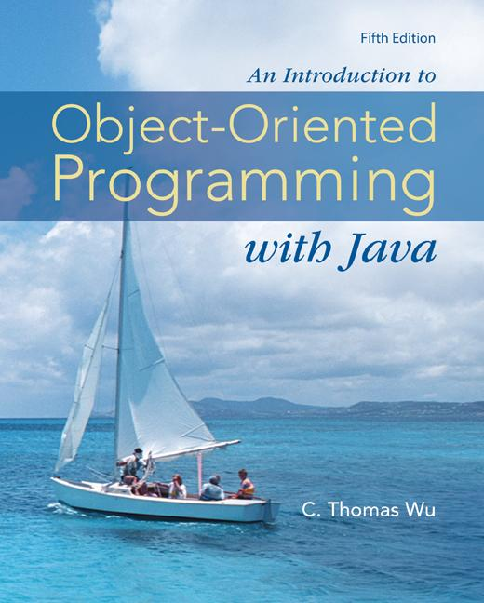
Chapter 3
Numerical Data
©The McGraw-Hill Companies, Inc. Permission required for reproduction or display.
Animated Version
Chapter 3 - <number>
Notes:
Introduction to OOP with Java 4th Ed, C. Thomas Wu
© The McGraw-Hill Companies, Inc.

Slide 2
Objectives
After you have read and studied this chapter, you should be able to
    Select proper types for numerical data.
    Write arithmetic expressions in Java.
    Evaluate arithmetic expressions using the precedence rules.
    Describe how the memory allocation works for objects and primitive data values.
    Write mathematical expressions, using methods in the Math class.
    Generate pseudo random numbers.
    Use the GregorianCalendar class in manipulating date information such as year, month, and day.
    Use the DecimalFormat class to format numerical data
    Input and output numerical data by using System.in and System.out
©The McGraw-Hill Companies, Inc. Permission required for reproduction or display.
Chapter 3 - <number>
Notes:
Intro to OOP with Java, C. Thomas Wu
©The McGraw-Hill Companies, Inc.

Slide 3
Manipulating Numbers
In Java, to add two numbers x and y, we write
x + y
But before the actual addition of the two numbers takes place, we must declare their data type. If x and y are integers, we write
int x, y;
or
int x;
int y;
©The McGraw-Hill Companies, Inc. Permission required for reproduction or display.
Chapter 3 - <number>
Notes:
Intro to OOP with Java, C. Thomas Wu
©The McGraw-Hill Companies, Inc.

Slide 4
Variables
When the declaration is made, memory space is allocated to store the values of x and y.
x and y are called variables. A variable has three properties:
      A memory location to store the value,
      The type of data stored in the memory location, and
      The name used to refer to the memory location.
Sample variable declarations:
  int x;
  int v, w, y;
©The McGraw-Hill Companies, Inc. Permission required for reproduction or display.
Chapter 3 - <number>
Notes:
Intro to OOP with Java, C. Thomas Wu
©The McGraw-Hill Companies, Inc.

Slide 5
Numerical Data Types
There are six numerical data types: byte, short, int, long, float, and double.
Sample variable declarations:
  int i, j, k;
    float numberOne, numberTwo;
    long bigInteger;
    double bigNumber;
At the time a variable is declared, it also can be initialized. For example, we may initialize the integer variables count and height to 10 and 34 as
int count = 10, height = 34;
©The McGraw-Hill Companies, Inc. Permission required for reproduction or display.
Chapter 3 - <number>
Notes:
Intro to OOP with Java, C. Thomas Wu
©The McGraw-Hill Companies, Inc.
In the same way that you can initialize variables for numbers, you can initialize with objects. For example, instead of
JFrame myWindow;
myWindow = new JFrame();
we can write more succintly as
JFrame myWindow = new JFrame();

Slide 6
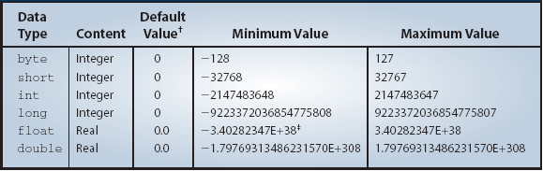
Data Type Precisions
The six data types differ in the precision of values they can store in memory.
©The McGraw-Hill Companies, Inc. Permission required for reproduction or display.
Chapter 3 - <number>
Notes:
Intro to OOP with Java, C. Thomas Wu
©The McGraw-Hill Companies, Inc.
This is for information only. You do not have to memorize this table. Just get some general idea on the range of values that can be represented by the six numerical data types.

Slide 7
Assignment Statements
We assign a value to a variable using an assignment statements.
The syntax is
<variable> = <expression> ;
Examples:
sum = firstNumber + secondNumber;
avg = (one + two + three) / 3.0;
©The McGraw-Hill Companies, Inc. Permission required for reproduction or display.
Chapter 3 - <number>
Notes:
Intro to OOP with Java, C. Thomas Wu
©The McGraw-Hill Companies, Inc.
To assign a value to a variable, we use an assignment statement. A single variable appears to the left of equal symbol and an expression appears to the right. Assignment statements are terminated by a semicolon.

Slide 8
Primitive Data Declaration and Assignments
int firstNumber, secondNumber;
firstNumber = 234;
secondNumber = 87;
A. Variables are allocated in memory.
firstNumber
234
A
int firstNumber, secondNumber;
int firstNumber, secondNumber;
secondNumber
firstNumber = 234;
secondNumber = 87;
87
firstNumber = 234;
secondNumber = 87;
B
B. Values are assigned to variables.
Code
State of Memory
©The McGraw-Hill Companies, Inc. Permission required for reproduction or display.
Chapter 3 - <number>
Notes:
Intro to OOP with Java, C. Thomas Wu
©The McGraw-Hill Companies, Inc.

Slide 9
Assigning Numerical Data
int number;
number = 237;
number = 35;
number
237
35
A. The variable is allocated in memory.
int number;
number = 237;
number = 35;
A
int number;
number = 237;
B
B. The value 237 is assigned to number.
number = 35;
C
C. The value 35 overwrites the previous value 237.
Code
State of Memory
©The McGraw-Hill Companies, Inc. Permission required for reproduction or display.
Chapter 3 - <number>
Notes:
Intro to OOP with Java, C. Thomas Wu
©The McGraw-Hill Companies, Inc.
Notice how the old value is over written by the new value.

Slide 10
Assigning Objects
customer
Customer customer;
customer = new Customer( );
customer = new Customer( );
Customer
Customer
A
Customer customer;
customer = new Customer( );
customer = new Customer( );
B
A. The variable is allocated in memory.
Customer customer;
customer = new Customer( );
B. The reference to the new object is assigned to customer.
customer = new Customer( );
C
C. The reference to another object overwrites the reference in customer.
Code
State of Memory
©The McGraw-Hill Companies, Inc. Permission required for reproduction or display.
Chapter 3 - <number>
Notes:
Intro to OOP with Java, C. Thomas Wu
©The McGraw-Hill Companies, Inc.
If the variable refers to an object, then the assignment and the corresponding effect to the memory allocation are different. Notice the content of the variable is not the value itself, as is the case with primitive data, but the address of, or reference to, the memory location where the object data is stored. We use arrows to indicate this memory reference.

Slide 11
Having Two References to a Single Object
Customer clemens, twain;
clemens = new Customer( );
twain = clemens;
clemens
twain
Customer
A
Customer clemens, twain,
clemens = new Customer( );
twain = clemens;
B
A. Variables are allocated in memory.
Customer clemens, twain;
clemens = new Customer( );
B. The reference to the new object is assigned to clemens.
twain = clemens;
C
C. The reference in clemens is assigned to customer.
Code
State of Memory
©The McGraw-Hill Companies, Inc. Permission required for reproduction or display.
Chapter 3 - <number>
Notes:
Intro to OOP with Java, C. Thomas Wu
©The McGraw-Hill Companies, Inc.
This sample code shows the effect of two reference variables pointing to the same object, which is perfectly legal. This slide highlights the critical fact that the name (variable) and object are two distinct and separate entities. It is no problem to have multiple variables referring to a single object, much as a single person can be referred by many different names.

Slide 12
Primitive vs. Reference
Numerical data are called primitive data types.
Objects are called reference data types, because the contents are addresses that refer to memory locations where the objects are actually stored.
©The McGraw-Hill Companies, Inc. Permission required for reproduction or display.
Chapter 3 - <number>
Notes:
Intro to OOP with Java, C. Thomas Wu
©The McGraw-Hill Companies, Inc.

Slide 13
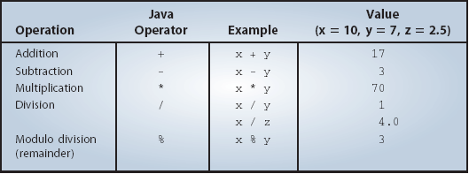
Arithmetic Operators
The following table summarizes the arithmetic operators available in Java.
This is an integer division where the fractional part is truncated.
©The McGraw-Hill Companies, Inc. Permission required for reproduction or display.
Chapter 3 - <number>
Notes:
Intro to OOP with Java, C. Thomas Wu
©The McGraw-Hill Companies, Inc.
This table lists five numerical operators. Unlike pure mathematics, the division whose two operands are integers will result in an integer.

Slide 14
Arithmetic Expression
How does the expression
x + 3 * y
get evaluated? Answer: x is added to 3*y.
We determine the order of evaluation by following the precedence rules.
A higher precedence operator is evaluated before the lower one. If two operators are the same precedence, then they are evaluated left to right for most operators.
©The McGraw-Hill Companies, Inc. Permission required for reproduction or display.
Chapter 3 - <number>
Notes:
Intro to OOP with Java, C. Thomas Wu
©The McGraw-Hill Companies, Inc.
You need to write the expression as
(x + 3) * y
if you want to multiply y to the sum of x and 3.

Slide 15
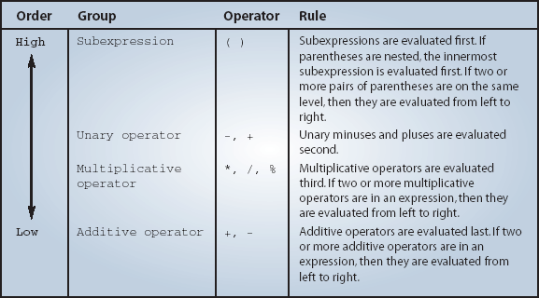
Precedence Rules
©The McGraw-Hill Companies, Inc. Permission required for reproduction or display.
Chapter 3 - <number>
Notes:
Intro to OOP with Java, C. Thomas Wu
©The McGraw-Hill Companies, Inc.
If you want to alter the precedence rules, then use parentheses to dictate the order of evaluation.

Slide 16
Type Casting
If x is a float and y is an int, what will be the data type of the following expression?
x * y
The answer is float.
The above expression is called a mixed expression.
The data types of the operands in mixed expressions are converted based on the promotion rules. The promotion rules ensure that the data type of the expression will be the same as the data type of an operand whose type has the highest precision.
©The McGraw-Hill Companies, Inc. Permission required for reproduction or display.
Chapter 3 - <number>
Notes:
Intro to OOP with Java, C. Thomas Wu
©The McGraw-Hill Companies, Inc.
When an arithmetic expression consists of variables and constants of the same data type, then the result of the expression will be that data type also.
When the data types of variables and constants in an arithmetic expression are of different data types, then a casting conversion will take place. A casting conversion, or type casting, is a process that converts a value of one data type to another data type. Two types of casting conversions in Java are implicit and explicit. An implicit conversion called numeric promotion is applied to the operands of an arithmetic operator.

Slide 17
Explicit Type Casting
Instead of relying on the promotion rules, we can make an explicit type cast by prefixing the operand with the data type using the following syntax:
( <data type> ) <expression>
Example
(float) x / 3
(int) (x / y * 3.0)
Type case x to float and then divide it by 3.
Type cast the result of the expression x / y * 3.0 to int.
©The McGraw-Hill Companies, Inc. Permission required for reproduction or display.
Chapter 3 - <number>
Notes:
Intro to OOP with Java, C. Thomas Wu
©The McGraw-Hill Companies, Inc.
We can always use the explicit type casting to change the data type of a value.

Slide 18
Implicit Type Casting
Consider the following expression:
double x = 3 + 5;
The result of 3 + 5 is of type int. However, since the variable x is double, the value 8 (type int) is promoted to 8.0 (type double) before being assigned to x.
Notice that it is a promotion. Demotion is not allowed.
int x = 3.5;
A higher precision value cannot be assigned to a lower precision variable.
©The McGraw-Hill Companies, Inc. Permission required for reproduction or display.
Chapter 3 - <number>
Notes:
Intro to OOP with Java, C. Thomas Wu
©The McGraw-Hill Companies, Inc.
When the explicit type casting is not included in the expression, then the implicit type casting is applied when a value is assigned to a variable. This implicit assignment type casting will promote the value of the expression to a higher precision to match the data type of the variable. Demotion on precision will not occur implicit. You need the explicit type casting for demotion, for example,
int x = (int) 4.5 / 2.2;

Slide 19
Constants
We can change the value of a variable. If we want the value to remain the same, we use a constant.
final double PI = 3.14159;
final int MONTH_IN_YEAR = 12;
final short FARADAY_CONSTANT = 23060;
The reserved word final is used to declare constants.
These are constants, also called named constant.
These are called literal constant.
©The McGraw-Hill Companies, Inc. Permission required for reproduction or display.
Chapter 3 - <number>
Notes:
Intro to OOP with Java, C. Thomas Wu
©The McGraw-Hill Companies, Inc.
The data type of literal constant 3.45 is double and the data type of literal constant 398 is int. To designate other data types for literal constants, we suffix the literal constants with the designators F or f for float and L or l for long. For example,
2.45f
1453L
Java convention uses all capitalized letters for constants.

Slide 20
Displaying Numerical Values
In Chapter 2, we showed how to output text (String) to the standard output
We use the same print and println methods to output numerical data to the standard output.
int num = 15;
System.out.print(num); //print a variable
System.out.print(“ “); //print a string
System.out.print(10); //print a constant
15 10
©The McGraw-Hill Companies, Inc. Permission required for reproduction or display.
Chapter 3 - <number>
Notes:
Intro to OOP with Java, C. Thomas Wu
©The McGraw-Hill Companies, Inc.

Slide 21
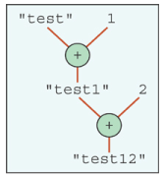
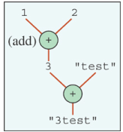
Overloaded Operator +
The plus operator + can mean two different operations, depending on the context.
<val1> + <val2> is an addition if both are numbers. If either one of them is a String, the it is a concatenation.
Evaluation goes from left to right.
output = “test” + 1 + 2;
output = 1 + 2 + “test”;
©The McGraw-Hill Companies, Inc. Permission required for reproduction or display.
Chapter 3 - <number>
Notes:
Intro to OOP with Java, C. Thomas Wu
©The McGraw-Hill Companies, Inc.
Notice the long expression in the previous slide
"Given Radius: " + radius + "\n" +
"Area: " + area + "\n" +
"Circumference: " + circumference
with string literal constants and double variables. The plus symbol is an overloaded operator. In this expression, they are string concatenations.

Slide 22
Sample Code Fragment
//code fragment to input radius and output
//area and circumference
final double PI = 3.14159;
double radius, area, circumference;
//compute area and circumference
area = PI * radius * radius;
circumference = 2.0 * PI * radius;
System.out.println("Given Radius: " + radius);
System.out.println("Area: " + area);
System.out.println(" Circumference: “ + circumference);
©The McGraw-Hill Companies, Inc. Permission required for reproduction or display.
Chapter 3 - <number>
Notes:
Intro to OOP with Java, C. Thomas Wu
©The McGraw-Hill Companies, Inc.
This code fragment accepts a radius as its input and outputs the circle’s area and circumference.

Slide 23
The DecimalFormat Class
Use a DecimalFormat object to format the numerical output.
double num = 123.45789345;
DecimalFormat df = new DecimalFormat(“0.000”);
//three decimal places
System.out.print(num);
System.out.print(df.format(num));
123.45789345
123.458
©The McGraw-Hill Companies, Inc. Permission required for reproduction or display.
Chapter 3 - <number>
Notes:
Intro to OOP with Java, C. Thomas Wu
©The McGraw-Hill Companies, Inc.
When you print out a double value, you may get eight or nine decimal places. To limit the number of decimal places to display, you can use the DecimalFormat class.

Slide 24
Getting Numerical Input
In Chapter 2, we learned how to input strings using the Scanner class.
We can use the same Scanner class to input numerical values
    Scanner scanner = new Scanner(System.in);
    int age;
    System.out.print( “Enter your age: “ );
    age = scanner.nextInt();
©The McGraw-Hill Companies, Inc. Permission required for reproduction or display.
Chapter 3 - <number>
Notes:
Intro to OOP with Java, C. Thomas Wu
©The McGraw-Hill Companies, Inc.

Slide 25
Scanner Methods
Method Example
nextByte( ) byte b = scanner.nextByte( );
nextDouble( ) double d = scanner.nextDouble( );
nextFloat( ) float f = scanner.nextFloat( );
nextInt( ) int i = scanner.nextInt( );
nextLong( ) long l = scanner.nextLong( );
nextShort( ) short s = scanner.nextShort( );
next() String str = scanner.next();
©The McGraw-Hill Companies, Inc. Permission required for reproduction or display.
Chapter 3 - <number>
Notes:
Intro to OOP with Java, C. Thomas Wu
©The McGraw-Hill Companies, Inc.

Slide 26
The Math class
The Math class in the java.lang package contains class methods for commonly used mathematical functions.
double num, x, y;
x = …;
y = …;
num = Math.sqrt(Math.max(x, y) + 12.4);
©The McGraw-Hill Companies, Inc. Permission required for reproduction or display.
Chapter 3 - <number>
Notes:
Intro to OOP with Java, C. Thomas Wu
©The McGraw-Hill Companies, Inc.
You assign a value of one numerical data type to a variable of another numerical data type (directly or via some form of type casting). But you cannot assign a number to a String variable or vice versa.

Slide 27
Some Math Class Methods
Method | Description
exp(a) | Natural number e raised to the power of a.
log(a) | Natural logarithm (base e) of a.
floor(a) | The largest whole number less than or equal to a.
max(a,b) | The larger of a and b.
pow(a,b) | The number a raised to the power of b.
sqrt(a) | The square root of a.
sin(a) | The sine of a. (Note: all trigonometric functions are computed in radians)
Table 3.7 page 113 in the textbook contains a list of class methods defined in the Math class.
©The McGraw-Hill Companies, Inc. Permission required for reproduction or display.
Chapter 3 - <number>
Notes:
Intro to OOP with Java, C. Thomas Wu
©The McGraw-Hill Companies, Inc.
This table list some of the Math class methods. Please refer to the actual Math class documentation for full description of all class methods.

Slide 28
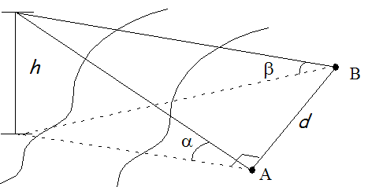

Computing the Height of a Pole
alphaRad = Math.toRadians(alpha);
betaRad = Math.toRadians(beta);
height = ( distance * Math.sin(alphaRad) * Math.sin(betaRad) )
/
Math.sqrt( Math.sin(alphaRad + betaRad) *
Math.sin(alphaRad - betaRad) );
Notes:
Intro to OOP with Java, C. Thomas Wu
©The McGraw-Hill Companies, Inc.
Here’s one sample showing how the given mathematical formula is written using the Math class methods. The formula computes the height of a statue given the distance between the two measuring points A and B.

Slide 29
Random Number Generation
We can use the nextInt(n) method of the Random class to generate a random number between 0 and n-1, inclusive.
import java.util.Random;
. . .
Random random = new Random();
. . .
int number = random.nextInt(11); //return x, 0 <= x <= 10
To return a random integer in [min, max] inclusively, where min <= max
. . .
int number = random.nextInt(max – min + 1) + min;
©The McGraw-Hill Companies, Inc. Permission required for reproduction or display.
Chapter 3 - <number>
Notes:
Intro to OOP with Java, C. Thomas Wu
©The McGraw-Hill Companies, Inc.

Slide 30
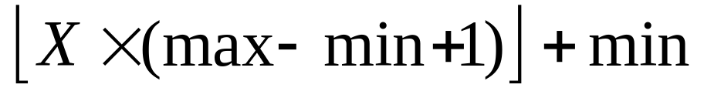
Random Number Generation - 2
The Math.random method is called a pseudo random number generator and returns a number (double) X, where 0.0 <= X < 1.0
To return a pseudo random integer in [min, max] inclusively, where min <= max, use the formula
int randomNumber = (int) (Math.floor(Math.random()
* (max – min + 1)) + min);
©The McGraw-Hill Companies, Inc. Permission required for reproduction or display.
Chapter 3 - <number>
Notes:
Intro to OOP with Java, C. Thomas Wu
©The McGraw-Hill Companies, Inc.

Slide 31
The GregorianCalendar Class
Use a GregorianCalendar object to manipulate calendar information
GregorianCalendar today, independenceDay;
today = new GregorianCalendar();
independenceDay
= new GregorianCalendar(1776, 6, 4);
//month 6 means July; 0 means January
©The McGraw-Hill Companies, Inc. Permission required for reproduction or display.
Chapter 3 - <number>
Notes:
Intro to OOP with Java, C. Thomas Wu
©The McGraw-Hill Companies, Inc.
When you print out a double value, you may get eight or nine decimal places. To limit the number of decimal places to display, you can use the DecimalFormat class.

Slide 32
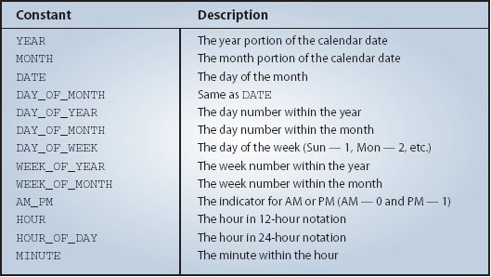
Retrieving Calendar Information
This table shows the class constants for retrieving different pieces of calendar information from Date.
©The McGraw-Hill Companies, Inc. Permission required for reproduction or display.
Chapter 3 - <number>
Notes:
Intro to OOP with Java, C. Thomas Wu
©The McGraw-Hill Companies, Inc.
We can use these class constants to retrieve different pieces of calendar information. We use the get method and pass the desired constant as an argument.
The next slide shows a sample use.

Slide 33
Sample Calendar Retrieval
GregorianCalendar cal = new GregorianCalendar();
//Assume today is Dec 18, 2008
System.out.print(“Today is ” +
(cal.get(Calendar.MONTH)+1) + “/” +
cal.get(Calendar.DATE) + “/” +
cal.get(Calendar.YEAR));
Output
Today is 12/18/2008
©The McGraw-Hill Companies, Inc. Permission required for reproduction or display.
Chapter 3 - <number>
Notes:
Intro to OOP with Java, C. Thomas Wu
©The McGraw-Hill Companies, Inc.
Here’s a sample code. Notice that we need to add 1 to the returned Month, because internally, January is represented as 0, February as 1, and so forth.

Slide 34
Problem Statement
Problem statement:
Write a loan calculator program that computes both monthly and total payments for a given loan amount, annual interest rate, and loan period.
©The McGraw-Hill Companies, Inc. Permission required for reproduction or display.
Chapter 3 - <number>
Notes:
Intro to OOP with Java, C. Thomas Wu
©The McGraw-Hill Companies, Inc.

Slide 35
Overall Plan
Tasks:
  Get three input values: loanAmount, interestRate, and loanPeriod.
  Compute the monthly and total payments.
  Output the results.
©The McGraw-Hill Companies, Inc. Permission required for reproduction or display.
Chapter 3 - <number>
Notes:
Intro to OOP with Java, C. Thomas Wu
©The McGraw-Hill Companies, Inc.
As a part of the overall plan, we begin by identifying the main tasks for the program. Notice this program follows the universal pattern of computer programs, namely, the pattern of input, computation, and output.

Slide 36
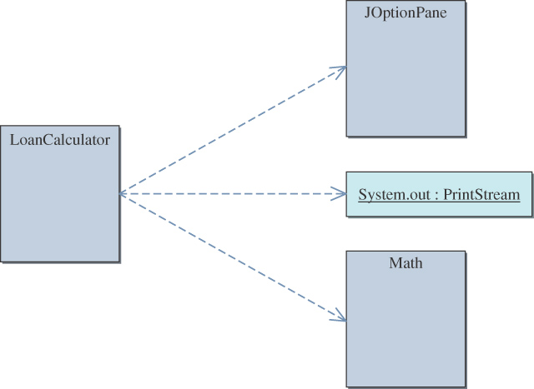
Required Classes
©The McGraw-Hill Companies, Inc. Permission required for reproduction or display.
Chapter 3 - <number>
Notes:
Intro to OOP with Java, C. Thomas Wu
©The McGraw-Hill Companies, Inc.
Given the tasks identified in the overall program flow, we need to find suitable classes and objects to carry out the tasks. For this program, we will use the Math class for computation, JOptionPane for input, and System.out for output. The LoanCalculator class is the main class of the program.

Slide 37
Development Steps
We will develop this program in four steps:
Start with code to accept three input values.
Add code to output the results.
Add code to compute the monthly and total payments.
Update or modify code and tie up any loose ends.
©The McGraw-Hill Companies, Inc. Permission required for reproduction or display.
Chapter 3 - <number>
Notes:
Intro to OOP with Java, C. Thomas Wu
©The McGraw-Hill Companies, Inc.
This order of development steps is quite common. Notice that we are implementing the code for output before implementing the code for computation. Since we need some kind of output routine to test the correct implementation of the computation code, we will implement the actual code for output first, so when we implement the code for computation we can use the actual output routine for testing the computation code.

Slide 38
Step 1 Design
Call the showInputDialog method to accept three input values:
  loan amount,
  annual interest rate,
  loan period.
Data types are
Input | Format | Data Type
loan amount | dollars and cents | double
annual interest rate | in percent (e.g.,12.5) | double
loan period | in years | int
©The McGraw-Hill Companies, Inc. Permission required for reproduction or display.
Chapter 3 - <number>
Notes:
Intro to OOP with Java, C. Thomas Wu
©The McGraw-Hill Companies, Inc.
We will use JOptionPane to input three values. What would be the data types for these three input values? And are these values entered by the users? For example, how should the user enter the loan period? Number of years? Number of months? We need to decide the format that is most natural to the users. After the input format, we need to decide the data types. Are the input values real numbers or integers?

Slide 39
Step 1 Code
    Directory: Chapter3/Step1
    Source File: Ch3LoanCalculator.java
Program source file is too big to list here. From now on, we ask
you to view the source files using your Java IDE.
©The McGraw-Hill Companies, Inc. Permission required for reproduction or display.
Chapter 3 - <number>
Notes:
Intro to OOP with Java, C. Thomas Wu
©The McGraw-Hill Companies, Inc.
Please open your Java IDE and run the program.

Slide 40
Step 1 Test
In the testing phase, we run the program multiple times and verify that
  we can enter three input values
  we see the entered values echo-printed correctly on the standard output window
©The McGraw-Hill Companies, Inc. Permission required for reproduction or display.
Chapter 3 - <number>
Notes:
Intro to OOP with Java, C. Thomas Wu
©The McGraw-Hill Companies, Inc.

Slide 41
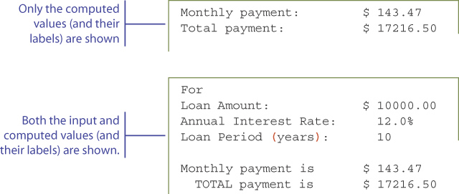
Step 2 Design
We will consider the display format for out.
Two possibilities are (among many others)
©The McGraw-Hill Companies, Inc. Permission required for reproduction or display.
Chapter 3 - <number>
Notes:
Intro to OOP with Java, C. Thomas Wu
©The McGraw-Hill Companies, Inc.
When designing an output routine, we need to decide what to display and how to display them, in other words, the layout of the display.

Slide 42
Step 2 Code
    Directory: Chapter3/Step2
    Source File: Ch3LoanCalculator.java
©The McGraw-Hill Companies, Inc. Permission required for reproduction or display.
Chapter 3 - <number>
Notes:
Intro to OOP with Java, C. Thomas Wu
©The McGraw-Hill Companies, Inc.
Run the program and check the output display format.

Slide 43
Step 2 Test
We run the program numerous times with different types of input values and check the output display format.
Adjust the formatting as appropriate
©The McGraw-Hill Companies, Inc. Permission required for reproduction or display.
Chapter 3 - <number>
Notes:
Intro to OOP with Java, C. Thomas Wu
©The McGraw-Hill Companies, Inc.
We run the the program numerous times and trying out many different input values. We cannot overemphasize the importance of trying out different input values. The output format that may look nice may look horrible for a different set of input values.

Slide 44
Step 3 Design
The formula to compute the geometric progression is the one we can use to compute the monthly payment.
The formula requires the loan period in months and interest rate as monthly interest rate.
So we must convert the annual interest rate (input value) to a monthly interest rate (per the formula), and the loan period to the number of monthly payments.
©The McGraw-Hill Companies, Inc. Permission required for reproduction or display.
Chapter 3 - <number>
Notes:
Intro to OOP with Java, C. Thomas Wu
©The McGraw-Hill Companies, Inc.
Notice the difference in input values and the values required to plug into the formula. For example, we input annual interest rate, but we need monthly interest rate for the formula to compute the monthly payment. It is not appropriate to change the input routine to accept the monthly interest rate. It is easier for the programmer because we need no conversion, but we are writing the program for the sake of users, not for the convenience of programmers. We should always accept the input values that are natural to the users.

Slide 45
Step 3 Code
    Directory: Chapter3/Step3
    Source File: Ch3LoanCalculator.java
©The McGraw-Hill Companies, Inc. Permission required for reproduction or display.
Chapter 3 - <number>
Notes:
Intro to OOP with Java, C. Thomas Wu
©The McGraw-Hill Companies, Inc.
Run the program and check the computation.

Slide 46
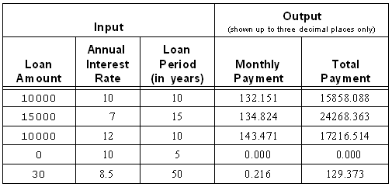
Step 3 Test
We run the program numerous times with different types of input values and check the results.
©The McGraw-Hill Companies, Inc. Permission required for reproduction or display.
Chapter 3 - <number>
Notes:
Intro to OOP with Java, C. Thomas Wu
©The McGraw-Hill Companies, Inc.
We run the final test by executing the program numerous times and enter different input values. The input values in the given table are only suggestions. They are not a complete list of test input values by any mean. You need to try out many other different input values.

Slide 47
Step 4: Finalize
We will add a program description
We will format the monthly and total payments to two decimal places using DecimalFormat.
    Directory: Chapter3/Step4
    Source File: Ch3LoanCalculator.java
©The McGraw-Hill Companies, Inc. Permission required for reproduction or display.
Chapter 3 - <number>
Notes:
Intro to OOP with Java, C. Thomas Wu
©The McGraw-Hill Companies, Inc.
Programmers must be always diligent in actively looking for features that may be missing or features that can use improvements. We notice two features that are must-haves for a good program.

