Slide 1
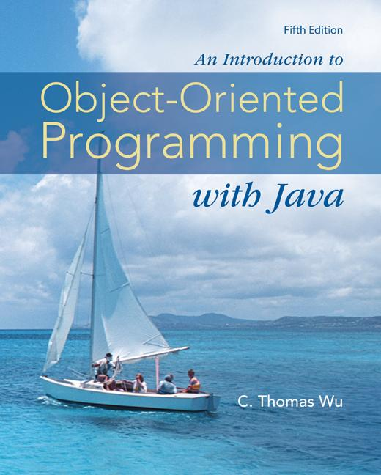
Chapter 11
Sorting
and
Searching
©The McGraw-Hill Companies, Inc. Permission required for reproduction or display.
Animated Version
Chapter 11 - <number>
Notes:
Introduction to OOP with Java 4th Ed, C. Thomas Wu
© The McGraw-Hill Companies, Inc.

Slide 2
Objectives
After you have read and studied this chapter, you should be able to
    Perform linear and binary search algorithms on small arrays.
    Determine whether a linear or binary search is more effective for a given situation.
    Perform selection and bubble sort algorithms.
    Describe the heapsort algorithm and show how its performance is superior to the other two algorithms.
    Apply basic sorting algorithms to sort an array of objects.
©The McGraw-Hill Companies, Inc. Permission required for reproduction or display.
Chapter 11 - <number>
Notes:
Intro to OOP with Java, C. Thomas Wu
©The McGraw-Hill Companies, Inc.

Slide 3
Searching
When we maintain a collection of data, one of the operations we need is a search routine to locate desired data quickly.
Here’s the problem statement:
    Given a value X, return the index of X in the array, if such X exists. Otherwise, return NOT_FOUND (-1). We assume there are no duplicate entries in the array.
We will count the number of comparisons the algorithms make to analyze their performance.
  The ideal searching algorithm will make the least possible number of comparisons to locate the desired data.
  Two separate performance analyses are normally done, one for successful search and another for unsuccessful search.
©The McGraw-Hill Companies, Inc. Permission required for reproduction or display.
Chapter 11 - <number>
Notes:
Intro to OOP with Java, C. Thomas Wu
©The McGraw-Hill Companies, Inc.

Slide 4
Search Result
Unsuccessful Search:
search( 45 )
NOT_FOUND
Successful Search:
search( 12 )
4
number
0
1
2
3
4
5
6
7
8
23
17
5
90
12
44
38
84
77
©The McGraw-Hill Companies, Inc. Permission required for reproduction or display.
Chapter 11 - <number>
Notes:
Intro to OOP with Java, C. Thomas Wu
©The McGraw-Hill Companies, Inc.

Slide 5
Linear Search
Search the array from the first to the last position in linear progression.
public int linearSearch ( int[] number, int searchValue ) {
int loc = 0;
while (loc < number.length && number[loc] != searchValue) {
loc++;
}
if (loc == number.length) { //Not found
return NOT_FOUND;
} else {
return loc; //Found, return the position
}
}
©The McGraw-Hill Companies, Inc. Permission required for reproduction or display.
Chapter 11 - <number>
Notes:
Intro to OOP with Java, C. Thomas Wu
©The McGraw-Hill Companies, Inc.

Slide 6
Linear Search Performance
We analyze the successful and unsuccessful searches separately.
We count how many times the search value is compared against the array elements.
Successful Search
  Best Case – 1 comparison
  Worst Case – N comparisons (N – array size)
Unsuccessful Search
  Best Case =
  Worst Case – N comparisons
©The McGraw-Hill Companies, Inc. Permission required for reproduction or display.
Chapter 11 - <number>
Notes:
Intro to OOP with Java, C. Thomas Wu
©The McGraw-Hill Companies, Inc.
Note: In the case of unsuccessful search, all elements in the array are compared against the search value, so the total number of comparisons is N. However, the actual number of times the while loop is executed is N+1 because we need one more go around to determine that loc becomes equal to number.length.

Slide 7
Binary Search
number
0
1
2
3
4
5
6
7
8
5
12
17
23
38
44
77
84
90
If the array is sorted, then we can apply the binary search technique.
The basic idea is straightforward. First search the value in the middle position. If X is less than this value, then search the middle of the left half next. If X is greater than this value, then search the middle of the right half next. Continue in this manner.
©The McGraw-Hill Companies, Inc. Permission required for reproduction or display.
Chapter 11 - <number>
Notes:
Intro to OOP with Java, C. Thomas Wu
©The McGraw-Hill Companies, Inc.

Slide 8
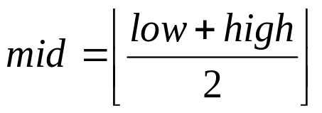
Sequence of Successful Search - 1
low high mid
search( 44 )
#1
0 8
4
0
1
2
3
4
5
6
7
8
5
12
17
23
38
44
77
84
90
low
mid
high
38 < 44
low = mid+1 = 5
©The McGraw-Hill Companies, Inc. Permission required for reproduction or display.
Chapter 11 - <number>
Notes:
Intro to OOP with Java, C. Thomas Wu
©The McGraw-Hill Companies, Inc.

Slide 9
Sequence of Successful Search - 2
low high mid
search( 44 )
#1
0 8
4
#2
5 8
6
0
1
2
3
4
5
6
7
8
5
12
17
23
38
44
77
84
90
low
mid
high
high = mid-1=5
44 < 77
©The McGraw-Hill Companies, Inc. Permission required for reproduction or display.
Chapter 11 - <number>
Notes:
Intro to OOP with Java, C. Thomas Wu
©The McGraw-Hill Companies, Inc.

Slide 10
Sequence of Successful Search - 3
low high mid
search( 44 )
#1
0 8
4
#2
5 8
6
#3
5 5
5
0
1
2
3
4
5
6
7
8
5
12
17
23
38
44
77
84
90
low
high
mid
Successful Search!!
44 == 44
©The McGraw-Hill Companies, Inc. Permission required for reproduction or display.
Chapter 11 - <number>
Notes:
Intro to OOP with Java, C. Thomas Wu
©The McGraw-Hill Companies, Inc.

Slide 11
Sequence of Unsuccessful Search - 1
low high mid
search( 45 )
#1
0 8
4
0
1
2
3
4
5
6
7
8
5
12
17
23
38
44
77
84
90
low
mid
high
38 < 45
low = mid+1 = 5
©The McGraw-Hill Companies, Inc. Permission required for reproduction or display.
Chapter 11 - <number>
Notes:
Intro to OOP with Java, C. Thomas Wu
©The McGraw-Hill Companies, Inc.

Slide 12
Sequence of Unsuccessful Search - 2
low high mid
search( 45 )
#1
0 8
4
#2
5 8
6
0
1
2
3
4
5
6
7
8
5
12
17
23
38
44
77
84
90
low
mid
high
high = mid-1=5
45 < 77
©The McGraw-Hill Companies, Inc. Permission required for reproduction or display.
Chapter 11 - <number>
Notes:
Intro to OOP with Java, C. Thomas Wu
©The McGraw-Hill Companies, Inc.

Slide 13
Sequence of Unsuccessful Search - 3
low high mid
search( 45 )
#1
0 8
4
#2
5 8
6
#3
5 5
5
0
1
2
3
4
5
6
7
8
5
12
17
23
38
44
77
84
90
low
high
mid
44 < 45
low = mid+1 = 6
©The McGraw-Hill Companies, Inc. Permission required for reproduction or display.
Chapter 11 - <number>
Notes:
Intro to OOP with Java, C. Thomas Wu
©The McGraw-Hill Companies, Inc.

Slide 14
Sequence of Unsuccessful Search - 4
low high mid
search( 45 )
#1
0 8
4
#2
5 8
6
#3
5 5
5
#4
6 5
0
1
2
3
4
5
6
7
8
5
12
17
23
38
44
77
84
90
high
low
Unsuccessful Search
no more elements to search
low > high
©The McGraw-Hill Companies, Inc. Permission required for reproduction or display.
Chapter 11 - <number>
Notes:
Intro to OOP with Java, C. Thomas Wu
©The McGraw-Hill Companies, Inc.

Slide 15
Binary Search Routine
public int binarySearch (int[] number, int searchValue) {
int low = 0,
high = number.length - 1,
mid = (low + high) / 2;
while (low <= high && number[mid] != searchValue) {
if (number[mid] < searchValue) {
low = mid + 1;
} else { //number[mid] > searchValue
high = mid - 1;
}
mid = (low + high) / 2; //integer division will truncate
}
if (low > high) {
mid = NOT_FOUND;
}
return mid;
}
©The McGraw-Hill Companies, Inc. Permission required for reproduction or display.
Chapter 11 - <number>
Notes:
Intro to OOP with Java, C. Thomas Wu
©The McGraw-Hill Companies, Inc.

Slide 16
Binary Search Performance
Successful Search
  Best Case – 1 comparison
  Worst Case – log₂N comparisons
Unsuccessful Search
  Best Case =
  Worst Case – log₂N comparisons
Since the portion of an array to search is cut into half after every comparison, we compute how many times the array can be divided into halves.
After K comparisons, there will be N/2^{K} elements in the list. We solve for K when N/2^{K} = 1, deriving K = log₂N.
©The McGraw-Hill Companies, Inc. Permission required for reproduction or display.
Chapter 11 - <number>
Notes:
Intro to OOP with Java, C. Thomas Wu
©The McGraw-Hill Companies, Inc.

Slide 17
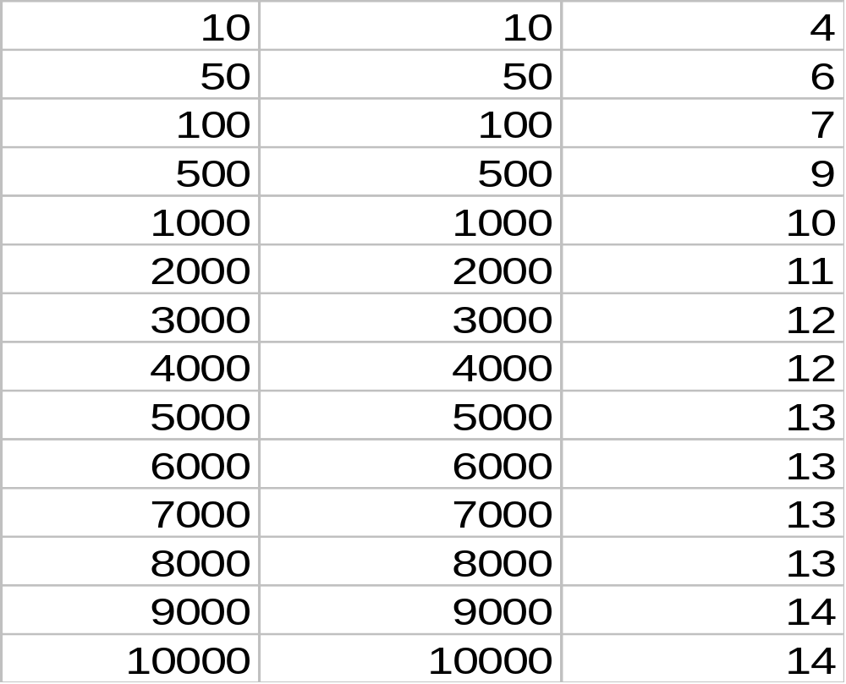
Comparing N and log₂N Performance
Array Size
Linear – N
Binary – log₂N
©The McGraw-Hill Companies, Inc. Permission required for reproduction or display.
Chapter 11 - <number>
Notes:
Intro to OOP with Java, C. Thomas Wu
©The McGraw-Hill Companies, Inc.
Note: The value of log₂N is a real number. Since the number of comparisons done is an integer, the result of log₂N is rounded up to an integer in the third column.

Slide 18
Sorting
When we maintain a collection of data, many applications call for rearranging the data in certain order, e.g. arranging Person information in ascending order of age.
Here’s the problem statement:
  Given an array of N integer values, arrange the values into ascending order.
We will count the number of comparisons the algorithms make to analyze their performance.
  The ideal sorting algorithm will make the least possible number of comparisons to arrange data in a designated order.
We will compare different sorting algorithms by analyzing their worst-case performance.
©The McGraw-Hill Companies, Inc. Permission required for reproduction or display.
Chapter 11 - <number>
Notes:
Intro to OOP with Java, C. Thomas Wu
©The McGraw-Hill Companies, Inc.

Slide 19
Selection Sort
first
min
Find the smallest element in the list.
0
1
2
3
4
5
6
7
8
Exchange the element in the first position and the smallest element. Now the smallest element is in the first position.
23
17
5
90
12
44
38
84
77
exchange
Repeat Step 1 and 2 with the list having one less element (i.e., the smallest element is discarded from further processing).
0
1
2
3
4
5
6
7
8
5
17
23
90
12
44
38
84
77
sorted
unsorted
This is the result of one pass.
©The McGraw-Hill Companies, Inc. Permission required for reproduction or display.
Chapter 11 - <number>
Notes:
Intro to OOP with Java, C. Thomas Wu
©The McGraw-Hill Companies, Inc.

Slide 20
Selection Sort Passes
Pass #
0
1
2
3
4
5
6
7
8
1
5
17
23
90
12
44
38
84
77
Result AFTER one pass is completed.
sorted
2
5
12
23
90
17
44
38
84
77
3
5
12
17
90
23
44
38
84
77
7
5
12
17
23
38
44
77
84
90
8
5
12
17
23
38
44
77
84
90
©The McGraw-Hill Companies, Inc. Permission required for reproduction or display.
Chapter 11 - <number>
Notes:
Intro to OOP with Java, C. Thomas Wu
©The McGraw-Hill Companies, Inc.
The figure shows the whole eight passes. The illustration for each pass shows the state right BEFORE the exchange was made for that pass. The illustrations in the slide show the state AFTER the exchange was made for that pass.

Slide 21
Selection Sort Routine
public void selectionSort( int[] number )
{
int startIndex, minIndex, length, temp;
length = number.length;
for (startIndex = 0; startIndex <= length-2; startIndex++){
//each iteration of the for loop is one pass
minIndex = startIndex;
//find the smallest in this pass at position minIndex
for (i = startIndex+1; i <= length-1; i++) {
if (number[i] < number[minIndex]) minIndex = i;
}
//exchange number[startIndex] and number[minIndex]
temp = number[startIndex];
number[startIndex] = number[minIndex];
number[minIndex] = temp;
}
}
©The McGraw-Hill Companies, Inc. Permission required for reproduction or display.
Chapter 11 - <number>
Notes:
Intro to OOP with Java, C. Thomas Wu
©The McGraw-Hill Companies, Inc.

Slide 22
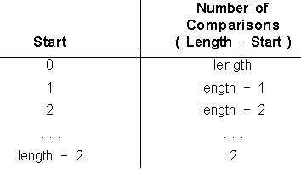
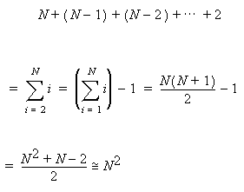

Selection Sort Performance
We derive the total number of comparisons by counting the number of times the inner loop is executed.
For each execution of the outer loop, the inner loop is executed length – start times.
The variable length is the size of the array. Replacing length with N, the array size, the sum is derived as…
©The McGraw-Hill Companies, Inc. Permission required for reproduction or display.
Chapter 11 - <number>
Notes:
Intro to OOP with Java, C. Thomas Wu
©The McGraw-Hill Companies, Inc.

Slide 23
Bubble Sort
With the selection sort, we make one exchange at the end of one pass.
The bubble sort improves the performance by making more than one exchange during its pass.
By making multiple exchanges, we will be able to move more elements toward their correct positions using the same number of comparisons as the selection sort makes.
The key idea of the bubble sort is to make pairwise comparisons and exchange the positions of the pair if they are out of order.
©The McGraw-Hill Companies, Inc. Permission required for reproduction or display.
Chapter 11 - <number>
Notes:
Intro to OOP with Java, C. Thomas Wu
©The McGraw-Hill Companies, Inc.

Slide 24
One Pass of Bubble Sort
0
1
2
3
4
5
6
7
8
23
17
5
90
12
44
38
84
77
17
5
23
12
44
90
38
84
77
exchange
exchange
17
23
5
90
12
44
38
84
77
17
5
23
12
44
38
90
84
77
exchange
exchange
17
5
23
90
12
44
38
84
77
17
5
23
12
44
38
84
90
77
exchange
ok
exchange
17
5
23
12
90
44
38
84
77
17
5
23
12
44
38
84
77
90
exchange
The largest value 90 is at the end of the list.
©The McGraw-Hill Companies, Inc. Permission required for reproduction or display.
Chapter 11 - <number>
Notes:
Intro to OOP with Java, C. Thomas Wu
©The McGraw-Hill Companies, Inc.
What is the meaning behind the name “bubble” sort? Notice the effect of one pass is to migrate the largest element to the last position of the array. In addition, because we are exchanging the pairs if they are out of order, other elements migrate toward the end of the array. If we view the array vertically with the first position at the bottom and the last position at the top, the data movements we see is like bubbles moving toward the surface of water.

Slide 25
Bubble Sort Routine
public void bubbleSort(int[] number) {
int temp, bottom, i;
boolean exchanged = true;
bottom = number.length - 2;
while (exchanged) {
exchanged = false;
for (i = 0; i <= bottom; i++) {
if (number[i] > number[i+1]) {
temp = number[i]; //exchange
number[i] = number[i+1];
number[i+1] = temp;
exchanged = true; //exchange is made
}
}
bottom--;
}
}
©The McGraw-Hill Companies, Inc. Permission required for reproduction or display.
Chapter 11 - <number>
Notes:
Intro to OOP with Java, C. Thomas Wu
©The McGraw-Hill Companies, Inc.
The bubble sort routine is implemented by exploiting the following two properties:
1. After one pass through the array, the largest element will be at the end of the array.
2. During one pass, if no pair of consecutive entries is out of order, then the array is sorted.

Slide 26
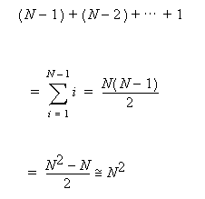
Bubble Sort Performance
In the worst case, the outer while loop is executed N-1 times for carrying out N-1 passes.
For each execution of the outer loop, the inner loop is executed bottom+1 times. The number of comparisons in each successive pass is N-1, N-2, … , 1. Summing these will result in the total number of comparisons.
So the performances of the bubble sort and the selection sort are approximately equivalent. However, on the average, the bubble sort performs much better than the selection sort because it can finish the sorting without doing all N-1 passes.
©The McGraw-Hill Companies, Inc. Permission required for reproduction or display.
Chapter 11 - <number>
Notes:
Intro to OOP with Java, C. Thomas Wu
©The McGraw-Hill Companies, Inc.
The selection sort will carry out N-1 passes no matter what. Whether the array is already sorted or very close to being sorted does not matter to the selection sort. It will carry out the same number of comparisons in sorting a given array.
The bubble sort, on the other hand, can detect if the array is or has become sorted during the sorting process. So the bubble sort is adaptable, it does fewer comparisons for the arrays that are closer to being sorted than those that are not.
In addition to the larger number of data movements during a single pass, the capability of checking the “sortedness” of the array enables the bubble sort routine to complete the whole sorting process much quicker than the selection sort. Indeed, the only situation that causes the bubble sort routine to execute the worst case number of comparisons is when the original array is in the reverse order (i.e., in descending order).

Slide 27
Heapsort
Selection and bubble sorts are two fundamental sorting algorithms that take approximately N² comparisons to sort an array of N elements.
One sorting algorithm that improves the performance to approximately 1.5Nlog₂N is called heapsort.
The heapsort algorithm uses a special data structure called a heap.
A heap structure can be implemented very effectively by using an array.
©The McGraw-Hill Companies, Inc. Permission required for reproduction or display.
Chapter 11 - <number>
Notes:
Intro to OOP with Java, C. Thomas Wu
©The McGraw-Hill Companies, Inc.

Slide 28
Sample Heap
Level #
0
1
90
root
1
2
index
2
84
44
3
4
5
6
3
77
12
5
38
7
8
4
17
23
left child
of
44
right child
of
44
©The McGraw-Hill Companies, Inc. Permission required for reproduction or display.
Chapter 11 - <number>
Notes:
Intro to OOP with Java, C. Thomas Wu
©The McGraw-Hill Companies, Inc.
We use integers as data values for the examples in this section.
The topmost node is called the root of a heap. Nodes in a heap are indexed 0, 1, 2, and so forth in the top-to-bottom, left-to-right order starting from the root.
A node in a heap has either zero, one, or two children. The children of a node are distinguished as the node’s left and right children.
If a node has only one child, then it is the left child of the node.

Slide 29
Heap Constraints
A heap must satisfy the following two constraints:
  Structural Constraint: Nodes in a heap with N nodes must occupy the positions numbered 0, 1, ..., N-1.
  Value Relationship Constraint: A value stored in a node must be larger than the maximum of the values stored in its left and right children.
©The McGraw-Hill Companies, Inc. Permission required for reproduction or display.
Chapter 11 - <number>
Notes:
Intro to OOP with Java, C. Thomas Wu
©The McGraw-Hill Companies, Inc.

Slide 30
Structural Constraints
Sample heaps and nonheaps that violate the structural constraints:
Heaps
Nonheaps
©The McGraw-Hill Companies, Inc. Permission required for reproduction or display.
Chapter 11 - <number>
Notes:
Intro to OOP with Java, C. Thomas Wu
©The McGraw-Hill Companies, Inc.

Slide 31
Value Relationship Constraints
Sample heaps and nonheaps that violate the value relationship constraints:
45
45
90
25
16
12
34
35
24
Heaps
22
3
12
9
11
22
12
13
16
45
45
45
55
16
25
33
25
55
Nonheaps
58
3
12
22
34
23
22
3
12
©The McGraw-Hill Companies, Inc. Permission required for reproduction or display.
Chapter 11 - <number>
Notes:
Intro to OOP with Java, C. Thomas Wu
©The McGraw-Hill Companies, Inc.

Slide 32
Heapsort Algorithm
How can we use the heap structure to sort N elements?
Heapsort is carried out in two phases:
  Construction Phase: Construct a heap with given N elements.
  Extraction Phase: Pull out the value in the root successively, creating a new heap with one less element after each extraction.
©The McGraw-Hill Companies, Inc. Permission required for reproduction or display.
Chapter 11 - <number>
Notes:
Intro to OOP with Java, C. Thomas Wu
©The McGraw-Hill Companies, Inc.

Slide 33
Extraction Phase
After each extraction, a heap must be rebuilt with one less element. One sample extraction step:
0
0
0
1
1
1
2
2
2
3
3
3
4
4
4
5
5
5
6
6
6
7
7
7
8
8
0
8
0
1
1
2
2
3
3
4
4
5
5
6
6
7
7
8
0
1
2
3
4
5
6
7
8
8
90
90
90
90
90
0
0
0
0
0
0
90
23
84
84
90
84
90
1
1
1
2
2
1
2
1
2
1
2
2
84
23
77
84
84
77
44
44
44
44
44
44
3
3
3
3
4
4
4
4
5
5
5
5
6
6
6
3
4
5
6
3
4
5
6
6
12
5
12
12
5
12
5
12
5
12
5
77
5
77
77
23
77
23
38
38
38
38
38
38
7
7
7
7
8
7
8
7
17
23
17
17
17
17
23
17
23 > max{17}?
23 > max{84, 44}?
23 > max{77, 12}?
YES, so stop.
NO, so swap.
NO, so swap.
Before
After
©The McGraw-Hill Companies, Inc. Permission required for reproduction or display.
Chapter 11 - <number>
Notes:
Intro to OOP with Java, C. Thomas Wu
©The McGraw-Hill Companies, Inc.

Slide 34
Rebuild Steps
A sequence of rebuild steps to sort the list.
0
1
2
3
4
5
6
7
8
0
0
0
0
0
0
0
0
0
0
1
1
1
1
1
1
1
1
1
1
2
2
2
2
2
2
2
2
2
2
3
3
3
3
3
3
3
3
3
3
4
4
4
4
4
4
4
4
4
4
5
5
5
5
5
5
5
5
5
5
6
6
6
6
6
6
6
6
6
6
7
7
7
7
7
7
7
7
7
7
8
8
8
8
8
8
8
8
8
8
12
12
5
12
5
90
90
90
90
90
90
90
90
90
84
90
84
84
84
84
84
84
84
17
84
17
17
23
23
23
38
38
38
17
23
38
23
38
38
44
44
44
44
44
44
44
77
77
77
77
77
77
77
77
0
0
0
0
0
0
0
0
0
0
44
23
90
12
84
77
38
17
5
90
84
90
77
38
5
44
17
12
23
1
2
1
1
2
1
1
1
1
2
2
2
1
2
1
2
2
Sorting was completed
after 8 rebuild steps.
23
17
5
23
23
84
12
84
77
38
44
5
44
44
5
5
44
3
3
4
5
3
3
3
4
4
4
5
5
6
3
4
5
6
3
4
5
6
6
12
5
12
12
5
12
5
12
12
5
17
5
77
12
77
17
17
38
23
38
38
38
7
8
7
7
8
17
23
17
23
17
Before
Done
©The McGraw-Hill Companies, Inc. Permission required for reproduction or display.
Chapter 11 - <number>
Notes:
Intro to OOP with Java, C. Thomas Wu
©The McGraw-Hill Companies, Inc.

Slide 35
Construction Phase
Rebuild steps are applied from position ⎣(N-2)/2 ⎦ to position 0.
0
0
0
0
0
0
0
⎣(9-2)/2 ⎦ = 3
23
23
23
23
23
90
1
2
1
1
1
1
1
1
2
2
2
2
2
2
17
17
17
17
90
5
84
5
5
44
44
44
3
4
5
6
3
3
3
3
3
4
4
4
4
4
5
5
5
5
5
6
6
6
6
3
6
12
44
12
12
12
12
12
44
44
5
5
90
90
5
90
90
84
38
77
38
38
38
38
38
7
8
7
7
7
7
7
8
8
8
8
8
84
77
84
84
84
17
17
77
77
77
77
23
Before
Done
©The McGraw-Hill Companies, Inc. Permission required for reproduction or display.
Chapter 11 - <number>
Notes:
Intro to OOP with Java, C. Thomas Wu
©The McGraw-Hill Companies, Inc.

Slide 36
Heap Implementation
We need to implement the abstract data structure heap into a concrete data structure.
0
90
1
2
0
1
2
3
4
5
6
7
8
84
44
90
84
44
77
12
5
38
17
23
3
4
5
6
77
12
5
38
7
8
17
23
Abstract Heap Structure
Concrete Implementation
©The McGraw-Hill Companies, Inc. Permission required for reproduction or display.
Chapter 11 - <number>
Notes:
Intro to OOP with Java, C. Thomas Wu
©The McGraw-Hill Companies, Inc.
The heap structure can be characterized as an abstract data structure because the Java language (and others) does not include such data structure as a part of its language definition. An array is a concrete data structure that is a part of the Java language and the one which we can use effectively here to implement the abstract data structure heap.
This slide shows the correspondence between the heap and the array representation. An important aspect in deciding which data structure to use is the ease of locating a given node’s left and right child. With an array implementation, we can locate any node’s left and right child easily. A node with index I has its left child at index 2ÞI + 1 and right child at index 2ÞI + 2.

Slide 37
The construct Method
private void construct( ) {
for (int i = (heap.length-2) / 2; i >= 0; i--) {
current = i;
done = false;
while ( !done ) {
if ( current has no children ) {
done = true;
} else {
if (current node < larger child) {
swap the two nodes;
set current points to the larger child;
} else {
done = true;
}
}
}
}
}
©The McGraw-Hill Companies, Inc. Permission required for reproduction or display.
Chapter 11 - <number>
Notes:
Intro to OOP with Java, C. Thomas Wu
©The McGraw-Hill Companies, Inc.
private void construct( )
{
int current, maxChildIndex;
boolean done;
for (int i = (heap.length-2) / 2; i >= 0; i--) {
current = i;
done = false;
while ( !done ) {//perform one rebuild step
//with the node at index i
if ( 2*current+1 > heap.length-1 ) {
//current node has no children, so stop
done = true;
}
else {
//current node has at least one child,
//get the index of larger child
maxChildIndex = maxChild( current, heap.length-1 );
if ( heap[current] < heap[maxChildIndex] ) {
//a child is larger, so swap and continue
swap( current, maxChildIndex );
current = maxChildIndex;
}
else { //the value relationship constraint
//is satisfied, so stop
done = true;
}
}
}
}
testPrint( heap.length ); //TEMP
}

Slide 38
The extract Method
private void extract( ) {
for (int size = heap.length-1; size >= 0; size--) {
remove the root node data;
move the last node to the root;
done = false; //rebuild the heap with one less element
while (!done) {
if (current has no children) {
done = true;
} else {
if (current node < larger child) {
swap the two nodes;
set current points to the larger child;
} else {
done = true;
}
}
}
}
}
©The McGraw-Hill Companies, Inc. Permission required for reproduction or display.
Chapter 11 - <number>
Notes:
Intro to OOP with Java, C. Thomas Wu
©The McGraw-Hill Companies, Inc.
private void extract( )
{
int current, maxChildIndex;
boolean done;
for (int size = heap.length-1; size >= 0; size--) {
//remove the root node data
sortedList[size] = heap[ 0 ];
//move the last node to the root
heap[ 0 ] = heap[size];
//rebuild the heap with one less element
current = 0;
done = false;
while ( !done ) {
if ( 2*current+1 > size ) {//current node has no children, so stop
done = true;
}
else {
//current node has at least one child,
//get the index of larger child
maxChildIndex = maxChild( current, size );
if ( heap[current] < heap[maxChildIndex] ) {
//a child is larger, so swap and continue
swap( current, maxChildIndex );
current = maxChildIndex;
}
else { //value relationship constraint
//is satisfied, so stop
done = true;
}
}
}
testPrint( size ); //TEMP
}
}

Slide 39
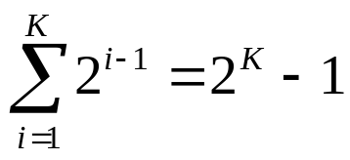

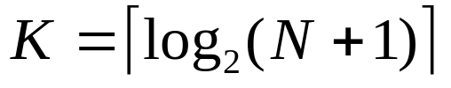

Heapsort Performance
The total number of comparisons in the extraction phase is (N-1)×K where K is the depth of a heap.
We solve for K using the fact that the heap must satisfy the structural constraint:
total # nodes in a heap
with depth K
this holds because
of the structural
constraint
Therefore,
©The McGraw-Hill Companies, Inc. Permission required for reproduction or display.
Chapter 11 - <number>
Notes:
Intro to OOP with Java, C. Thomas Wu
©The McGraw-Hill Companies, Inc.

Slide 40
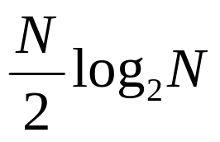
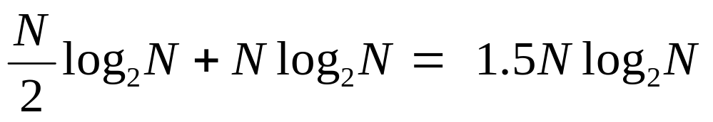
Heapsort Performance (cont'd)
There are N/2 rebuild steps in the construction phase.
Each rebuild step will take no more than K comparisons.
The total number of comparisons in the construction phase is approximately
Therefore, the total number of comparisons for both phases is
©The McGraw-Hill Companies, Inc. Permission required for reproduction or display.
Chapter 11 - <number>
Notes:
Intro to OOP with Java, C. Thomas Wu
©The McGraw-Hill Companies, Inc.

Slide 41
Problem Statement
Add the sorting capability to the AddressBook class from Chapter 10. The new AddressBook class will include a method that sort Person objects in alphabetical order of their names or in ascending order of their ages.
©The McGraw-Hill Companies, Inc. Permission required for reproduction or display.
Chapter 11 - <number>
Notes:
Intro to OOP with Java, C. Thomas Wu
©The McGraw-Hill Companies, Inc.

Slide 42
Overall Plan
Instead of going through the development steps, we will present three different implementations.
The three versions are named AddressBookVer1, AddressBookVer2, and AddressBookVer3.
These classes will implement the AddressBook interface.
©The McGraw-Hill Companies, Inc. Permission required for reproduction or display.
Chapter 11 - <number>
Notes:
Intro to OOP with Java, C. Thomas Wu
©The McGraw-Hill Companies, Inc.

Slide 43
The AddressBook Interface
interface AddressBook {
public void add(Person newPerson);
public boolean delete(String searchName);
public Person search(String searchName);
public Person[ ] sort (int attribute);
}
©The McGraw-Hill Companies, Inc. Permission required for reproduction or display.
Chapter 11 - <number>
Notes:
Intro to OOP with Java, C. Thomas Wu
©The McGraw-Hill Companies, Inc.

Slide 44
AddressBookVer1 Design
We use an array of Person objects
We provide our own sorting method in the AddressBookVer1 class
We define the Person class so we can compare Person objects by name or by age
©The McGraw-Hill Companies, Inc. Permission required for reproduction or display.
Chapter 11 - <number>
Notes:
Intro to OOP with Java, C. Thomas Wu
©The McGraw-Hill Companies, Inc.

Slide 45
Comparing Person Objects
First, we need to determine how to compare Person objects
The following does not make sense:
        Person p1 = …;
        Person p2 = …;
        if ( p1 < p2 ) { … }
©The McGraw-Hill Companies, Inc. Permission required for reproduction or display.
Chapter 11 - <number>
Notes:
Intro to OOP with Java, C. Thomas Wu
©The McGraw-Hill Companies, Inc.

Slide 46
Modify the Person Class
Modify the Person class to include a variable that tells which attribute to compare.
class Person {
…
public static final int NAME = 0;
public static final int AGE = 1;
public static int compareAttribute = NAME;
…
public static void setCompareAttribute(int attribute) {
compareAttribute = attribute;
}
…
}
©The McGraw-Hill Companies, Inc. Permission required for reproduction or display.
Chapter 11 - <number>
Notes:
Intro to OOP with Java, C. Thomas Wu
©The McGraw-Hill Companies, Inc.

Slide 47
The compareTo Method
To compare Person objects, first set the comparison attribute and then call the compareTo Method.
Person.setCompareAttribute
(Person.NAME);
int compResult = p1.compareTo(p2);
if (compResult < 0) {
//p1 “less than” p2
} else if (compResult == 0) {
//p1 “equals” pw
} else {
//p2 “greater than” p2
}
public int compareTo(Person p) {
int compResult;
if ( comparisonAttribute == AGE ) {
int p2age = p.getAge();
if ( this.age < p2age ) {
compResult = LESS;
}
…
} else { //compare Name
String p2Name = p.getName();
compResult = this.name.
compareTo(p2Name);
}
return compResult;
}
©The McGraw-Hill Companies, Inc. Permission required for reproduction or display.
Chapter 11 - <number>
Notes:
Intro to OOP with Java, C. Thomas Wu
©The McGraw-Hill Companies, Inc.
public int compareTo( Person person )
{
int comparisonResult;
if ( compareAttribute == AGE ) {
int p2age = person.getAge( );
if (this.age < p2age) {
comparisonResult = LESS;
}
else if (this.age == p2age) {
comparisonResult = EQUAL;
}
else { //this.age > p2age
comparisonResult = MORE;
}
}
else { //compare names with String’s compareTo
String p2name = person.getName( );
comparisonResult = this.name.compareTo( p2name );
}
return comparisonResult;
}

Slide 48
The sort Method
public Person[ ] sort (int attribute) {
Person[ ] sortedList = new Person[count];
Person p1, p2, temp;
//copy references to sortedList
for (int i = 0; i < count; i++) {
sortedList[i] = entry[i];
}
//Set the comparison attribute
Person.setCompareAttribute(attribute);
//begin the bubble sort on sortedList
…
}
return sortedList;
}
©The McGraw-Hill Companies, Inc. Permission required for reproduction or display.
Chapter 11 - <number>
Notes:
Intro to OOP with Java, C. Thomas Wu
©The McGraw-Hill Companies, Inc.
public Person[ ] sort ( int attribute )
{
Person[ ] sortedList = new Person[ count ];
Person p1, p2, temp;
//copy references to sortedList; see Figure 10.17
for (int i = 0; i < count; i++) {
sortedList[i] = entry[i];
}
//Set the comparison attribute
Person.setCompareAttribute( attribute );
//begin the bubble sort on sortedList
int bottom, i, comparisonResult;
boolean exchanged = true;
bottom = sortedList.length - 2;
while ( exchanged ) {
exchanged = false;
for (i = 0; i <= bottom; i++) {
p1 = sortedList[i];
p2 = sortedList[i+1];
comparisonResult = p1.compareTo(p2, attribute);
if ( comparisonResult > 0 ) { //p1 is 'larger'
sortedList[i] = p2; //than p2,so
sortedList[i+1] = p1; //exchange
exchanged = true; //exchange is made
}
}
bottom--;
}
return sortedList;
}

Slide 49
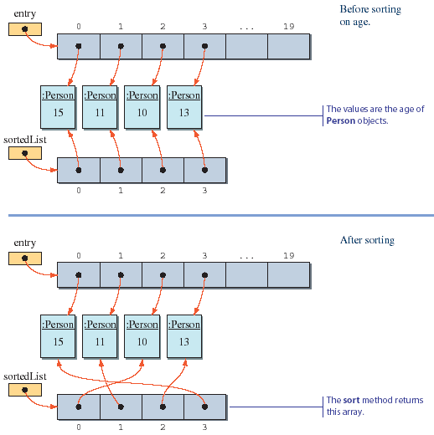
The Use of sortedList in the sort Method
Before
Sorting
This is the age value
After
Sorting
Return this array
©The McGraw-Hill Companies, Inc. Permission required for reproduction or display.
Chapter 11 - <number>
Notes:
Intro to OOP with Java, C. Thomas Wu
©The McGraw-Hill Companies, Inc.

Slide 50
AddressBookVer1 Code
    Directory: Chapter11/
    Source Files: AddressBookVer1.java
Program source file is too big to list here. From now on, we ask
you to view the source files using your Java IDE.
©The McGraw-Hill Companies, Inc. Permission required for reproduction or display.
Chapter 11 - <number>
Notes:
Intro to OOP with Java, C. Thomas Wu
©The McGraw-Hill Companies, Inc.
Please use your Java IDE to view the source files and run the program.

Slide 51
AddressBookVer2 Design
We use the java.util.Arrays class to sort an array of Person objects
The Person class does not include any comparison methods. Instead, we implement the Comparator interface. We can define the implementation class so we can compare Person objects using any combination of their attributes
  For example, we can define a comparator that compares Person objects by using both name and age
©The McGraw-Hill Companies, Inc. Permission required for reproduction or display.
Chapter 11 - <number>
Notes:
Intro to OOP with Java, C. Thomas Wu
©The McGraw-Hill Companies, Inc.

Slide 52
The AgeComparator Class
This class compares the age attributes of Person objects
class AgeComparator implements Comparator<Person> {
private final int LESS = -1;
private final int EQUAL = 0;
private final int MORE = 1;
public int compare(Person p1, Person p2) {
int comparisonResult;
int p1age = p1.getAge( );
int p2age = p2.getAge( );
if (p1age < p2age) {
comparisonResult = LESS;
} else if (p1age == p2age) {
comparisonResult = EQUAL;
} else {
assert p1age > p2age;
comparisonResult = MORE;
}
return comparisonResult;
}
}
©The McGraw-Hill Companies, Inc. Permission required for reproduction or display.
Chapter 11 - <number>
Notes:
Intro to OOP with Java, C. Thomas Wu
©The McGraw-Hill Companies, Inc.

Slide 53
The NameComparator Class
This class compares the age attributes of Person objects
Because the name attribute is a string we can use the compareTo method of the String class
class NameComparator implements Comparator<Person> {
public int compare(Person p1, Person p2) {
String p1name = p1.getName( );
String p2name = p2.getName( );
return p1name.compareTo(p2name);
}
}
©The McGraw-Hill Companies, Inc. Permission required for reproduction or display.
Chapter 11 - <number>
Notes:
Intro to OOP with Java, C. Thomas Wu
©The McGraw-Hill Companies, Inc.

Slide 54
The sort Method
We use the sort method of the java.util.Arrays class
public Person[ ] sort ( int attribute ) {
if (!(attribute == Person.NAME ||
attribute == Person.AGE) ) {
throw new IllegalArgumentException( );
}
Person[ ] sortedList = new Person[ count ];
//copy references to sortedList
for (int i = 0; i < count; i++) {
sortedList[i] = entry[i];
}
Arrays.sort(sortedList, getComparator(attribute));
return sortedList;
}
©The McGraw-Hill Companies, Inc. Permission required for reproduction or display.
Chapter 11 - <number>
Notes:
Intro to OOP with Java, C. Thomas Wu
©The McGraw-Hill Companies, Inc.

Slide 55
AddressBookVer2 Code
    Directory: Chapter11/
    Source Files: AddressBookVer2.java
Program source file is too big to list here. From now on, we ask
you to view the source files using your Java IDE.
©The McGraw-Hill Companies, Inc. Permission required for reproduction or display.
Chapter 11 - <number>
Notes:
Intro to OOP with Java, C. Thomas Wu
©The McGraw-Hill Companies, Inc.
Please use your Java IDE to view the source files and run the program.

Slide 56
AddressBookVer3 Design
In the previous two versions, we used an array data structure to maintain a collection of Person objects
In the third version, we don't use an array at all.
Instead, we use a Map from the Java Collection Framework to maintain a collection of Person objects.
We use the person's name as the key of a Map entry and the person object as the value of a Map entry.
©The McGraw-Hill Companies, Inc. Permission required for reproduction or display.
Chapter 11 - <number>
Notes:
Intro to OOP with Java, C. Thomas Wu
©The McGraw-Hill Companies, Inc.

Slide 57
The sort Method
We retrieve a collection of values in the map, converts it to an array, and use the sort method of the java.util.Arrays class to sort this array.
public Person[ ] sort ( int attribute ) {
if (!(attribute == Person.NAME ||
attribute == Person.AGE) ) {
throw new IllegalArgumentException( );
}
Person[ ] sortedList = new Person[entry.size()];
entry.values().toArray(sortedList);
Arrays.sort(sortedList, getComparator(attribute));
return sortedList;
}
©The McGraw-Hill Companies, Inc. Permission required for reproduction or display.
Chapter 11 - <number>
Notes:
Intro to OOP with Java, C. Thomas Wu
©The McGraw-Hill Companies, Inc.

Slide 58
AddressBookVer3 Code
    Directory: Chapter11/
    Source Files: AddressBookVer3.java
Program source file is too big to list here. From now on, we ask
you to view the source files using your Java IDE.
©The McGraw-Hill Companies, Inc. Permission required for reproduction or display.
Chapter 11 - <number>
Notes:
Intro to OOP with Java, C. Thomas Wu
©The McGraw-Hill Companies, Inc.
Please use your Java IDE to view the source files and run the program.

