Slide 1
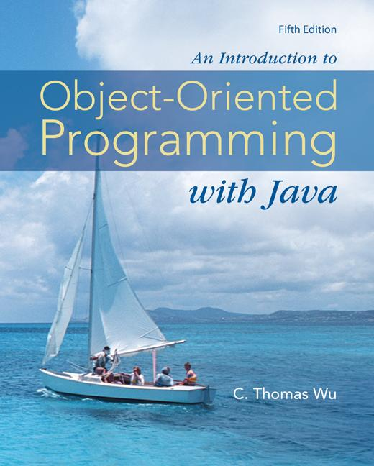
Chapter 13
Inheritance
and
Polymorphism
©The McGraw-Hill Companies, Inc. Permission required for reproduction or display.
Animated Version
Chapter 13 - <number>
Notes:
Introduction to OOP with Java 4th Ed, C. Thomas Wu
© The McGraw-Hill Companies, Inc.

Slide 2
Chapter 13 Objectives
After you have read and studied this chapter, you should be able to
  Write programs that are easily extensible and modifiable by applying polymorphism in program design.
  Define reusable classes based on inheritance and abstract classes and abstract methods.
  Differentiate the abstract classes and Java interfaces.
  Define methods, using the protected modifier.
  Parse strings, using a String Tokenizer object.
©The McGraw-Hill Companies, Inc. Permission required for reproduction or display.
Chapter 13 - <number>
Notes:
Intro to OOP with Java, C. Thomas Wu
©The McGraw-Hill Companies, Inc.

Slide 3
Simple Example
We can effectively model similar, but different types of objects using inheritance
Suppose we want to model dogs and cats. They are different types of pets. We can define the Pet class and the Dog and Cat classes as the subclasses of the Pet class.
Pet
Dog
Cat
©The McGraw-Hill Companies, Inc. Permission required for reproduction or display.
Chapter 13 - <number>
Notes:
Intro to OOP with Java, C. Thomas Wu
©The McGraw-Hill Companies, Inc.

Slide 4
The Pet Class
class Pet {
private String name;
public String getName() {
return name;
}
public void setName(String petName) {
name = petName;
}
public String speak( ) {
return “I’m your cuddly little pet.”;
}
}
©The McGraw-Hill Companies, Inc. Permission required for reproduction or display.
Chapter 13 - <number>
Notes:
Intro to OOP with Java, C. Thomas Wu
©The McGraw-Hill Companies, Inc.

Slide 5
Subclasses of The Pet Class
class Cat extends Pet {
public String speak( ) {
return “Don’t give me orders.\n” +
“I speak only when I want to.”;
}
}
The Cat subclass
overrides the
inherited method
speak.
class Dog extends Pet {
public String fetch( ) {
return “Yes, master. Fetch I will.”;
}
}
The Dog subclass
adds a new method
fetch.
©The McGraw-Hill Companies, Inc. Permission required for reproduction or display.
Chapter 13 - <number>
Notes:
Intro to OOP with Java, C. Thomas Wu
©The McGraw-Hill Companies, Inc.

Slide 6
Sample Usage of the Subclasses
Dog myDog = new Dog();
System.out.println(myDog.speak());
System.out.println(myDog.fetch());
I’m your cuddly little pet.
Yes, master. Fetch I will.
Cat myCat = new Cat();
System.out.println(myCat.speak());
System.out.println(myCat.fetch());
Don’t give me orders.
I speak only when I want to.
ERROR
©The McGraw-Hill Companies, Inc. Permission required for reproduction or display.
Chapter 13 - <number>
Notes:
Intro to OOP with Java, C. Thomas Wu
©The McGraw-Hill Companies, Inc.

Slide 7
Defining Classes with Inheritance
Case Study:
  Suppose we want implement a class roster that contains both undergraduate and graduate students.
  Each student’s record will contain his or her name, three test scores, and the final course grade.
  The formula for determining the course grade is different for graduate students than for undergraduate students.
©The McGraw-Hill Companies, Inc. Permission required for reproduction or display.
Chapter 13 - <number>
Notes:
Intro to OOP with Java, C. Thomas Wu
©The McGraw-Hill Companies, Inc.

Slide 8
Modeling Two Types of Students
There are two ways to design the classes to model undergraduate and graduate students.
  We can define two unrelated classes, one for undergraduates and one for graduates.
  We can model the two kinds of students by using classes that are related in an inheritance hierarchy.
Two classes are unrelated if they are not connected in an inheritance relationship.
©The McGraw-Hill Companies, Inc. Permission required for reproduction or display.
Chapter 13 - <number>
Notes:
Intro to OOP with Java, C. Thomas Wu
©The McGraw-Hill Companies, Inc.

Slide 9
Classes for the Class Roster
For the Class Roster sample, we design three classes:
  Student
  UndergraduateStudent
  GraduateStudent
The Student class will incorporate behavior and data common to both UndergraduateStudent and GraduateStudent objects.
The UndergraduateStudent class and the GraduateStudent class will each contain behaviors and data specific to their respective objects.
©The McGraw-Hill Companies, Inc. Permission required for reproduction or display.
Chapter 13 - <number>
Notes:
Intro to OOP with Java, C. Thomas Wu
©The McGraw-Hill Companies, Inc.

Slide 10
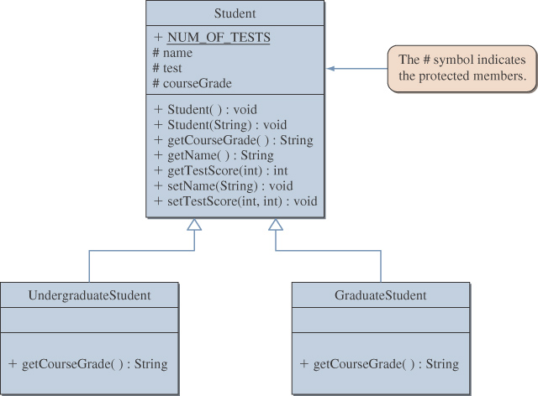
Inheritance Hierarchy
©The McGraw-Hill Companies, Inc. Permission required for reproduction or display.
Chapter 13 - <number>
Notes:
Intro to OOP with Java, C. Thomas Wu
©The McGraw-Hill Companies, Inc.

Slide 11
The Protected Modifier
The modifier protected makes a data member or method visible and accessible to the instances of the class and the descendant classes.
Public data members and methods are accessible to everyone.
Private data members and methods are accessible only to instances of the class.
©The McGraw-Hill Companies, Inc. Permission required for reproduction or display.
Chapter 13 - <number>
Notes:
Intro to OOP with Java, C. Thomas Wu
©The McGraw-Hill Companies, Inc.

Slide 12
Polymorphism
Polymorphism allows a single variable to refer to objects from different subclasses in the same inheritance hierarchy
For example, if Cat and Dog are subclasses of Pet, then the following statements are valid:
Pet myPet;
myPet = new Dog();
. . .
myPet = new Cat();
©The McGraw-Hill Companies, Inc. Permission required for reproduction or display.
Chapter 13 - <number>
Notes:
Intro to OOP with Java, C. Thomas Wu
©The McGraw-Hill Companies, Inc.
A variable of class X may not refer to an object from the superclass or sibling classes of X.
Sibling classes are those that share the common ancestor class.
For example, the following statements are invalid:
Dog myDog = new Cat();
Cat myCat = new Pet();

Slide 13
Creating the roster Array
We can maintain our class roster using an array, combining objects from the Student, UndergraduateStudent, and GraduateStudent classes.
Student roster = new Student[40];
. . .
roster[0] = new GraduateStudent();
roster[1] = new UndergraduateStudent();
roster[2] = new UndergraduateStudent();
. . .
©The McGraw-Hill Companies, Inc. Permission required for reproduction or display.
Chapter 13 - <number>
Notes:
Intro to OOP with Java, C. Thomas Wu
©The McGraw-Hill Companies, Inc.

Slide 14
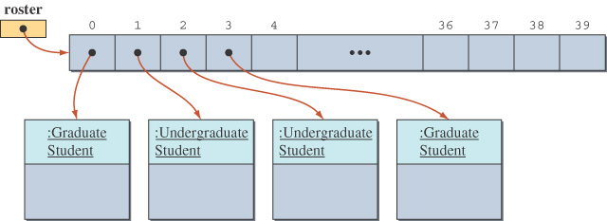
State of the roster Array
The roster array with elements referring to instances of GraduateStudent or UndergraduateStudent classes.
©The McGraw-Hill Companies, Inc. Permission required for reproduction or display.
Chapter 13 - <number>
Notes:
Intro to OOP with Java, C. Thomas Wu
©The McGraw-Hill Companies, Inc.

Slide 15
Sample Polymorphic Message
To compute the course grade using the roster array, we execute
for (int i = 0; i < numberOfStudents; i++) {
roster[i].computeCourseGrade();
}
If roster[i] refers to a GraduateStudent, then the computeCourseGrade method of the GraduateStudent class is executed.
If roster[i] refers to an UndergraduateStudent, then the computeCourseGrade method of the UndergraduateStudent class is executed.
©The McGraw-Hill Companies, Inc. Permission required for reproduction or display.
Chapter 13 - <number>
Notes:
Intro to OOP with Java, C. Thomas Wu
©The McGraw-Hill Companies, Inc.

Slide 16
The instanceof Operator
The instanceof operator can help us learn the class of an object.
The following code counts the number of undergraduate students.
int undergradCount = 0;
for (int i = 0; i < numberOfStudents; i++) {
if ( roster[i] instanceof UndergraduateStudent ) {
undergradCount++;
}
}
©The McGraw-Hill Companies, Inc. Permission required for reproduction or display.
Chapter 13 - <number>
Notes:
Intro to OOP with Java, C. Thomas Wu
©The McGraw-Hill Companies, Inc.

Slide 17
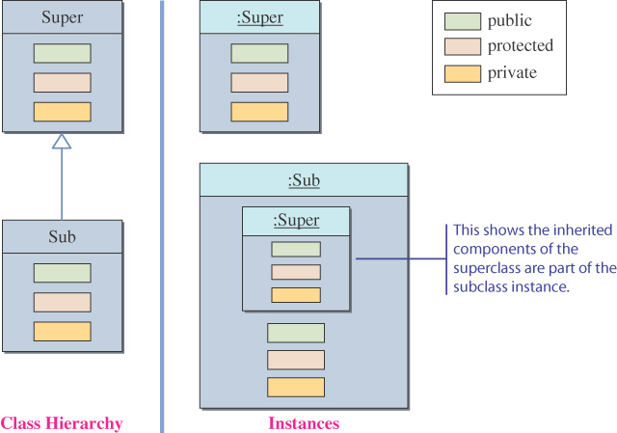
Inheritance and Member Accessibility
We use the following visual representation of inheritance to illustrate data member accessibility.
Instances
This shows the inherited
components of the
superclass are part of
the subclass instance
Class Hierarchy
©The McGraw-Hill Companies, Inc. Permission required for reproduction or display.
Chapter 13 - <number>
Notes:
Intro to OOP with Java, C. Thomas Wu
©The McGraw-Hill Companies, Inc.

Slide 18
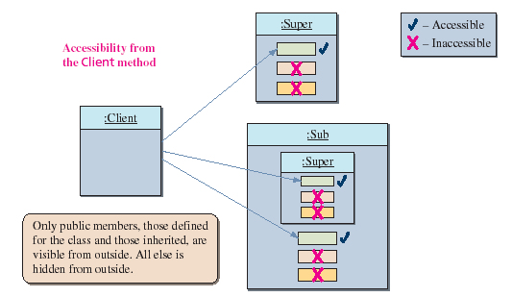
The Effect of Three Visibility Modifiers
package one
package two
©The McGraw-Hill Companies, Inc. Permission required for reproduction or display.
Chapter 13 - <number>
Notes:
Intro to OOP with Java, C. Thomas Wu
©The McGraw-Hill Companies, Inc.

Slide 19
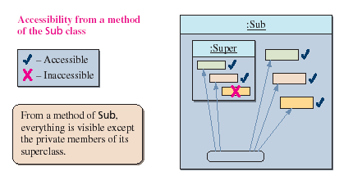
Accessibility of Super from Sub
Everything except the private members of the Super class is visible from a method of the Sub class.
©The McGraw-Hill Companies, Inc. Permission required for reproduction or display.
Chapter 13 - <number>
Notes:
Intro to OOP with Java, C. Thomas Wu
©The McGraw-Hill Companies, Inc.

Slide 20
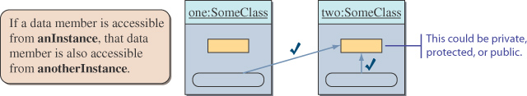
Accessibility from Another Instance
Data members accessible from an instance are also accessible from other instances of the same class.
©The McGraw-Hill Companies, Inc. Permission required for reproduction or display.
Chapter 13 - <number>
Notes:
Intro to OOP with Java, C. Thomas Wu
©The McGraw-Hill Companies, Inc.

Slide 21
Inheritance and Constructors
Unlike members of a superclass, constructors of a superclass are not inherited by its subclasses.
You must define a constructor for a class or use the default constructor added by the compiler.
The statement
super();
calls the superclass’s constructor.
If the class declaration does not explicitly designate the superclass with the extends clause, then the class’s superclass is the Object class.
©The McGraw-Hill Companies, Inc. Permission required for reproduction or display.
Chapter 13 - <number>
Notes:
Intro to OOP with Java, C. Thomas Wu
©The McGraw-Hill Companies, Inc.

Slide 22
Abstract Superclasses and Abstract Methods
When we define a superclass, we often do not need to create any instances of the superclass.
Depending on whether we need to create instances of the superclass, we must define the class differently.
We will study examples based on the Student superclass defined earlier.
©The McGraw-Hill Companies, Inc. Permission required for reproduction or display.
Chapter 13 - <number>
Notes:
Intro to OOP with Java, C. Thomas Wu
©The McGraw-Hill Companies, Inc.

Slide 23
Definition: Abstract Class
An abstract class is a class
  defined with the modifier abstract OR
  that contains an abstract method OR
  that does not provide an implementation of an inherited abstract method
An abstract method is a method with the keyword abstract, and it ends with a semicolon instead of a method body.
  Private methods and static methods may not be declared abstract.
No instances can be created from an abstract class.
©The McGraw-Hill Companies, Inc. Permission required for reproduction or display.
Chapter 13 - <number>
Notes:
Intro to OOP with Java, C. Thomas Wu
©The McGraw-Hill Companies, Inc.

Slide 24
Case 1
Student Must Be Undergraduate or Graduate
  If a student must be either an undergraduate or a graduate student, we only need instances of UndergraduateStudent or GraduateStudent.
  Therefore, we must define the Student class so that no instances may be created of it.
©The McGraw-Hill Companies, Inc. Permission required for reproduction or display.
Chapter 13 - <number>
Notes:
Intro to OOP with Java, C. Thomas Wu
©The McGraw-Hill Companies, Inc.

Slide 25
Case 2
Student Does Not Have to Be Undergraduate or Graduate.
In this case, we may design the Student class in one of two ways.
  We can make the Student class instantiable.
  We can leave the Student class abstract and add a third subclass, OtherStudent, to handle a student who does not fall into the UndergraduateStudent or GraduateStudent categories.
©The McGraw-Hill Companies, Inc. Permission required for reproduction or display.
Chapter 13 - <number>
Notes:
Intro to OOP with Java, C. Thomas Wu
©The McGraw-Hill Companies, Inc.

Slide 26
Which Approach to Use
The best approach depends on the particular situation.
When considering design options, we can ask ourselves which approach allows easier modification and extension.
©The McGraw-Hill Companies, Inc. Permission required for reproduction or display.
Chapter 13 - <number>
Notes:
Intro to OOP with Java, C. Thomas Wu
©The McGraw-Hill Companies, Inc.

Slide 27
Inheritance versus Interface
The Java interface is used to share common behavior (only method headers) among the instances of different classes.
Inheritance is used to share common code (including both data members and methods) among the instances of related classes.
In your program designs, remember to use the Java interface to share common behavior. Use inheritance to share common code.
If an entity A is a specialized form of another entity B, then model them by using inheritance. Declare A as a subclass of B.
©The McGraw-Hill Companies, Inc. Permission required for reproduction or display.
Chapter 13 - <number>
Notes:
Intro to OOP with Java, C. Thomas Wu
©The McGraw-Hill Companies, Inc.

Slide 28
Problem Statement
Write an application that reads in a text file organized in the manner shown below and displays the final course grades.The course grades are computed differently for the undergraduate and graduate students based on the formulas listed on page 717. The input text file format is as follows:
• A single line is used for information on one student.
• Each line uses the format
<Type> <Name> <Test 1> <Test 2> <Test 3>
where <Type> designates either a graduate or an undergraduate
student,<Name> designates the student’s first and last name, and
<Test i> designates the ith test score.
• End of input is designated by the word END. The case of the letters is insignificant.
©The McGraw-Hill Companies, Inc. Permission required for reproduction or display.
Chapter 13 - <number>
Notes:
Intro to OOP with Java, C. Thomas Wu
©The McGraw-Hill Companies, Inc.

Slide 29
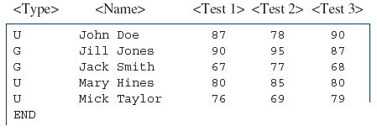
Overall Plan
Tasks
  1. Read an input text file.
  2. Compute the course grades.
  3. Print out the result.
Input File Format
©The McGraw-Hill Companies, Inc. Permission required for reproduction or display.
Chapter 13 - <number>
Notes:
Intro to OOP with Java, C. Thomas Wu
©The McGraw-Hill Companies, Inc.

Slide 30
Development Steps
We will develop this program in five steps:
  1. Start with the program skeleton.Define the skeleton ComputeGrades classes.
  2. Implement the printResult method.Define any other methods necessary to implement printResult.
  3. Implement the computeGrade method.Define any other methods necessary to implement computeGrade.
  4. Implement the readData method.Define any other methods necessary to implement readData.
  5. Finalize and look for improvements.
©The McGraw-Hill Companies, Inc. Permission required for reproduction or display.
Chapter 13 - <number>
Notes:
Intro to OOP with Java, C. Thomas Wu
©The McGraw-Hill Companies, Inc.

Slide 31
Step 1 Design
We start with a program skeleton.
We will define two constructors so the programmer can create a roster of default size or the size of her choice.
©The McGraw-Hill Companies, Inc. Permission required for reproduction or display.
Chapter 13 - <number>
Notes:
Intro to OOP with Java, C. Thomas Wu
©The McGraw-Hill Companies, Inc.

Slide 32
Step 1 Code
    Directory: Chapter13/Step1
    Source Files: ComputeGrades.java
Program source file is too big to list here. From now on, we ask
you to view the source files using your Java IDE.
©The McGraw-Hill Companies, Inc. Permission required for reproduction or display.
Chapter 13 - <number>
Notes:
Intro to OOP with Java, C. Thomas Wu
©The McGraw-Hill Companies, Inc.
Please use your Java IDE to view the source files and run the program.

Slide 33
Step 1 Test
We include a temporary output statement inside the (currently stub) method we define.
We run the test main class and verify that the methods are called correctly.
©The McGraw-Hill Companies, Inc. Permission required for reproduction or display.
Chapter 13 - <number>
Notes:
Intro to OOP with Java, C. Thomas Wu
©The McGraw-Hill Companies, Inc.

Slide 34
Step 2 Design
We design and implement the printResult method
We use the helper class OutputBox for displaying the result.
for each element i in the roster array {
output the name of roster[i];
output the test scores of roster[i];
output the course grade of roster[i];
skip to the next line;
}
©The McGraw-Hill Companies, Inc. Permission required for reproduction or display.
Chapter 13 - <number>
Notes:
Intro to OOP with Java, C. Thomas Wu
©The McGraw-Hill Companies, Inc.

Slide 35
Step 2 Code
    Directory: Chapter13/Step2
    Source Files: ComputeGrades.java
©The McGraw-Hill Companies, Inc. Permission required for reproduction or display.
Chapter 13 - <number>
Notes:
Intro to OOP with Java, C. Thomas Wu
©The McGraw-Hill Companies, Inc.

Slide 36
Step 2 Test
We verify the temporary readData method is working correctly. This confirms that we are using the correct student classes and using their methods correctly.
We verify the printResult method does indeed display the data in our desired format.
©The McGraw-Hill Companies, Inc. Permission required for reproduction or display.
Chapter 13 - <number>
Notes:
Intro to OOP with Java, C. Thomas Wu
©The McGraw-Hill Companies, Inc.

Slide 37
Step 3 Design
We design and implement the computeGrade method.
The code for actually determining the course grade is embedded in individual student classes
  So the code to add to the ComputeGrades class is very simplistic.
  This is a direct benefit of using polymorphism effectively.
©The McGraw-Hill Companies, Inc. Permission required for reproduction or display.
Chapter 13 - <number>
Notes:
Intro to OOP with Java, C. Thomas Wu
©The McGraw-Hill Companies, Inc.

Slide 38
Step 3 Code
    Directory: Chapter13/Step3
    Source Files: ComputeGrades.java
©The McGraw-Hill Companies, Inc. Permission required for reproduction or display.
Chapter 13 - <number>
Notes:
Intro to OOP with Java, C. Thomas Wu
©The McGraw-Hill Companies, Inc.

Slide 39
Step 3 Test
We will repeat the same test routines from Step 2.
Instead of seeing four asterisks, we should be seeing the correct grades.
We test both the passing and not passing test scores.
©The McGraw-Hill Companies, Inc. Permission required for reproduction or display.
Chapter 13 - <number>
Notes:
Intro to OOP with Java, C. Thomas Wu
©The McGraw-Hill Companies, Inc.

Slide 40
Step 4 Design
We design and implement the core functionality of the program—the readData method
We can express its logic as
get the filename from the user;
if (the filename is provided)
read in data and build the roster array;
else
output an error message;
©The McGraw-Hill Companies, Inc. Permission required for reproduction or display.
Chapter 13 - <number>
Notes:
Intro to OOP with Java, C. Thomas Wu
©The McGraw-Hill Companies, Inc.

Slide 41
The buildRoster Method
The logic of the workhorse private method buildRoster is as follows:
set bufReader for input;
while ( !done ) {
line = get next line;
if (line is END) {
done = true;
} else {
student = createStudent( line );
if (student != null) {
roster[studentCount] = student; //add to roster
studentCount++;
}
}
}
©The McGraw-Hill Companies, Inc. Permission required for reproduction or display.
Chapter 13 - <number>
Notes:
Intro to OOP with Java, C. Thomas Wu
©The McGraw-Hill Companies, Inc.

Slide 42
The createStudent Method
We use the StringTokenizer class to break down items in a single line of input
StringTokenizer parser = new StringTokenizer( line );
String type;
try {
type = parser.nextToken();
if (type.equals(UNDER_GRAD) || type.equals(GRAD)) {
student = newStudentWithData(type, parser);
} else { //invalid type is encountered
student = null;
}
} catch (NoSuchElementException e) { //no token
student = null;
}
return student;
©The McGraw-Hill Companies, Inc. Permission required for reproduction or display.
Chapter 13 - <number>
Notes:
Intro to OOP with Java, C. Thomas Wu
©The McGraw-Hill Companies, Inc.

Slide 43
Step 4 Code
    Directory: Chapter13/Step4
    Source Files: ComputeGrades.java
©The McGraw-Hill Companies, Inc. Permission required for reproduction or display.
Chapter 13 - <number>
Notes:
Intro to OOP with Java, C. Thomas Wu
©The McGraw-Hill Companies, Inc.

Slide 44
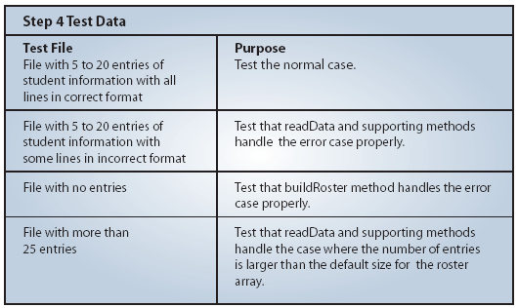
Step 4 Test
We run through a more complete testing routine in this step.We need to run the program for various types of input files. Some of the possible file contents are as follows:
©The McGraw-Hill Companies, Inc. Permission required for reproduction or display.
Chapter 13 - <number>
Notes:
Intro to OOP with Java, C. Thomas Wu
©The McGraw-Hill Companies, Inc.

Slide 45
Step 5: Finalize and Improve
We finalize the program by correcting any remaining errors, inconsistency, or unfinished methods.
We want to review the methods and improve them as necessarily.
One problem (which would have been identified in step 4 testing) we need to correct is the missing method for expanding the roster array when the input file includes more student entries than the set default size of 25.
  We leave this method as Exercise 3.
  We also leave some of the possible improvements as exercises.
©The McGraw-Hill Companies, Inc. Permission required for reproduction or display.
Chapter 13 - <number>
Notes:
Intro to OOP with Java, C. Thomas Wu
©The McGraw-Hill Companies, Inc.

