Slide 1
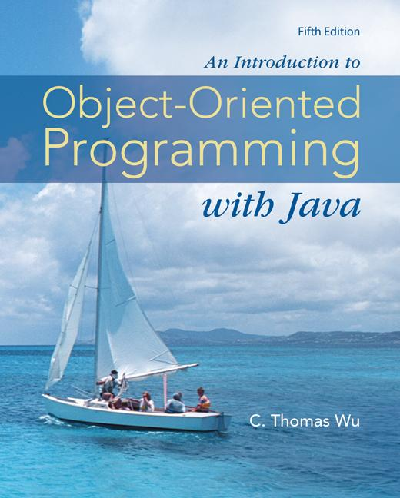
Chapter 14
GUI and
Event-Driven Programming
©The McGraw-Hill Companies, Inc. Permission required for reproduction or display.
Animated Version
Chapter 14 - <number>
Notes:
Introduction to OOP with Java 4th Ed, C. Thomas Wu
© The McGraw-Hill Companies, Inc.

Slide 2
Objectives
After you have read and studied this chapter, you should be able to
  Define a subclass of JFrame to implement a customized frame window.
  Write event-driven programs using Java's delegation-based event model
  Arrange GUI objects on a window using layout managers and nested panels
  Write GUI application programs using JButton, JLabel, ImageIcon, JTextField, JTextArea, JCheckBox, JRadioButton, JComboBox, JList, and JSlider objects from the javax.swing package
  Write GUI application programs with menus
  Write GUI application programs that process mouse events
Notes:
Intro to OOP with Java, C. Thomas Wu
©The McGraw-Hill Companies, Inc.
We will learn how to create a customized frame window by defining a subclass of the JFrame class. Among the many different types of GUI objects, arguably the buttons are most common. We will learn how to create and place buttons on a frame in this lesson.

Slide 3
Graphical User Interface
In Java, GUI-based programs are implemented by using classes from the javax.swing and java.awt packages.
The Swing classes provide greater compatibility across different operating systems. They are fully implemented in Java, and behave the same on different operating systems.
©The McGraw-Hill Companies, Inc. Permission required for reproduction or display.
Chapter 14 - <number>
Notes:
Intro to OOP with Java, C. Thomas Wu
©The McGraw-Hill Companies, Inc.
Classes we use to develop GUI-based programs are located in two packages javax.swing and java.awt. Many of the classes in the java.awt package are replaced by Swing counterparts, and for the most part, using the Swing classes over the AWT classes is the preferred approach because the newer Swing classes are better implementation. We still have to refer to java.awt package because there are some classes that are defined only in the java.awt package.

Slide 4
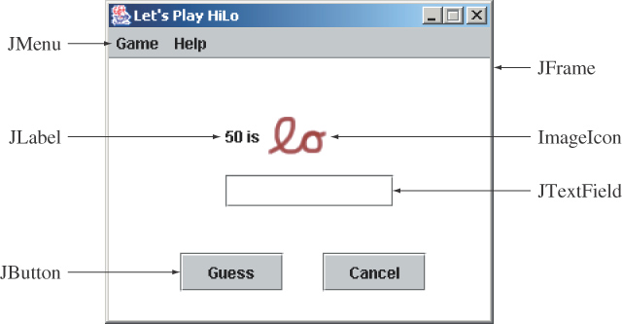
Sample GUI Objects
Various GUI objects from the javax.swing package.
©The McGraw-Hill Companies, Inc. Permission required for reproduction or display.
Chapter 14 - <number>
Notes:
Intro to OOP with Java, C. Thomas Wu
©The McGraw-Hill Companies, Inc.
Here's a sample frame that includes a number of common Swing components. We will see examples using JFrame and JButton in this lesson. We will see other components in the later lessons of this module.

Slide 5
JOptionPane
Using the JOptionPane class is a simple way to display the result of a computation to the user or receive an input from the user.
We use the showMessageDialog class method for output.
We use the showInputDialog class method for input. This method returns the input as a String value so we need to perform type conversion for input of other data types
©The McGraw-Hill Companies, Inc. Permission required for reproduction or display.
Chapter 14 - <number>
Notes:
Intro to OOP with Java, C. Thomas Wu
©The McGraw-Hill Companies, Inc.

Slide 6
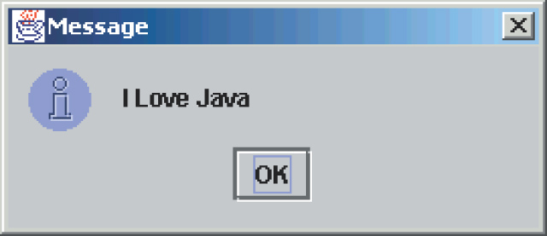
Using JOptionPane for Output
import javax.swing.*;
. . .
JOptionPane.showMessageDialog( null, “I Love Java” );
©The McGraw-Hill Companies, Inc. Permission required for reproduction or display.
Chapter 14 - <number>
Notes:
Intro to OOP with Java, C. Thomas Wu
©The McGraw-Hill Companies, Inc.

Slide 7
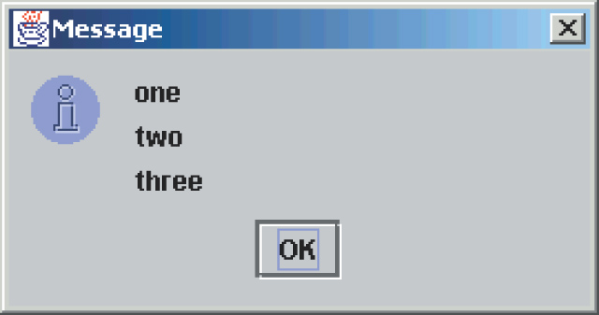
Using JOptionPane for Output - 2
import javax.swing.*;
. . .
JOptionPane.showMessageDialog( null, “one\ntwo\nthree” );
//place newline \n to display multiple lines of output
©The McGraw-Hill Companies, Inc. Permission required for reproduction or display.
Chapter 14 - <number>
Notes:
Intro to OOP with Java, C. Thomas Wu
©The McGraw-Hill Companies, Inc.

Slide 8
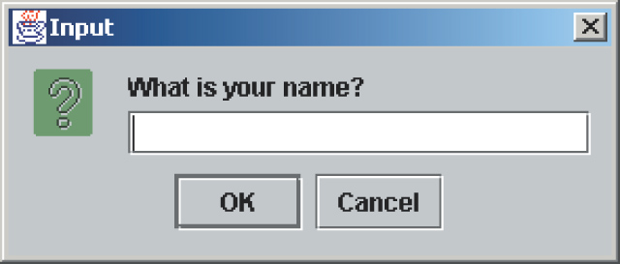
JOptionPane for Input
import javax.swing.*;
. . .
String inputstr =
JOptionPane.showInputDialog( null, “What is your name?” );
©The McGraw-Hill Companies, Inc. Permission required for reproduction or display.
Chapter 14 - <number>
Notes:
Intro to OOP with Java, C. Thomas Wu
©The McGraw-Hill Companies, Inc.

Slide 9
Subclassing JFrame
To create a customized frame window, we define a subclass of the JFrame class.
The JFrame class contains rudimentary functionalities to support features found in any frame window.
©The McGraw-Hill Companies, Inc. Permission required for reproduction or display.
Chapter 14 - <number>
Notes:
Intro to OOP with Java, C. Thomas Wu
©The McGraw-Hill Companies, Inc.
The standard JFrame class includes only most basic functionalities. When we need a frame window in our application, it is typical for us to define a subclass of JFrame to create a frame window that is customized to our needs. We will study the basics of this customization.

Slide 10

Creating a Plain JFrame
import javax.swing.*;
class Ch7DefaultJFrame {
public static void main( String[] args ) {
JFrame defaultJFrame;
defaultJFrame = new JFrame();
defaultJFrame.setVisible(true);
}
}
©The McGraw-Hill Companies, Inc. Permission required for reproduction or display.
Chapter 14 - <number>
Notes:
Intro to OOP with Java, C. Thomas Wu
©The McGraw-Hill Companies, Inc.
Before we start to explore how to customize a frame window, let's see the behavior of a plain standard JFrame object. This sample program creates a default JFrame object. When you run this program, a very tiny window appears at the top left corner of the screen.

Slide 11
Creating a Subclass of JFrame
To define a subclass of another class, we declare the subclass with the reserved word extends.
import javax.swing.*;
class Ch7JFrameSubclass1 extends JFrame {
. . .
}
©The McGraw-Hill Companies, Inc. Permission required for reproduction or display.
Chapter 14 - <number>
Notes:
Intro to OOP with Java, C. Thomas Wu
©The McGraw-Hill Companies, Inc.
A subclass of any class is declared by including the keyword 'extends' the class definition header. The example here defines a subclass of JFrame named Ch7JFrameSubclass1.

Slide 12
Customizing Ch14JFrameSubclass1
An instance of Ch14JFrameSubclass1 will have the following default characteristics:
  The title is set to My First Subclass.
  The program terminates when the close box is clicked.
  The size of the frame is 300 pixels wide by 200 pixels high.
  The frame is positioned at screen coordinate (150, 250).
These properties are set inside the default constructor.
Source File: Ch14JFrameSubclass1.java
Notes:
Intro to OOP with Java, C. Thomas Wu
©The McGraw-Hill Companies, Inc.
Open the sample Ch7JFrameSubclass1 class and see how the constructor includes a number of statements such as setTitle and setLocation to set the properties. These methods are all inherited from the superclass JFrame. The last statement is setDefaultCloseOperation that defines the frame's behavior when the close box of the frame is clicked. Passing the class constant EXIT_ON_CLOSE specifies to stop the application when the close box of a frame is clicked. Remove this statement and see what happens.

Slide 13
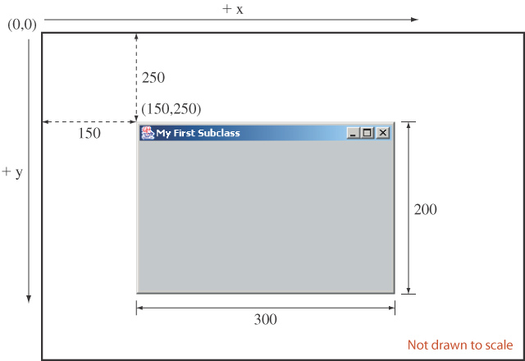
Displaying Ch14JFrameSubclass1
Here's how a Ch14JFrameSubclass1 frame window will appear on the screen.
©The McGraw-Hill Companies, Inc. Permission required for reproduction or display.
Chapter 14 - <number>
Notes:
Intro to OOP with Java, C. Thomas Wu
©The McGraw-Hill Companies, Inc.
This diagram illustrates how the arguments to the setSize and setLocation methods affect the frame window appearance on the screen. The top left corner of the screen has coordinate (0,0). The value of x increases as you move toward right and the value of y increases as you move down. Notice that the screen coordinate is different from the coordinate system of a mathematical 2-D graph.

Slide 14
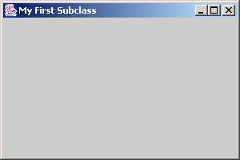
The Content Pane of a Frame
The content pane is where we put GUI objects such as buttons, labels, scroll bars, and others.
We access the content pane by calling the frame’s getContentPane method.
This gray area is the content pane of this frame.
©The McGraw-Hill Companies, Inc. Permission required for reproduction or display.
Chapter 14 - <number>
Notes:
Intro to OOP with Java, C. Thomas Wu
©The McGraw-Hill Companies, Inc.
A frame window is composed of four borders, a title bar, and a content area. The content area is called a content pane in Java, and this is the area we can use to place GUI components.

Slide 15
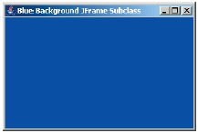
Changing the Background Color
Here's how we can change the background color of a content pane to blue:
Container contentPane = getContentPane();
contentPane.setBackground(Color.BLUE);
Source File:
Ch14JFrameSubclass2.java
©The McGraw-Hill Companies, Inc. Permission required for reproduction or display.
Chapter 14 - <number>
Notes:
Intro to OOP with Java, C. Thomas Wu
©The McGraw-Hill Companies, Inc.
We access the content pane of a frame by calling the JFrame method called getContentPane. We declare the data type for the object returned by the getContentPane method to Container. Once we get the content pane object, we can call its methods. The example here calls the setBackground method to change the default background color of gray to white. The complete sample code can be found in the file Ch7JFrameSubclass2.java.

Slide 16
Placing GUI Objects on a Frame
There are two ways to put GUI objects on the content pane of a frame:
  Use a layout manager
    FlowLayout
    BorderLayout
    GridLayout
  Use absolute positioning
    null layout manager
©The McGraw-Hill Companies, Inc. Permission required for reproduction or display.
Chapter 14 - <number>
Notes:
Intro to OOP with Java, C. Thomas Wu
©The McGraw-Hill Companies, Inc.
The content pane of a frame is where we can place GUI components. Among the approaches available to us to place components, we will study the easier one here. The easier absolute positioning is not a recommended approach for practical applications, but our objective here is to learn the basic handling of events and placement of GUI objects, we will use the easier approach. Chapter 12 of the textbook discusses different layout managers.

Slide 17
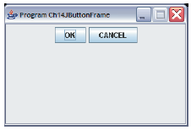
Placing a Button
A JButton object a GUI component that represents a pushbutton.
Here's an example of how we place a button with FlowLayout.
contentPane.setLayout(
new FlowLayout());
okButton
= new JButton("OK");
cancelButton
= new JButton("CANCEL");
contentPane.add(okButton);
contentPane.add(cancelButton);
©The McGraw-Hill Companies, Inc. Permission required for reproduction or display.
Chapter 14 - <number>
Notes:
Intro to OOP with Java, C. Thomas Wu
©The McGraw-Hill Companies, Inc.
The key point to remember in using absolute positioning:
Set the layout manager of the content pane to null as
conentPane.setLayout(null)
Set the bounds to a GUI object. For example
okButton.setBounds(70, 125, 80, 20);
Add a GUI object to the content pane by calling the add method as
contentPane.add(okButton);

Slide 18
Event Handling
An action involving a GUI object, such as clicking a button, is called an event.
The mechanism to process events is called event handling.
The event-handling model of Java is based on the concept known as the delegation-based event model.
With this model, event handling is implemented by two types of objects:
  event source objects
  event listener objects
©The McGraw-Hill Companies, Inc. Permission required for reproduction or display.
Chapter 14 - <number>
Notes:
Intro to OOP with Java, C. Thomas Wu
©The McGraw-Hill Companies, Inc.
JButton and other GUI objects are event source objects. Any object can be designated as event listener objects.

Slide 19
Event Source Objects
An event source is a GUI object where an event occurs. We say an event source generates events.
Buttons, text boxes, list boxes, and menus are common event sources in GUI-based applications.
Although possible, we do not, under normal circumstances, define our own event sources when writing GUI-based applications.
©The McGraw-Hill Companies, Inc. Permission required for reproduction or display.
Chapter 14 - <number>
Notes:
Intro to OOP with Java, C. Thomas Wu
©The McGraw-Hill Companies, Inc.
A single event source can generate more than one type of events. When an event is generated, a corresponding event listener is notified. Whether there is a designated listener or not, event sources generates events. If there's a no matching listeners, generated events are simply ignored.

Slide 20
Event Listener Objects
An event listener object is an object that includes a method that gets executed in response to the generated events.
A listener must be associated, or registered, to a source, so it can be notified when the source generates events.
©The McGraw-Hill Companies, Inc. Permission required for reproduction or display.
Chapter 14 - <number>
Notes:
Intro to OOP with Java, C. Thomas Wu
©The McGraw-Hill Companies, Inc.
A listener can listen to a single type of events. If an event source generates two types of events, then we need two different listeners if we want process both types of events. A single listener, however, can be set to listen to single type of events from more than one event source.

Slide 21
Connecting Source and Listener
event source
event listener
notify
JButton
Handler
register
A listener must be registered to a event source. Once
registered, it will get notified when the event source
generates events.
©The McGraw-Hill Companies, Inc. Permission required for reproduction or display.
Chapter 14 - <number>
Notes:
Intro to OOP with Java, C. Thomas Wu
©The McGraw-Hill Companies, Inc.
This diagram shows the relationship between the event source and listener. First we register a listener to an event source. Once registered, whenever an event is generated, the event source will notify the listener.

Slide 22
Event Types
Registration and notification are specific to event types
    Mouse listener handles mouse events
    Item listener handles item selection events
    and so forth
Among the different types of events, the action event is the most common.
  Clicking on a button generates an action event
  Selecting a menu item generates an action event
  and so forth
Action events are generated by action event sources and handled by action event listeners.
©The McGraw-Hill Companies, Inc. Permission required for reproduction or display.
Chapter 14 - <number>
Notes:
Intro to OOP with Java, C. Thomas Wu
©The McGraw-Hill Companies, Inc.
There are different types of events. Some event sources generate only one type of events, while others generate three or four different types of events. For example, a button can generate an action event, a change event, and a item event. The most common type of event we are interested in processing for various types of GUI components is the action event.

Slide 23
Handling Action Events
action event
source
actionPerformed
action event
listener
JButton
Button
Handler
addActionListener
JButton button = new JButton("OK");
ButtonHandler handler = new ButtonHandler( );
button.addActionListener(handler);
©The McGraw-Hill Companies, Inc. Permission required for reproduction or display.
Chapter 14 - <number>
Notes:
Intro to OOP with Java, C. Thomas Wu
©The McGraw-Hill Companies, Inc.
This code shows how we register an action event listener to a button. The object we register as an action listener must be an instance of a class that implements the ActionListener interface. The class must define a method named actionPerformed. This is the method executed in response to the generated action events.

Slide 24
The Java Interface
A Java interface includes only constants and abstract methods.
An abstract method has only the method header, or prototype. There is no method body. You cannot create an instance of a Java interface.
A Java interface specifies a behavior.
A class implements an interface by providing the method body to the abstract methods stated in the interface.
Any class can implement the interface.
©The McGraw-Hill Companies, Inc. Permission required for reproduction or display.
Chapter 14 - <number>
Notes:
Intro to OOP with Java, C. Thomas Wu
©The McGraw-Hill Companies, Inc.
Before we give the definition of the ButtonHandler class, we need to describe the concept of Java interface. We use the term "Java interface" to distinguish it from the "graphical user interface" when necessary.

Slide 25
ActionListener Interface
When we call the addActionListener method of an event source, we must pass an instance of a class that implements the ActionListener interface.
The ActionListener interface includes one method named actionPerformed.
A class that implements the ActionListener interface must therefore provide the method body of actionPerformed.
Since actionPerformed is the method that will be called when an action event is generated, this is the place where we put a code we want to be executed in response to the generated events.
©The McGraw-Hill Companies, Inc. Permission required for reproduction or display.
Chapter 14 - <number>
Notes:
Intro to OOP with Java, C. Thomas Wu
©The McGraw-Hill Companies, Inc.

Slide 26
The ButtonHandler Class
import javax.swing.*;
import java.awt.*;
import java.awt.event.*;
class ButtonHandler implements ActionListener {
. . .
public void actionPerformed(ActionEvent event) {
JButton clickedButton = (JButton) event.getSource();
JRootPane rootPane = clickedButton.getRootPane( );
Frame frame = (JFrame) rootPane.getParent();
frame.setTitle("You clicked " + clickedButton.getText());
}
}
©The McGraw-Hill Companies, Inc. Permission required for reproduction or display.
Chapter 14 - <number>
Notes:
Intro to OOP with Java, C. Thomas Wu
©The McGraw-Hill Companies, Inc.
This actionPerformed method is programmed to change the title of the frame to 'You clicked OK' or 'You clicked Cancel'. The actionPerformed method accepts one parameter of type ActionEvent. The getSource method of ActionEvent returns the event source source object. Because the object can be of any type, we type cast it to JButton. The next two statements are necessary to get a frame object that contains this event source. Once we have a reference to this frame object, we call its setTitle method to change the frame's title. More discussion on this actionPerformed method is presented on page 397 of the textbook.

Slide 27
Container as Event Listener
Instead of defining a separate event listener such as ButtonHandler, it is much more common to have an object that contains the event sources be a listener.
  Example: We make this frame a listener of the action events of the buttons it contains.
event listener
event source
©The McGraw-Hill Companies, Inc. Permission required for reproduction or display.
Chapter 14 - <number>
Notes:
Intro to OOP with Java, C. Thomas Wu
©The McGraw-Hill Companies, Inc.
Because ActionListener is a Java interface and not a class, action event listener objects are not limited to instances of fixed classes. Any class can implement the ActionListener interface, so any object from a class that implements this interface can be an action event listener. This adds flexibility as this example illustrates.
Instead of using a ButtonHandler object, we can make the frame object itself to be an action event listener.

Slide 28
Ch14JButtonFrameHandler
. . .
class Ch14JButtonFrameHandler extends JFrame
implements ActionListener {
. . .
public void actionPerformed(ActionEvent event) {
JButton clickedButton
= (JButton) event.getSource();
String buttonText = clickedButton.getText();
setTitle("You clicked " + buttonText);
}
}
©The McGraw-Hill Companies, Inc. Permission required for reproduction or display.
Chapter 14 - <number>
Notes:
Intro to OOP with Java, C. Thomas Wu
©The McGraw-Hill Companies, Inc.
This is how a frame that contains the buttons can be made to be their event listeners. Notice that because the actionPerformed method is defined in the frame class, setting the title is matter of calling its setTitle method.

Slide 29
GUI Classes for Handling Text
The Swing GUI classes JLabel, JTextField, and JTextArea deal with text.
A JLabel object displays uneditable text (or image).
A JTextField object allows the user to enter a single line of text.
A JTextArea object allows the user to enter multiple lines of text. It can also be used for displaying multiple lines of uneditable text.
©The McGraw-Hill Companies, Inc. Permission required for reproduction or display.
Chapter 14 - <number>
Notes:
Intro to OOP with Java, C. Thomas Wu
©The McGraw-Hill Companies, Inc.
Notice that JLabel objects are not limited to text. Using them is actually the easiest and quickest way to display an image. JTextArea has dual pursposes. It can be used to display noneditable multi-line text, similar to using multiple JLabel objects. It can also be used to allow the user to enter multiple lines of text, similar to using multiple JTextField objects.

Slide 30
JTextField
We use a JTextField object to accept a single line to text from a user. An action event is generated when the user presses the ENTER key.
The getText method of JTextField is used to retrieve the text that the user entered.
JTextField input = new JTextField( );
input.addActionListener(eventListener);
contentPane.add(input);
©The McGraw-Hill Companies, Inc. Permission required for reproduction or display.
Chapter 14 - <number>
Notes:
Intro to OOP with Java, C. Thomas Wu
©The McGraw-Hill Companies, Inc.
The getText method is most commonly used inside the actionPerformed method of an action listener.

Slide 31
JLabel
We use a JLabel object to display a label.
A label can be a text or an image.
When creating an image label, we pass ImageIcon object instead of a string.
JLabel textLabel = new JLabel("Please enter your name");
contentPane.add(textLabel);
JLabel imgLabel = new JLabel(new ImageIcon("cat.gif"));
contentPane.add(imgLabel);
©The McGraw-Hill Companies, Inc. Permission required for reproduction or display.
Chapter 14 - <number>
Notes:
Intro to OOP with Java, C. Thomas Wu
©The McGraw-Hill Companies, Inc.
A JLabel is strictly for displaying noneditable text or image. A JLabel object does not generate any events.

Slide 32
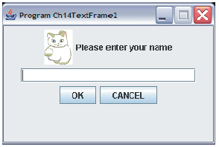
Ch14TextFrame2
JLabel
(with a text)
JLabel
(with an image)
JTextField
©The McGraw-Hill Companies, Inc. Permission required for reproduction or display.
Chapter 14 - <number>
Notes:
Intro to OOP with Java, C. Thomas Wu
©The McGraw-Hill Companies, Inc.
The sample Ch7TextFrame2 class includes five GUI components: two JLabel objects, one JTextField object, and two JButton objects.

Slide 33
JTextArea
We use a JTextArea object to display or allow the user to enter multiple lines of text.
The setText method assigns the text to a JTextArea, replacing the current content.
The append method appends the text to the current text.
JTextArea textArea
= new JTextArea( );
. . .
textArea.setText("Hello\n");
textArea.append("the lost ");
textArea.append("world");
Hello
the lost world
JTextArea
©The McGraw-Hill Companies, Inc. Permission required for reproduction or display.
Chapter 14 - <number>
Notes:
Intro to OOP with Java, C. Thomas Wu
©The McGraw-Hill Companies, Inc.
Notice how the append method works. If you want to place the text to be appended on a new line, you have ouput the newline control character \n at the appropriate point.

Slide 34
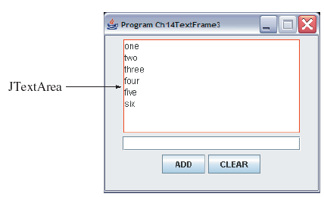
Ch14TextFrame3
The state of a Ch14TextFrame3 window after six words are entered.
©The McGraw-Hill Companies, Inc. Permission required for reproduction or display.
Chapter 14 - <number>
Notes:
Intro to OOP with Java, C. Thomas Wu
©The McGraw-Hill Companies, Inc.
Run the program and explore it. This frame has one JTextField object and one JTextArea object. Every time a text is entered in the text field and the ENTER key is pressed or the ADD button is clicked, the entered text is append to the text area. The border of red color is adorned to the text area to demarcate the region.

Slide 35
Adding Scroll Bars to JTextArea
By default a JTextArea does not have any scroll bars. To add scroll bars, we place a JTextArea in a JScrollPane object.
JTextArea textArea = new JTextArea();
. . .
JScrollPane scrollText = new JScrollPane(textArea);
. . .
contentPane.add(scrollText);
©The McGraw-Hill Companies, Inc. Permission required for reproduction or display.
Chapter 14 - <number>
Notes:
Intro to OOP with Java, C. Thomas Wu
©The McGraw-Hill Companies, Inc.
Here's a sample to wrap the text area with scroll bars.

Slide 36
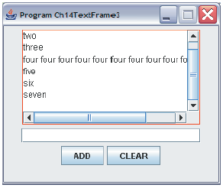
Ch14TextFrame3 with Scroll Bars
A sample Ch14TextFrame3 window when a JScrollPane is used.
©The McGraw-Hill Companies, Inc. Permission required for reproduction or display.
Chapter 14 - <number>
Notes:
Intro to OOP with Java, C. Thomas Wu
©The McGraw-Hill Companies, Inc.
Initially, there will be no scroll bars. Run the program and confirm this behavior. When the displayed text goes beyond the horizontal or vertical boundary, the corresponding scroll bar appears.

Slide 37
Layout Managers
The layout manager determines how the GUI components are added to the container (such as the content pane of a frame)
Among the many different layout managers, the common ones are
  FlowLayout (see Ch14FlowLayoutSample.java)
  BorderLayout (see Ch14BorderLayoutSample.java)
  GridLayout (see Ch14GridLayoutSample.java)
©The McGraw-Hill Companies, Inc. Permission required for reproduction or display.
Chapter 14 - <number>
Notes:
Intro to OOP with Java, C. Thomas Wu
©The McGraw-Hill Companies, Inc.

Slide 38
FlowLayout
In using this layout, GUI componentsare placed in left-to-right order.
  When the component does not fit on the same line, left-to-right placement continues on the next line.
As a default, components on each line are centered.
When the frame containing the component is resized, the placement of components is adjusted accordingly.
©The McGraw-Hill Companies, Inc. Permission required for reproduction or display.
Chapter 14 - <number>
Notes:
Intro to OOP with Java, C. Thomas Wu
©The McGraw-Hill Companies, Inc.

Slide 39
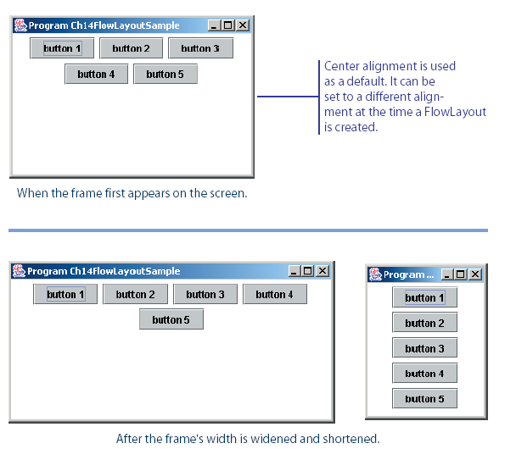
FlowLayout Sample
This shows the placement of five buttons by using FlowLayout.
©The McGraw-Hill Companies, Inc. Permission required for reproduction or display.
Chapter 14 - <number>
Notes:
Intro to OOP with Java, C. Thomas Wu
©The McGraw-Hill Companies, Inc.

Slide 40
BorderLayout
This layout manager divides the container into five regions: center, north, south, east, and west.
The north and south regions expand or shrink in height only
The east and west regions expand or shrink in width only
The center region expands or shrinks on both height and width.
Not all regions have to be occupied.
©The McGraw-Hill Companies, Inc. Permission required for reproduction or display.
Chapter 14 - <number>
Notes:
Intro to OOP with Java, C. Thomas Wu
©The McGraw-Hill Companies, Inc.

Slide 41
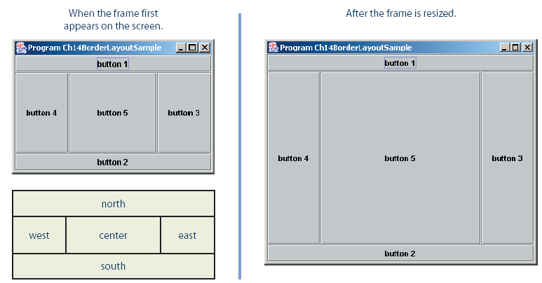
BorderLayout Sample
©The McGraw-Hill Companies, Inc. Permission required for reproduction or display.
Chapter 14 - <number>
Notes:
Intro to OOP with Java, C. Thomas Wu
©The McGraw-Hill Companies, Inc.
contentPane.setLayout(new BorderLayout());
contentPane.add(button1, BorderLayout.NORTH);
contentPane.add(button2, BorderLayout.SOUTH);
contentPane.add(button3, BorderLayout.EAST);
contentPane.add(button4, BorderLayout.WEST);
contentPane.add(button5, BorderLayout.CENTER);

Slide 42
GridLayout
This layout manager placesGUI components on equal-size N by M grids.
Components are placed in top-to-bottom, left-to-right order.
The number of rows and columns remains the same after the frame is resized, but the width and height of each region will change.
©The McGraw-Hill Companies, Inc. Permission required for reproduction or display.
Chapter 14 - <number>
Notes:
Intro to OOP with Java, C. Thomas Wu
©The McGraw-Hill Companies, Inc.

Slide 43
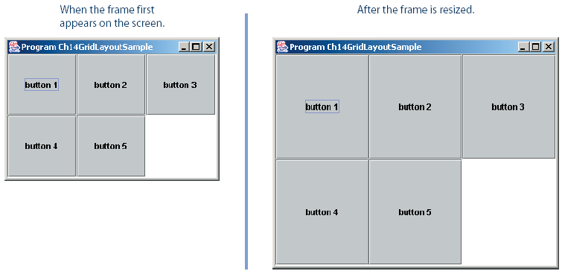
GridLayout Sample
©The McGraw-Hill Companies, Inc. Permission required for reproduction or display.
Chapter 14 - <number>
Notes:
Intro to OOP with Java, C. Thomas Wu
©The McGraw-Hill Companies, Inc.

Slide 44
Nesting Panels
It is possible, but very difficult, to place all GUI components on a single JPanel or other types of containers.
A better approach is to use multiple panels, placing panels inside other panels.
To illustrate this technique, we will create two sample frames that contain nested panels.
Ch14NestedPanels1.java provides the user interface for playing Tic Tac Toe.
Ch14NestedPanels2.java provides the user interface for playing HiLo.
©The McGraw-Hill Companies, Inc. Permission required for reproduction or display.
Chapter 14 - <number>
Notes:
Intro to OOP with Java, C. Thomas Wu
©The McGraw-Hill Companies, Inc.

Slide 45
Other Common GUI Components
JCheckBox
  see Ch14JCheckBoxSample1.java and Ch14JCheckBoxSample2.java
JRadioButton
  see Ch14JRadioButtonSample.java
JComboBox
  see Ch14JComboBoxSample.java
JList
  see Ch14JListSample.java
JSlider
  see Ch14JSliderSample.java
©The McGraw-Hill Companies, Inc. Permission required for reproduction or display.
Chapter 14 - <number>
Notes:
Intro to OOP with Java, C. Thomas Wu
©The McGraw-Hill Companies, Inc.

Slide 46
Menus
The javax.swing package contains three menu-related classes: JMenuBar, JMenu, and JMenuItem.
JMenuBar is a bar where the menus are placed. There is one menu bar per frame.
JMenu (such as File or Edit) is a group of menu choices. JMenuBar may include many JMenu objects.
JMenuItem (such as Copy, Cut, or Paste) is an individual menu choice in a JMenu object.
Only the JMenuItem objects generate events.
©The McGraw-Hill Companies, Inc. Permission required for reproduction or display.
Chapter 14 - <number>
Notes:
Intro to OOP with Java, C. Thomas Wu
©The McGraw-Hill Companies, Inc.
Almost all nontrivial GUI programs support menus. By using these three menu-related classes, we can easily add menus to our Java programs.

Slide 47
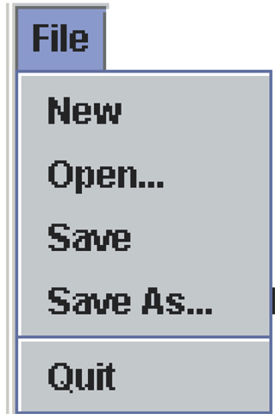
Menu Components
Edit
View
Help
JMenuBar
File
Edit
View
Help
JMenu
JMenuItem
separator
©The McGraw-Hill Companies, Inc. Permission required for reproduction or display.
Chapter 14 - <number>
Notes:
Intro to OOP with Java, C. Thomas Wu
©The McGraw-Hill Companies, Inc.
The diagram shows how the menu-related objects correspond to the actual menus.

Slide 48
Sequence for Creating Menus
Create a JMenuBar object and attach it to a frame.
Create a JMenu object.
Create JMenuItem objects and add them to the JMenu object.
Attach the JMenu object to the JMenuBar object.
©The McGraw-Hill Companies, Inc. Permission required for reproduction or display.
Chapter 14 - <number>
Notes:
Intro to OOP with Java, C. Thomas Wu
©The McGraw-Hill Companies, Inc.
This is not the only valid sequence. Other sequences are possible. We list this sequence as one possible sequence you can follow in creating menus.

Slide 49
Handling Mouse Events
Mouse events include such user interactions as
  moving the mouse
  dragging the mouse (moving the mouse while the mouse button is being pressed)
  clicking the mouse buttons.
The MouseListener interface handles mouse button
  mouseClicked, mouseEntered, mouseExited, mousePressed, and mouseReleased
The MouseMotionListener interface handles mouse movement
  mouseDragged and mouseMoved.
See Ch14TrackMouseFrame and Ch14SketchPad
©The McGraw-Hill Companies, Inc. Permission required for reproduction or display.
Chapter 14 - <number>
Notes:
Intro to OOP with Java, C. Thomas Wu
©The McGraw-Hill Companies, Inc.

