Slide 1
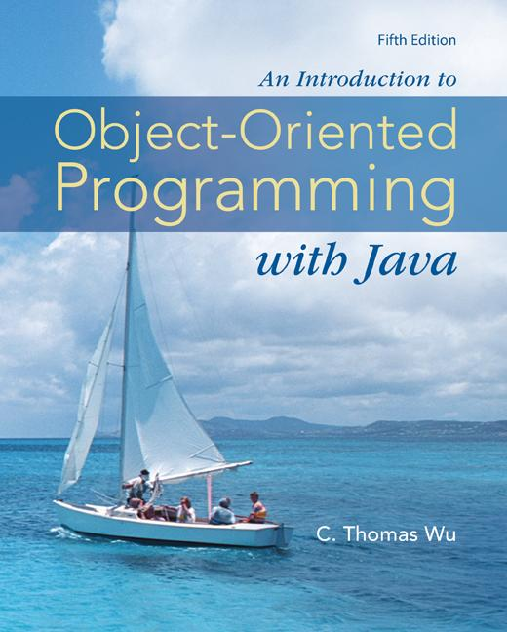
Chapter 15
Recursive Algorithms
©The McGraw-Hill Companies, Inc. Permission required for reproduction or display.
Animated Version
Chapter 15 - <number>
Notes:
Introduction to OOP with Java 4th Ed, C. Thomas Wu
© The McGraw-Hill Companies, Inc.

Slide 2
Objectives
After you have read and studied this chapter, you should be able to
  Write recursive algorithms for mathematical functions and nonnumerical operations.
  Decide when to use recursion and when not to.
  Describe the recursive quicksort algorithm and explain how its performance is better than selection and bubble sort algorithms.
©The McGraw-Hill Companies, Inc. Permission required for reproduction or display.
Chapter 15 - <number>
Notes:
Intro to OOP with Java, C. Thomas Wu
©The McGraw-Hill Companies, Inc.

Slide 3
Recursion
The factorial of N is the product of the first N positive integers:
        N * (N – 1) * (N – 2 ) * . . . * 2 * 1
The factorial of N can be defined recursively as
      1 if N = 1
      factorial( N ) =
      N * factorial( N-1 ) otherwise
©The McGraw-Hill Companies, Inc. Permission required for reproduction or display.
Chapter 15 - <number>
Notes:
Intro to OOP with Java, C. Thomas Wu
©The McGraw-Hill Companies, Inc.
The two most important concepts in object-oriented programming are the class and the object. In the broadest term, an object is a thing, both tangible and intangible, which we can imagine.
A program written in object-oriented style will consist of interacting objects. For a program to maintain bank accounts for a bank, we may have many Account, Customer, Transaction, and ATM objects.
An object is comprised of data and operations that manipulate these data.

Slide 4
Recursive Method
An recursive method is a method that contains a statement (or statements) that makes a call to itself.
Implementing the factorial of N recursively will result in the following method.
  public int factorial( int N ) {
  if ( N == 1 ) {
  return 1;
  }
  else {
  return N * factorial( N-1 );
  }
  }
Test to stop or continue.
End case: recursion stops.
Recursive case: recursion continues.
©The McGraw-Hill Companies, Inc. Permission required for reproduction or display.
Chapter 15 - <number>
Notes:
Intro to OOP with Java, C. Thomas Wu
©The McGraw-Hill Companies, Inc.
The two most important concepts in object-oriented programming are the class and the object. In the broadest term, an object is a thing, both tangible and intangible, which we can imagine.
A program written in object-oriented style will consist of interacting objects. For a program to maintain bank accounts for a bank, we may have many Account, Customer, Transaction, and ATM objects.
An object is comprised of data and operations that manipulate these data.

Slide 5
Directory Listing
List the names of all files in a given directory and its subdirectories.
  public void directoryListing(File dir) {
  //assumption: dir represents a directory
  String[] fileList = dir.list(); //get the contents
  String dirPath = dir.getAbsolutePath();
  for (int i = 0; i < fileList.length; i++) {
  File file = new File(dirPath + "/" + fileList[i]);
  if (file.isFile()) { //it's a file
  System.out.println( file.getName() );
  } else {
  directoryListing( file ); //it's a directory
  } //so make a
  } //recursive call
  }
Test
End case
Recursive case
©The McGraw-Hill Companies, Inc. Permission required for reproduction or display.
Chapter 15 - <number>
Notes:
Intro to OOP with Java, C. Thomas Wu
©The McGraw-Hill Companies, Inc.
In pseudocode the above method is expressed as follows:
public void directoryListing( File dir )
{
//assumption: dir represents a directory
fileList = an array of names of files and
subdirectories in the directory dir;
for (each element in fileList) {
if (an element is a file) {
output the element’s filename; //end case: it’s //a file.
}
else { //recursive case: it’s a directory
call directoryListing with element as an argument;
}
}
}

Slide 6
Anagram
List all anagrams of a given word.
Word
C A T
C T A
A T C
A C T
T C A
T A C
Anagrams
©The McGraw-Hill Companies, Inc. Permission required for reproduction or display.
Chapter 15 - <number>
Notes:
Intro to OOP with Java, C. Thomas Wu
©The McGraw-Hill Companies, Inc.
In pseudocode the above method is expressed as follows:
public void directoryListing( File dir )
{
//assumption: dir represents a directory
fileList = an array of names of files and
subdirectories in the directory dir;
for (each element in fileList) {
if (an element is a file) {
output the element’s filename; //end case: it’s //a file.
}
else { //recursive case: it’s a directory
call directoryListing with element as an argument;
}
}
}

Slide 7
Anagram Solution
The basic idea is to make recursive calls on a sub-word after every rotation. Here’s how:
C A T
C T A
C
A
T
Recursion
Rotate Left
A T C
A C T
A
T
C
Recursion
Rotate Left
T C A
T A C
T
C
A
Recursion
©The McGraw-Hill Companies, Inc. Permission required for reproduction or display.
Chapter 15 - <number>
Notes:
Intro to OOP with Java, C. Thomas Wu
©The McGraw-Hill Companies, Inc.
In pseudocode the above method is expressed as follows:
public void directoryListing( File dir )
{
//assumption: dir represents a directory
fileList = an array of names of files and
subdirectories in the directory dir;
for (each element in fileList) {
if (an element is a file) {
output the element’s filename; //end case: it’s //a file.
}
else { //recursive case: it’s a directory
call directoryListing with element as an argument;
}
}
}

Slide 8
Anagram Method
public void anagram( String prefix, String suffix ) {
String newPrefix, newSuffix;
int numOfChars = suffix.length();
if (numOfChars == 1) {
//End case: print out one anagram
System.out.println( prefix + suffix );
} else {
for (int i = 1; i <= numOfChars; i++ ) {
newSuffix = suffix.substring(1, numOfChars);
newPrefix = prefix + suffix.charAt(0);
anagram( newPrefix, newSuffix );
//recursive call
//rotate left to create a rearranged suffix
suffix = newSuffix + suffix.charAt(0);
}
}
}
Test
End case
Recursive case
©The McGraw-Hill Companies, Inc. Permission required for reproduction or display.
Chapter 15 - <number>
Notes:
Intro to OOP with Java, C. Thomas Wu
©The McGraw-Hill Companies, Inc.
In pseudocode the above method is expressed as follows:
public void directoryListing( File dir )
{
//assumption: dir represents a directory
fileList = an array of names of files and
subdirectories in the directory dir;
for (each element in fileList) {
if (an element is a file) {
output the element’s filename; //end case: it’s //a file.
}
else { //recursive case: it’s a directory
call directoryListing with element as an argument;
}
}
}

Slide 9
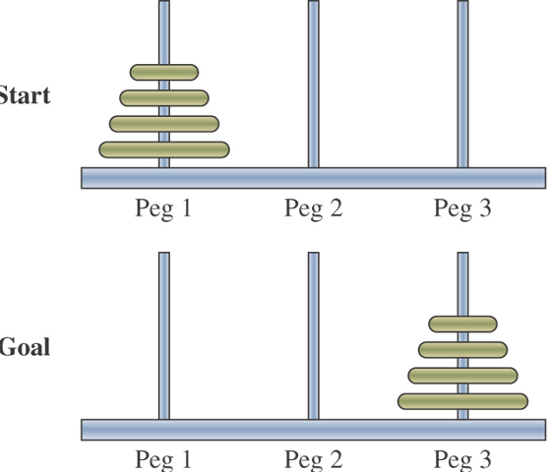
Towers of Hanoi
The goal of the Towers of Hanoi puzzle is to move N disks from peg 1 to peg 3:
  You must move one disk at a time.
  You must never place a larger disk on top of a smaller disk.
©The McGraw-Hill Companies, Inc. Permission required for reproduction or display.
Chapter 15 - <number>
Notes:
Intro to OOP with Java, C. Thomas Wu
©The McGraw-Hill Companies, Inc.

Slide 10
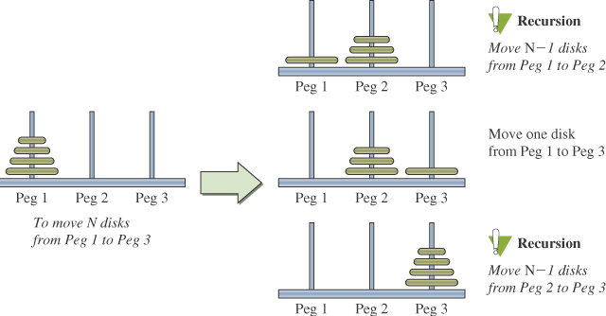
Towers of Hanoi Solution
©The McGraw-Hill Companies, Inc. Permission required for reproduction or display.
Chapter 15 - <number>
Notes:
Intro to OOP with Java, C. Thomas Wu
©The McGraw-Hill Companies, Inc.

Slide 11
towersOfHanoi Method
public void towersOfHanoi(int N, //number of disks
int from, //origin peg
int to, //destination peg
int spare ){//"middle" peg
if ( N == 1 ) {
moveOne( from, to );
} else {
towersOfHanoi( N-1, from, spare, to );
moveOne( from, to );
towersOfHanoi( N-1, spare, to, from );
}
}
private void moveOne( int from, int to ) {
System.out.println( from + " ---> " + to );
}
Test
End case
Recursive case
©The McGraw-Hill Companies, Inc. Permission required for reproduction or display.
Chapter 15 - <number>
Notes:
Intro to OOP with Java, C. Thomas Wu
©The McGraw-Hill Companies, Inc.
In pseudocode the above method is expressed as follows:
public void directoryListing( File dir )
{
//assumption: dir represents a directory
fileList = an array of names of files and
subdirectories in the directory dir;
for (each element in fileList) {
if (an element is a file) {
output the element’s filename; //end case: it’s //a file.
}
else { //recursive case: it’s a directory
call directoryListing with element as an argument;
}
}
}

Slide 12
Quicksort
To sort an array from index low to high, we first select a pivot element p.
  Any element may be used for the pivot, but for this example we will user number[low].
Move all elements less than the pivot to the first half of an array and all elements larger than the pivot to the second half. Put the pivot in the middle.
Recursively apply quicksort on the two halves.
©The McGraw-Hill Companies, Inc. Permission required for reproduction or display.
Chapter 15 - <number>
Notes:
Intro to OOP with Java, C. Thomas Wu
©The McGraw-Hill Companies, Inc.

Slide 13
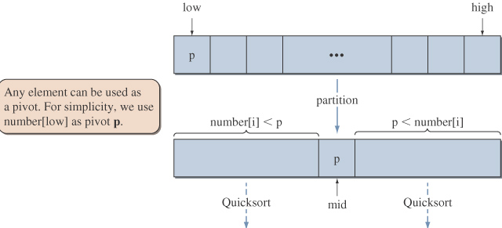
Quicksort Partition
©The McGraw-Hill Companies, Inc. Permission required for reproduction or display.
Chapter 15 - <number>
Notes:
Intro to OOP with Java, C. Thomas Wu
©The McGraw-Hill Companies, Inc.

Slide 14
quicksort Method
public void quickSort( int[] number,
int low, int high ) {
if ( low < high ) {
int mid = partition( number, low, high );
quickSort( number, low, mid-1 );
quickSort( number, mid+1, high );
}
}
©The McGraw-Hill Companies, Inc. Permission required for reproduction or display.
Chapter 15 - <number>
Notes:
Intro to OOP with Java, C. Thomas Wu
©The McGraw-Hill Companies, Inc.

Slide 15
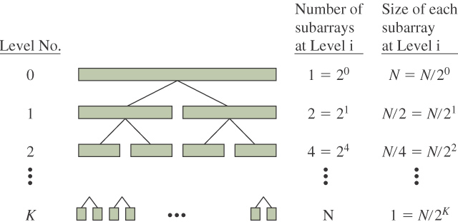
Quicksort Performance
In the worst case, quicksort executes roughly the same number of comparisons as the selection sort and bubble sort.
On average, we can expect a partition process to split the array into two roughly equal subarrays.
©The McGraw-Hill Companies, Inc. Permission required for reproduction or display.
Chapter 15 - <number>
Notes:
Intro to OOP with Java, C. Thomas Wu
©The McGraw-Hill Companies, Inc.
When the size of all subarrays becomes 1, the array is sorted.
The total number of comparisons for sorting the whole array is
K * N
N = 2^{K}
log₂N = K
KN = N log₂N

Slide 16
When Not to Use Recursion
When recursive algorithms are designed carelessly, it can lead to very inefficient and unacceptable solutions.
For example, consider the following:
public int fibonacci( int N ) {
if (N == 0 || N == 1) {
return 1;
} else {
return fibonacci(N-1) + fibonacci(N-2);
}
}
©The McGraw-Hill Companies, Inc. Permission required for reproduction or display.
Chapter 15 - <number>
Notes:
Intro to OOP with Java, C. Thomas Wu
©The McGraw-Hill Companies, Inc.

Slide 17
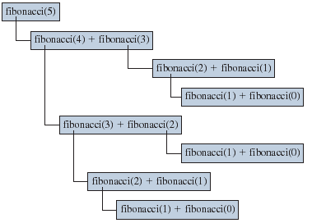
Excessive Repetition
Recursive Fibonacci ends up repeating the same computation numerous times.
©The McGraw-Hill Companies, Inc. Permission required for reproduction or display.
Chapter 15 - <number>
Notes:
Intro to OOP with Java, C. Thomas Wu
©The McGraw-Hill Companies, Inc.

Slide 18
Nonrecursive Fibonacci
public int fibonacci( int N ) {
int fibN, fibN1, fibN2, cnt;
if (N == 0 || N == 1 ) {
return 1;
} else {
fibN1 = fibN2 = 1;
cnt = 2;
while ( cnt <= N ) {
fibN = fibN1 + fibN2; //get the next fib no.
fibN1 = fibN2;
fibN2 = fibN;
cnt ++;
}
return fibN;
}
}
©The McGraw-Hill Companies, Inc. Permission required for reproduction or display.
Chapter 15 - <number>
Notes:
Intro to OOP with Java, C. Thomas Wu
©The McGraw-Hill Companies, Inc.
A nonrecursive version is just as easy to understand and has much better performance.

Slide 19
When Not to Use Recursion
In general, use recursion if
  A recursive solution is natural and easy to understand.
  A recursive solution does not result in excessive duplicate computation.
  The equivalent iterative solution is too complex.
©The McGraw-Hill Companies, Inc. Permission required for reproduction or display.
Chapter 15 - <number>
Notes:
Intro to OOP with Java, C. Thomas Wu
©The McGraw-Hill Companies, Inc.

