Slide 1
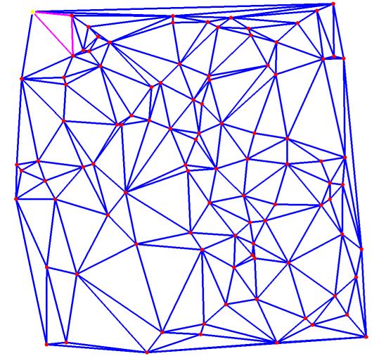

Slide 3
3
4
5
2
1
0

Slide 4
3
2
4
1
5
0

Slide 5
3
2
1
1
side(0)=side(1)
side(2)=side(3)
flipable
pop
0

Slide 6
3
2
1
1
side(0)=side(1)
side(2)=side(3)
flipable
pop
0

Slide 7
3
2
1
2
side(0)=side(1)
=side(3)
flipable
pop
0

Slide 8
3
2
1
2
side(0)=side(1)
=side(3)
flipable
pop
finish edge
0

Slide 9
3
2
1
3
side(0)=side(1)
side(2)=side(3)
not flipable
push
0

Slide 10
3
2
1
3
side(0)=side(1)
side(2)=side(3)
not flipable
push
0

Slide 11
3
2
1
4
side(0)=side(1)
=side(3)
not flipable
push
0

Slide 12
3
2
1
4
side(0)=side(1)
=side(3)
not flipable
push
0

Slide 13
3
2
1
5
side(0)=side(2)
=side(3)
flipable
pop
0

Slide 14
3
2
1
5
side(0)=side(2)
=side(3)
flipable
pop
finish edge
0

Slide 15
3
2
1
6
side(0)=side(2)
side(1)=side(3)
flipable
no pop
0

Slide 16
3
2
1
6
side(0)=side(2)
side(1)=side(3)
flipable
no pop
0

Slide 17
3
2
1
7
side(0)=side(2)
=side(3)
not flipable
push
0

Slide 18
3
2
1
7
side(0)=side(2)
=side(3)
not flipable
push
0

Slide 19
3
2
1
8
side(0)=side(2)
side(1)=side(3)
not flipable
push
0

Slide 20
3
2
1
8
side(0)=side(2)
side(1)=side(3)
not flipable
push
0

Slide 21
1
2
3
4
side(0)=side(1)
side(2)=side(3)
flipable
pop
side(0)=side(1)
=side(3)
flipable
no pop
side(0)=side(1)
side(2)=side(3)
not flipable
push
side(0)=side(1)
=side(3)
not flipable
push
5
6
7
8
side(0)=side(2)
=side(3)
flipable
pop
side(0)=side(2)
side(1)=side(3)
flipable
no pop
side(0)=side(2)
=side(3)
not flipable
push
side(0)=side(2)
side(1)=side(3)
not flipable
push
1
1
2
side(2)=side(3)
2
1
2
3
4
3
3
4
4
side(0)=side(1)
flipable
5
5
6
side(1)=side(3)
6
5
6
7
8
7
7
8
8

Slide 22
3
2
1
7
side(0)=side(2)
=side(3)
not flipable
push
0

