Slide 1
Problems to solve
Code easily driven by multiple sources
Code which is ease to test
Well organized code
Notes:
Code driven by multiple sources: ui, batch, inne programy

Slide 2
Why Hexagon?
Application usually has inputs and outputs (left’s and right’s)
Layard diagrams don’t show the whole picture.
Tool for software visualization
Notes:
Tutaj opowiedziec ze sa sily ktore steruja aplikacja – Primary (driving) things. I takie ktore sa sterowane – Secondary (driven).

Slide 3
Why Hexagon?
Notes:
Tutaj opowiedziec ze sa sily ktore steruja aplikacja – Primary (driving) things. I takie ktore sa sterowane – Secondary (driven).

Slide 4
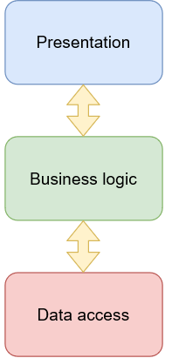
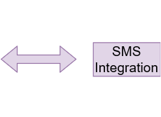
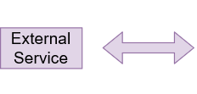
Often layer’s doesn’t represent reality well.
Notes:
Warstyw na pierwszy zut oka sa proste do zrozumienia, ale im dalej w las tym trudniej przedstawić rozne rzeczy związane np. Z dodatkowa integracja.

Slide 5
Primary(Driving) ports
First communication points between the outside and the application core
Drive the application
Requests get through them to application
Reside on the left side on hexagon

Slide 6
Primary adapters
Primary ports are used by primary adapters
Primary ports are injected into primary Adapters

Slide 7
Primary port and adapter examples
Primary adapter
Rest Controller,
console Interface.
Primary Ports:
Application service

Slide 8
AccountController
Account Application Service
Notes:
Primary ports and adapters animation. Create account example.

Slide 9
Primary Adapter
AccountController
Create Account DTO
Account Application Service
Primary Port
Notes:
Primary ports and adapters animation. Create account example.

Slide 10
Code

Slide 11
Secondary(Driven) ports
The application core uses secondary ports to upstream data to external entities.
Injected into application core (Belongs to the application).
Sends data to the outside
Reside on the right side on hexagon

Slide 12
Secondary adapters
Specific implementation of the port. Secondary port is an interface and adapters are real implementation.
The application core uses secondary ports to upstream data to external entities.
Reside on the right side outside hexagon

Slide 13
Secondary port and adapter examples
Secondary adapters
Jpa repository
External application adapter
Email service implementation
Primary Ports:
Interfaces to the above adapters

Slide 14
Secondary Port
Account JPA Repository
Account Application Service
Account Repository
Create Account DTO
Account In memory Repository
Secondary Adapter
Notes:
Primary ports and adapters animation. Create account example.

Slide 15
Primary Port
Account Application Service
Account Repository
Account
Controller
Account JPA Repository
Primary Adapter
Secondary Port
Secondary Adapter
Notes:
Primary ports and adapters animation. Create account example.

Slide 16
Code

Slide 17
Source
https://herbertograca.com/2017/11/16/explicit-architecture-01-ddd-hexagonal-onion-clean-cqrs-how-i-put-it-all-together/
https://herbertograca.com/2017/09/14/ports-adapters-architecture/
https://www.youtube.com/watch?v=sOaS83Ir8Ck
https://medium.com/sciforce/another-story-about-microservices-hexagonal-architecture-23db93fa52a2
https://medium.com/@codespeaks/a-quick-and-practical-example-of-hexagonal-architecture-in-java-7334e7f2ad43

