Slide 1
Bridge Pattern
Bridge Pattern bridges abstraction and it's implementation, letting them vary independently.

Slide 2
Use cases
separate API from the implementation - hiding implementation to clients,
decoupling interface and implementation,
open for changes,
Changes/new functionalities don’t affect existing code.

Slide 3
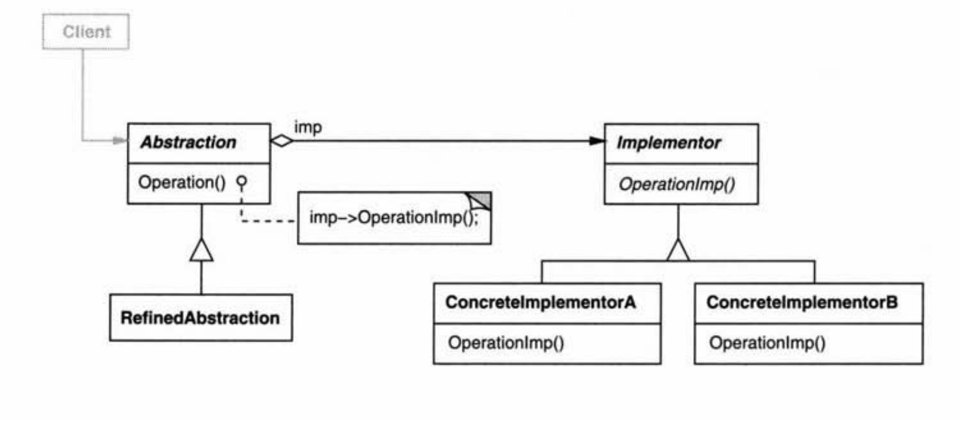
Bridge pattern structure (Design Patterns: Elements of reusable software)

Slide 4
Elements
Abstraction: Defines API used by client. Maintenance reference to the implementator.
Implementator: Provides rules for concrete implementators.
Concrete Implementator: Concrete representation of the Implementator.

Slide 5
Elements
Refined Abstraction: implements abstraction. Add specific implementation one level higher.
Can implements low level functions from abstractions and run inside some functions specified by the implementator.
Can implements high level functions from abstraction and add high level functionality which is different than in implementator.

Slide 6
Real life examples
Socket class from java.net
Button from java.awt

