Slide 1
Bridge Pattern
Bridge Pattern bridges abstraction and it's implementation, letting them vary independently.

Slide 2
Use cases
separate API from the implementation - hiding implementation to clients,
decoupling interface and implementation,
open for changes,

Slide 3
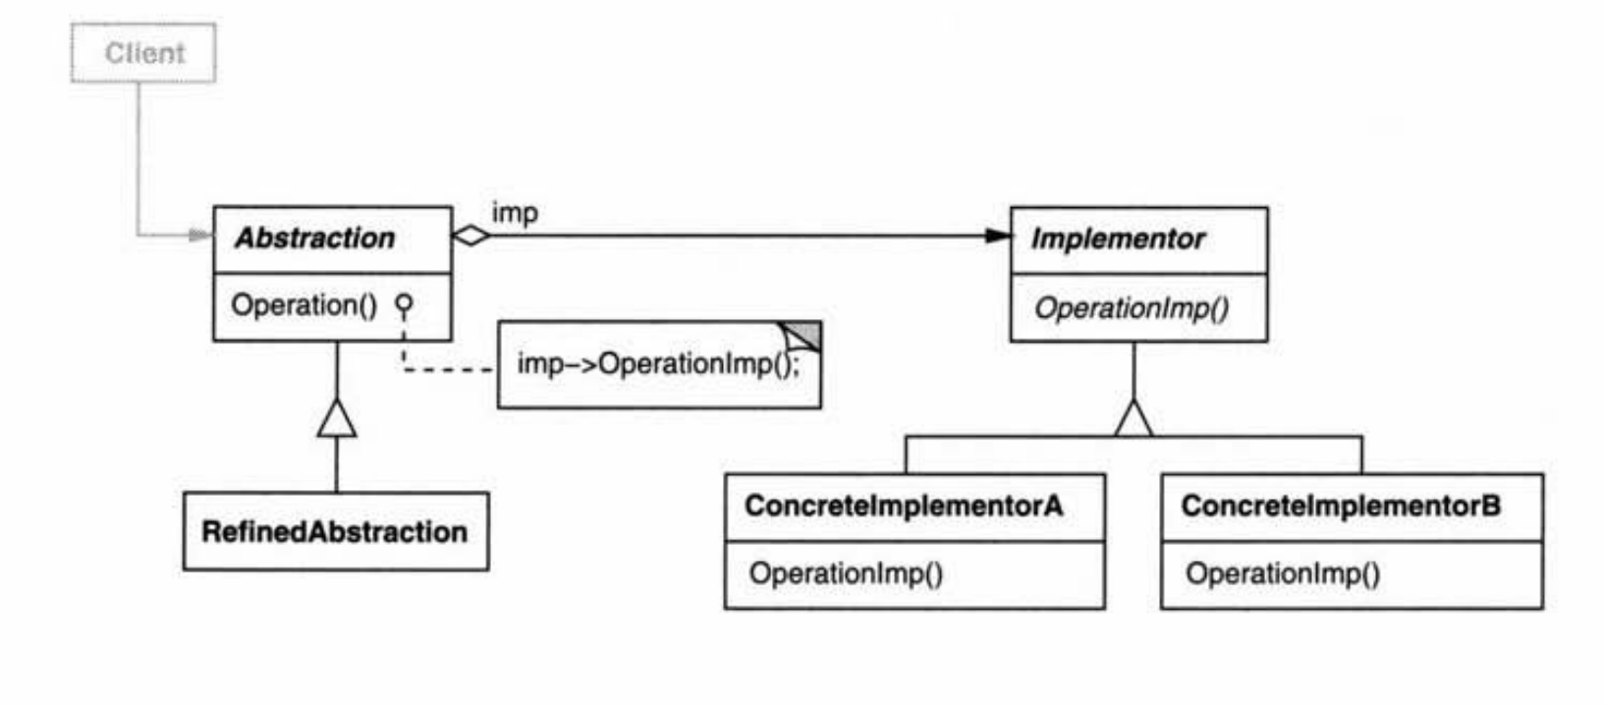
Bridge pattern structure (Design Patterns: Elements of reusable software)

Slide 4
Elements
Abstraction
Implementator
Concrete Implementator

Slide 5
Elements
Refined Abstraction: implements abstraction. Add specific implementation one level higher.
Can implements low level functions from abstractions and run inside some functions specified by the implementator.
Can implements high level functions from abstraction and add high level functionality which is different than in implementator.

