Slide 1


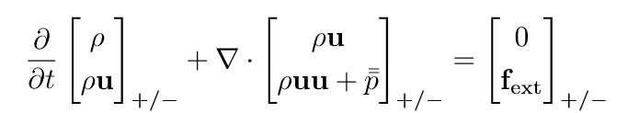

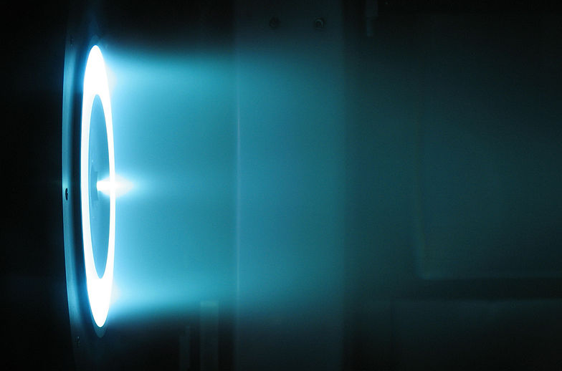

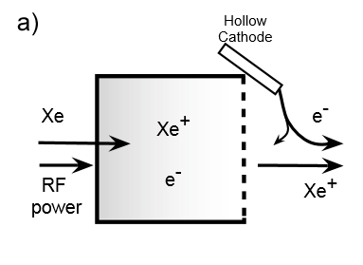
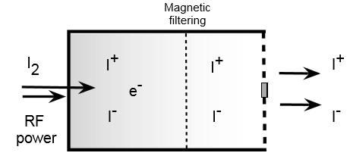
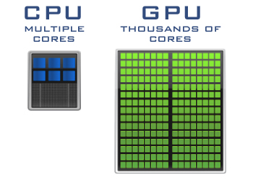
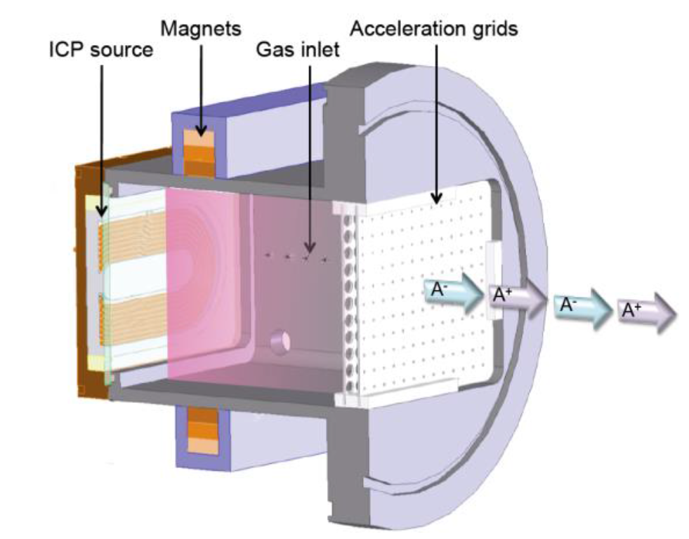
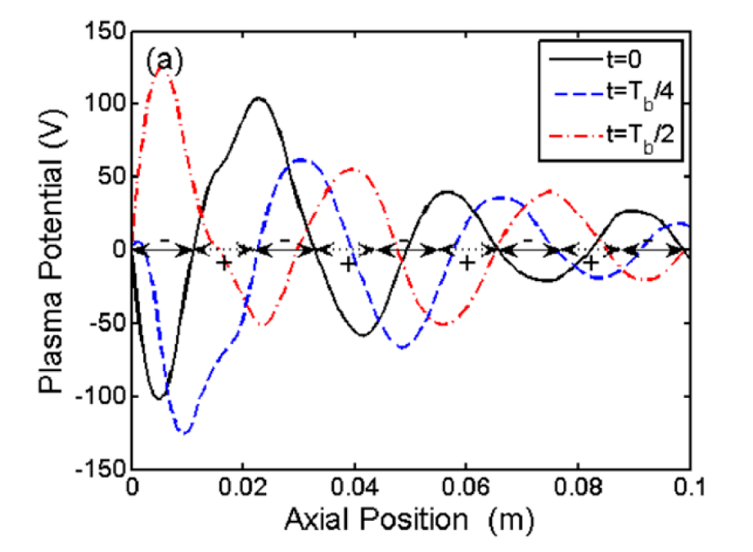
Parallelized Computational Model of
Plasma Flow in Ion-Ion Thrusters
Thomas Dale Travis Widmer Advisor: Dr. Kamesh Sankaran
Goals
Numerical Modeling
Results
After verifying test cases, we created and ran our simulation to find results that our system included some important aspects that earlier publications did not.
The simulation calculates voltage, electric field, positive/negative ion density, and positive/negative ion velocity in both the radial and axial direction.
Our preliminary results after many simulations show that a net neutral voltage is not achieved at 10 cm downstream.
Long run times (i.e. 50-100 μs) cause some ions to flow back into thruster.
Once results like these are received,
any calculations past this time are
considered incorrect due to the
physical meaning of these high
velocities into the thruster.
Must ensure that results are consistent
with all other physical laws.
This greatly affects the validity of
any simulation result which requires
extra checks to be included to catch
these errors and note where they
occur for further examination.
Future Steps
Code updates are ongoing to address issues stated above. These contradictory results from that of other researchers must be shown to be accurate and not a coding or math error.
Conservation of energy is important in this problem and is yet another addition to be made that previous researches omitted from simulations.
Simulation currently tests plasma propulsion in space-like conditions, to verify simulation with actual engineering tests simulation should also be able to test cases where domain edges are grounded and not continuous.
To develop a computational model of plasma flow downstream of an ion-ion thruster.
To verify that the thruster achieves net electrically neutral exhaust within a reasonably short distance downstream.
To use GPU computation to speed up simulation to a reasonable runtime.
Figure: Conservation equations of plasma flows in thrusters
Why Plasma Propulsion?
Figure: Relationship of voltage in the plasma plume
Chemical rockets have low propellant utilization efficiency.
For deep-space missions and long-duration satellite operations, a longer lasting propellant technology is needed.
Plasma propulsion works
well for ionized gases
with high charge to mass
ratios (e.g., xenon
and iodine).
Electromagnetic forces
propel plasma causing a
effective long term
propulsion.
These equations can not be analytically solved so a numerical solution for specific boundary conditions is required.
Other simulations¹ of ion-ion thrusters use a particle model to simulate flow and interactions of ions. This assumes each simulated particle (or packet) accurately represent a vary large number of real particles. This also assumes that the electric potential goes to zero at 10 cm downstream, a claim that needs to be verified. This also ignores potentially important variables like collisions.
Our simulation treats the plasma flow as a continuum, instead of simulated macro-particles. It also sets the electrical potential at the downstream end to “float” to accurately estimate if the exhaust actually neutralizes. It also accounts for collisions within the plasma stream.
Positive ion density distribution after 10 μs with a 0.01 m thruster radius.
Negative ion density distribution after 10 μs with a 0.01 m thruster radius.
The geometry of a plasma thruster and its exhaust is cylindrical in nature so all calculations are done in cylindrical coordinates to match.
It’s assumed the exhaust from the thruster has no rotational motion because electric field forces are conservative. This allows us to eliminate any angular calculations.
For expansive numerical solutions, independent calculations must be made for every discretized time and space location which can be time consuming warranting the need for parallelized computing.
Xenon Hall Thruster, NASA JPL
Typical Grid Layout
Electrostatic Plasma Thrusters
Thruster outlet
Classical Ion Thruster
Voltage and electric fields after 10 μs with a 0.01 m thruster radius.
Voltage and electric fields after 10 μs with a 0.01 m thruster radius.
Accelerates positive ions out of a chamber using a negatively charged grid creating thrust.
Ions must be neutralized downstream by a cathode.
Exterior cathode neutralizer is a common source of failure, bringing about the need for a new thruster design.
Axis of Rotation
Parallelized Computation
Model of Classical Propulsion Thruster
Graphics Processing Unit vs Central Processing Unit
Using parallelized computation dramatically reduces run-time by calculating many operations at once.
CPUs excel at processing inline using their few very fast cores.
GPUs contain thousands of cores making them optimal for large parallelized computation without the need for multiple CPUs.
Using CPU alongside GPU
To optimize computation time,
data exchange is most important.
In GPU computation, memory is
held by individual cores and sharing
information is expensive.
By regulating memory in the CPU
each step in time, the GPU can
process data all at once without
having to pause and trade data.
Simulations were completed using an NVIDIA Tesla K40.
New Ion-Ion Thruster
Accelerates alternating fluxes of positive and negative ions using a charged gird with oscillating voltage.
Theoretically, a neutralizer will not be needed if positive and negative ions are alternatingly propelled.
Positive/negative velocity vectors after 60 μs with a 0.5 m thruster radius zoomed into (0.05 x 0.05) m domain.
Model of Ion-Ion Propulsion Thruster
Exhaust Neutralization
Exhaust must be neutralized otherwise the ions will pulled back by the charged grid.
Returning ions collide with back of thruster causing damage.
Other simulations¹ claim zero net charge at 10 cm downstream
Fig. CPU-GPU schematic (NVIDIA)
Procedural Development
References
N Oudini et al., 2016 Plasma Sources Sci. Technol., 25, 055013
R. G. Jahn, Physics of Electric Propulsion. New York: McGraw-Hill 1968.
K. Sankaran and K.A. Polzin, “Numerical Investigation of Near-Field Plasma Flows in Magnetic Nozzles”, AIAA, 2009.
K. Sankaran, “Simulation of Plasma Flows in Self-Field Lorentz Force Accelerators”, Ph.D. Thesis, Princeton University, 2005.
A. Aanesland, A. Meige and P. Chabert, “Electric propulsion using ion-ion plasmas”, Journal of Physics, 2009.
W. H. Press et al., Numerical Recipes, Cambridge, 2007.
J Sanders and E Kandrot, CUDA by Example , Addison-Wesley Professional, 2010
Creating a computer simulation for a problem with no known solution has specific problems that must be considered.
Knowing the difference between a bug and an actual, unconsidered result comes down to specifications of how the program is designed and analyzed.
Multiple test cases were used before the final simulation was ever implemented. By using similar methods to compute already solved problems, it is possible to systematically test components used in the actual code.
After running an instance of the simulation, it is difficult to know if the results realistically represent the physics. To check for correctness portions of the code are isolated and run often verified by hand calculations.
PEGASES Ion-Ion Thruster Image from L. Garrigues
Near-field plume properties of Ion Ion thruster simulation
Image from N.Oudini

