Slide 1
AAVAIL predict monthly revenue - EDA.
Accurately predicted monthly revenue is needed to improve manager and executive decision making. Well-projected numbers will help stabilize staffing and budget projections which will have a beneficial ripple effect throughout the company.

Slide 2
Possible hypotheses to test
Timeseries for revenue is stationary
Revenue mean between months is statistically similar
Timeseries for revenue is seasonal
Ideal data to address the business opportunity
Data data are at a transaction level to know What, was bought by Who, Where and When
Data about other timeseries e.g. marketing spending, promo offers, offer difference between countries
The amount of data should be sufficient to observe seasonal aspect

Slide 3
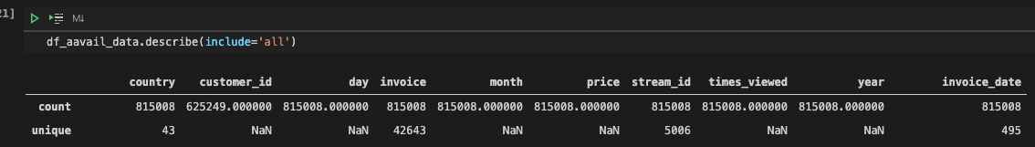
General Outline
Available training data contains purchases (81508) from 43 unique countries, 42643 invoices, 5006 unique streams, across 495 distinct dates.
It was required to unify column names, and drop few rows with negative price values (stream_id in letter form).

Slide 4
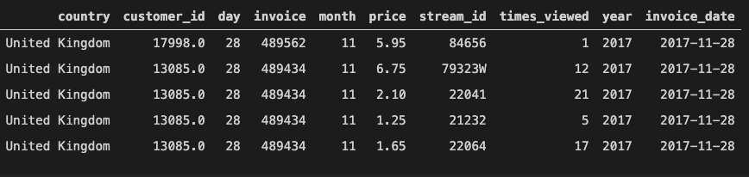
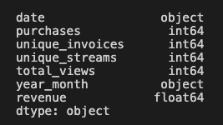
Available information
After data transforms are converted to time series with daily interval

Slide 5
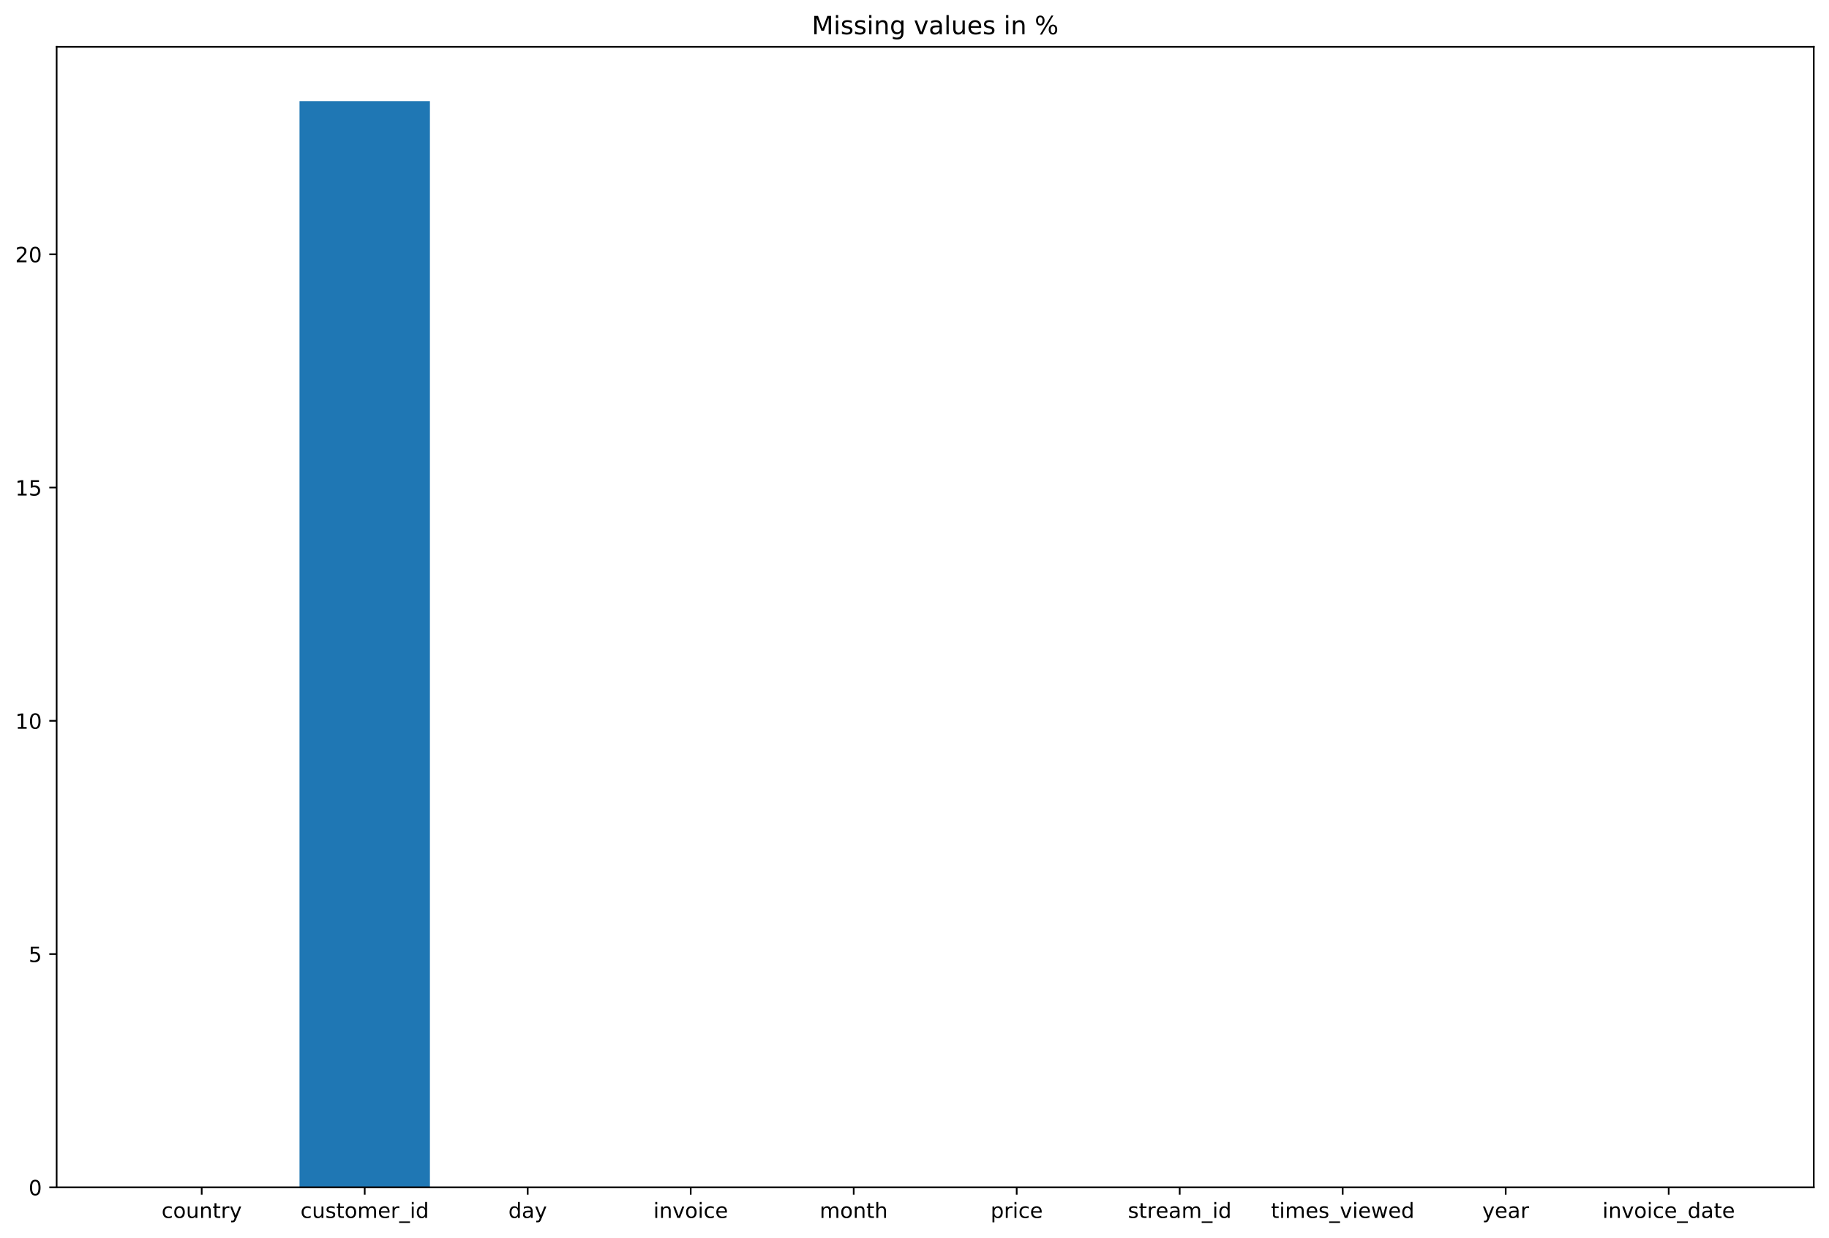
Missing values – only on customer_id, which is not used anyway

Slide 6
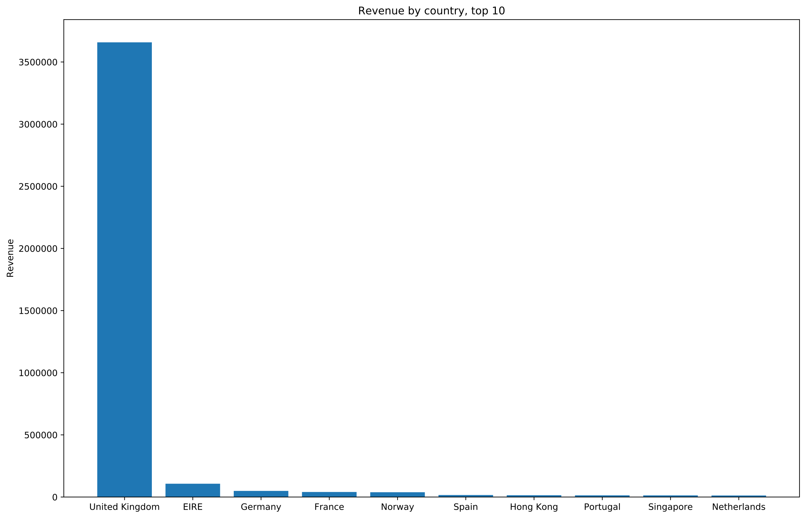
Revenue by country for top 10 countries

Slide 7
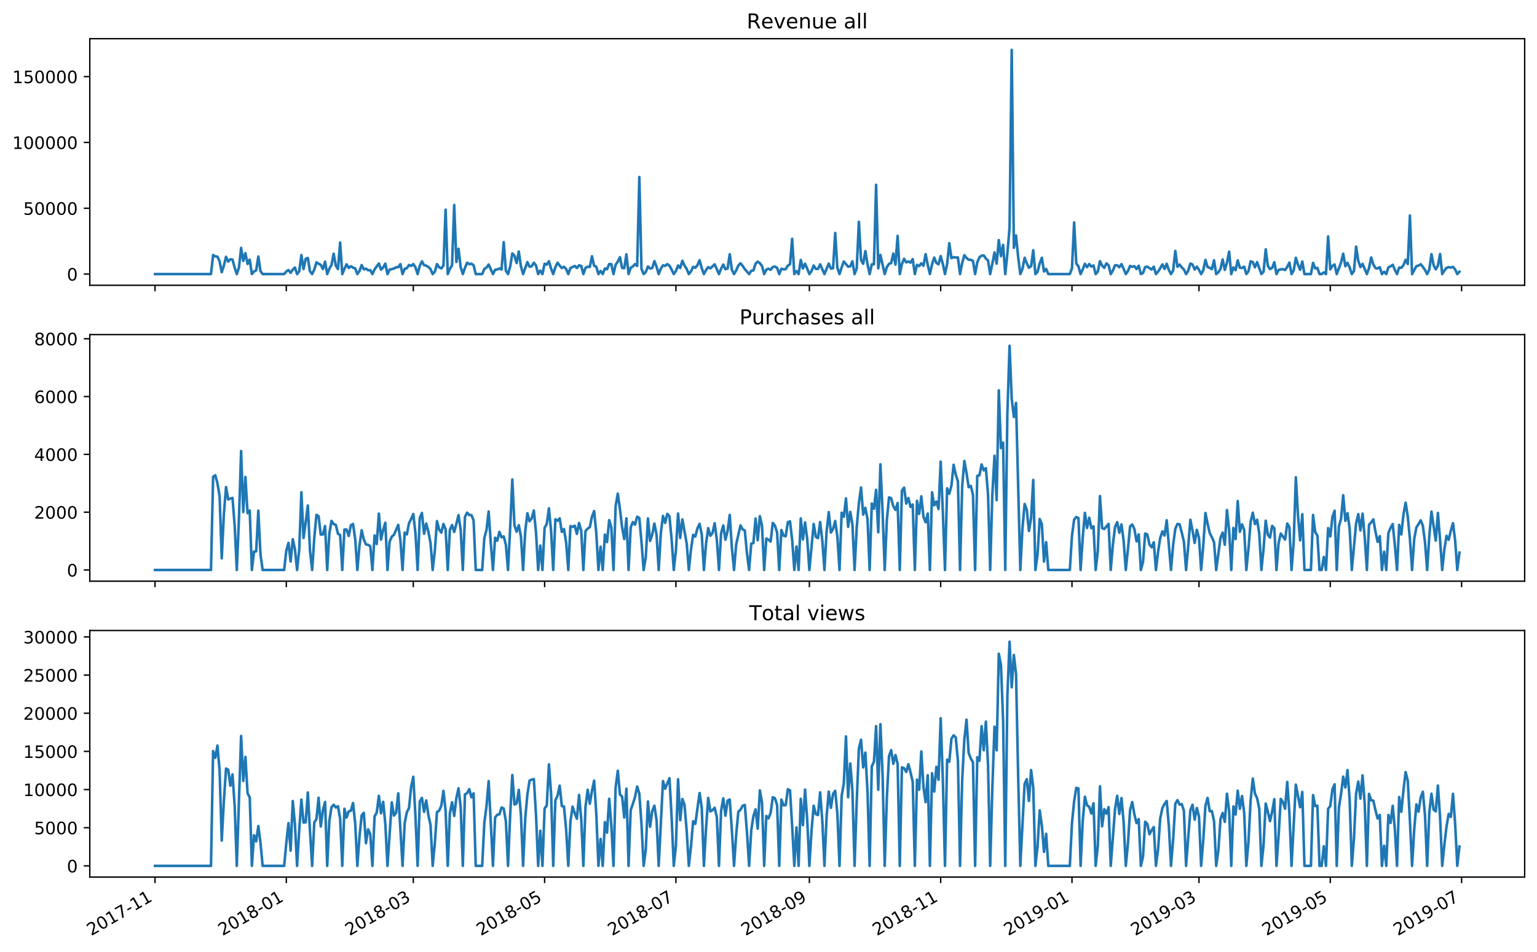
Time series

Slide 8
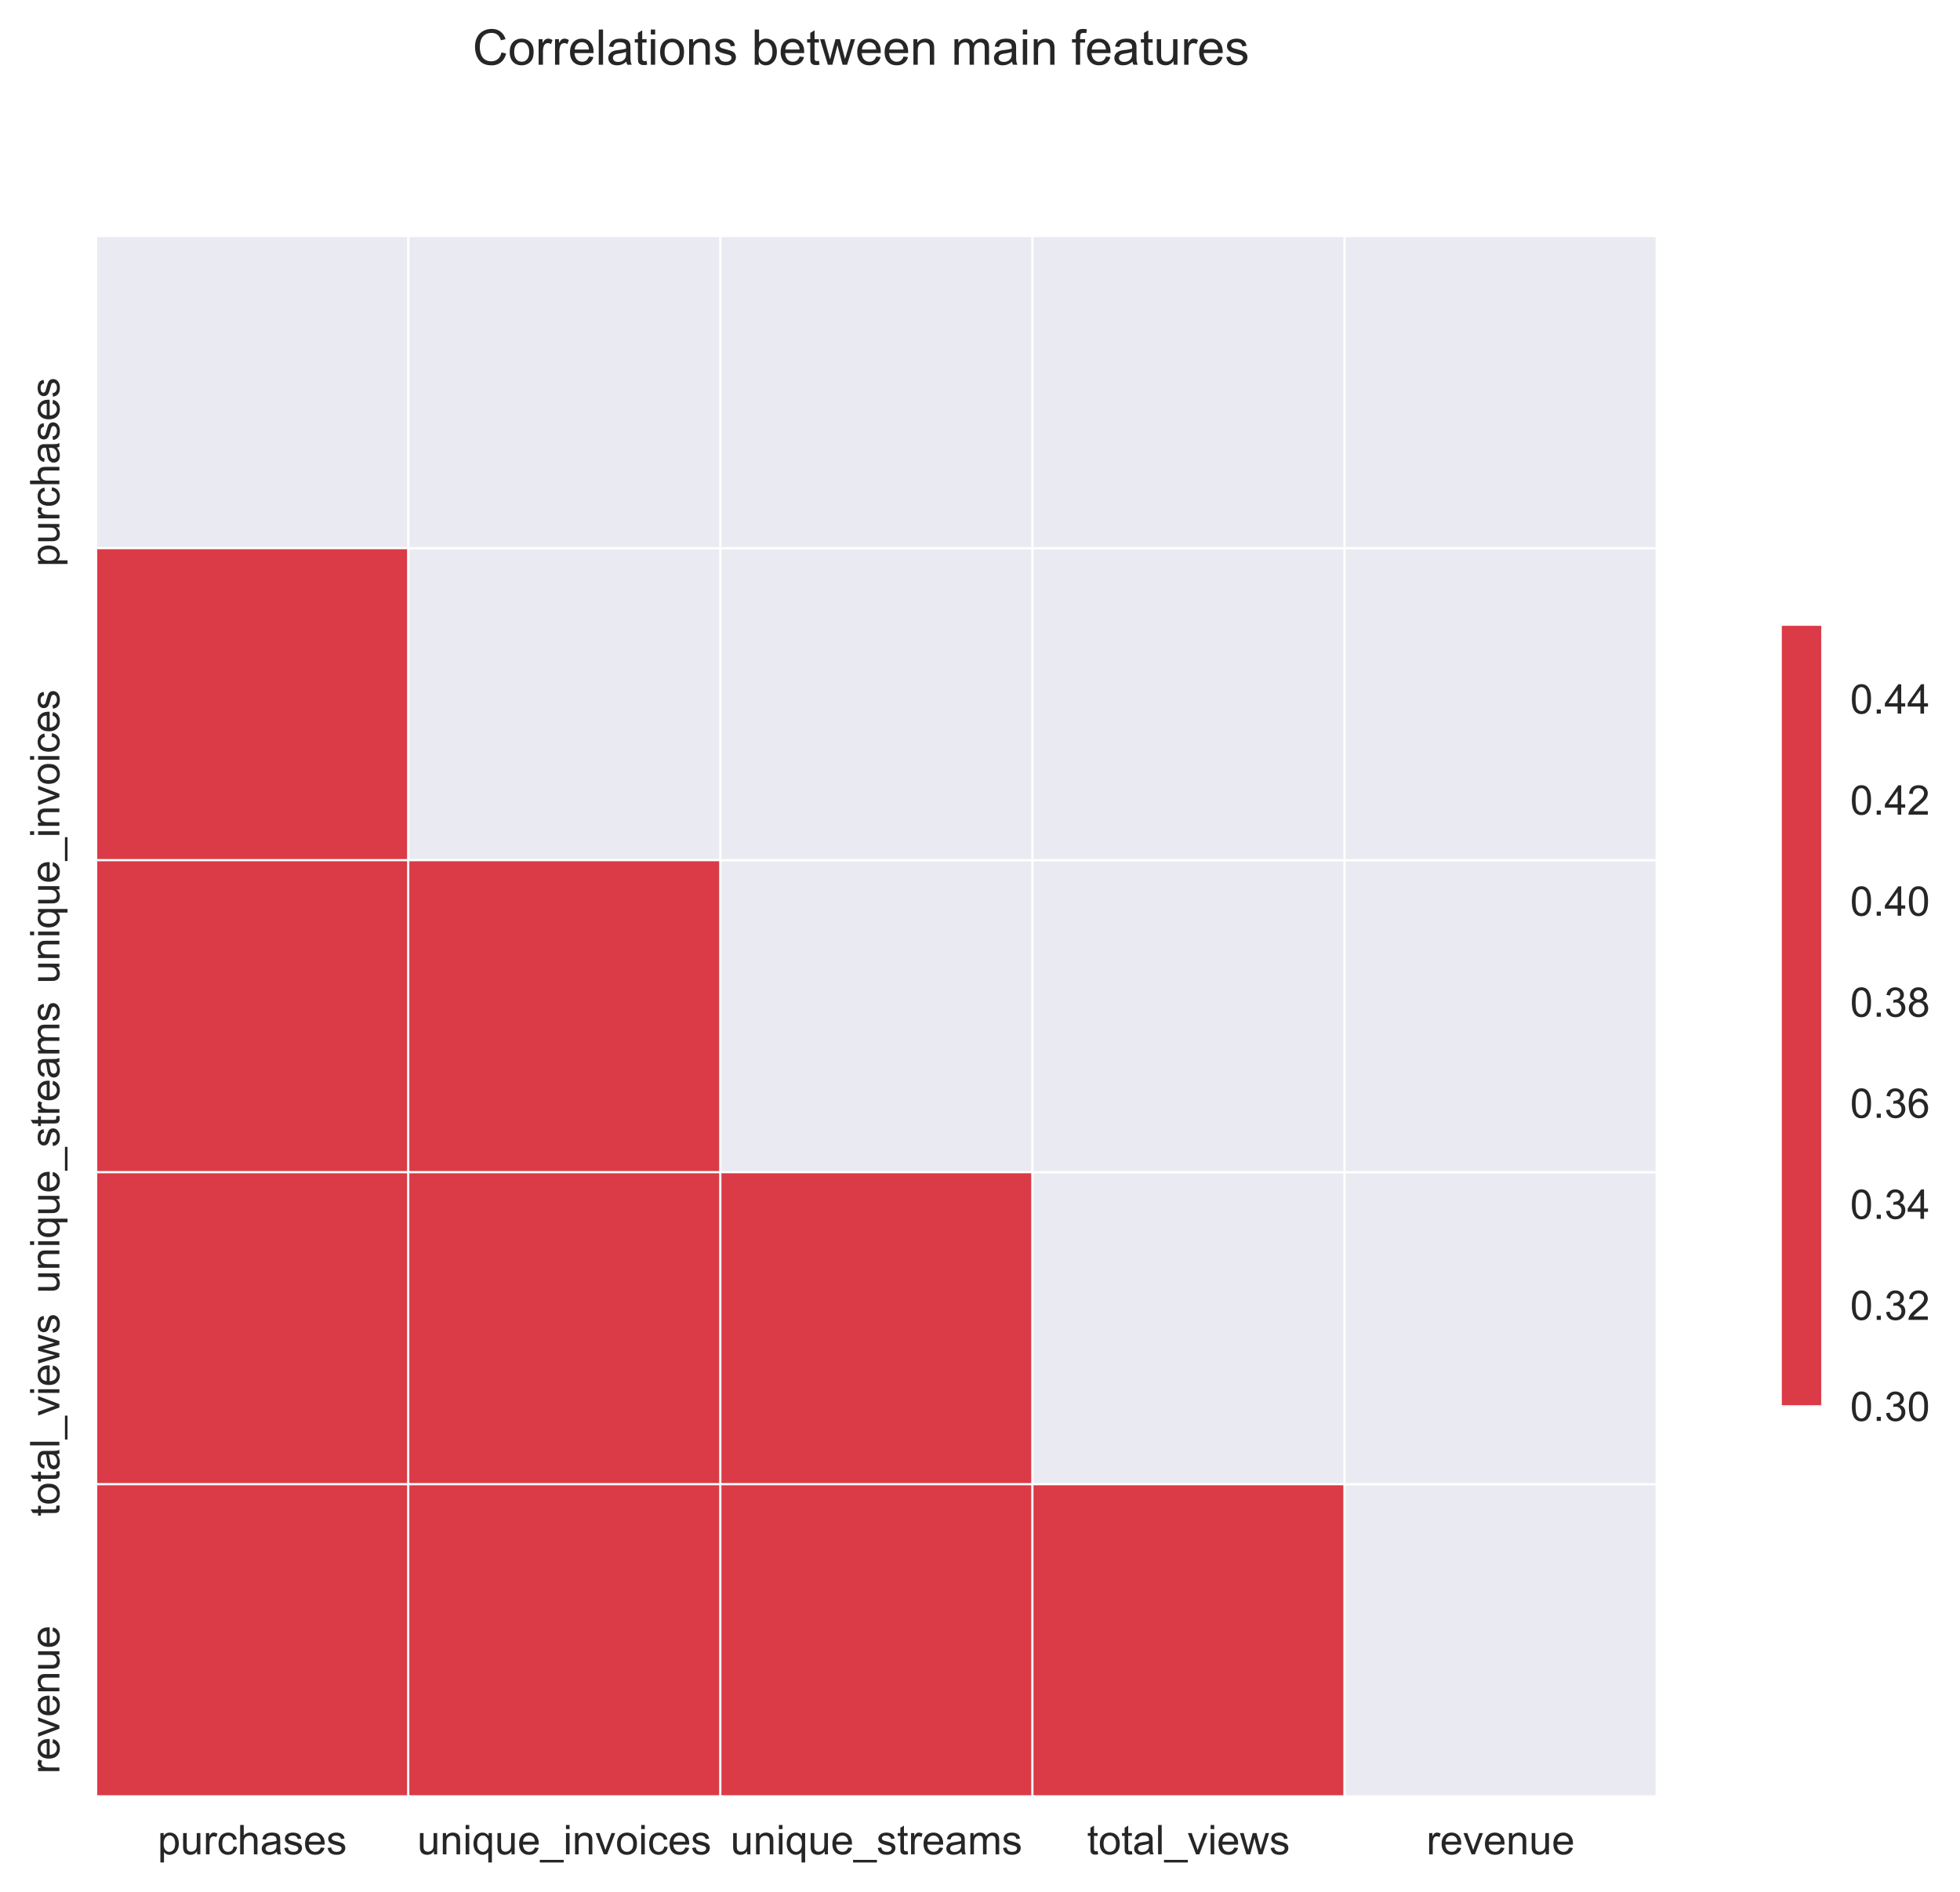
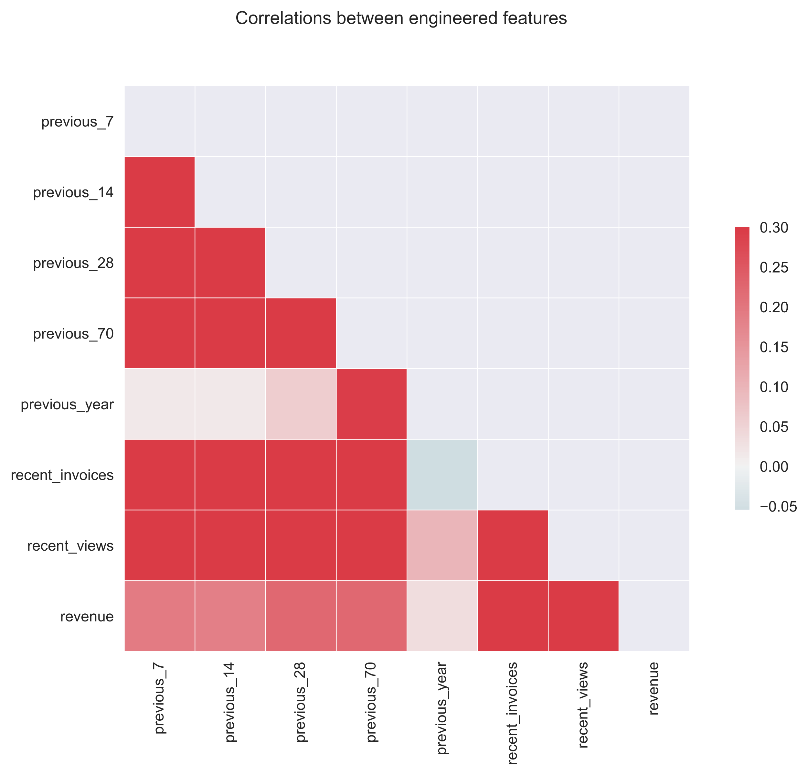
Supervised learning approach - correlations between main and engineered features

Slide 9
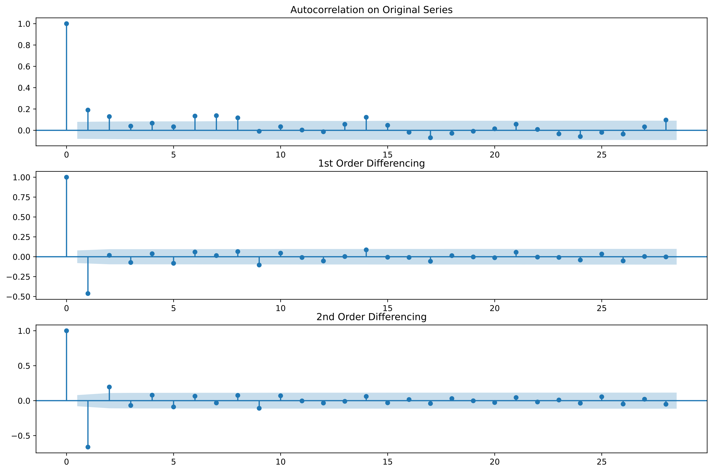
Time-series forecasting aproach - Autocorrelation to identify stationary for ARIMA model It looks that timeseries is stationiary and we can use d = 0, and higher AR. Also we can try d = 1.

Slide 10
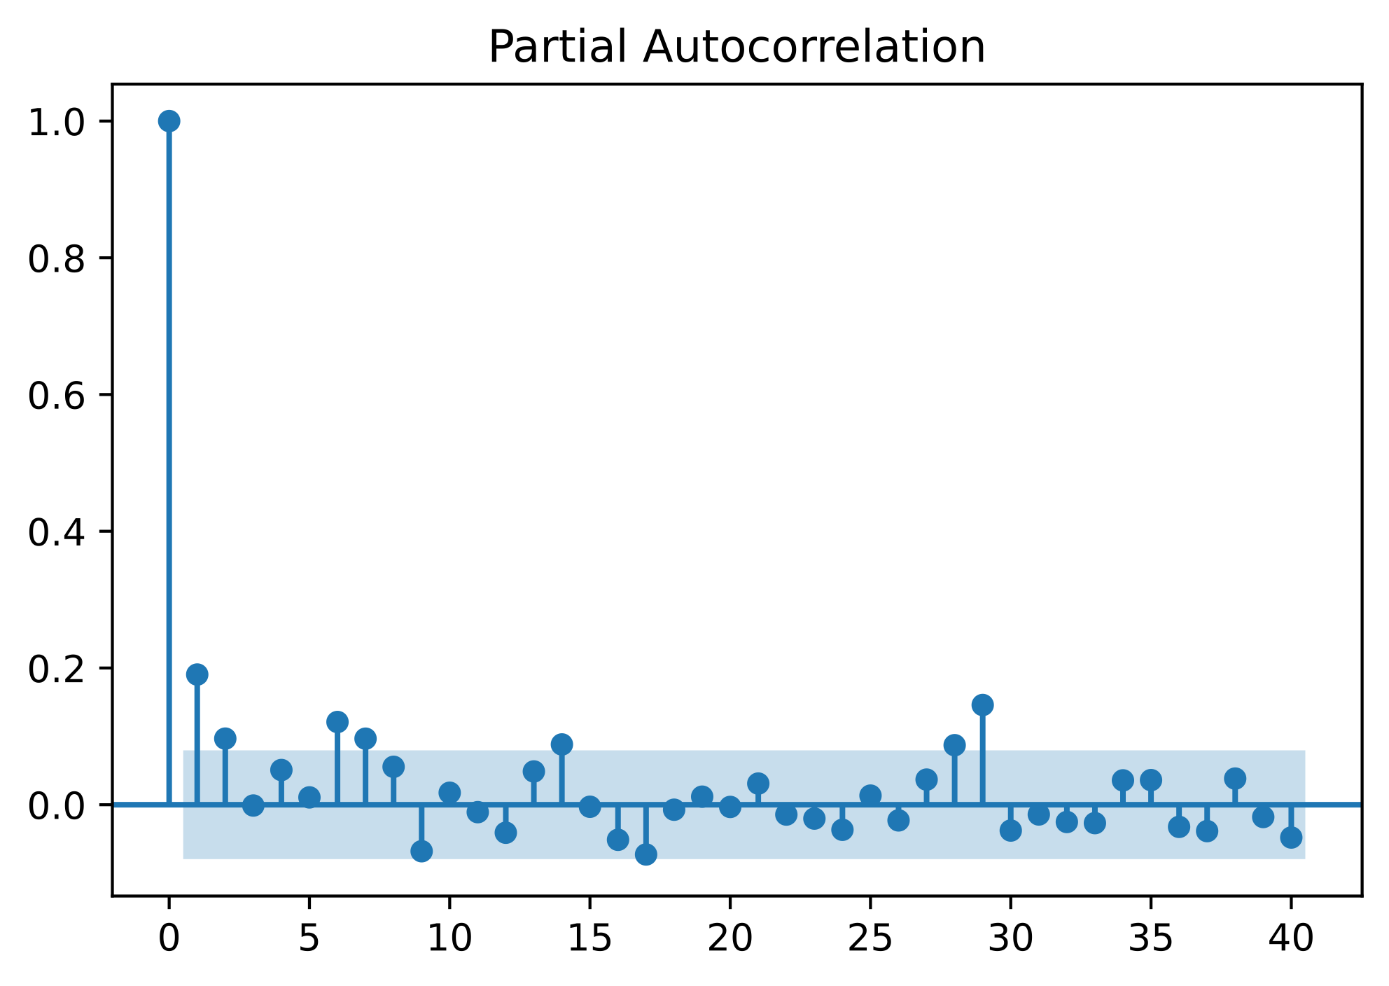
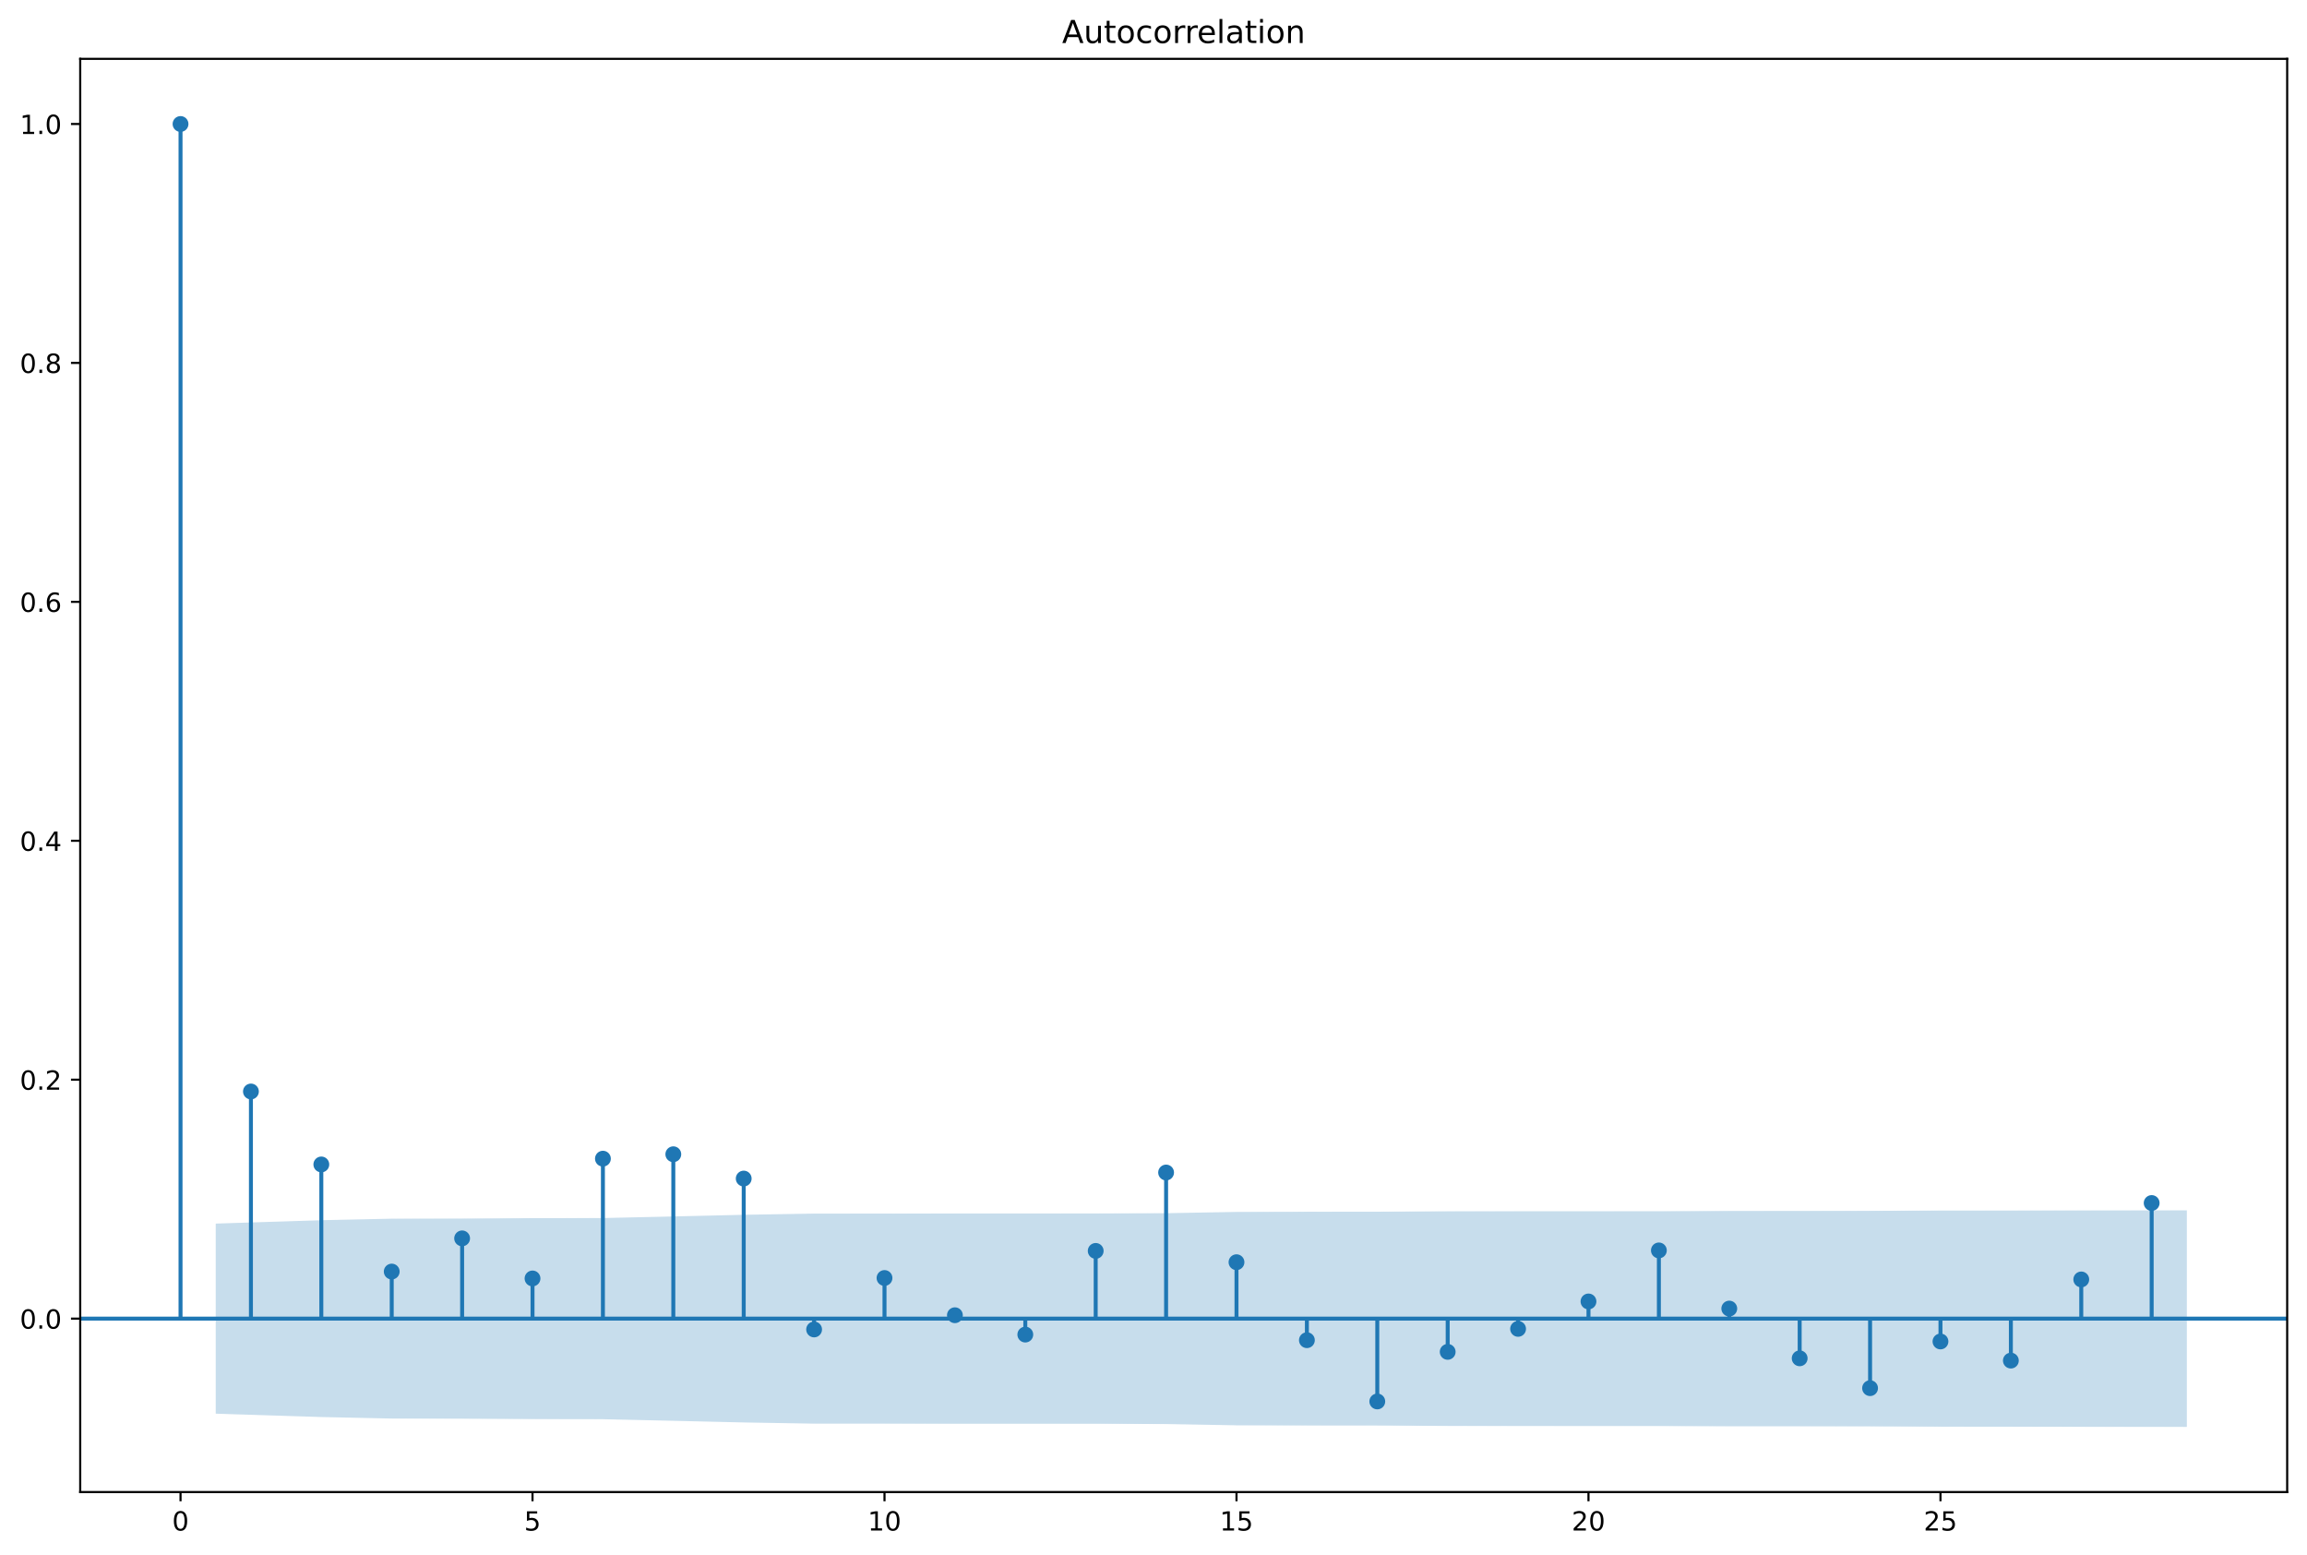
Time-series forecasting aproach ACF (Autocorrelation) and PACF (Partial Autocorrelation) plots for d = 0, to find p and q values for ARIMA(p, d, q)

Slide 11
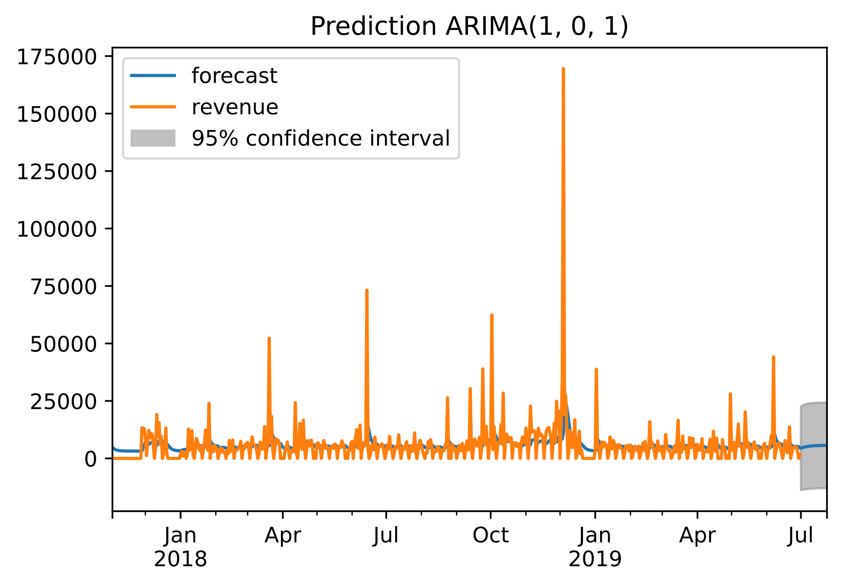
Time-series forecasting aproach Prediction for United Kingdom ARIMA (1, 0, 1)

Slide 12
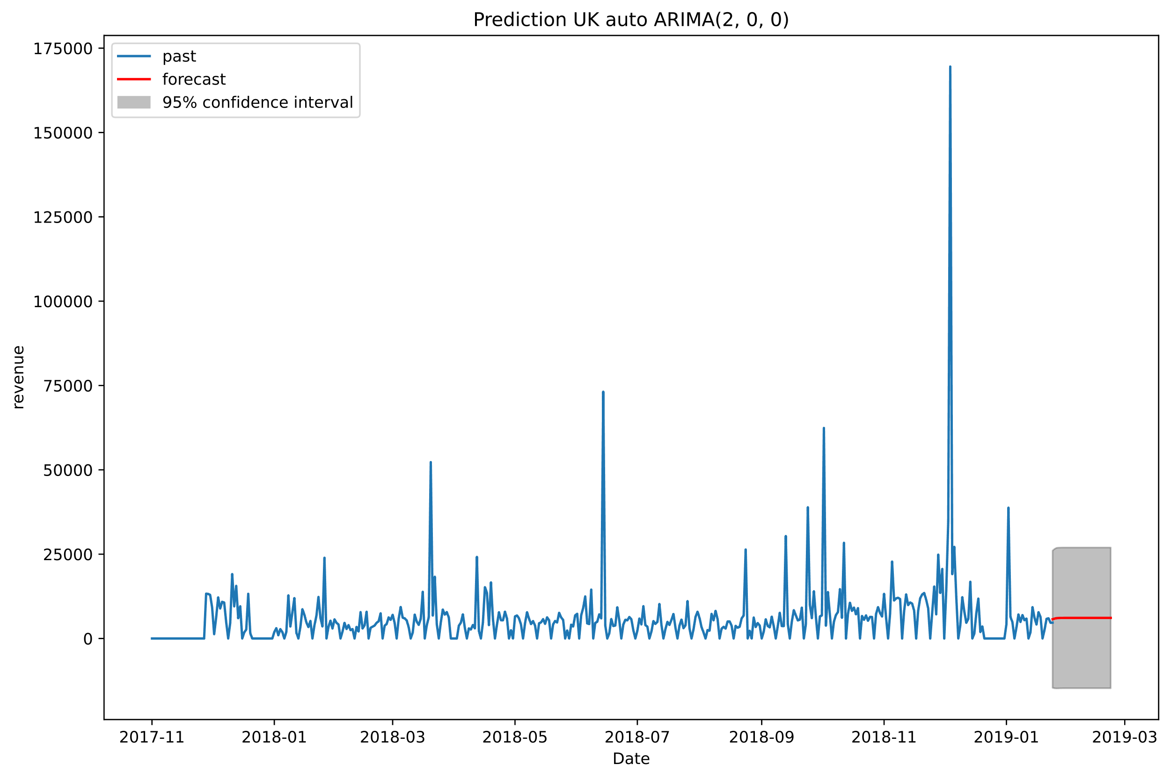
Time-series forecasting aproach – Auto ARIMA Prediction for United Kingdom auto ARIMA (2, 0, 0)

Slide 13
Time-series forecasting aproaches - compare
Manually I’ve got (p, d , q) = (1, 0, 1) and auto_arima found the lowest AIC value with (2, 0, 0).
Based on plots, it looks that model selected by auto ARIMA has high AR part (p) which produce almost horizontal line. Differences between AIC values were very small, so I think using ARIMA (1, 0, 0), or ARIMA (1, 0, 1) with small limited number of steps/days of forecast will work better.
Because limited time for capstone project, I was not comparing supervised learning (SR) approach with time-series forecasting. Most likely ARIMA model would perform better than SR, since this approach only tries to mimic how time-series forecasting works.
We can observe seasonality in timeseries. Most active period is from November to December, with highest revenue.
Docker image has SR approach implemented with use of RandomForestRegressor.

