Slide 1



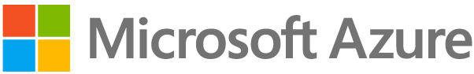

https://example.northeurope.azurecontainerapps.io
Container App Environment
Ingress
Ingress
Self-Hosted Gateway Container App
Bacon API Container App
Sync Configuration
Azure API Management
Ingress
External Ingress – Exposed Publicly
Ingress
Internal Ingress – Exposed insides Container Environment

Slide 2
api-gateway.bicep
app.bicep
Provision Azure API Management
Manage service instance
Manage self-hosted gateway
Provision infrastructure
Deploy Bacon API with internal ingress
Integrate container workloads with Azure API Management
Deploy Apps on Azure Container Apps
Deploy API gateway with external ingress
Manage Bacon API
Manage Bacon backend
Use policy to set backend for self-hosted gateway
Expose Bacon API on self-hosted gateway
Manage Log Analytics

