Slide 1
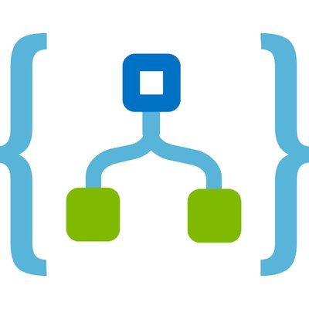




Scheduled Trigger for KEDA images
Azure Logic Apps
Scrape Requests
Azure Service Bus Queue
Docker Hub Metric Scraper
Azure Functions
Metrics Application Insights
Scheduled Trigger for Promitor images
Azure Logic Apps

