Slide 1

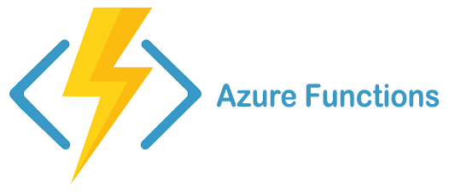

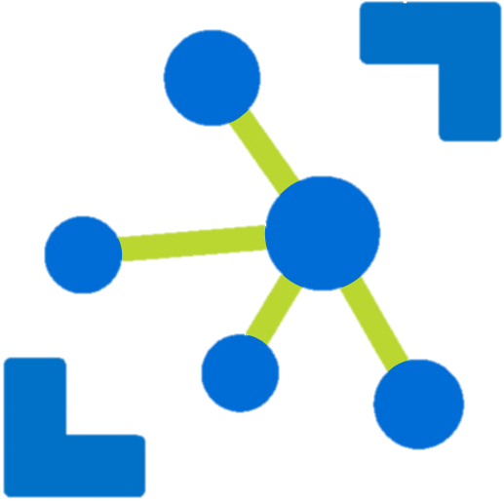




Device Twin Changes Azure Function
Device Twin Changes event hub
Device Registry
Notify New Twin Change
Device Telemetry Azure Function
Forward Messages
Device API ASP.NET Core API
Device Actors
Device Messages event hub
Protocol Gateway
Issue Commands
Commands queue
State Store

Slide 2



