Slide 1






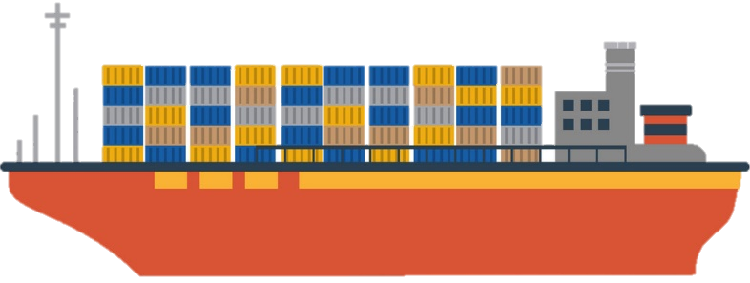
Azure Event Grid
…
…
Kubernetes API Server
Kubernetes Event Grid Bridge
Kubernetes Event Grid Bridge
Kubernetes API Server

Slide 2

Azure Event Grid
E.g. Opsgenie’s Kubernetes Event Exporter
Event Exporter
Kubernetes API Server
Kubernetes Event Grid Bridge

Slide 3
Azure Logic Apps
Azure Event Grid
E.g. Opsgenie’s Kubernetes Event Exporter
Event Exporter
Kubernetes API Server
Kubernetes Event Grid Bridge

Slide 4

Scaling Dashboard Scaling over-time
Azure Application Insights
Azure Functions
Azure Event Grid
Azure Logic Apps
E.g. Opsgenie’s Kubernetes Event Exporter
Event Exporter
Slack Keep team up-to-date on scaling of apps & cluster
Zendesk Open tickets for failing applications
Kubernetes API Server
Kubernetes Event Grid Bridge

