Slide 1
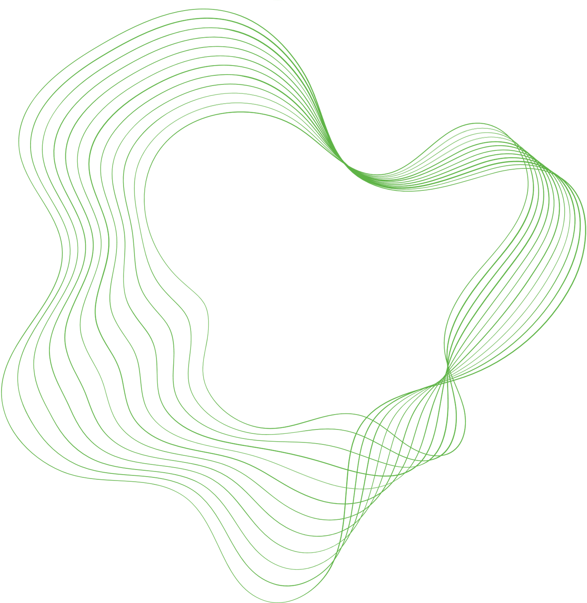

InferCell
Inference-first whole-cell modelling
Tom Kimpson
University of Melbourne
International Scientific Advisory Board · 12 August 2026
Notes:
[0:20]
Thanks. I'm Tom, a research fellow at Melbourne.
I want to put one architectural argument to you: whole-cell models today can
only be run forward, and that limits what we can learn from them. InferCell is
an attempt to build one that can be run backwards — conditioned on data.
Three parts: the problem, what we've built, and then four questions I'd
genuinely like your advice on.

Slide 2
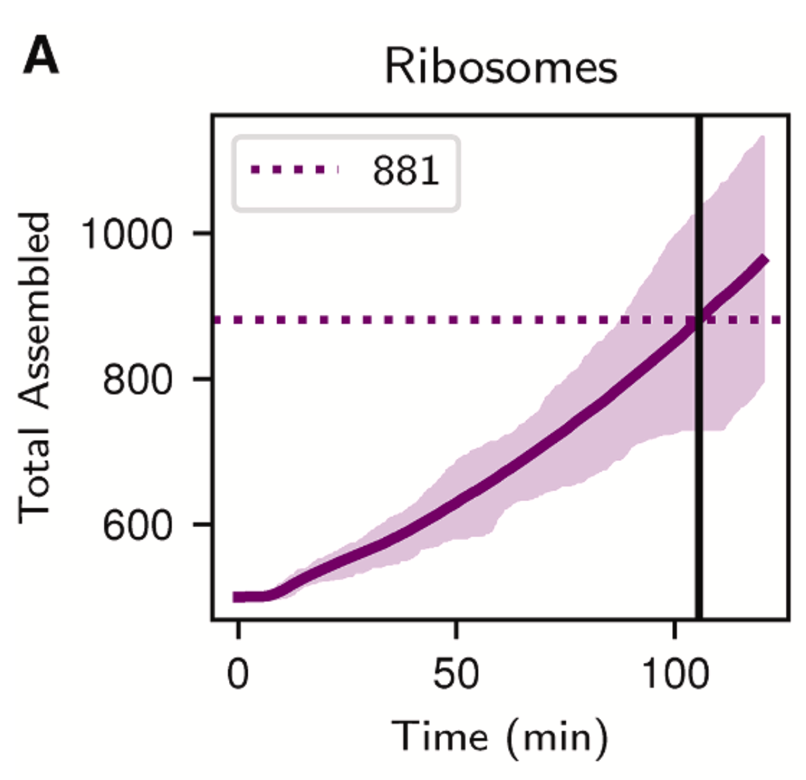
Whole-cell models are forward simulators
State of the art: the Luthey-Schulten lab's 4D minimal cell — 493 genes, four coupled solvers, 10 nm voxels, a full cell cycle on GPU (Thornburg et al., Cell 2026).
A remarkable feat of science and engineering.
Four solvers — RDME, CME, ODE metabolism, Brownian dynamics.
It answers: can we simulate a complete minimal cell cycle?
It cannot answer: how much should we believe any of it?
Parameters θ
Whole-cell model
Predictions
≈1000 parameters, each entered as a single number from the literature.
Thornburg et al., Cell 2026, Fig. 5
Impressive science. But there is no uncertainty anywhere in this picture.
InferCell · MACSYS ISAB · 12 August 2026
1
Notes:
[1:10]
My reference point for the state of the art is the Luthey-Schulten lab's 4D
model, published in Cell this year. 493 genes, four coupled solvers — RDME, CME,
ODE metabolism, Brownian dynamics — on GPU, over a full cell cycle.
This is genuinely impressive work and I want to be clear that what follows is
not a criticism of it. It answers the question it set out to answer: can we
simulate a complete minimal cell in four dimensions.
But look at the shape of the computation. Parameters go in, predictions come
out. Roughly a thousand parameters, each entered as a single number. The plot
on the right is a prediction of ribosome assembly over the cell cycle — and the
spread you see there is stochastic variation between runs, not uncertainty
about the parameters.
Transition: because the parameters themselves are not known.

Slide 3
But the parameters themselves are uncertain
Rate constants come from the literature — often a different organism, often an adjacent measurement.
What we pretend
k_tx = 0.05 s⁻¹
measured in E. coli,
applied to syn3A
range: 0.02 – 0.12
γ = 0.002 s⁻¹
extrapolated from
M. pneumoniae
range: 0.001 – 0.004
k_tx = 0.05 s⁻¹
What we actually know
p(k_tx)
the number we use
[mRNA]ₛₛ = k_tx / γ
range: 5 – 120 copies (nominal: 25)
Protein → flux → growth rate
a 24-fold range, from two parameters
k_tx
plausible range: 0.02 – 0.12
Two parameters and one equation give a 24-fold range. A whole-cell model has ~1000 parameters feeding coupled nonlinear dynamics.
InferCell · MACSYS ISAB · 12 August 2026
2
Notes:
[1:30]
Every one of those thousand numbers came from someone, somewhere, doing an
experiment on something — and then a statistical analysis that produced a
number with an error bar. The error bar is what gets dropped.
Often the measurement is in a different organism. Transcription rates measured
in E. coli, applied to syn3A. Degradation rates extrapolated from
M. pneumoniae.
Note this is epistemic uncertainty — uncertainty about the parameter, not
stochastic variation in the cell. Two different things, and only one of them
shows up in an ensemble of forward runs.
And it propagates nonlinearly. Take the simplest possible model: mRNA
production and decay. Steady state is just k_tx over gamma. A factor of six on
one, a factor of four on the other, and the steady state spans 5 to 120 copies
— a 24-fold range, from two parameters and one equation.
Transition: so why not just propagate it? Because of where those numbers live.

Slide 4
And the architecture has nowhere to put it
Subsystems are calibrated in isolation, then assembled from point estimates.
Fit subsystem A
isolated experiment
Fit subsystem B
different experiment
Fit subsystem C
literature value
point estimate
θ̂
θ̂
θ̂
Whole-cell model (forward simulation)
Uncertainty is discarded at every step.
Coupling is invisible during fitting — parameters that are jointly plausible in the coupled model may never be found.
Prediction (no uncertainty)
There is no place in the architecture to store or propagate a probability.
InferCell · MACSYS ISAB · 12 August 2026
3
Notes:
[1:05]
This is the structural part of the argument, and it's the bit I'd most like to
convince you of.
Each subsystem is calibrated on its own experiment. Each fit is collapsed to a
point estimate. The point estimates are assembled into the whole-cell model,
which is run forward to a prediction.
Two things die here. First, uncertainty is discarded at every arrow — by the
time you reach the prediction there is nothing left to propagate. Second, and
less obvious: because each subsystem is fitted in isolation, the coupling is
invisible during fitting. A combination of parameters that is jointly plausible
once the modules talk to each other may never be found.
And you can't fix this by bolting on a sampler. If the model stores parameters
as floats, there is nowhere to put a distribution. The gap is semantic.
Transition: so let's change the question.

Slide 5
Inverting the question
Forward simulation
Inference
Parameters θ
Observed data
Model
Model
Predictions
p(θ | data)
“Given θ, what does the cell do?”
“Given data, which θ are consistent with it?”
The model becomes something you condition on data, not just something you run.
InferCell · MACSYS ISAB · 12 August 2026
4
Notes:
[0:45]
Forward simulation asks: given the parameters, what does the cell do?
Inference asks the inverse: given the data, which parameters are consistent
with it? The output is not a trajectory — it's a posterior distribution.
That one change is what buys you uncertainty quantification, calibration,
identifiability, model comparison, experimental design. All of it follows from
having a posterior instead of a point.
The catch is that you can't retrofit it. Which is why we started again.

Slide 6
InferCell: design principles
A composable, inference-first whole-cell modelling framework in Julia.
swap
Inference-first.
Uncertainty quantification and probabilistic prediction are built in, not bolted on.
Modular.
Swap a module for a different formalism; the inference layer still works.
Information flow as the design test.
At every module boundary, ask: how does inference cross this? If you can't answer, the design changes.
One language, one computational graph.
Models, solvers and inference share a single compiled representation — so gradients compose end to end.
TX/TL v1
TX/TL v2
Inference layer
unchanged
p(θ) ?
Module A
Module B
Models
Solvers
one Julia
graph
Inference
InferCell · MACSYS ISAB · 12 August 2026
5
Notes:
[1:05]
Four principles.
Inference-first: the framework is organised around the posterior, not the
trajectory. UQ is not a feature we add later.
Modular: a module is defined by a contract — states, parameters with priors,
dynamics, and a declared inference mode. Swap an ODE metabolism module for a
constraint-based one or a neural surrogate, and inference still works.
The third one is the design discipline, and it's the sentence I'd most want you
to remember. At every boundary in the system: how does inference cross this?
If we can't answer that, the design is wrong. That single question rules out
cross-language orchestration, black-box sub-models, and point-estimate
handoffs.
Fourth: one language. Julia, so that models, solvers and inference share one
compiled graph and gradients compose. Happy to go into why not Python or JAX
in questions — I have a backup slide.

Slide 7
What becomes possible
Questions that forward simulation cannot pose.
Probabilistic prediction
“Is the doubling time 110 ± 5 min, or is it 60 – 200?”
Parameter calibration
“What is k_tx for this gene, given our data?”
Identifiability
“Does the data constrain k_tx alone, or only the ratio k_tx / γ?”
Model selection
“Does the data prefer deterministic or bursty transcription?”
Experimental design
“Which experiment most reduces uncertainty in γ_prot?”
Biology
“Does the data require enzyme feedback in metabolism at all?”
time
θ
θ
prediction with a credible interval
model comparison: M₁ vs M₂
identifiability: prior vs posterior
InferCell · MACSYS ISAB · 12 August 2026
6
Notes:
[1:20]
This is the payoff slide, and it's the one I'd like to hear your reaction to.
Probabilistic prediction: not "the doubling time is 110 minutes" but "110 plus
or minus 5" — or, just as usefully, "somewhere between 60 and 200", which tells
you the prediction isn't yet worth much.
Calibration: learn the rate from data rather than importing it from another
organism.
Identifiability: this one is underrated. Often the data doesn't constrain k_tx
and gamma separately — only their ratio. A posterior shows you that
immediately; a point estimate hides it, and you go on believing you know both.
Model selection: does the data actually prefer bursty transcription over
constitutive? That's a Bayes factor, and it's a downstream calculation once you
have posteriors.
Experimental design: which measurement would most reduce uncertainty. You can
answer that before you run the experiment, which is where I think the real
value to experimentalists is.
And at the bottom: does the data require enzyme feedback at all? That's a
biological question you can only ask once the model is probabilistic.
Transition: so how does it work.

Slide 8
Which predictions can you trust?
Propagate the posterior through the model, and the predictions sort themselves into two kinds.
Robust.
Barely moves across the posterior. You can trust this output regardless of what you don't know about the parameters.
Fragile.
Swings wildly. Sensitive to parameters the data cannot constrain — this is where you need more data, or a simpler model.
Robust
growth rate
t
narrow credible interval
Fragile
metabolic flux
Same model, same run, two very different levels of trust — and nothing on the surface distinguishes them.
t
Forward simulation never tells you which is which. Every prediction looks equally confident.
wide credible interval
InferCell · MACSYS ISAB · 12 August 2026
7
Notes:
[0:55]
This is the slide I'd most like to leave you with, because it's the practical
consequence of everything before it.
Once you have a posterior, you can push it through the model and look at the
spread on any output you care about. Predictions then sort themselves into two
kinds.
Some are robust: the output barely moves as you sweep across the posterior. You
can trust that number regardless of what you don't know about the parameters.
Others are fragile: the output swings wildly, because it depends on parameters
the data doesn't constrain. That's not a failure — it's a finding. It tells you
either to go and measure something, or that your model has more freedom than the
biology warrants.
And here's the thing: forward simulation never tells you which is which. Both of
these come out of the same model in the same run, and on the surface every
prediction looks equally confident.
Transition: so how do we actually get the posterior.

Slide 9
One graph, two inference regimes
Cells mix fundamentally different dynamics in the same model — and no single inference method handles both.
Differentiable dynamics
Stochastic dynamics
ODE metabolism, continuous kinetics
Gillespie SSA, bursty gene switching
→ Gradients exist
→ NUTS / HMC
orders of magnitude more sample-efficient
→ No gradient path
→ SBI / ABC-SMC
handles any simulator as a black box
t
t
Observed data
DifferentiableBlock · NUTS
SimulationBlock · SBI
TX/TL
Metabolism
boundary protocol
Gene expression (SSA)
uncertainty crosses here
p(θ | data)
InferCell · MACSYS ISAB · 12 August 2026
8
Notes:
[1:30]
Here's the technical core, and then I'll show you it working.
A cell mixes two kinds of dynamics. Metabolism is well described by ODEs —
smooth, differentiable, so gradients exist and you can use NUTS, which is
orders of magnitude more sample-efficient than anything else.
Gene expression with a bursty promoter is a jump process. Discrete, stochastic,
no gradient path. There you need simulation-based inference — ABC-SMC today.
No single method handles both. So the framework partitions the model into
blocks by the inference mode each module declares, and runs the right method in
each block.
The interesting part is the red arrow. Two blocks, two different inference
algorithms, and the uncertainty from one has to reach the other. That boundary
is the actual research problem — and it's where our honest result comes from,
which I'll get to in two slides.

Slide 10
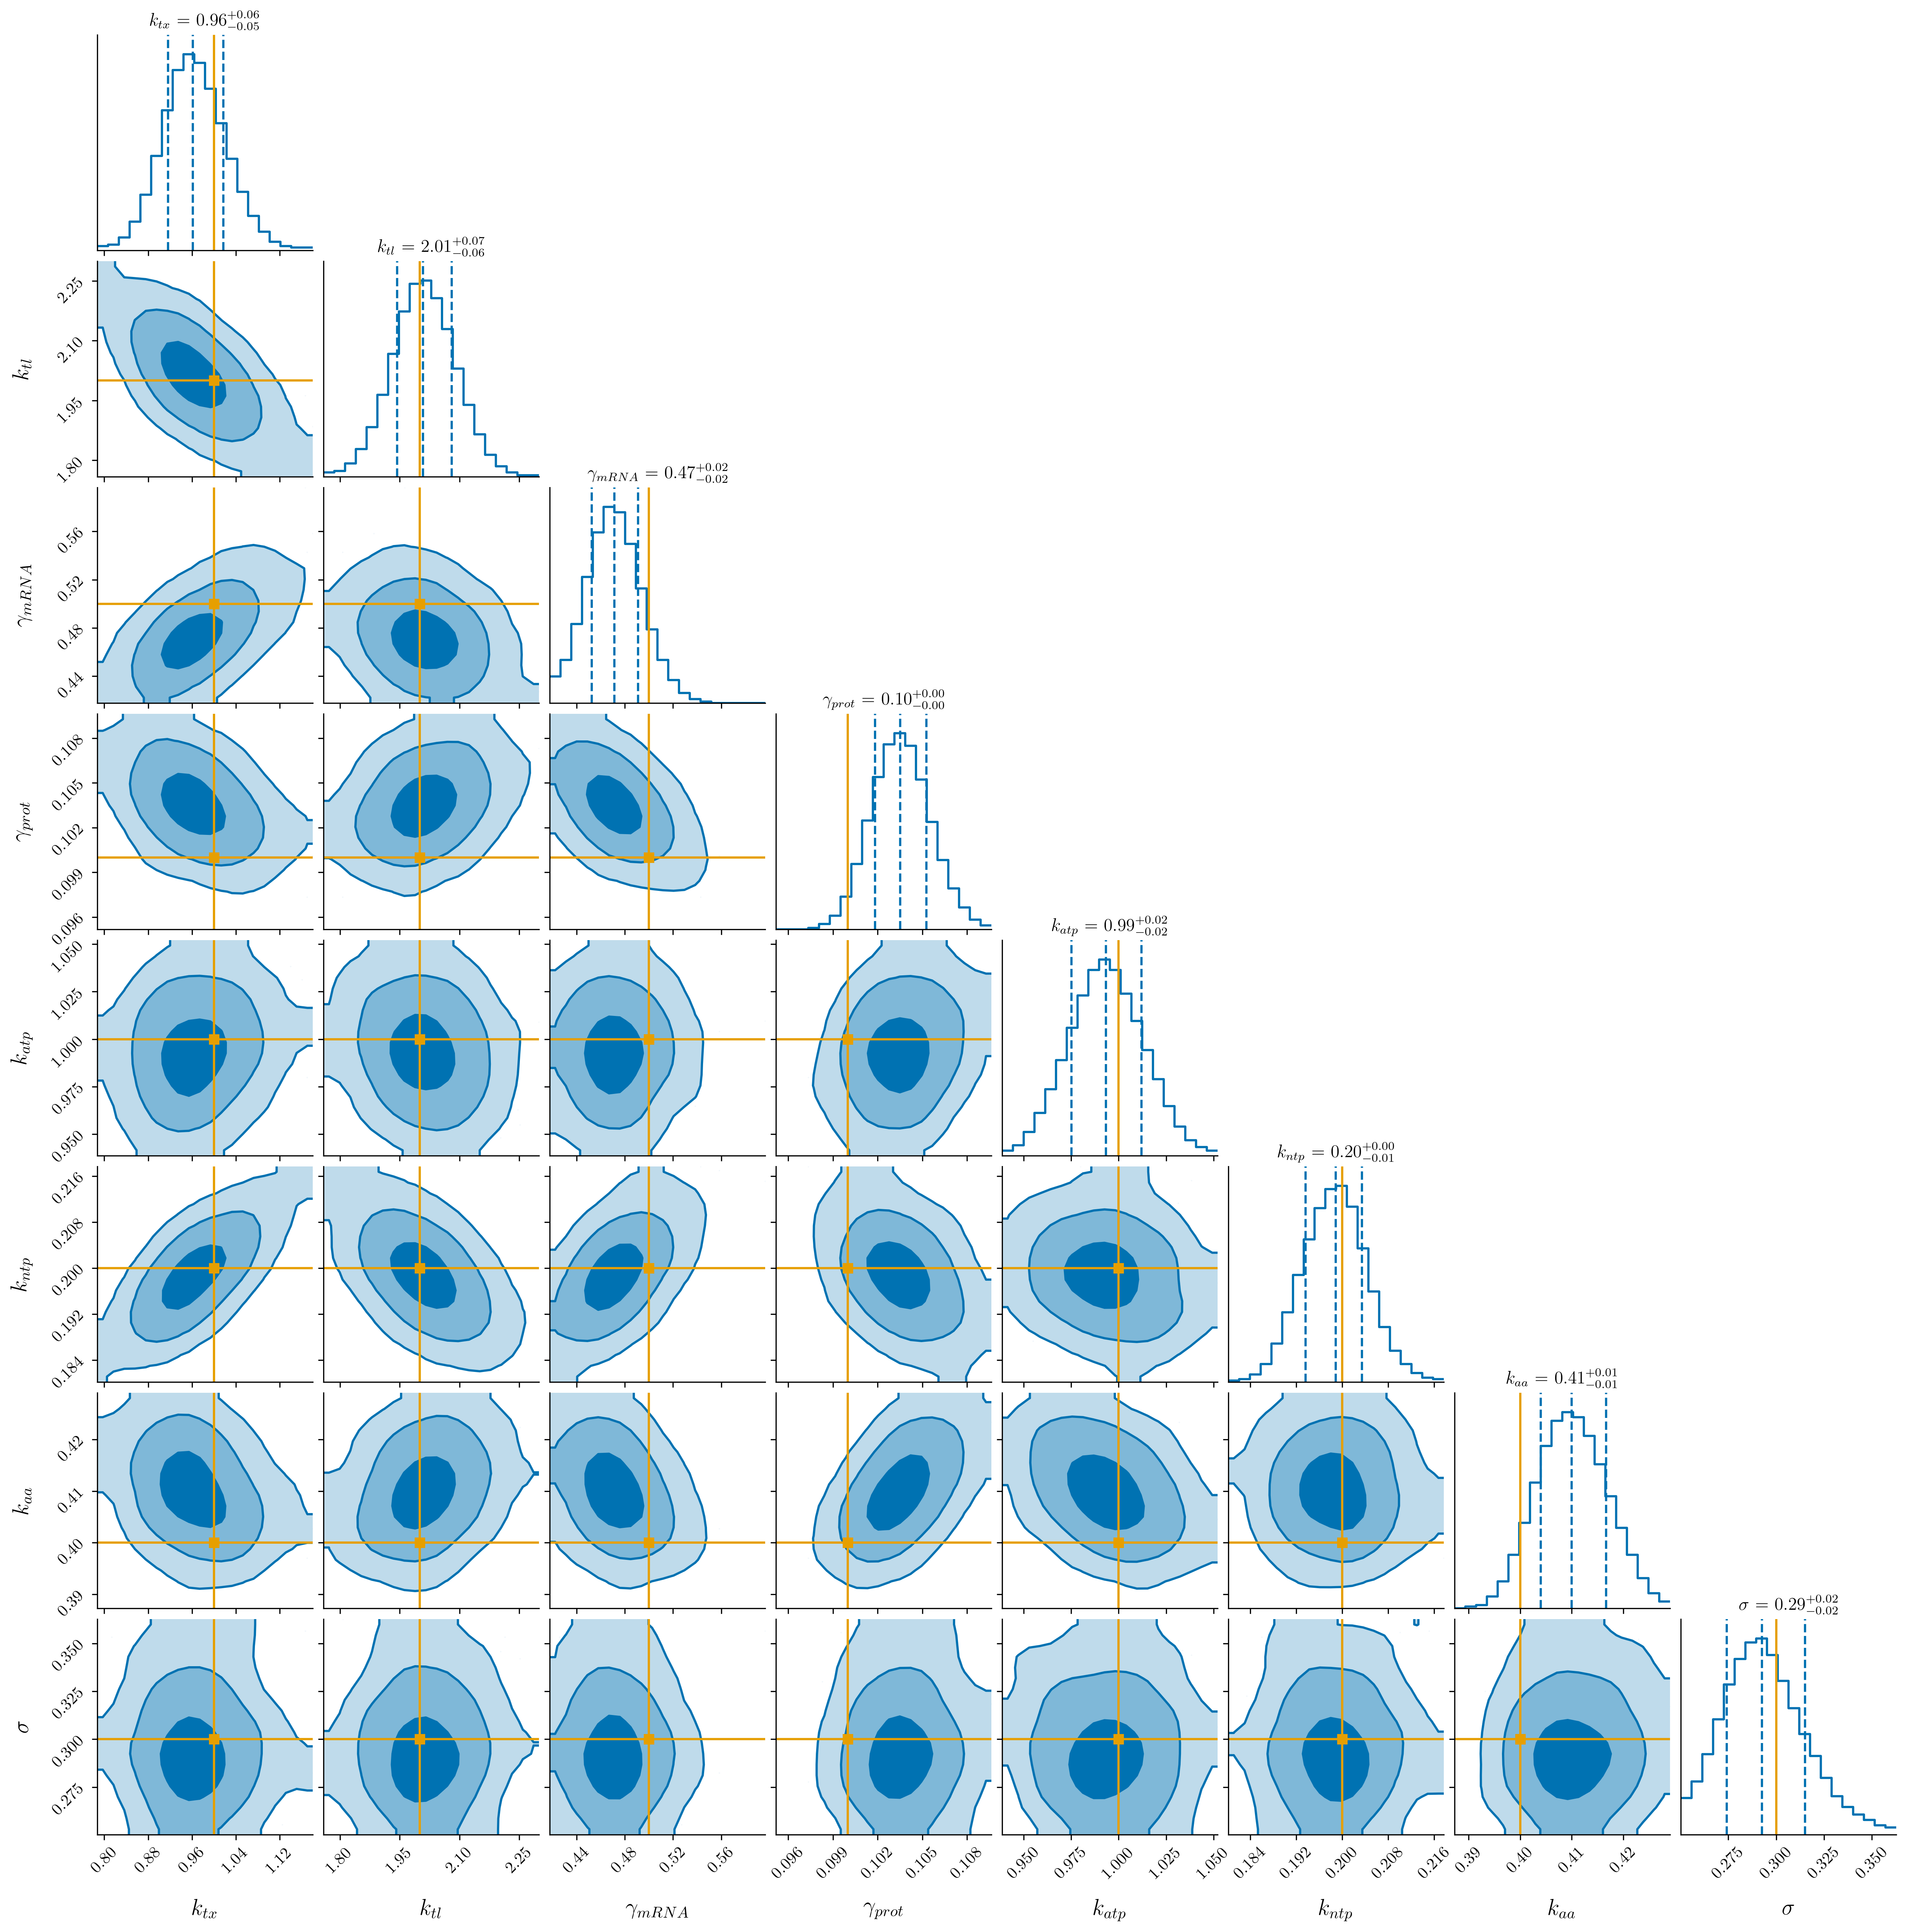
A three-module test cell
Same biology modelled two ways — ODE and SSA — so the posteriors can be compared across formalisms.
DifferentiableBlock · NUTS
TX/TL (ODE)
Metabolism (ODE)
conditioned on the
shared parameters
k_tx, k_tl, γ_mRNA, γ_prot
Gene expression (SSA)
SimulationBlock · ABC-SMC
≈9 unique parameters after deduplication, every one with a prior.
Validated on synthetic data, where the ground truth is known.
What this computes is a cut posterior — an approximation to the joint.
The framework spans cut → message passing → joint NUTS as the oracle. The gap between them is itself a result.
Joint posterior over the differentiable block. Ground truth recovered on every parameter.
InferCell · MACSYS ISAB · 12 August 2026
9
Notes:
[1:25]
Concretely, here's what runs today. Three modules. Transcription-translation
and a light metabolism as ODEs in the differentiable block, inferred jointly
with NUTS. A bursty gene-expression module — telegraph promoter — as a
Gillespie process in the simulation block, inferred with ABC-SMC.
Two things worth noting. The two blocks share parameters: k_tx, k_tl, and the
two degradation rates appear in both. So the same biology is modelled two ways,
by two different formalisms, inferred by two different algorithms — and we can
ask whether the posteriors agree. That's a real consistency check, and I don't
know of another framework that can pose it.
About nine unique parameters after deduplication, all with priors. On the right
is the joint posterior for the differentiable block on synthetic data. The truth
is recovered on every parameter.
This is a synthetic twin — we generated the data from the model we're fitting.
That tests self-consistency, not biological correctness. I want to be precise
about that, which brings me to the next slide.

Slide 11
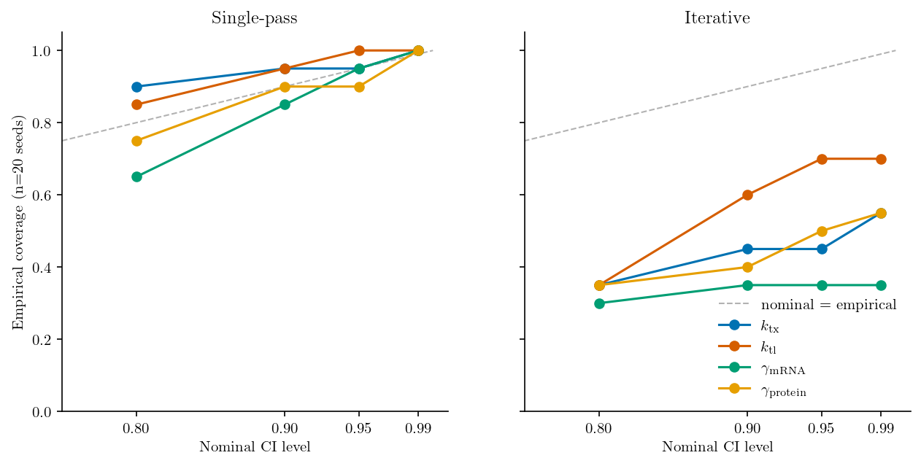
Where we are, honestly
Built
TX/TL and metabolism as ODE modules, inferred jointly with NUTS.
A bursty SSA module inferred with ABC-SMC.
Parameter-posterior handoff across the block boundary. 270 tests passing.
Found — and this is the useful part
The iterative boundary protocol is systematically over-confident: at a nominal 95% interval it covers the truth on 35 – 70% of seeds.
It costs ~4× the compute and no seed converged. The narrower intervals were the bug, not the result.
Single-pass conditioning is honestly calibrated, and is now the default.
Coverage against nominal level, 20 seeds. Single-pass tracks the diagonal; the iterative protocol sits far below it.
Claiming
v0.0.1 is a modular inference prototype on synthetic data — a methods contribution, not yet a biological one.
InferCell · MACSYS ISAB · 12 August 2026
10
Notes:
[1:20]
I want to be straight with you about where this actually is, because I think
the negative result is the most useful thing I have to report.
Built: the ODE modules under joint NUTS, the stochastic module under ABC-SMC,
and a working handoff between them. 270 tests passing.
Found: we ran a calibration sweep on the iterative boundary protocol — the one
where the two blocks pass information back and forth. It looked like a success
at first: the credible intervals tightened by more than half. Then we checked
coverage. At a nominal 95% interval it covers the truth on somewhere between 35
and 70 per cent of seeds, depending on the parameter. It costs four times the
compute, and not one of the twenty seeds converged.
So the tightening wasn't a win — the tightening *was* the failure. It's a
textbook over-propagation of confidence: each iteration treats the other
block's density as a hard prior and cuts the tails a bit more.
The single-pass protocol is honestly calibrated and is now the default. We've
documented the negative result rather than shipping the tighter number.
Which means: v0.0.1 is a modular inference prototype on synthetic data. A
methods contribution. Not yet a biological one, and I don't want to claim
otherwise.

Slide 12
Where this is going
Put calibrated error bars on a
well-mixed reduction of the Luthey-Schulten /
Thornburg syn3A minimal cell.
Sequencing
v0.0.1
methods contribution
synthetic twins; one honest boundary protocol
Their simulator becomes our ground-truth generator.
≈1000 literature parameters are a known injection; their outputs are data we can condition on and try to recover.
Their parameter set is the comparison baseline.
“We put error bars on the Luthey-Schulten minimal cell” is a one-line contribution.
Complementary to MC4D, not competing.
That architecture structurally cannot do UQ. Ours is built for nothing else.
v0.0.x
close the machinery
hybrid ODE-SSA graph, trajectory boundary, neural likelihood
v0.1+
scientific instrument
real syn3A data; UQ over the well-mixed minimal cell
InferCell · MACSYS ISAB · 12 August 2026
11
Notes:
[1:05]
The north star. The concrete target is to put calibrated error bars on a
well-mixed reduction of the Luthey-Schulten minimal cell — their metabolism,
gene expression and tRNA charging, without the spatial lattice and the
chromosome dynamics.
Why theirs and not a model of our own? Two reasons. Their simulator runs
forward from about a thousand literature parameters, so it hands us a
ground-truth generator: those parameters are a known injection, and we can ask
whether we recover them. And it hands us a baseline — "we put error bars on the
Luthey-Schulten minimal cell" is a one-line contribution that the field can
immediately place. Complementary to what they've built, not competing with it.
The sequencing matters. Every release through v0.0.x stays a methods
contribution on a deliberately minimal cell. It earns the word "instrument"
at v0.1, when it conditions on real data. I'd rather under-claim on the way
there.

Slide 13
What we'd like your advice on
The four questions where an outside view would change what we do next.
1
Is the north star the right target?
Or would putting error bars on a different system be more valuable to the field?
2
How long should we stay on synthetic data?
When do we commit to real syn3A datasets — and which ones would you point us to?
3
Who should we design for?
Experimentalists choosing what to measure, whole-cell modellers, or inference-methods researchers?
4
Is the Luthey-Schulten lab the collaboration to pursue?
Or is there a better route into this community?
github.com/MACSYS-CoE/InferCell
InferCell · MACSYS ISAB · 12 August 2026
12
Notes:
[0:55]
So — four questions, and then I'll stop.
One. Is this the right north star? We've picked the Luthey-Schulten minimal
cell because it hands us ground truth and a baseline. If there's a system where
calibrated uncertainty would matter more to the field, I'd rather hear it now
than in two years.
Two. How long should we stay on synthetic data? Synthetic twins test the
machinery honestly but they can't tell us the model is biologically wrong. If
you think we should be on real data sooner, I'd like to know which datasets you'd
reach for.
Three. Who should we design for? An experimentalist deciding what to measure
next wants very different ergonomics from a modeller composing sub-models, or a
methods researcher testing a new sampler. We can't optimise for all three.
Four. Is the Luthey-Schulten lab the collaboration to pursue, or is there a
better way into this community?
Thank you — I'd welcome your thoughts.

Slide 14
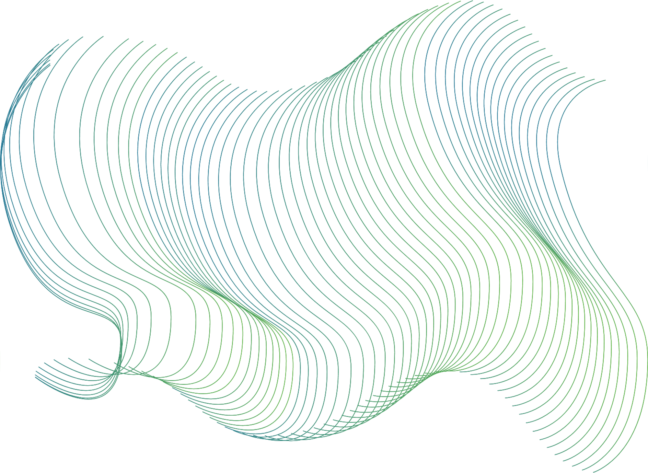
Backup
Detail for questions.
Notes:
Everything past here is for questions only.

Slide 15
Bayesian inference in one slide
Given noisy mRNA measurements, what is the transcription rate k_tx?
Prior p(θ)
Data p(data | θ)
Posterior p(θ | data)
what we believe before seeing data
what the experiment says
what we believe after
×
×
θ
θ
θ
broad — many values plausible
noisy observations of the model
tight — the data has constrained it
p(θ | data) ∝ p(data | θ) · p(θ)
The posterior is the output. Credible intervals, identifiability and model comparison all follow from it.
InferCell · MACSYS ISAB · 12 August 2026

Slide 16
Why not just run it a thousand times?
The natural response: perturb the parameters, run an ensemble, read off a spread. Two reasons that doesn't close the gap.
1. An ensemble is not a posterior
2. Each run is expensive
Without a likelihood you cannot condition on observed data.
You cannot weight parameter combinations by how plausible they are.
You cannot compare models, compute Bayes factors, or update beliefs.
You cannot ask about identifiability or expected information gain.
MC4D: ≈300 GPU-hours per replicate.
A 1000-run ensemble: ≈3 × 10⁵ GPU-hours.
And even with a likelihood, the architecture could not evaluate it efficiently:
No gradient path — so no HMC, no automatic differentiation.
Re-encoding of data at every module boundary.
No substrate a surrogate could slot into.
A spread of point predictions is not a probability distribution.
Two separate gaps: probability, and substrate.
InferCell · MACSYS ISAB · 12 August 2026

Slide 17
Conditioning the whole model
The same contrast on one slide: what is done now, and what changes.
Standard approach
InferCell approach
Fit A
isolated
Fit B
isolated
Fit C
isolated
All observed data
θ̂
θ̂
θ̂
coupled model
TX/TL
Metabolism
Gene expr.
Whole-cell model (forward simulation)
Joint posterior p(θ | data)
Prediction (no uncertainty)
✕ uncertainty discarded at every step
✕ coupling invisible during fitting
Prediction with credible intervals
✓ uncertainty propagated throughout
✓ coupling visible during inference
InferCell · MACSYS ISAB · 12 August 2026
Notes:
Backup. Use this if someone asks how the approach differs from current
practice, or if the distinction didn't land the first time.
Side by side. On the left, what's done now — three isolated fits, three point
estimates, assembled, run forward, one prediction with no error bars.
On the right, InferCell. All the data enters one coupled model. The modules
talk to each other during inference, not just during simulation. What comes out
is a joint posterior over all the parameters, and predictions with credible
intervals.
The important difference is the red arrows in the middle of the right panel.
Because the modules are coupled while we infer, the data about metabolism
constrains the gene-expression parameters, and vice versa. That's the
information flow the isolated-fit picture throws away.

Slide 18
How much inferential coupling do you need?
Joint inference over every parameter is intractable at scale; isolated fits discard all coupling. The framework spans the middle.
Level 1 — Cut
Level 2 — Message passing
Level 3 — Particle MCMC
Downstream sees upstream uncertainty; no feedback.
Information flows both ways; approximate.
Asymptotically correct; never tractable at whole-cell scale.
Implemented. Honestly calibrated. The default.
Implemented, and found over-confident. Experimental only.
Ruled out. Joint NUTS on small problems is the oracle instead.
isolated fits
accuracy and cost →
full joint
Diagnostic: does the posterior change when you allow feedback? If not, the cut was sufficient.
InferCell · MACSYS ISAB · 12 August 2026

Slide 19
Where machine learning fits
One decision rule settles it: a likelihood composes into the graph, and a posterior does not.
The ML object is a neural likelihood
Surrogates are an architectural lever
A learned, differentiable p(x | θ) for the stochastic block.
Replaces ABC-SMC and makes the boundary message differentiable in both directions.
Governed by a ladder, not a default.
Start at the synthetic-likelihood end — a conditional Gaussian or mixture-density network over summaries. Upgrade to a normalising flow only if that fails.
Why not an amortised posterior (NPE)?
A posterior has a prior baked in, so you cannot multiply it against the other modules' contributions.
SSA module
SimulationBlock · SBI
train a surrogate offline
on (θ, y) pairs
Neural surrogate
DifferentiableBlock · NUTS
The catch: it must share the AD substrate.
A PyTorch surrogate plus a Julia model is still a polyglot stack, and gradients die at the language boundary.
Rejected: neural ODEs as black-box biology.
They survive only as a v0.1+ discrepancy term. Fourier neural operators are parked as a spatial-emulator bet.
InferCell · MACSYS ISAB · 12 August 2026

Slide 20
Why one language?
Standard whole-cell models are polyglot stacks, glued by IO.
Python + C++ + CUDA + LAMMPS, coordinated by a Python hook script.
Every module boundary re-encodes data.
File IO, language bindings, GPU→CPU copies — rather than passing a pointer.
Gradients do not compose across a language boundary.
No AD path means no HMC, no adjoint sensitivities, no Fisher information.
RDME
CUDA
ODE metabolism
Python
GPU → CPU copy
in-process
hook.py
library bindings
subprocess
InferCell: one Julia stack, one compiled graph
CME
lm (C++)
Brownian dynamics
LAMMPS
This is the argument for one language. The next slide is the honest comparison against the obvious alternative.
InferCell · MACSYS ISAB · 12 August 2026

Slide 21
Why Julia, and not JAX?
The honest version: Julia wins on composability, and loses on ecosystem.
Julia wins on composability
JAX is ahead on
DifferentialEquations, Turing, SciMLSensitivity and Catalyst share one type system — AD flows end to end with no language boundary.
Multiple dispatch makes the sub-model interface natural: the declared formalism dispatches to the right solver and the right inference backend.
Catalyst.jl gives a reaction-network DSL with no JAX equivalent — which matters if we ever infer structure, not just rates.
Simulation-based inference tooling. Python's sbi library is more mature: neural density estimators, normalising flows.
GPU at scale. XLA compilation and vmap/pmap over samples give a smoother path past 100 parameters.
ML integration. Neural surrogates and amortised inference live in PyTorch and JAX.
Contributors. A far larger pool in computational biology.
The bet: through v0.0.x the contribution is the architecture, not the scale, and Julia expresses it most directly.
The risk to watch: if neural SBI or heavy GPU batching becomes critical, the ecosystem gap will bite.
InferCell · MACSYS ISAB · 12 August 2026

Slide 22
What a single compiled runtime buys
Engineering consequences of the one-language choice.
End-to-end gradients
AD through solvers, models and inference — HMC/NUTS, Bayesian experimental design, Fisher information.
Hybrid inference in one pipeline
NUTS and simulation-based inference in the same graph, with no inter-language plumbing.
Composability
Swap ODE ↔ SSA, drop in an ML surrogate, without touching the inference layer.
One program, one type system
One IR, one GPU pipeline, one dependency stack.
Uniform diagnostics
One logger, one profiler, stack traces that cross the whole model.
Cheap prototyping
Add a module without committing to another language's ecosystem.
InferCell · MACSYS ISAB · 12 August 2026

Slide 23
Does it scale?
Nine parameters today. A whole-cell model needs ~1000. This is the honest gap, and the answer is partly a bet.
The bottleneck
What one runtime gives us
Every NUTS leapfrog step solves the full ODE system.
Order 10⁴ solves per chain.
Gradient cost currently grows linearly in parameter count.
ForwardDiffSensitivity is O(n_params) per gradient — fine at 5, questionable at 30.
Adjoint methods are the switch.
InterpolatingAdjoint / BacksolveAdjoint from SciMLSensitivity. Needs benchmarking at 5, 10, 20, 30 parameters before we commit.
InferCell — sub-models and priors
Turing.jl — NUTS
SciMLSensitivity.jl — AD through solvers
DiffEqGPU.jl — batched ensemble solves
CUDA / ROCm / Metal
Same code, one-line backend switch. No serialisation between sampler, solver and device.
The graph scales by adding modules, not by growing one sampler — but that is a claim, not yet a demonstration.
InferCell · MACSYS ISAB · 12 August 2026

Slide 24
The modules, concretely
Every free parameter carries a prior; every module declares its inference mode.
TX/TL — ODE, differentiable block
Bursty gene expression — SSA, simulation block
d[mRNA]/dt = k_tx − γ_mRNA · [mRNA]
d[protein]/dt = k_tl · [mRNA] − γ_prot · [protein]
promoter off ⇄ on k_on, k_off
∅ → mRNA k_tx,burst · promoter
mRNA → ∅ γ_mRNA · mRNA
∅ → protein k_tl · mRNA
protein → ∅ γ_prot · protein
k_tx, k_tl, γ_mRNA, γ_prot ~ LogNormal(0, 1)
σ_obs ~ Normal(0, 1) truncated ≥ 0. Initial conditions declared, fixed by default.
Telegraph promoter as six constant-rate jumps. States: promoter ∈ {0,1}, mRNA, protein.
k_on, k_off, k_tx,burst ~ LogNormal(0, 1). k_tl, γ_mRNA and γ_prot are shared with TX/TL — the same biology, a different formalism.
Inference: ABC-SMC on summary statistics, no explicit likelihood. Shared parameters receive conditioned priors from the differentiable block via the boundary protocol.
Light metabolism — ODE, same block
Three states (ATP, NTP, AA) with enzyme-modulated ATP production; reads mRNA and enzyme protein from TX/TL.
k_atp, k_ntp, k_aa ~ LogNormal(0, 1); k_tx and k_tl are shared with TX/TL, so joint NUTS infers one posterior over both modules.
InferCell · MACSYS ISAB · 12 August 2026

Slide 25
The API
Two formalisms, two inference backends, one call. The user does not choose the backend.
using InferCell
# ODE model -> NUTS, gradient-based
model = TranscriptionTranslation()
prob = build_problem(model; tspan=(0.0, 50.0))
data = observe(solve(prob, Tsit5()), 0:2.5:50, model; sigma=0.3)
chain = infer(model, data; n_samples=1000)
using InferCell
# SSA model -> ABC-SMC, likelihood-free
model = StochasticGeneExpression()
prob = build_problem(model; tspan=(0.0, 50.0))
trajs = [solve(prob, SSAStepper(); saveat=0:2.5:50) for _ in 1:200]
result = infer(model, observe(trajs, 0:2.5:50, model); n_samples=300)
Same four steps, same infer() call.
The framework partitions the model and dispatches on each module's declared formalism and likelihood capability.
Adoption cost is the substance of question three — who we design for.
InferCell · MACSYS ISAB · 12 August 2026

Slide 26
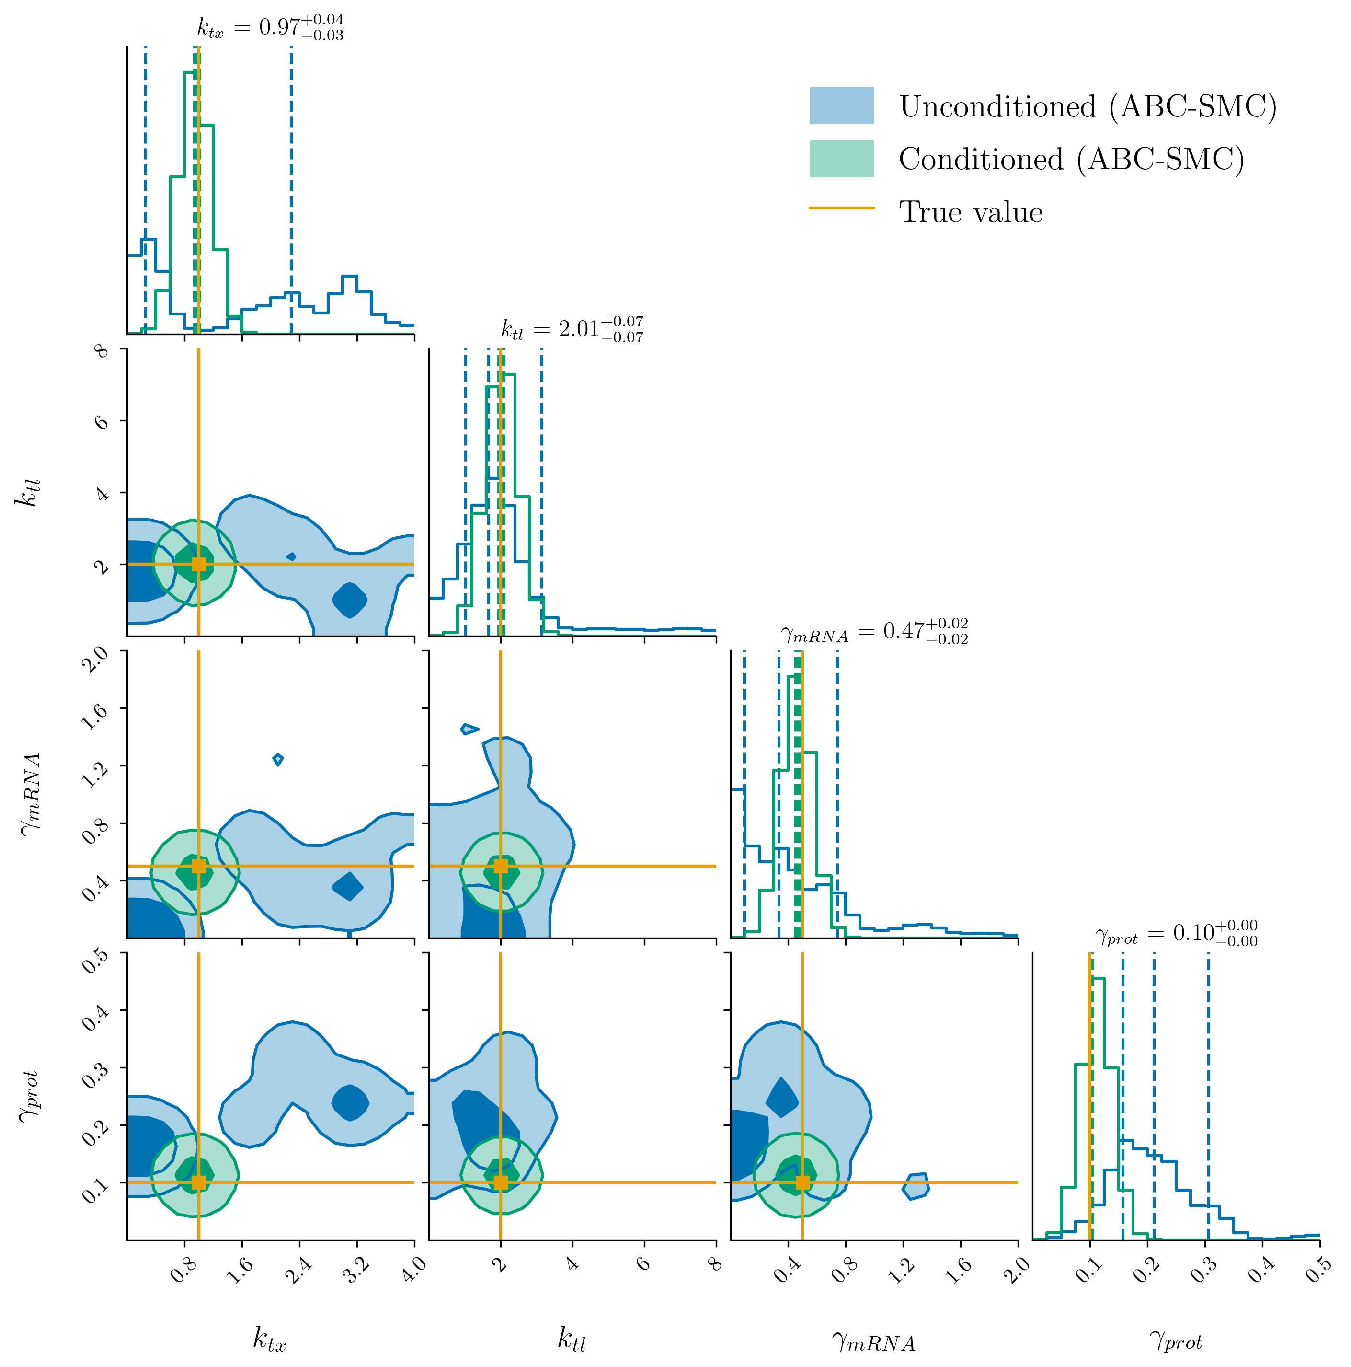
Simulation block: posteriors from ABC-SMC
The stochastic module, inferred without a likelihood.
InferCell · MACSYS ISAB · 12 August 2026

Slide 27
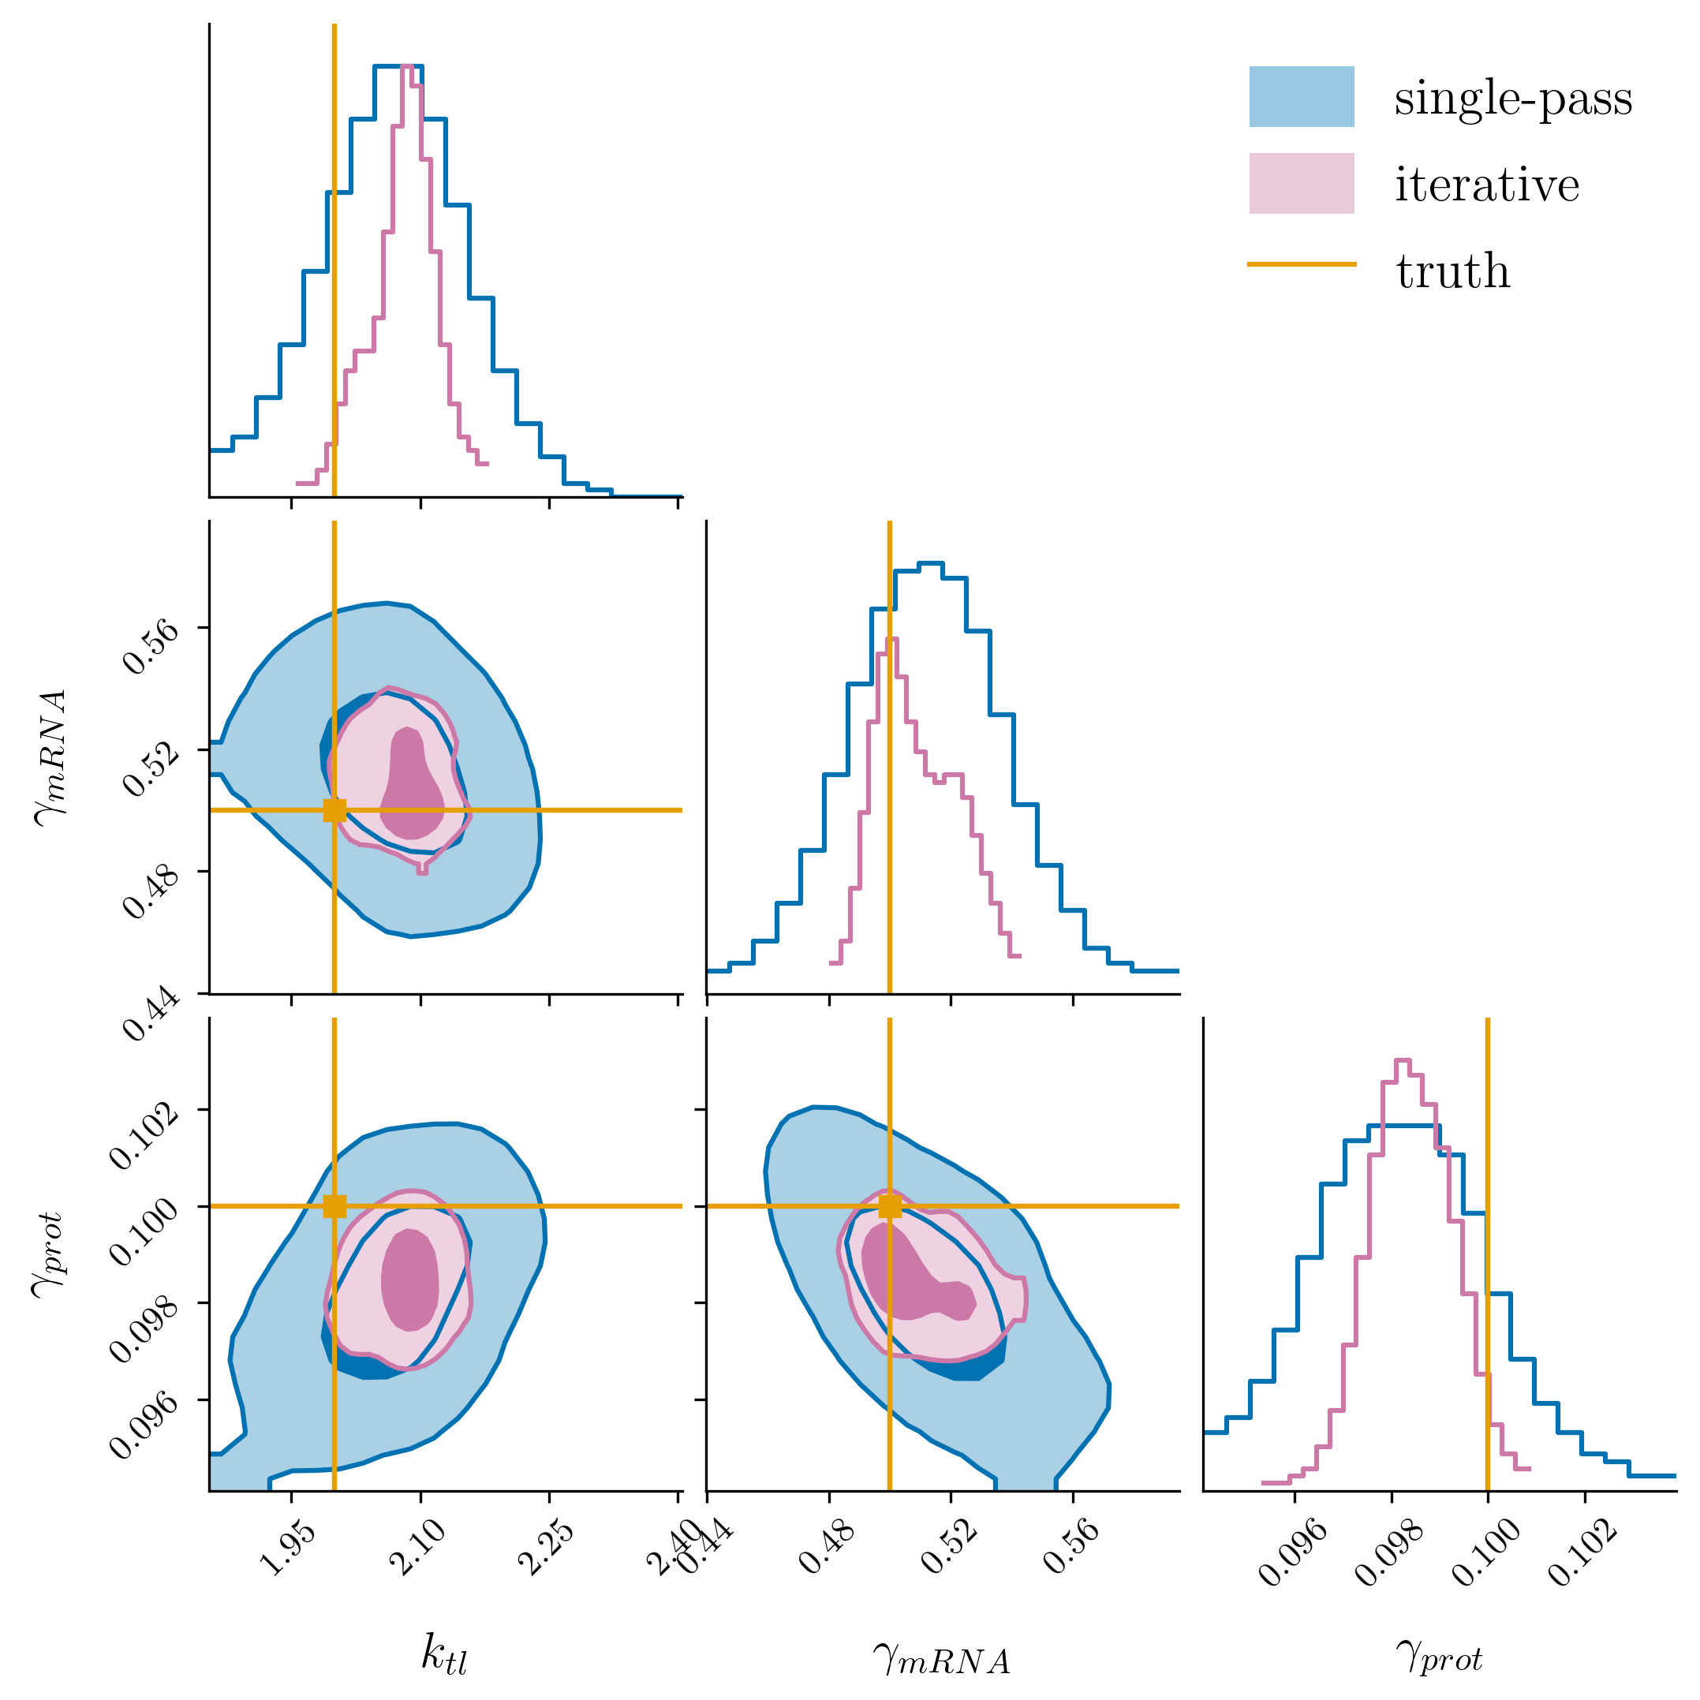
Boundary protocol: what the iterative loop does
Shared parameters after message passing between the blocks. The intervals tighten — and coverage degrades with them.
Single-pass, iterative and truth overlaid.
Iterative CIs shrink 55 – 60% on every shared parameter.
Coverage at nominal 95%: 35 – 70%. Not a free win.
InferCell · MACSYS ISAB · 12 August 2026

