Slide 1

Derivation of Eigentriphones by Weighted Principal Component Analysis
Tom Ko and Brian Mak
The Hong Kong University of Science and Technology

Slide 2
Outline
Introduction
Existing Solutions
Review of Eigentriphones
Proposed Improvements
Derivation of Eigentriphones by Weighted PCA (WPCA)
Experimental Evaluation
Conclusion and Future Works

Slide 3
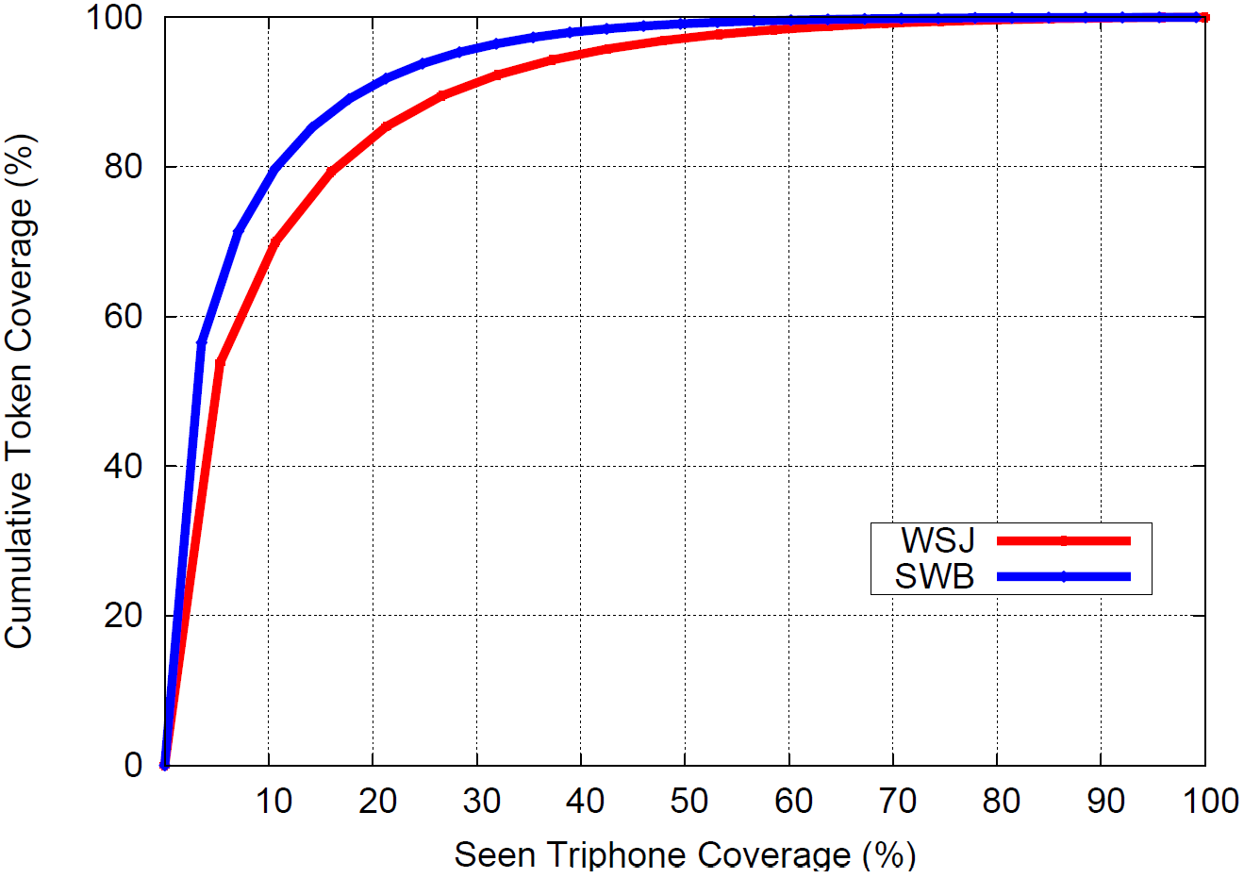
Data Sparsity in Triphone Modeling
WSJ : 80% of samples consist of the most frequent 20% of triphones
SWB: 90% of samples consist of the most frequent 20% of triphones

Slide 4
Existing Solutions
Triphone-by-composition
Model Interpolation
Quasi-triphones
Parameter Tying
Generalized Triphones
Tied States
Subspace Distribution Clustering HMM
Canonical State Model
Semi-continuous Hidden Markov Model
Subspace Gaussian Mixture Model

Slide 5
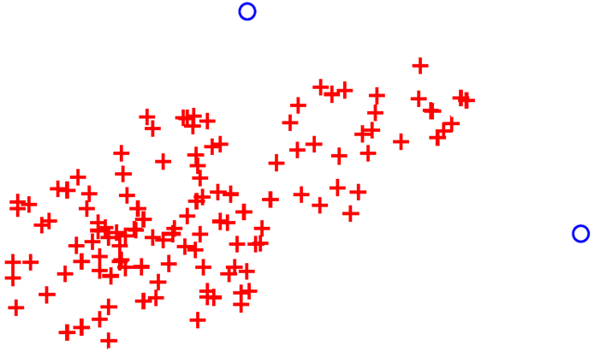

Review of Eigentriphones (1)
“Adapt” infrequent (poor) triphones from frequent (rich) triphones.

Slide 6
Review of Eigentriphones (2)
A basis is derived for each base phoneme – eigentriphones.
All triphones of a base phoneme are distinct points in its triphone space.
Adapt the infrequent triphones using the Eigenvoice adaptation approach.

Slide 7
The Eigentriphone Framework
Rich
Triphones
Supervectors
Eigentriphones
Training Data of
A Triphone
…
…
…
PCA
ML
Supervector
Model
Penalty
Function

Slide 8
Motivations
Degree of automation: To avoid the ad hoc categorization of triphones into the rich set or poor set. Instead, all triphones may contribute to the derivation of eigentriphones.
Robustness: It is desirable to incorporate some notion of triphone reliability in the construction of the eigentriphones.

Slide 9
Weighted PCA
All
Triphones
Rich
Triphones
Supervectors
Eigentriphones
Sample Count of
Triphones
Training Data of
A Triphone
…
…
…
WPCA
PCA
ML
Supervector
Model
Penalty
Function

Slide 10
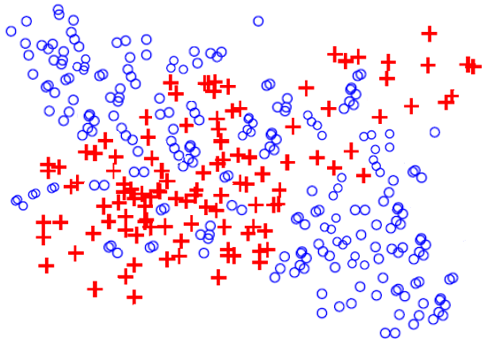

Derivation of Eigentriphones
WPCA
PCA

Slide 11
Experiment Setup
Training Set : SI-284 WSJ Training Set (37,413 utterances)
Dev. Set : 93’ WSJ 5K Development Set (248 utterances)
Test Set : WSJ Nov93 5K Evaluation Set (215 utterances)
#Tri-phones : 18,777
#Gaussian / state : 16
#State / phone : 3
Language model : WSJ standard 5K bigram / trigram
Feature Vector : standard 39-dimensional MFCC

Slide 12
Comparison with Baselines (Bigram)
Model | Description | Nov’93
Baseline 1 | Tied-state Triphones (6,481 states) | 91.97%
Baseline 2 | Eigentriphone Modeling result using PCA (Interspeech 2011) | 92.44%
 | Eigentriphone Modeling result using WPCA (this paper) | 92.67%

Slide 13
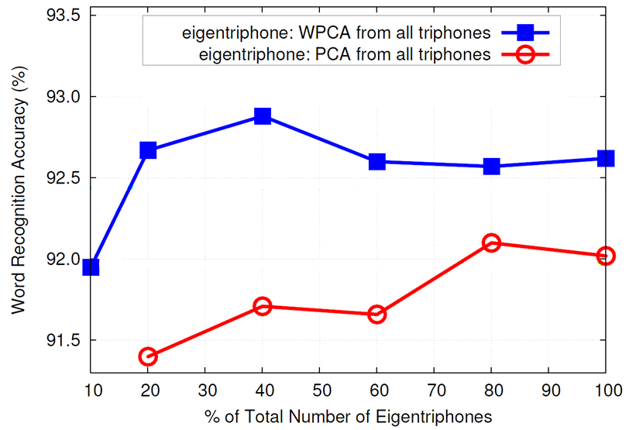
Result with Pruning (Nov’93, Bigram)

Slide 14
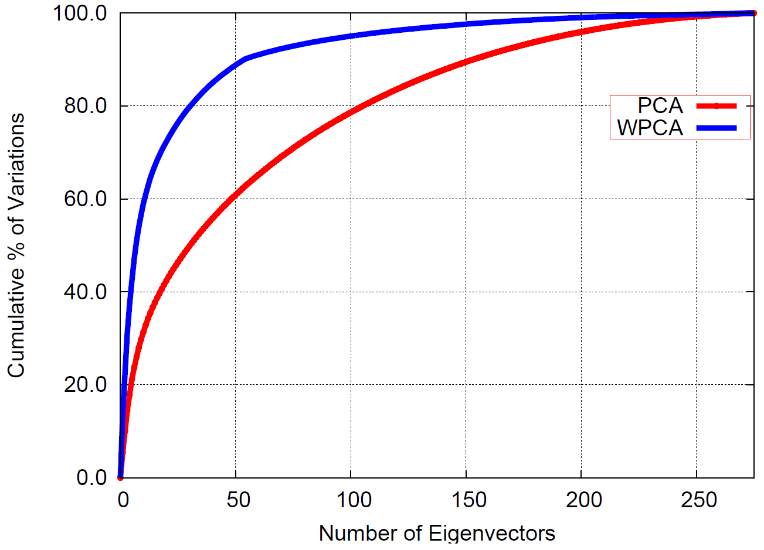
Pruning of Eigentriphones

Slide 15
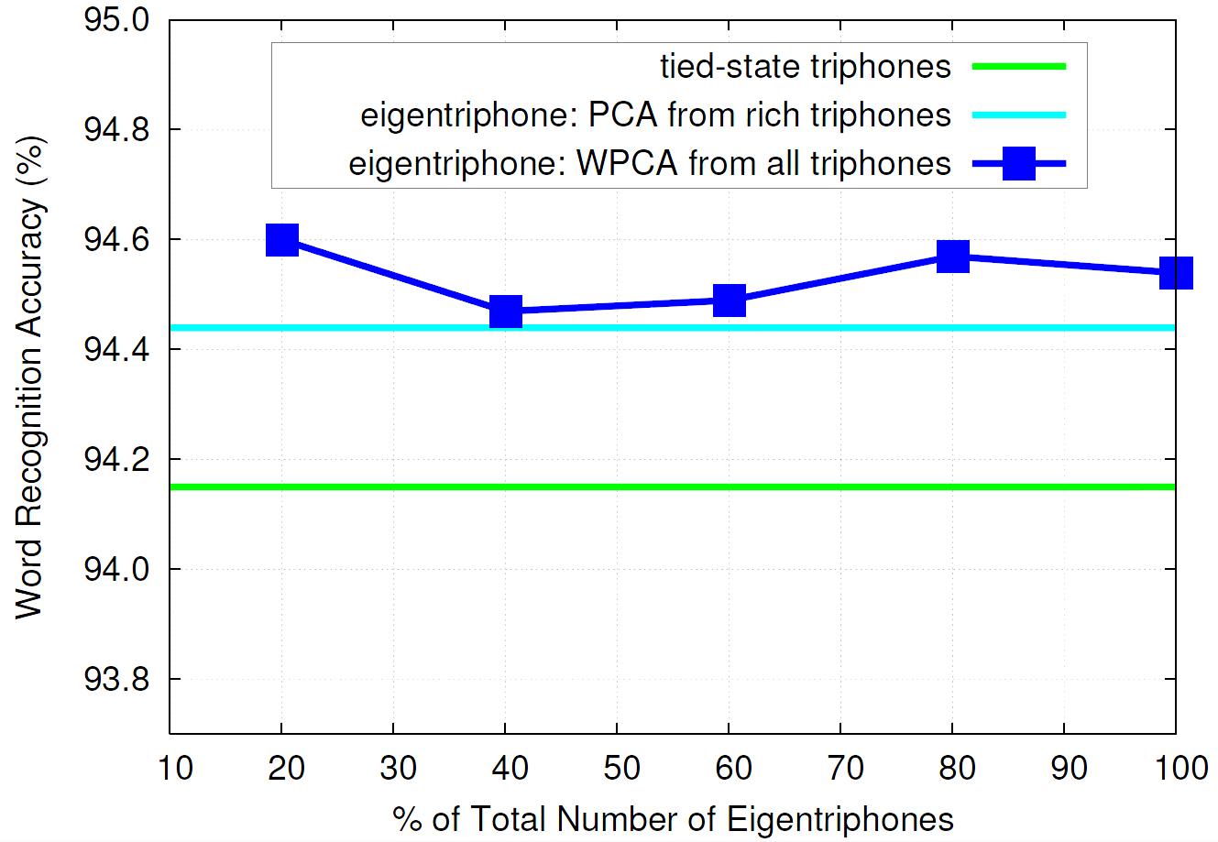
Result on Nov’93 using Trigram

Slide 16
Summary
Eigentriphone acoustic modeling is improved by using weighted-PCA in deriving the eigenvectors.
A few leading eigentriphones are sufficient to represent all the triphones
the final triphone models are much compact.

Slide 17
Future Works
Derive eigentriphones from groups of base phones
Discriminative training
Speaker adaptation

Slide 18
The End

Slide 19
Break Down of the Results (Bigram)
Description | Nov’93
No state tying; train only Gaussian means of all seen triphones | 90.34%
+ Eigentriphone “adaptation” using WPCA (for the Gaussian means of all seen triphones) | 91.43%
+ Copy Gaussian covariances from tied-state triphones | 92.44%
+ Further re-estimation of Gaussian covariances, mixture weights, and transition probabilities when the respective re-estimation thresholds are met | 92.67%

